Slide 1


React Component Profiling
90min
(confac)
Demos
Code-Show
Theoretical
War Story
FrontendTrack

Slide 2
Performance?
It’s always the database
If it’s not, it’s typically something unexpected
confac reads the entire db in memory at startup … so it’s not the database in this case
Which is good… Otherwise this would be a db perf session!

Slide 3
Confac?
Consultant facturatie
Software om een factuur te maken omdat ik nogal fouten durfde te maken in het docx document dat ik kopiërde.
Algemene configuratie, klanten en facturen.
Notes:
Demo van toen:
https://www.pongit.be/assets/confac-demo/index.html

Slide 4
Growth with itenium
Consultants
Projects
Monthly follow up (Project Months)
Security (Google Auth, Users, Roles)
Emailing
Audit
Contracting

Slide 5
what happened
Itenium was a young company and they wanted to save as much money as possible so they started using confac, something Wouter created when he started on a project that was using React (pre-hooks), mongo, Node & Express and he didn’t really know any of those technologies.
confac was a project started to learn this tech stack
Notes:
Before Express, there was Koa

Slide 6
Let’s Start

Slide 7
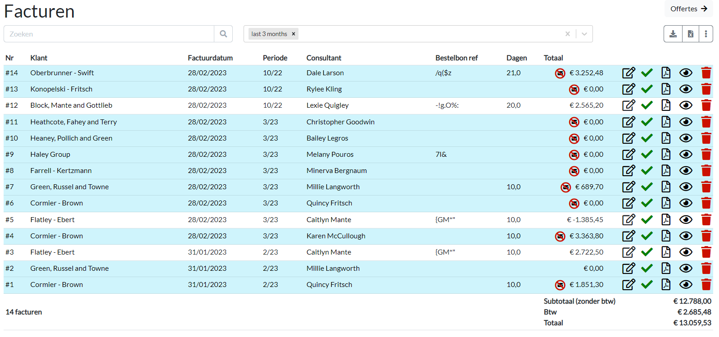
Invoices page

Slide 8
So Performance issues?
On the /invoices page?
Impossible!
I already did a huge performance optimalization there by switching between react-tooltip to rc-tooltip
Notes:
Commit SHA rc-tooltip: c98f49f64
Performance issue on the invoices page: the tooltips for the icons took a long time to render.

Slide 9
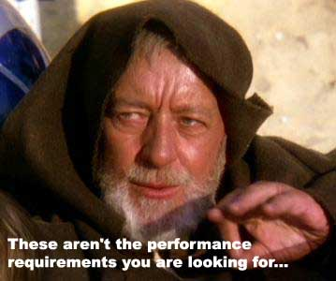
First tried to trick steven
Notes:
But that trick only worked the first 4 times

Slide 10
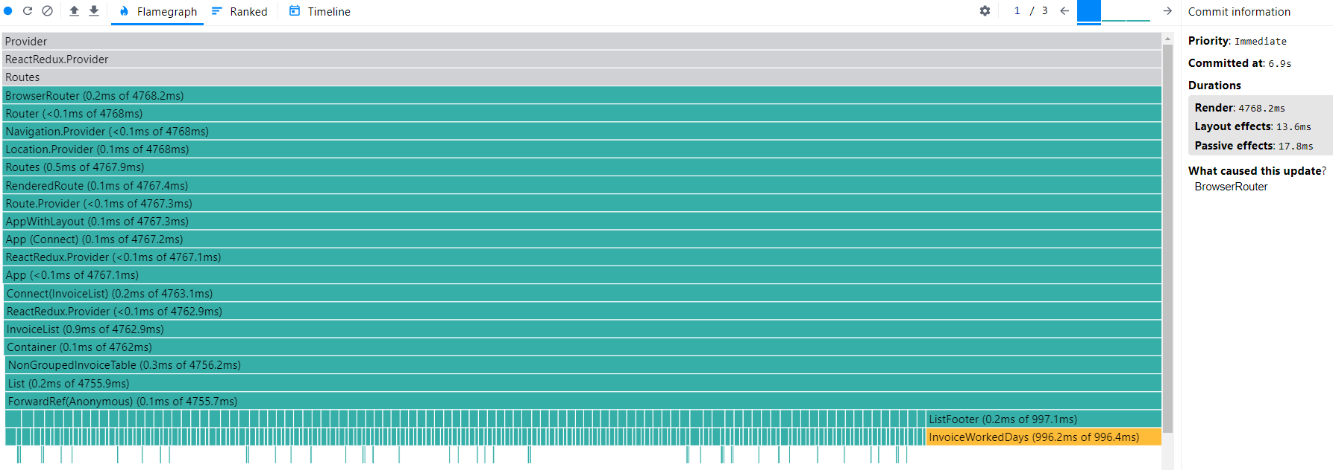
Performance issues?
6 seconds for 100 invoices/rows

Slide 11
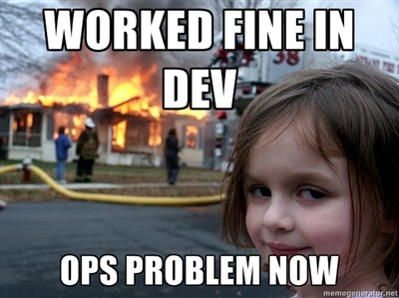
Invoices
Rendering 100 invoices takes 6 seconds.
Well, that's not good.
Notes:
100 invoices would’ve taken me 8 years
Ops problem now:
Then it turned out, I was ops. Damn.

Slide 12

Invoices
Rendering InvoiceWorkedDays takes 1sec (for 100 rows)

Slide 13
Invoices
DEMO TIME
profiling-0-start
Notes:
Branch: profiling Start tag: git checkout profiling-0-start
DEMO: InvoiceWorkedDays + DownloadIcons + WithClaim

Slide 14
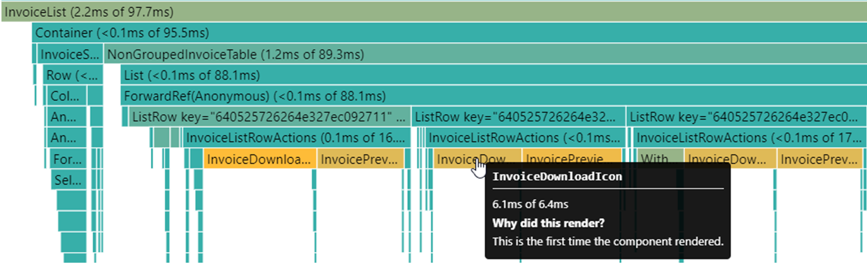
Invoices: Icons

Slide 15
Invoices
6s → 2s
The easiest optimization is just not doing it
InvoiceWorkedDays: do not calculate holidays
InvoiceDownloadIcon & InvoicePreviewIcon: useProjectMonthFromInvoice calculated for all invoices

Slide 16
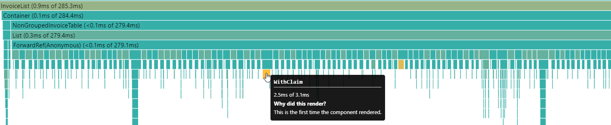
Invoices: With Claim
Profiler: Flamegraph

Slide 17
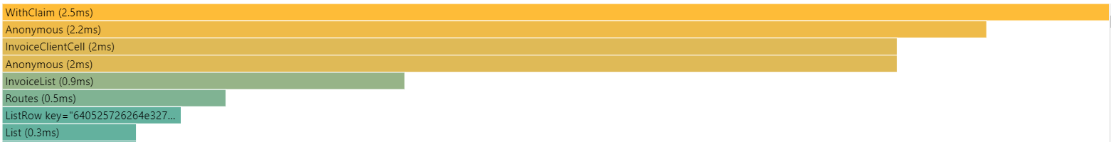
Invoices: With Claim
Profiler: Ranked

Slide 18
Invoices
2s → 360ms
I/O operations are expensive
AuthService: Accessed localStorage for all operations.

Slide 19
Invoices
360ms
360ms. Not great but good enough for now.
Because this was the warmup… There is another screen…

Slide 20
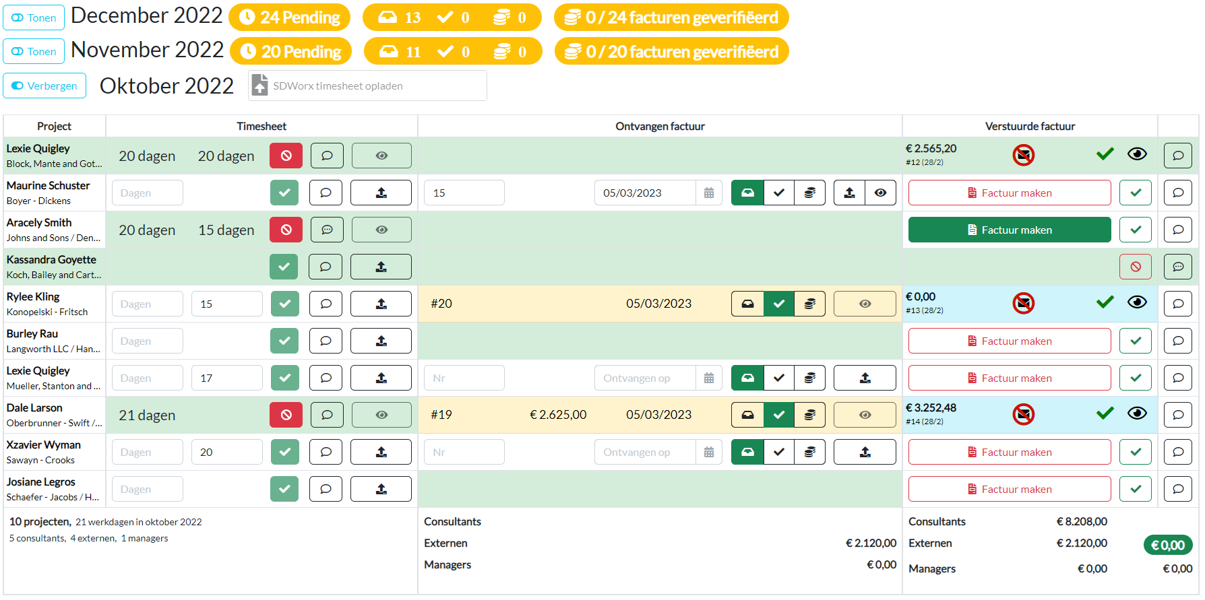
The other screen

Slide 21
Project Months
It’s disastrous
Everything is re-rendered whenever a projectMonth gets collapsed/opened. → Opening more and more projectMonths gets slower and slower
Filters are remembered between route changes → Navigating back can be painfully slow when many projectMonths are opened

Slide 22

Project Months
So, how bad are we talking here?
18 months & 718 projects
First opened with 38 projects:
2nd with 38:
3rd with 76:
4th with 74:
all opened:
renavigate with all opened:
350ms
660ms
950ms
1.2s
5s
4.4s

Slide 23
Project Months
DEMO TIME
profiling-?
Notes:
Branch: profiling-2
Start tag:
DEMO: Footers,

Slide 24
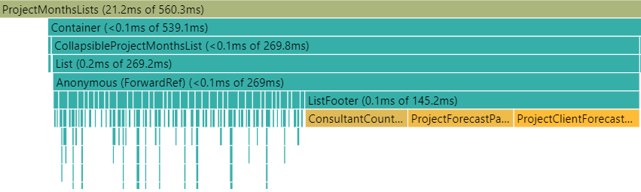
Project Months: footers

Slide 25
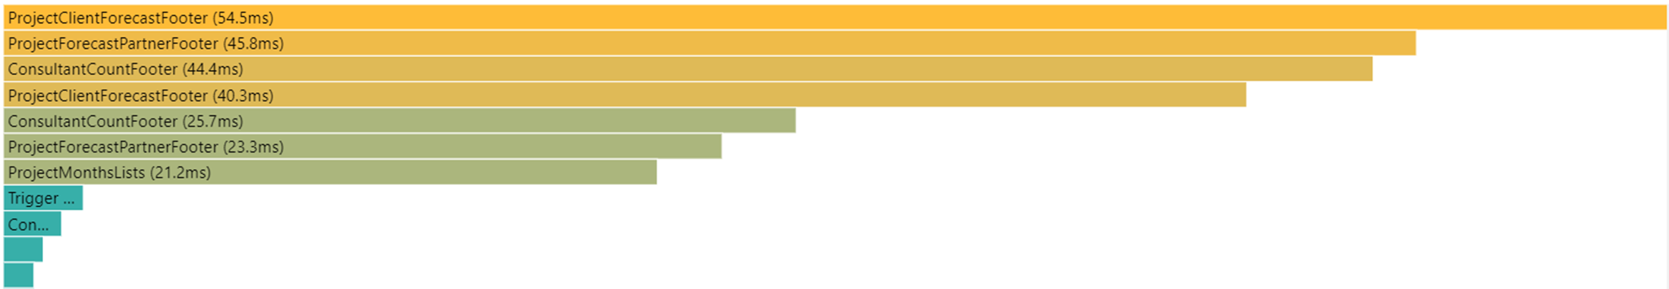
Project Months: footers
Notes:
It’s actually just three footers that show up multiple times.

Slide 26
Project Months: Holidays
Don’t trust 3rd Party Packages (to be performant)
Checking if a day is a holiday is slow?
code is tiny (literally like 30 lines) but… the… dependencies …
date-holidays-parser: 160kb
astronomia:
/data: 8,6MB JS
/src: 500kb
confac itself is 500kb (src folder)
Notes:
And further dependencies:
Caldate, date-bengali-revised, date-Chinese, date-easter, deepmerge, jalaali-js, moment-timezone, etc
The data load:
https://github.com/commenthol/astronomia
https://github.com/commenthol/astronomia/tree/master/data

Slide 27



Date-holidays
It’s using classes, which are not treeshakable
10MB JS executed 😀
to check for a Belgian holiday
Notes:
There wasn’t a single time when I used a class in JavaScript and later thought, “That was a good idea” (including a few times in confac)
So yeah, stick to functions (unless you really need a class) 😃
Why maybe still do classes: need “this”, “instanceof” or lots of internal object logic?
Could also just have looked for another package which does just the Belgian holidays…

Slide 28
Holidays Cache
Remember: with caching comes cache invalidation
There are only two hard things in Computer Science: cache invalidation and naming things. -- Phil Karlton
and off by one errors.
But luckily for me, past Belgian holidays are literally never going to change!
Notes:
Phew, crisis averted!

Slide 29
Project Months
The holiday caching aftermath
18 months & 718 projects
First opened with 38 projects:
2nd with 38:
3rd with 76:
4th with 74:
all opened:
350ms → 220ms
660ms → 320ms
950ms → 540ms
1.2s → 680ms
5s → 1.7s

Slide 30
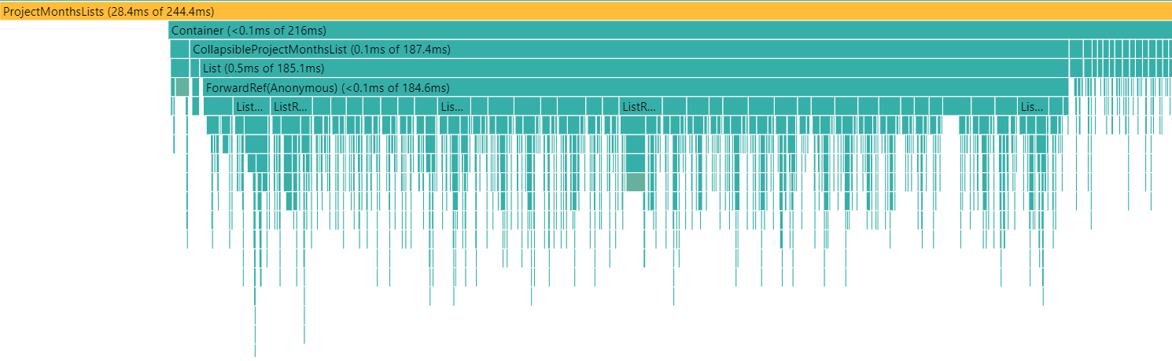
Project Months Holiday Caching Aftermath
A more even distribution now… So no easy performance targets
Notes:
A more even distribution now… So no easy performance optimalization targets.

Slide 31

‘‘Break’’
No easy perf target? Uuuh… Okay, let’s take a…
Quick, divert them with a meme
Notes:
So now the joke is, no easy performance targets? This session is over!! Break? I’m not coming back 😃
But first try to divert attention to this hot potato with the story of how one guy broke every CI in the world.
On 23 March 2016 Azer Koçulu unpublished all his code from npm over the Kik dispute.
By deleting Just 11 lines of code (left-pad) he broke stuff like Babel, so basically every JavaScript project.
The same thing happened with Jade templating library (=Jade is a trusted IT services partner for global enterprises), so they renamed to “Pug” – which is used in confac (pug -> html -> pdf)
I remember that that morning my “npm install” failed.

Slide 32
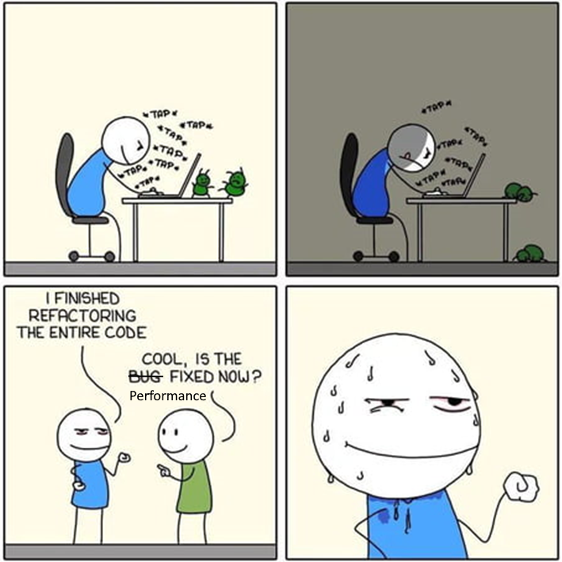
Refactoring In Progress
(unrelated to performance)
Notes:
Refactoring for easier deployment (joining of three separate repositories into one)

Slide 33
Project Months
The Goal: Avoid rerenders when just the filters change
DEMO TIME

Slide 34
Project Months
DEMO TIME

Slide 35
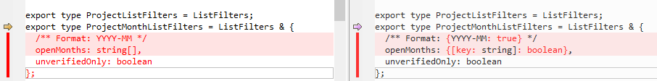
Project Months
The Goal: Avoid rerenders when just the filters change

Slide 36
The Future of confac?
Consultant single source of truth?
Skill Matrix bijwerken en zoeken
Downloaden documenten
Indienen ziekte dagen
Bekijken projecten andere consultants (tech stack, …)
…
Notes:
Met dan ook natuurlijk integratie met de itenium slack chatbot…

Slide 37
Next
26/9 : RXJS (FTrack, Hands-On)
6/10 : Docker & Docker-Compose ;) (FunTrack, Hands-On)
x/11 : ???

Slide 38
Resources
Confac:

Slide 39
Infos
WiFi: itenium-guest / Wifi4Ufree

