Slide 1


Redux
1h
(Frontend) State Management with Unidirectonial Data Flow
Theoretical
Introduction
FrontendTrack

Slide 2
MENU
High Level
Why Redux
The Store
Angular

Slide 3
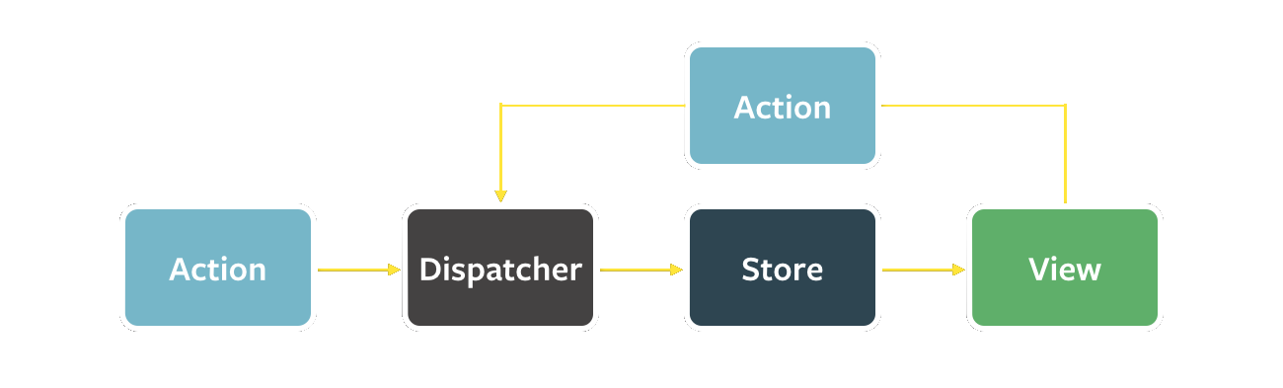
High level
Notes:
Facilitate communication and sharing of data across components.
Avoid pass through components that just pass props through to their children without actually using the data themselves.
Dispatcher / Reducer: Easy UnitTesting. Pure Functions (Side-Effect Free).
Store: The immutable store. State Tree.
View: The components. Clicking a button etc triggers an Action.
Action: Fetch some data when a component or the app loads, timeouts/interval based actions, websockets, … Typically has a “key” (or type) and a payload.

Slide 4
WHY
Immutable Single Source Of Truth
Hot Reloading
No more passing props down and actions up
Time Travel (Undo – Redo)
Restore State at startup / navigation
Developer Tools
Middleware / Meta-Reducers
Dream it up
Notes:
Dream it up:
Handling Concurrent Users
Fetch a list of TODOs.
- When navigating back to the list: fetch a list of TODOs with a modified date after the time the list was first fetched (or last refreshed)
When navigating to the details of an item:
We can display all properties
Fetch from the backend to see if we have the last version
If we do not have the last version, show this on the screen “This record has been updated by xxx”
If a value for a field has changed, display this on the field: Current Value: X, New Value: Y
Offload Expensive Queries
Reduce the amount of joins needed in a query by
Having all reference data in the store
Having (small) entities in the store

Slide 5
The Store
What (not) to put in the store?
Fetched data
App State
Avoid Calculated Data
Avoid Form Data
Avoid Non-Serializable Values
Do not mutate the state directly! Always use actions!
Avoid deep nesting
UnitTesting of State Changes
Do not store multiple copies of the same entity
Notes:
Multiple Entities: Now you need multiple reducers to keep all parts of your store in sync!
A list with (partial) entities and a selectedEntity → Store just the selectedEntityId
A popup with partial entity information → pipe(map) the entity to the popup model or have the popup model just accept the entire entity even if not all props are needed
Deep Nesting: Since everything is immutable, you end up with a lot of spread operators
UnitTesting: Put as much as the mapping/business logic in the reducer because of the ease of testing

Slide 6
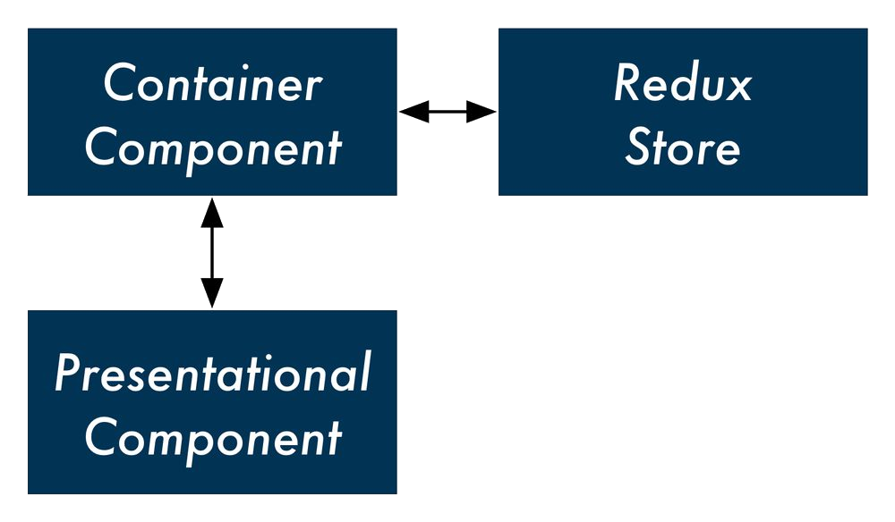
Presentational Components
vs
Container Components

Slide 7
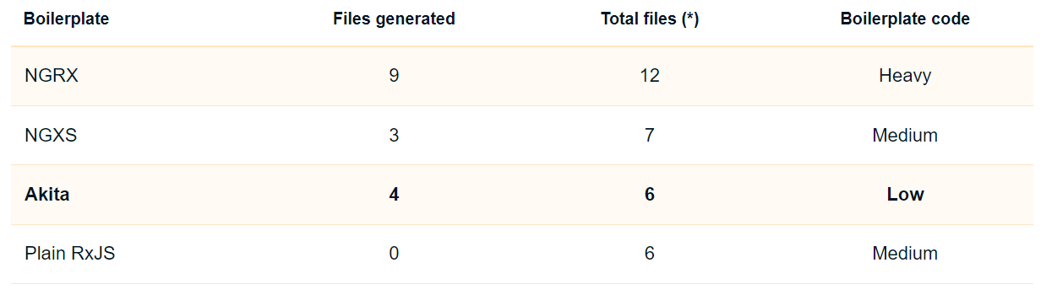
Angular Frameworks

Slide 8
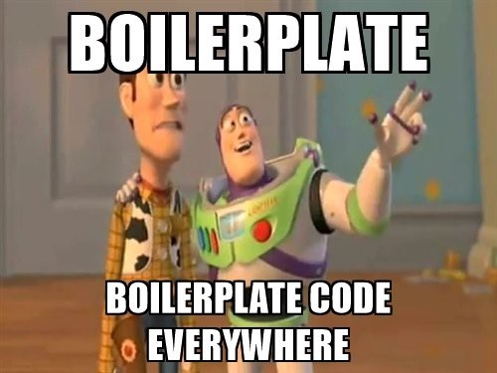


Slide 9
Use case: Providers - NGRX
Do Not Mutate State
Structure Files as Feature Folders with Single-File Logic
Put as Much Logic as Possible in Reducers
Organize State Structure Based on Data Types, Not Components
Normalize Complex Nested/Relational State
Keep State Minimal and Derive Additional Values
Model Actions as Events, Not Setters
Use Selector Functions to Read from Store State
Single Source Of Truth
Notes:
Structure Files as Feature Folders with Single-File Logic: Don’t have folders “actions”, “reducers”, “stores”, “components” but have a folder Vouchers, Settings, Providers.
Put as Much Logic as Possible in Reducers:
Do not map to a different model in a component before dispatching the action.
Do not map to a different model in a component before displaying the state
Ideally there are no mappers (so only one model and less code) but this cannot always be achieved
Organize State Structure Based on Data Types, Not Components: Do not create providers, activeProviders and providerDetails reducers but create just one providers reducer
→ Also called “Ducks methodology”
Normalize Complex Nested/Relational State: Example: Taking Enterprise & EnterpriseContact together or separately → 2 arrays is easier
Keep State Minimal and Derive Additional Values: loading, loaded, …
Model Actions as Events, Not Setters: SetFilters, SetPagination, SetSorting, ResetPage → SetFilters(). At ngOnDestroy: launches SetFilters, SetPagination, SetSorting in sequence.

Slide 10
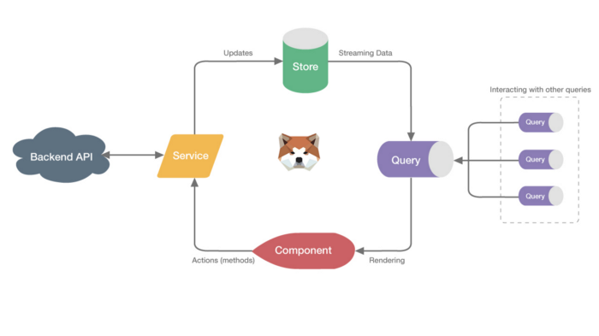
Akita

Slide 11
Questions?

Slide 12
resources
Dan Abramov: You Might Not Need Redux
Redux Style Guide
Successor of Akita: Elf
Successor of Vuex: Pinia

Slide 13
Next session?
Angular
RXJS
TypeScript
NServiceBus
ServiceFabric

