Slide 1

Redux
(Frontend) State Management with Unidirectonial Data Flow

Slide 2
MENU
High Level
Why Redux
The Store
Angular

Slide 3
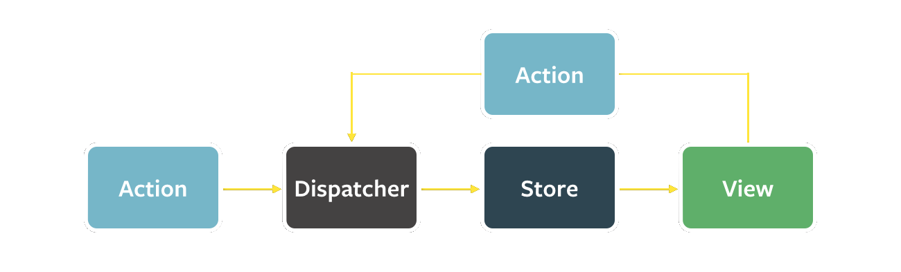
High level
Notes:
Facilitate communication and sharing of data across components.
Avoid pass through components that just pass props through to their children without actually using the data themselves.
Dispatcher / Reducer: Easy UnitTesting. Pure Functions (Side-Effect Free).
Store: The immutable store. State Tree.
View: The components. Clicking a button etc triggers an Action.
Action: Fetch some data when a component or the app loads, timeouts/interval based actions, websockets, … Typically has a “key” (or type) and a payload.

Slide 4
WHY
Immutable Single Source Of Truth
Hot Reloading
No more passing props down and actions up
Time Travel (Undo – Redo)
Restore State at startup / navigation
Developer Tools
Middleware / Meta-Reducers

Slide 5
The Store
What (not) to put in the store?
Fetched data
App State
Avoid Form Data
Avoid Non-Serializable Values
Do not mutate the state directly! Always use actions!
Avoid deep nesting
UnitTesting of State Changes
Do not store multiple copies of the same entity
Notes:
Multiple Entities: Now you need multiple reducers to keep all parts of your store in sync!
A list with (partial) entities and a selectedEntity → Store just the selectedEntityId
A popup with partial entity information → pipe(map) the entity to the popup model or have the popup model just accept the entire entity even if not all props are needed
Deep Nesting: Since everything is immutable, you end up with a lot of spread operators
UnitTesting: Put as much as the mapping/business logic in the reducer because of the ease of testing

Slide 6
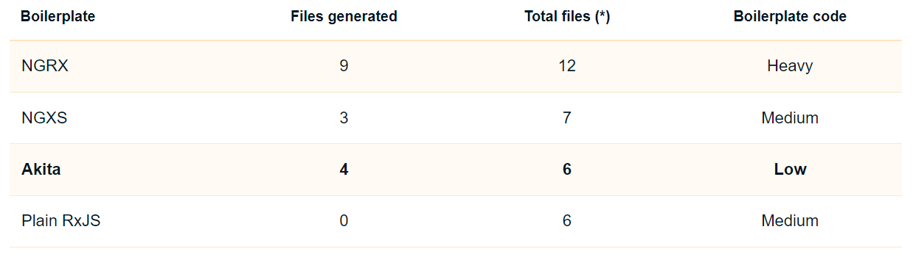
Angular Frameworks

Slide 7



Slide 8
Providers - NGRX
Do Not Mutate State
Structure Files as Feature Folders with Single-File Logic
Put as Much Logic as Possible in Reducers
Organize State Structure Based on Data Types, Not Components
Normalize Complex Nested/Relational State
Keep State Minimal and Derive Additional Values
Model Actions as Events, Not Setters
Use Selector Functions to Read from Store State
Single Source Of Truth
Notes:
Structure Files as Feature Folders with Single-File Logic: Don’t have folders “actions”, “reducers”, “stores”, “components” but have a folder Vouchers, Settings, Providers.
Put as Much Logic as Possible in Reducers:
Do not map to a different model in a component before dispatching the action.
Do not map to a different model in a component before displaying the state
Ideally there are no mappers (so only one model and less code) but this cannot always be achieved
Organize State Structure Based on Data Types, Not Components: Do not create providers, activeProviders and providerDetails reducers but create just one providers reducer
→ Also called “Ducks methodology”
Normalize Complex Nested/Relational State: Example: Taking Enterprise & EnterpriseContact together or separately → 2 arrays is easier
Keep State Minimal and Derive Additional Values: loading, loaded, …
Model Actions as Events, Not Setters: SetFilters, SetPagination, SetSorting, ResetPage → SetFilters(). At ngOnDestroy: launches SetFilters, SetPagination, SetSorting in sequence.

Slide 9
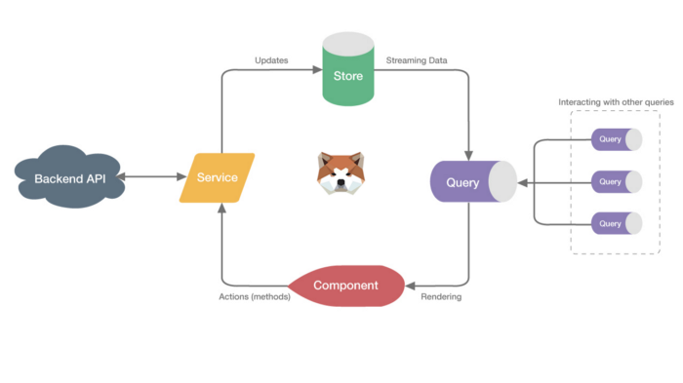
Akita

Slide 10
Questions?

Slide 11
resources
Dan Abramov: You Might Not Need Redux
Redux Style Guide
Successor of Akita: Elf

Slide 12
Next session?
Angular
RXJS
TypeScript
NServiceBus
ServiceFabric

Slide 13
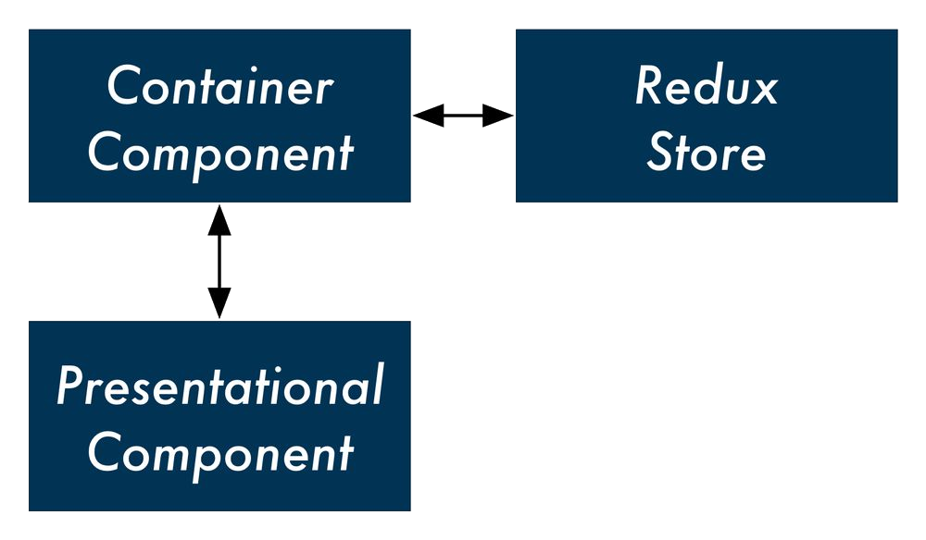
Presentational Components
vs
Container Components

