Slide 1
Robocode
PlayerImage

Slide 2
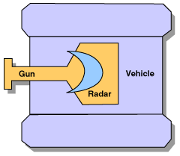
setAdjustGunForRobotTurn
setAdjustRadarForRobotTurn
Notes:
Robot moves slowest, turret faster and radar fastest

Slide 3
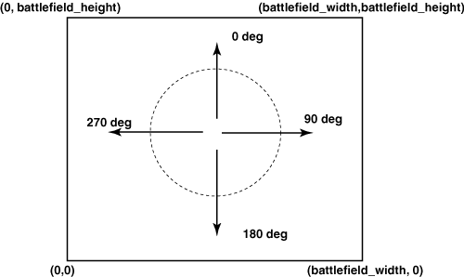
Battlefield
Notes:
The degrees as on the picture is what you get from getHeading()

Slide 4
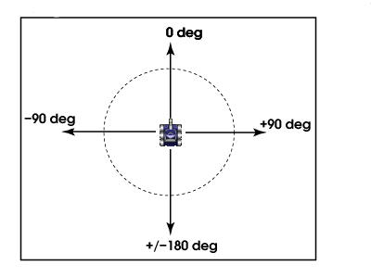
Bearing
Notes:
For example in the onScannedRobot event. Turn to: turnRight(event.getBearing())

