Slide 1


Team4Talent
React
Leaving the DOM behind

Slide 2

Menu
What is React

Slide 3
What is React

Slide 4
PART VIII: Final Thoughts

Slide 5
What to remember
Git All Things
Especially Git folders that have brothers like _backup, _20150402 etc
Git can be strange… (It gets better with the years)
Do not rewrite published commits
Define aliases that fit your workflow
And finally:
You'll love Git (most of the time)

Slide 6
Links
Links here...

Slide 7
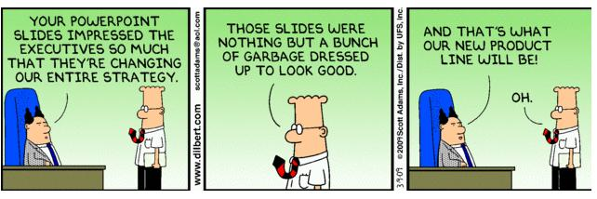
Questions?

