Slide 1
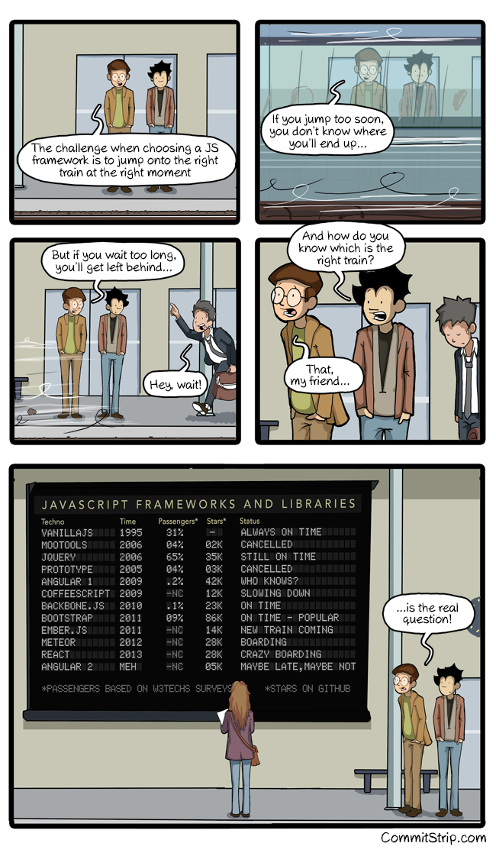


React
Leavin' the DOM behind

Slide 2
React Menu
What is it

Slide 3

React High Level
React is
  Open-Source, maintained by Facebook
  Used at Instagram, Netflix, Paypal, Imgur, Feedly, ...
  Current version v0.14 (Breaking changes!)
  Just the View in MVC
Flux
Graph

Slide 4
React Technical
Plain JavaScript
  ES6, TypeScript, ... possible
  Optionally with JSX:
  Composable HTML in JavaScript
React == "This is my state, you render it"
  Declarative
  One Way Data Flow
  Virtual DOM

Slide 5
React Setup
Sublime Text
  Babel
  EsLint
  ES6
  Gulp – Preprocessor
  Yo template:
Chrome Web Store: React Dev Tools

