Slide 1
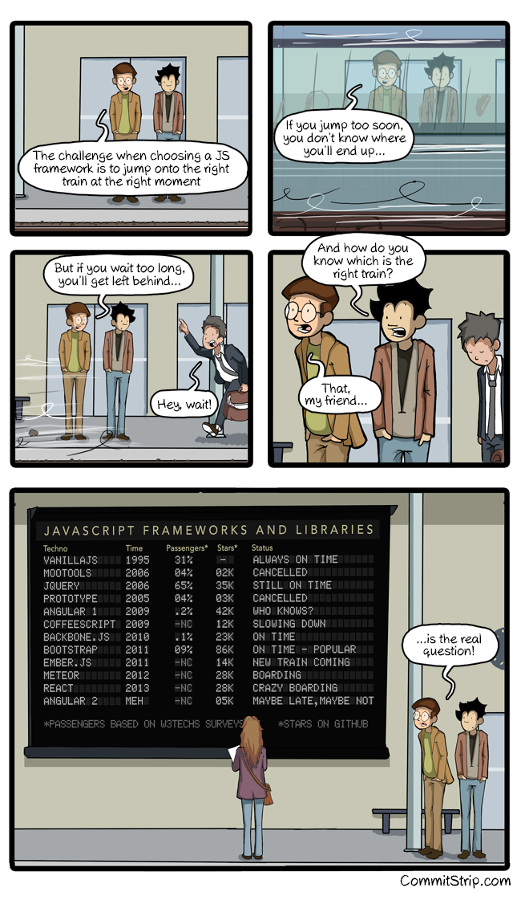


React
Leavin' the DOM behind

Slide 2
React Menu
React High Level
React Technical
React Setup
Codez
Flux
More Codez

Slide 3

React High Level
React is
  Open-Source, maintained by Facebook
  Used at Instagram, Netflix, Paypal, Imgur, Feedly, ...
  Current version v0.14 (Breaking changes!)
  Just the View in MVC
  IE8 and above (polyfills required)
Flux
Relay & GraphQL

Slide 4
React Technical
Plain JavaScript
  ES6, TypeScript, ... possible
  Optionally with JSX:
  Composable HTML in JavaScript
React == "This is my state, you render it"
  Declarative
  One Way Data Flow
  Virtual DOM

Slide 5
JSX Technical
var x = React.createClass({
render: function() {
return (<div id="yaye">ouch</div>);
}});
return React.createElement(
"div",
{ id: "yaye" },
"ouch");
https://facebook.github.io/react/html-jsx.html
https://babeljs.io/repl/

Slide 6
React Setup
Sublime Text
  Babel + ES6
  EsLint
Gulp + Browserify
Yo template
Chrome Web Store: React Dev Tools

Slide 7
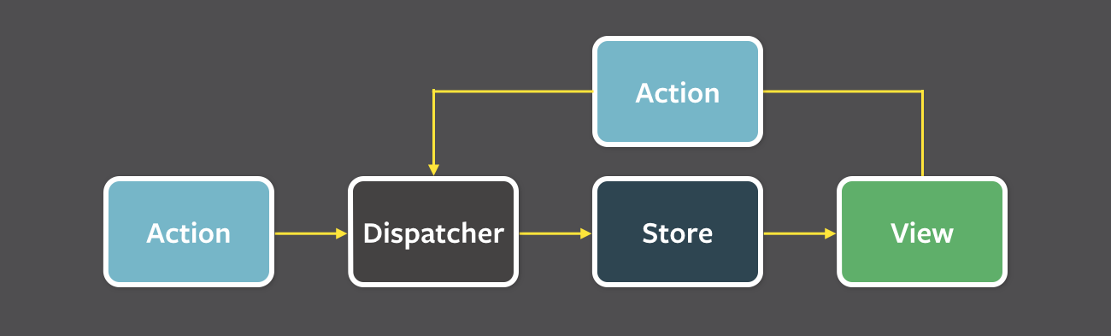
Flux

