Slide 1






60min
UnitTesting
TDD
Theoretical
Introduction
ArchitectureTrack

Slide 2




Menu
Role Team Leads & Architects
Why?
What? 100% Coverage?
Feedback Loop & Mocking
Implementation Considerations
Common Pitfalls
TDD
Notes:
What – A Definition:
Unit testing is the process of writing code to test the behavior and functionality of your system.

Slide 3

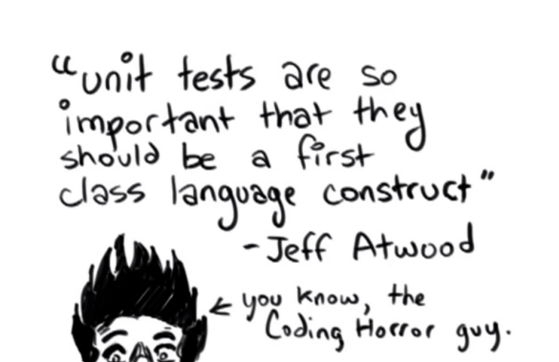

Inspirational Quote

Slide 4



UnitTesting?
Job of the Tech Lead / Architect
Setup Testing
Configure CI
Convince Managers, Business, …
Teach/Help with implementation
Notes:
Part of the architecture track???
Setup Testing: Setup the project, add the dependencies (xUnit, Mockito, …), and have at least one working UnitTest even if it’s a dummy one. If the framework for UnitTesting is already there, it’s so much easier for the developers to actually write some tests.
Configure CI: If the tests do not run on the CI and block the CI in case of issues – it’s basically the same as not having a UnitTest suite at all. You can force running the tests locally at some point (ex when pushing code with Git Hooks) but there is no guarantee that all devs will do this.
Teach/Help: Many developers still don’t have (a lot) of experience with UnitTesting. They may need help writing a test for a tricky part of code. Or they may need a firmer grasp on the basics…

Slide 5
Why
Small continuous steps forward
Avoiding Regressions
Living Documentation (Given/When/Then)
Quick Feedback Loop (Avoid I/O)
Fixing Bugs
Thinking about Design
Pay Now vs Pay More Later
Notes:
Small continuous steps forward: When the going gets so though that you are not making progress at all. For example when implementing some particularly weird business logic (or algorithm). One of the advantages of working in a TDD style.
Avoiding Regressions: After every change to the code, the test suite is run, catching any regressions that may have been introduced. Since there is a mechanism in place to catch regressions you can also refactor without fear, a safety net. (Working Effectively with Legacy Code)
Living Documentation: Weird rules are defined in the code: there is a UnitTest detailing the input/action/output. It documents how the software should behave. Could use a naming convention for the test names like Given/When/Then. Also a way for new developers to get acquainted with the API surface.
This is also a case AGAINST parameterized tests. These tests typically leave you hanging when they fail : which parameters caused the error? And why? You lose the documentation value if you rely to heavily on parameterized tests. They can be handy from time to time: in certain domains, to test a whole ”Decision Table”, to quickly implement the scenarios of the FA/Tester.
For this to be true, you need to see the inputs/assertions easily. Often UnitTest setup (or even assertions) is moved away from the test (to eliminate duplication), now to see what is going on, you need to look at the test, at the test setup in some other class and also at yet another class for the assertions. It becomes difficult to see why something is working/is failing if the inputs are somewhere else completely.
Quick Feedback Loop: I make a small change or fix a small bug, then run the test suite right away to see if I messed up something else. If it takes 30min to run the test suite, developers will not bother running it locally and leave it up to the CI. The problem there is that you will only be notified on the bug you introduced after 30minutes! At that point you have already switched contexts (new story, new branch, …) and suddenly need to switch back… Avoid I/O. I/O slows down test CONSIDERABLY. Avoid the network, the FileSystem, the DB, …
Fixing Bugs: Found a bug? Write tests for it and the test suite will catch regressions. Production bugs: Sometimes it helps to fix the issues by writing the test first. Sometimes you’ll want to get it fixed in production ASAP and can write the test later. UnitTests should also help localizing bugs (~Documentation).
Thinking About Design: If UnitTests are written, the code must be written in such a way that UnitTesting is possible. Adding UnitTests forces the developer to think about Design – at least a little bit.
Pay More Later:
Writing tests takes time
How much time is wasted?
When will the tests pay off?
Is it worth the effort?
YES → Google was held captive by fear of change, until they made UnitTesting mandatory.
YES → The team needs to get over “the hump” – whereas before the hump all change takes much longer, once over it, it becomes faster to develop new features because of the tests & the better design that comes from it

Slide 6

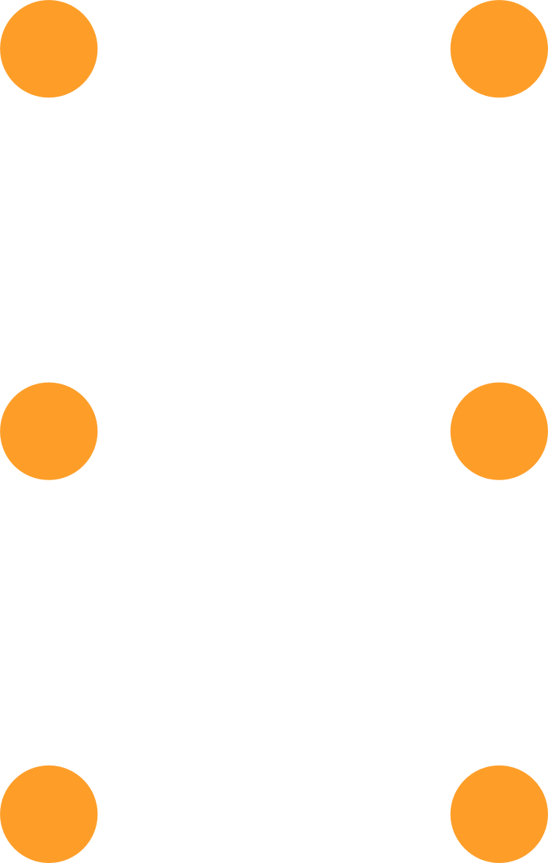
What? “FIRST”
Fast – Feedback loop
Independent – Tests should not interact with one another
Repeatable – Without code change test results do not change
Self-Validating – No manual steps allowed!
Thorough – Don’t just test the happy path
Notes:
Fast: 1/10th of a second
Independent or Isolated: Test sequence should not be important. Avoid tests that need to run after a certain test in order to setup the inputs correctly.
Repeatable: Do not depend on things that can change: the records in a database, relying on the current time, a certain file being on the FileSystem, …
Self-Validating: Tests should succeed or fail without human interaction. Do not check console.logs manually, write code to check it.

Slide 7

What
Business Logic / Weird Rules
Legacy Code
Regression Galore
Technical Frameworks / Design
“select isn’t broken”
Notes:
What to test
Business Logic: UnitTests can be your documentation for that Illogical Business Logic. Since the rules often don’t make sense (unless you are for example a domain expert), UnitTests avoid developers introducing “incorrect logic”.
Legacy Code: Fixing one thing breaks another thing? All the time? UnitTests can be your friend to start to tame the legacy beast.
Regression Galore: If there is a piece of code that is changing frequently and were regressions are also appearing frequently, add UnitTests!!
Technical Frameworks: If you are introducing design to eliminate duplication, or to easily achieve some common functionality. These “small frameworks” should be tested thoroughly. Examples: A grid framework (sorting, filtering, pagination, …), an Mailer interface that sends emails in the language of the user, … It’s typically enough to test the framework and overkill to add additional tests whenever the framework is actually being used. “select isn’t broken”: Pragmatic Programmers tip: It is rare to find a bug in the OS, Compiler, Language framework libraries, or even in third party products/libraries.
→ Do NOT write tests for these things. They should have their own test suite (and they probably have)

Slide 8
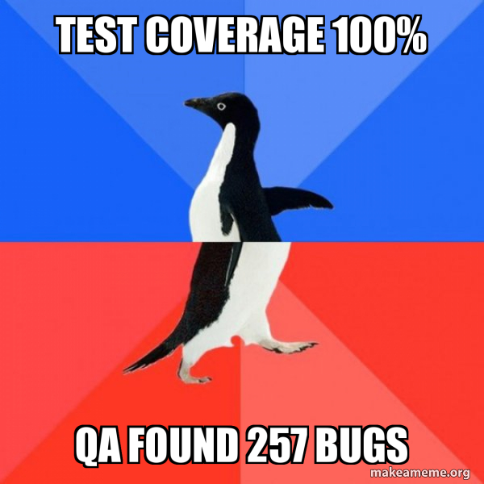
100% Coverage?
Startup Code?
Trivial Code?
Branchless Code?
Technical Code?
One-time migrations?
Notes:
Personal Choice:
However is there much value in testing the following:
Startup Code: Do you want to test setting up your IOC container?
Trivial Code: Do you want to test constructors? Getters/Setters?
Branchless Code: Another form of trivial code: If there are no if/switch branches – do you still want to test it?
Technical Code: Do you want to test your implementation of ILogger? EntityFramework EntityConfiguration?
One-time migrations: Do you want tests for a migration that will run only once?

Slide 9
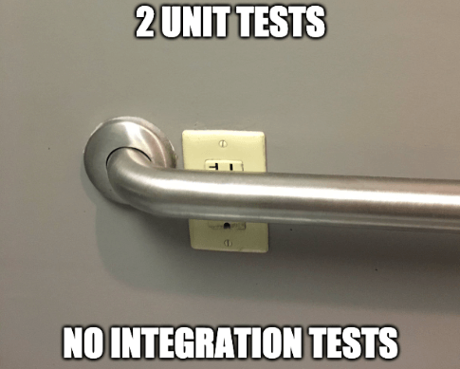
100% Coverage?
It does not cover all bases
Notes:
Note that we are only talking about UnitTesting here
→ Other tests, like integration tests are also needed!

Slide 10
But What?
A Happy Path / Sunny Day Test
Test Branches (if/switch)
Unhappy paths (GuardClauses, Exceptions, …)
Common / Real World Scenarios
Boundaries
Notes:
Happy Path: Have at least one test to cover the happy path where everything works entirely as expected.
Branches: If you have an “if”: make sure there is a test covering all if/else statements. Same for a glorified if/else like a switch statement. Could also do testing for a State Machine.
Unhappy Paths: Also test that the software behaves as expected when things do go wrong. Validation failure, unexpected exceptions, short circuiting guard clauses, …)
Scenarios: If you know the test data / scenario’s the Tester/FA is going to use, you can write those tests.
Boundaries: Theory for a Tester also applies to UnitTesting. For example Boundary Value Analysis and Equivalence Partitioning.

Slide 11
But What?
Code Coverage vs Branch Coverage
// Example 1
if (condition) {} else {}
if (condition2) {} else {}
// Example 2
if (cond1 && (cond2 || cond3)) {}
Notes:
Code Coverage aka Statement Coverage
Branch Coverage aka Decision Coverage
Example 1
For 100% Code Coverage, 2 tests are needed
For 100% Branch Coverage, 4 tests are needed
Example 2
Code Coverage: 1 test
Branch Coverage: 4 tests

Slide 12
But What?
Boundaries
Equivalence Partitioning
Boundary Value Analysis
Edge Case Testing
Notes:
Equivalence Partitioning:
Example: we expect an Amount between 0 and 100.
An invalid low value (ex: -10)
A correct value (ex: 20)
An invalid high value (ex: 200)
Boundary Value Analysis:
Example: instead of using semi-random values, we use/add values at the boundaries.
The values -1 and 0
The values 100 and 101
Edge Case Testing:
Example for an EnergyAmount, we could add tests for NULL, PositiveInfinity, NegativeInfinity, NaN, …

Slide 13
Quick Feedback Loop
Achievable Only By Avoiding I/O
Database
FileSystem
Network Access
Rest Calls
Notes:
Database: If you use a Db in a “UnitTest”, you need to setup this Db before the test so that it is in a predictable state. If multiple tests are using the same db, they could interfere with eachother.
Network Access: Some other service, endpoint, dns, …
Rest Calls: Talk to some third party service to send email(s)
→ MOCKING

Slide 14

Test Doubles

Slide 15
State vs Behavior
State Testing Validate that a property has a certain value
Behavior Testing Validate that a method was (not) called
Notes:
State:
Examples:
When updating an entity, the audit fields LastModifiedBy and LastModifiedOn are properly updated. Checking the value of properties of the class.
When doing a calculation, assert that the result returned is as expected.
Behavior:
Verify that a method was (not) called, or called with specific arguments.
Example: verify that when an exception occurs, that an Emergency is raised, or verify that in a certain case an email is (not) sent, or that DbContext.Save is called.

Slide 16
Mocking
Dummy: Passed around but not relevant for the test itself
Fake: Has actual implementation but takes shortcuts
Stub: Provide canned values
Spy: Record what happened, what methods were (not) called
Mock: Stub + Spy
Notes:
Which one to use?
WHO CARES?
Use whatever makes most sense: do not use a mock for a DTO, just instantiate it with the values you want to test with
Ex: do not use a mock if you could use a dummy…
Sometimes also handy OUTSIDE of testing:
The real implementation is not available yet
The real implementation costs the company money
Dummy: Could be “null” or a NullObject or a default value (ex for a struct)
Fake: Example InMemoryDb
Stub: Manual implementation of a mock?
Spy: How many times was the EmailService invoked?
Mock: Typically with a mocking framework (Mockito/Moq)

Slide 17
Mocking
Abstract the I/O dependencies away
Program against an interface, not an implementation
Notes:
Inject interfaces for things that need to be mocked.
Dependency Injection is your friend here.
Also: DateTimeProvider → writing UnitTests for code that do a GetCurrentDate() is hard, so we provide an interface so we can return a canned date value in our tests.
Strict Mock vs Non-Strict Mock
Strict will fail for anything that was not explicitely setup.
Non-Strict mocks will allow calls that have not been setup.
Messy Setup Code
If you’re having a lot of mock setup and it’s no longer readable/maintainable,
Does everything needs to be a mock, really?
Is there another way that would hinder development less? (ex: Dummy, actual implementation, handwritten stub, …)

Slide 18
Mocking
Mockist vs Classicist
Mockist / Solitary: Mock everything. Danger of testing the implementation instead of behavior.
Classicist / Sociable: Mock I/O and/or “awkward” things. Tests survive refactorings more easily.
Notes:
Mockist:
Watch out for “Tautological Tests” (https://fabiopereira.me/blog/2010/05/27/ttdd-tautological-test-driven-development-anti-pattern/)
→ You want to test BEHAVIOR, not IMPLEMENTATION.
Classicist:
https://www.thoughtworks.com/insights/blog/mockists-are-dead-long-live-classicists
Also see:
https://martinfowler.com/articles/mocksArentStubs.html
Solitary vs Sociable:
MicroServices book: talks about “Sociable tests”
https://martinfowler.com/bliki/UnitTest.html

Slide 19
Implementation
Testing & Mocking Framework
Typically has SetUp/TearDown hooks
Usually works with Attributes/Decorators
Test method naming convention
Put the tests close to the code
Notes:
Testing Framework: xUnit, JUnit, NUnit
Mocking Framework: Mockito, Moq, NSubstitute
Naming Convention:
Depends on language, project, team etc.
One possibility is: MethodName_StateUnderTest/Scenario_ExpectedBehavior
“IsValidFileName_validFile_returnsTrue”
Close to the code
If the UnitTests are “far” away from the code it is testing (another solution, another project, somewhere deep in the FileSystem hierarchy) then developers are less inclined to write the tests.
If the tests are right next to the code itself – the dev will be much more likely to add the tests
→ But expect strong push-back when you want to introduce this practice.

Slide 20
Implementation
A – Arrange
A – Act
A – Assert
G – Given
W – When
T – Then
Please don’t add these three as a comment in each test
Notes:
The layout of a UnitTest
Arrange: setup the SUT (System Under Test), CUT (Code Under Test) by creating and setting up objects
Act: act on an object → Invoke the method
Assert: (and/or verify) that everything went as expected
There was also “Record-And-Replay” but no one seems to be using that anymore.

Slide 21
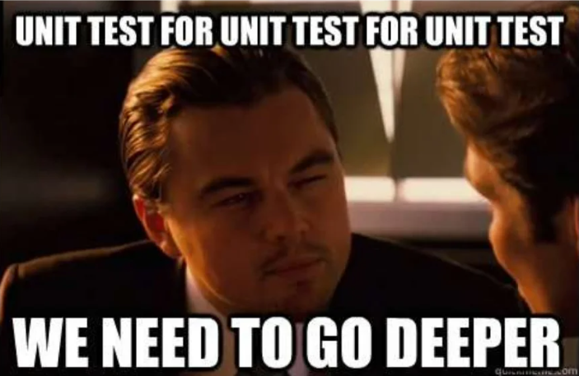
Common Pitfalls
Only test production code
Notes:
Sounds stupid but especially developers new to UnitTesting fall into this trap.
Do not test things that do not happen.
Do not test
Scenario’s that do not happen, scenario’s that are “illegal” for the business
Do not write branches that are only hit during UnitTesting
Defect Insertion:
Your test must be able to fail by changing the production code.
If you cannot make the test fail by changing the code, it’s not testing anything.

Slide 22
Common Pitfalls
Make sure your test fails at least once
Are you testing what you think you are testing?
Notes:
If you’ve only ever seen a test be “Green”
Are you sure you are testing the thing you think you are testing?
Or are you falling back due to a GuardClause short circuit which accidently results in the same Assertions/Verificatons being true?
Example:
Testing a “RecordNotFound” results in an Exception but we don’t actually get so far into the test because it crashes because the FeatureFlags object is null

Slide 23
Common Pitfalls
Avoid brittle tests
Notes:
Are all your tests failing after any change made to the code?
Are you validating too much?
Only validate what you are testing.
If you have a UnitTest for each case but you are Assering/Verifying everything in each test, each test will be red whenever there is any change.
Is your API too volatile?
Thing about your API / Design – APIs should be pretty fixed
Perhaps you can test on a higher level where there is a more stable API?
For example at a “Pinch Point” == A place where we can detect ALL effects of a code change
Test Interception Points as close as possible to the code under test
Think a public method on a class
At an interception point, the effects of a code change can be detected
A Base Class vs No Base Class
Sometimes it helps to write a base class for example for all tests implementing the same interface
Sometimes it hinders test readability / maintainability instead
A test should not have logic in itself
switch, if, else statements
foreach, for, while loops

Slide 24
Common Pitfalls
Failures should be informative
Avoid: CollectionAssert(bigCollection, otherCollection)
Notes:
If you are comparing 2 (big) collections and the test fails because
One collection contains 182 items and the other one 200 items – what does this mean?
Items 65 in the collections differ – what does this mean?

Slide 25
Legacy Code
The UnitTesting Dilemma
To change the code, we need tests
To test code, we need to change it
Notes:
Change Code Need Tests:
This is a different session – Working Effectively with Legacy Code
Were we’ll talk about Seams, Refactoring, Sensing Variables and more…
Seams: Change the behavior of a program without changing the program.
Virtual methods & Polymorphism
Inject different implementations of an interface
Preprocessing Seams (ex: ConditionalAttributes, Compiler Directives)
Sensing Variable:
Introduce a variable that can be tested against.

Slide 26
Legacy Code
How to test tricky code
Singleton
Create an internal setter
Optionally create an interface
Service Locator
Register stubs to the IOC
Notes:
Internal setter: InternalsVisibleTo assembly directive.

Slide 27
Legacy Code
How to test tricky code
Static Methods
Switch to ServiceLocator or Singleton
Or even better, switch to DI

Slide 28
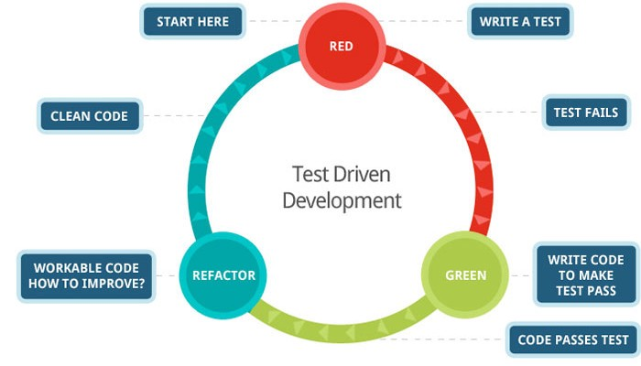
Test Driven Development
Red – Green – Refactor
Notes:
The Refactor step is often indicated as “Remove Duplication”. Logically TTD results in 100% coverage
TDD can be used for the entire system
OR
Take advantage of continuous small improvements when you are stuck on a difficult piece of code.

Slide 29
Test Driven Development
Thinking about design
Breaking the “fear cycle”
A whole bunch of useless tests?
Notes:
The Fear Cycle:
The more stress you feel, the less testing you will do.
The less testing you do, the more errors you’ll make. The more errors you make, the more stress you feel…
Write tests until fear is transformed into boredom.
Useless Tests:
Personal opinion: if you like working TDD, go for it
If you don’t like it:
Still consider using it when you are stuck and can’t seem to make progress
But most importantly: not doing TDD does not mean you can skip the UnitTest suite entirely

Slide 30

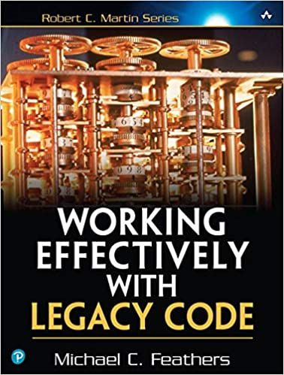

Resources
Books:
Working Effectively with Legacy Code
The Art Of UnitTesting
Test Driven Development
xUnit Test Patterns: Refactor Test Code
Fowler: Mocks Aren’t Stubs

Slide 31
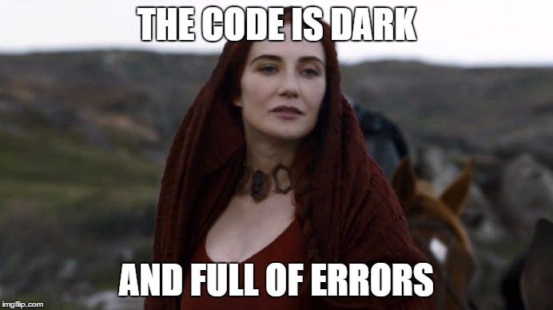
And Remember…
Notes:
No matter how much testing is done on each level of the testing pyramid, no system is entirely bug free.

Slide 32








Our Socials
@itenium
@itenium_be
itenium
itenium-be
itenium.be
@itenium
itenium.be

Slide 33



THANK YOU!

