Slide 1

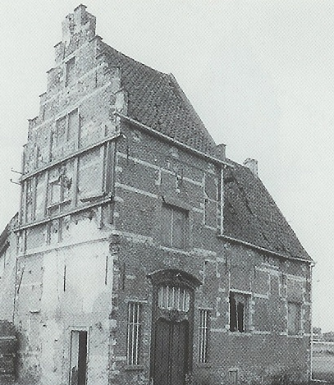

BOOTCAMP 3d MODELLING
Network: Itenium! Password: Itenium2024
Copy USB Contents (short path!!)
Start “Grand_Roman_Env.uproject”

Slide 2


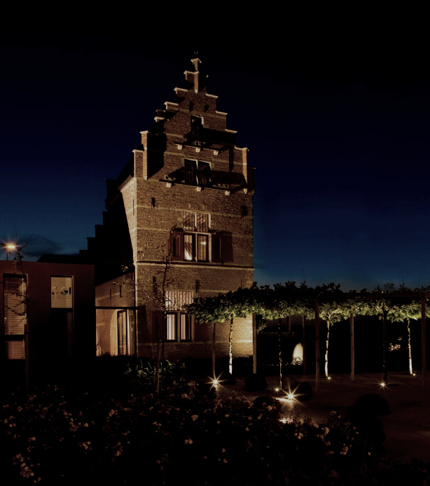

Project:
Sourcefiles\UNREAL\Grand_Roman_Env\Grand_Roman_Env.uproject
Start with:
C:\Program Files\Epic Games\UE_5.3\Engine\Binaries\Win64\UnrealEditor.exe

Slide 3
Word Doc:
https://onedrive.live.com/edit?id=24BE1EADBCC0528!s6cfd08fc81ba4dfbb1c71371bae322b6&resid=24BE1EADBCC0528!s6cfd08fc81ba4dfbb1c71371bae322b6&cid=024be1eadbcc0528&ithint=file%2Cdocx&redeem=aHR0cHM6Ly8xZHJ2Lm1zL3cvYy8wMjRiZTFlYWRiY2MwNTI4L0Vmd0lfV3k2Z2Z0TnNjY1RjYnJqSXJZQnZud3F5dmRTVGxhZF9aMjMzamhtaUE_ZT1MVE9ZR0s&migratedtospo=true&wdo=2

Slide 4
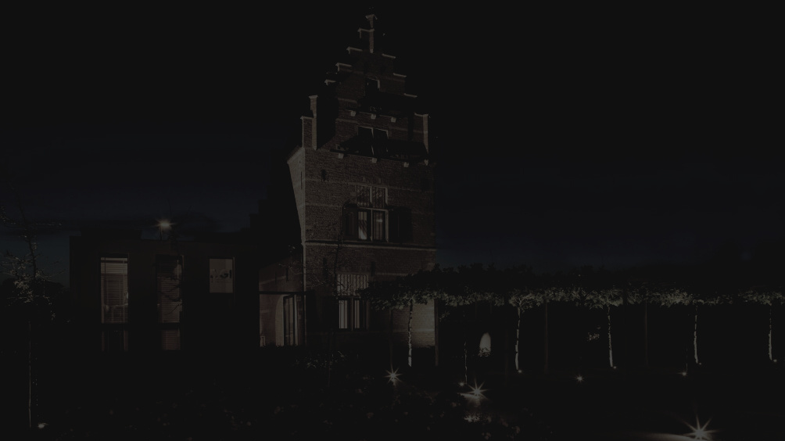


THANK YOU!

