Slide 1

git
How to get out of a mess
git noun – British – informal an unpleasant or contemptible person. “that mean old git”

Slide 2
Next time?
Mobile Development (ReactNative, Flutter, ...)
DeepDive Library X (vb: Formik, TypeScript, Git)
WebSockets
Introduction Language: Rust, Wasm, Python, AutoHotkey, ...
Docker, MongoDb, Redux, ...
Bootcamp: Security, MicroServices

Slide 3



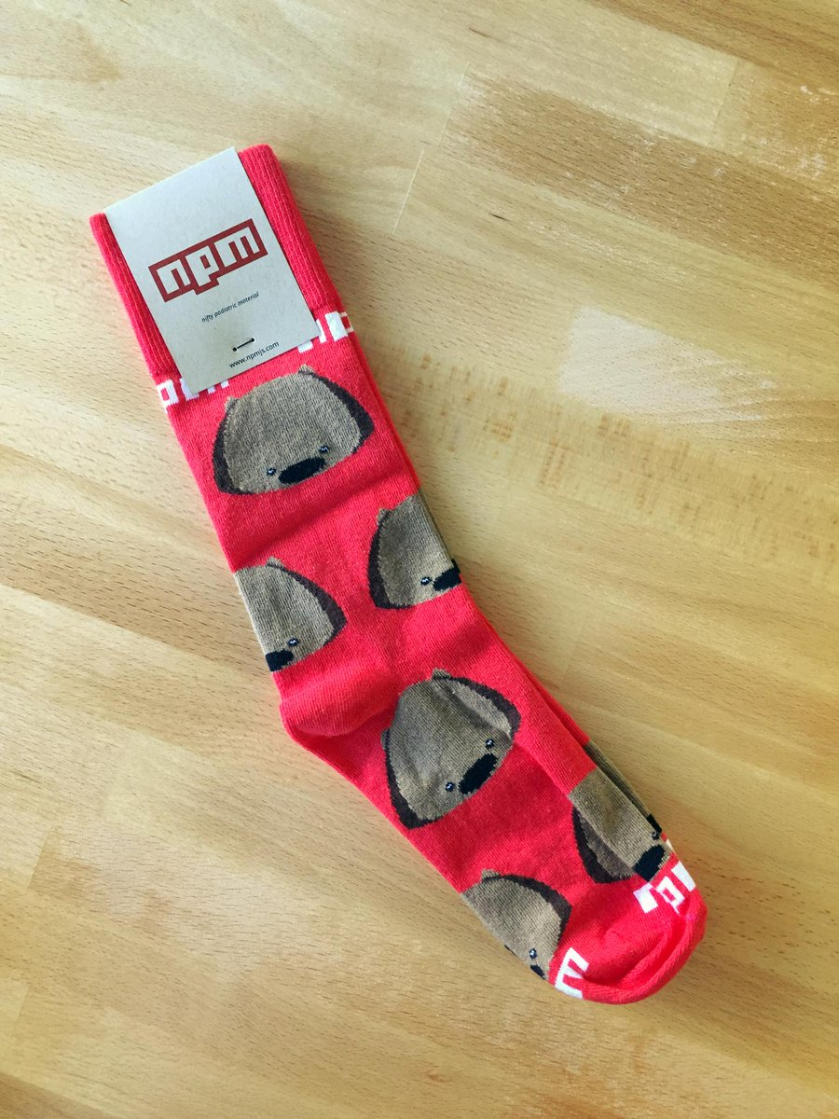
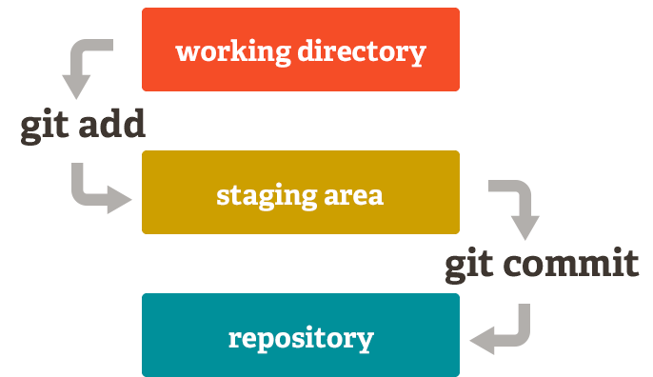
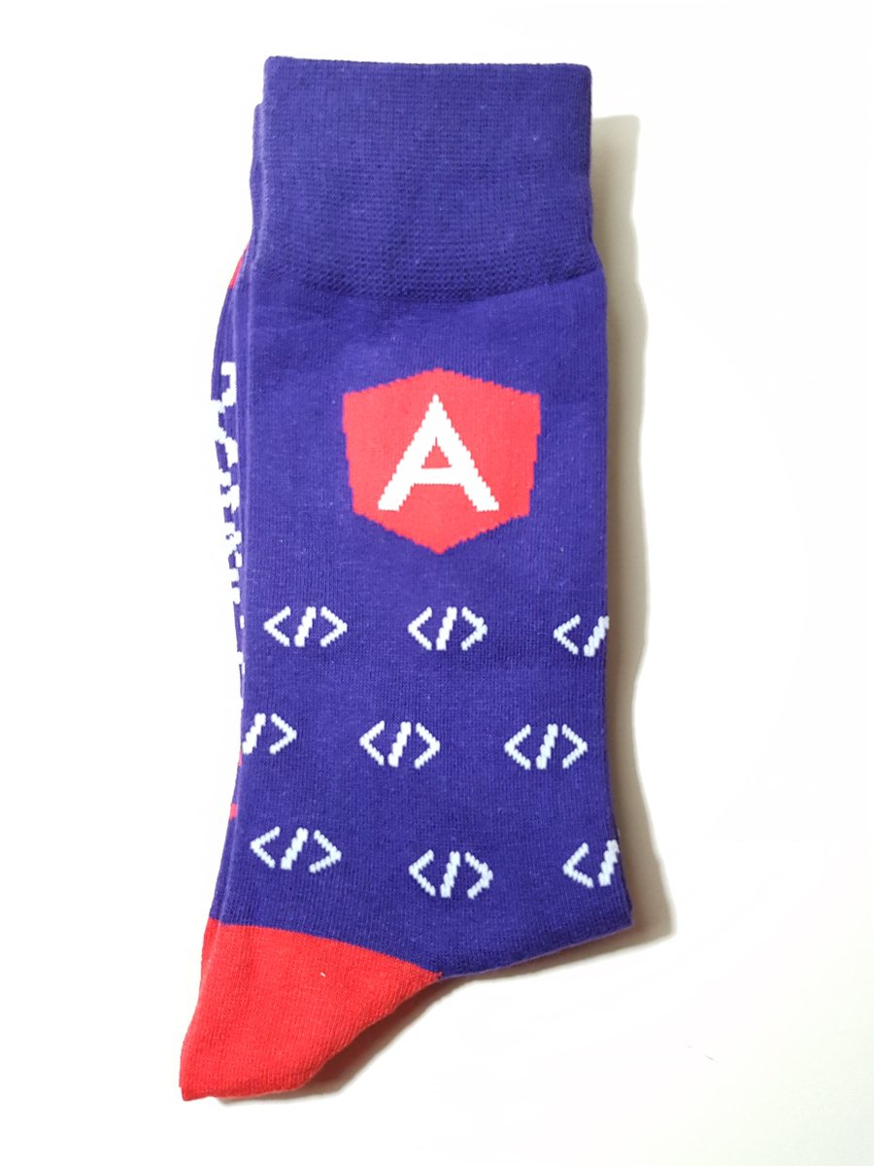
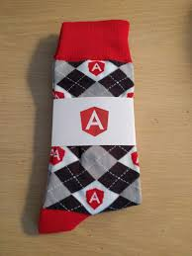
Le Basic
Playing with your local repository

Slide 4
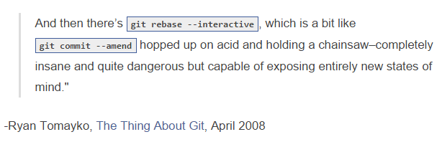
Le Advance

Slide 5
Moving On
Config Folder
Resources
Think Like (a) Git
Git For Ages 4 And Up
git-game & Git-game-2
git-gud (Python3)
learngitbranching.js
Githug (Ruby)

Slide 6
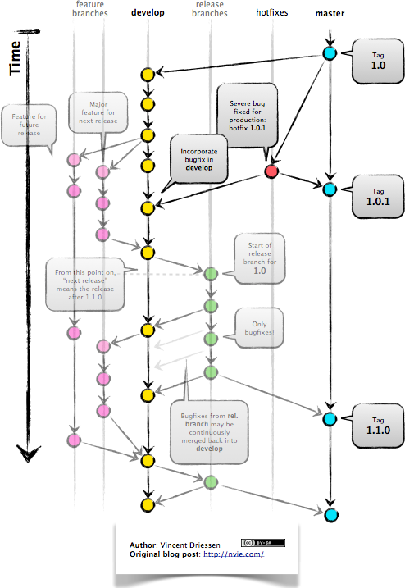
How to Not get into a mess

Slide 7
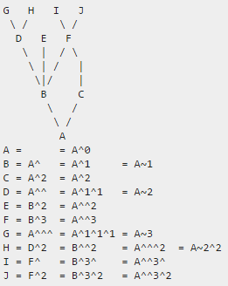
HEAD~ vs HEAD^
Rules of thumb
Use ~ most of the time — to go back a number of generations, usually what you want
Use ^ on merge commits — because they have two or more (immediate) parents
Mnemonics
Tilde ~ is almost linear in appearance and wants to go backward in a straight line
Caret ^ suggests an interesting segment of a tree or a fork in the road

Slide 8

Git
All the things

