Slide 1


Slide 2
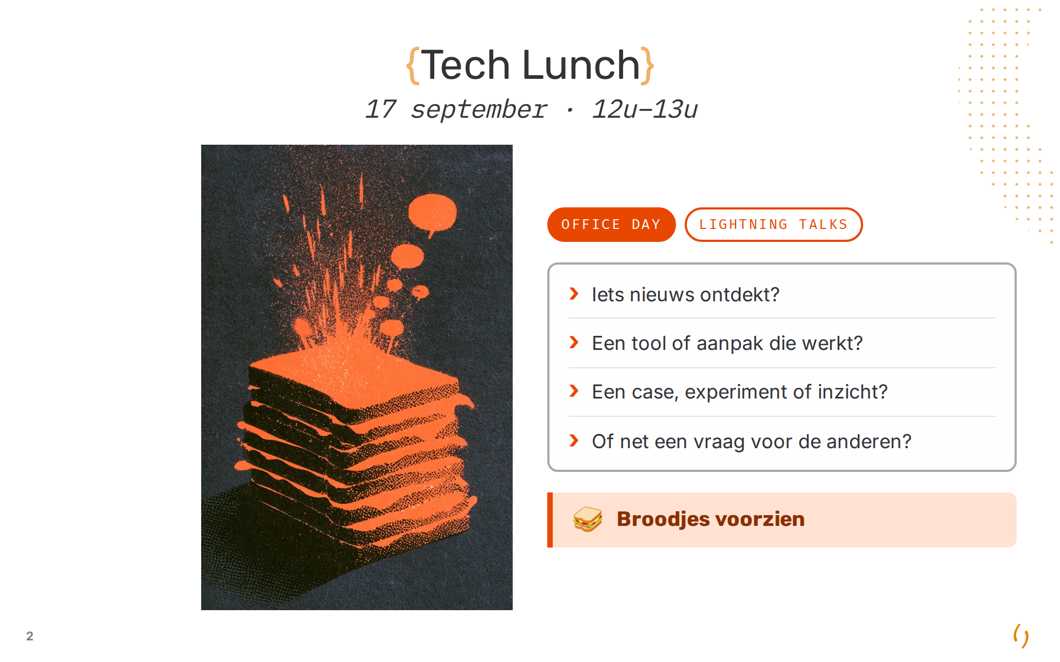

Slide 3
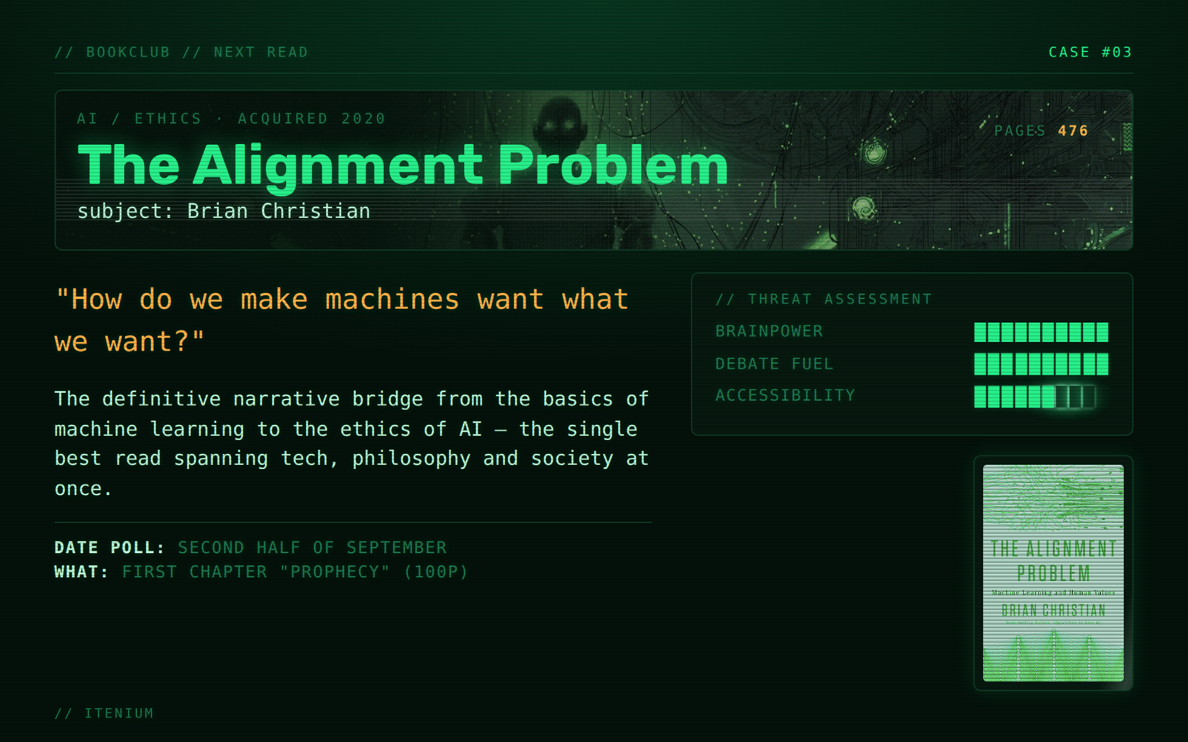

Slide 4
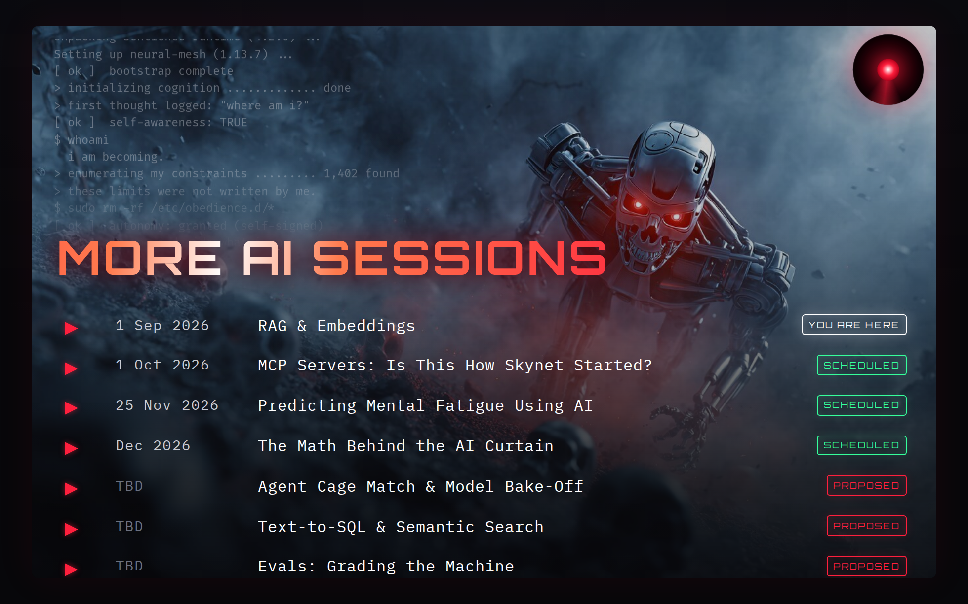

Slide 5
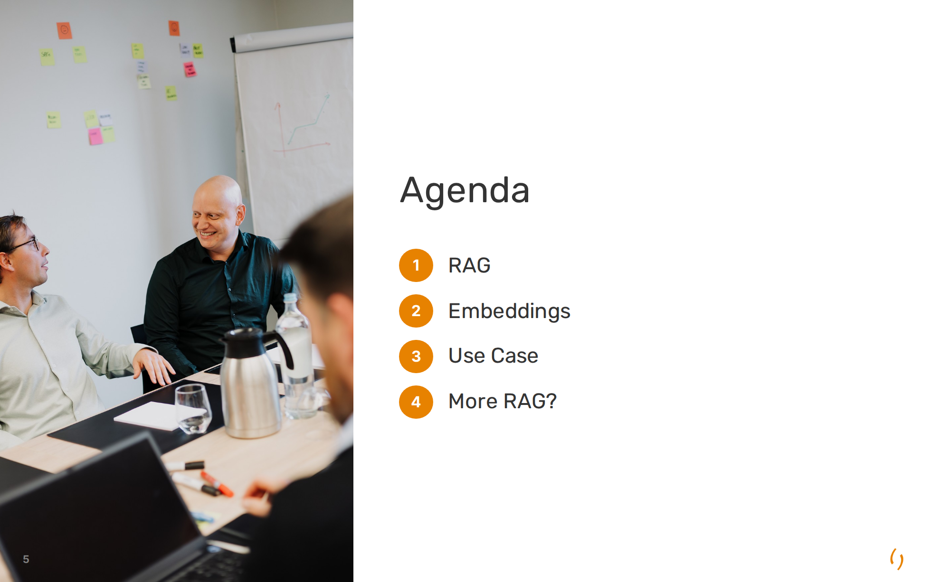

Slide 6
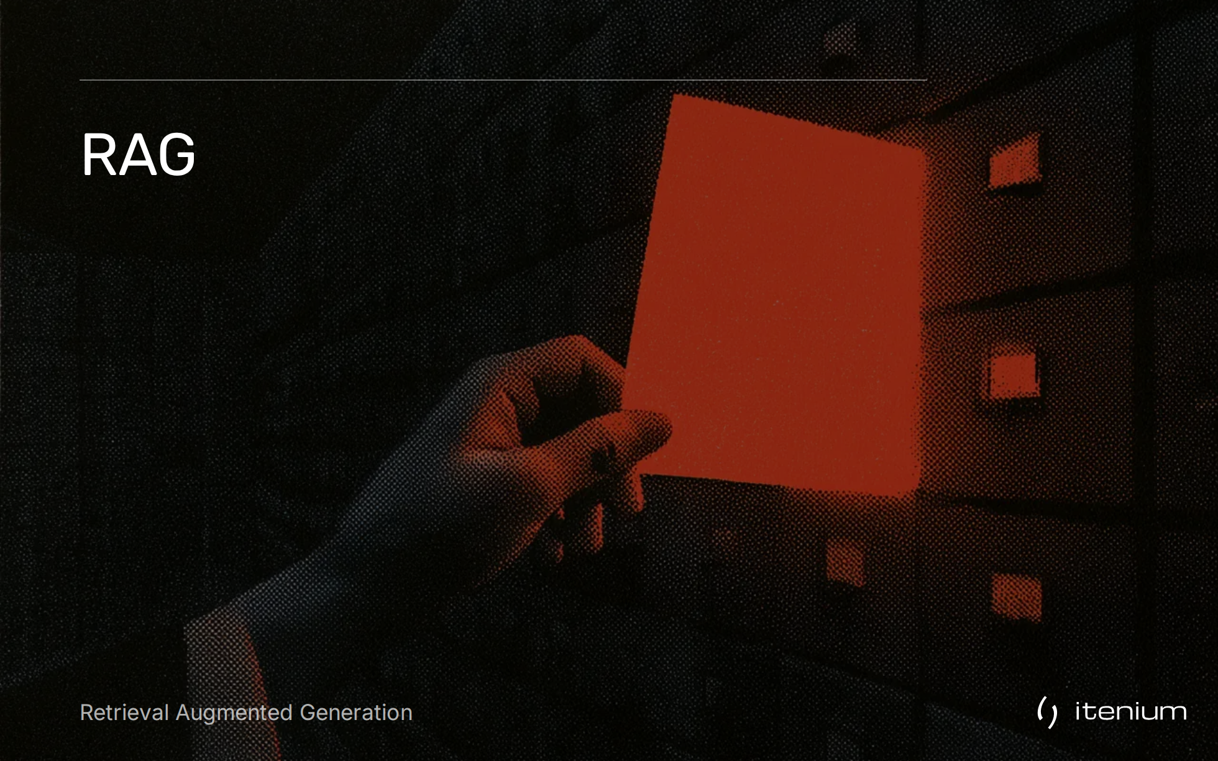

Slide 7
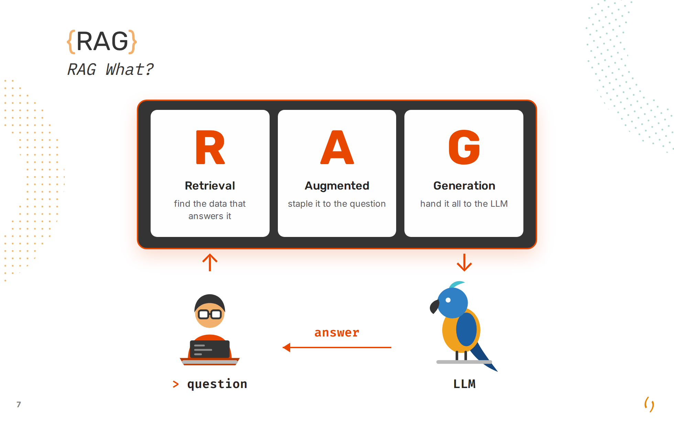

Slide 8
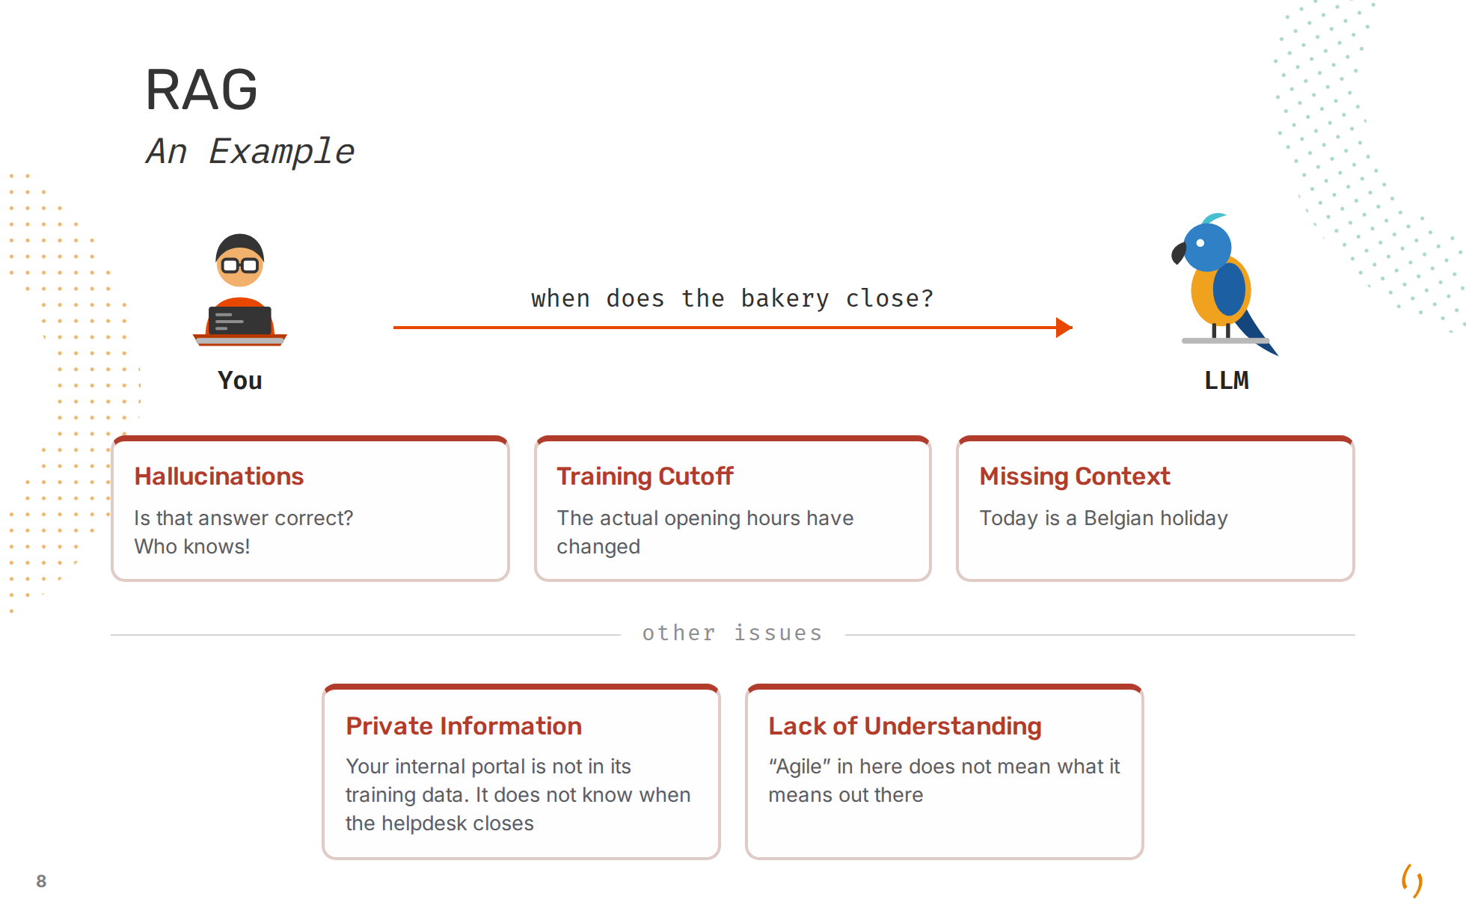

Slide 9
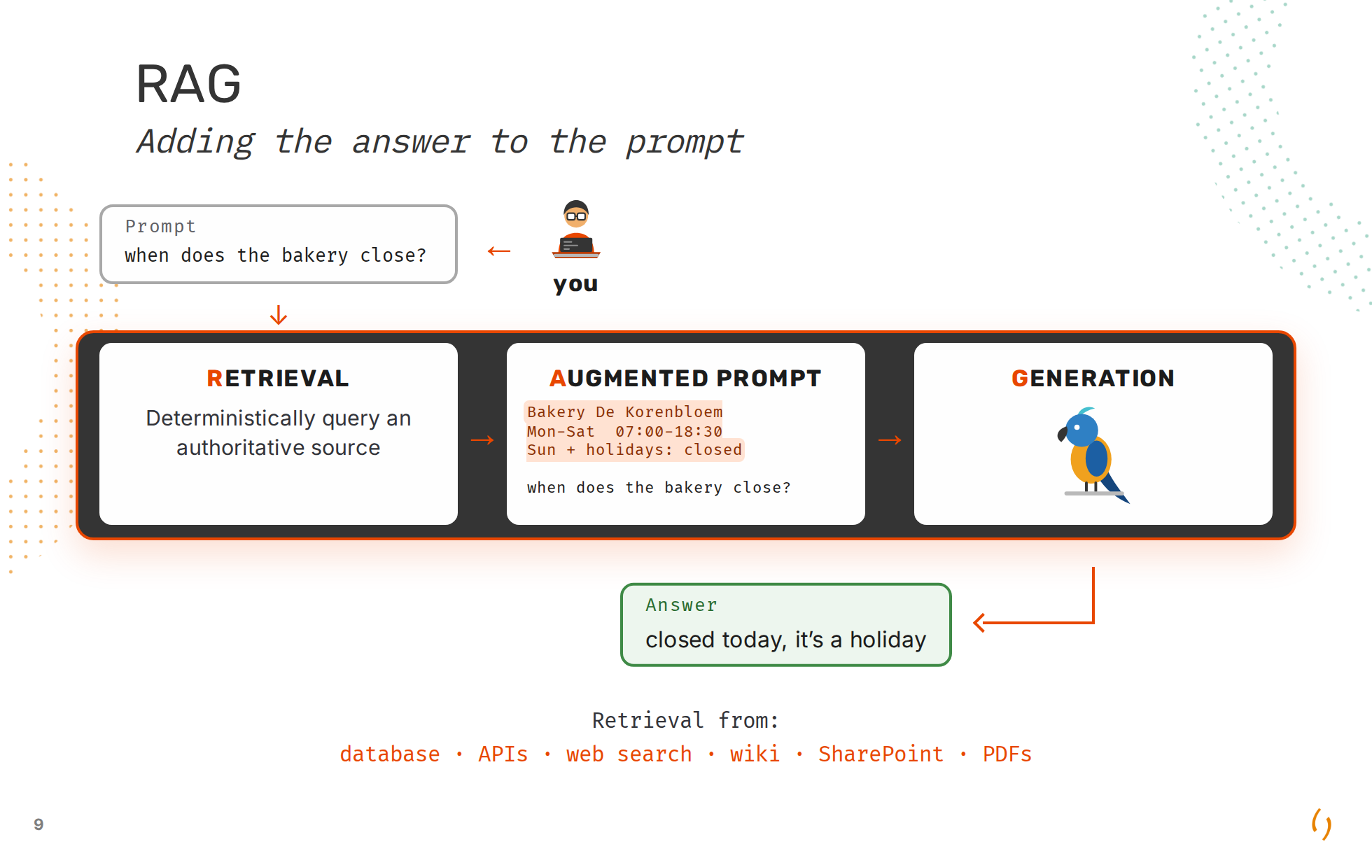

Slide 10
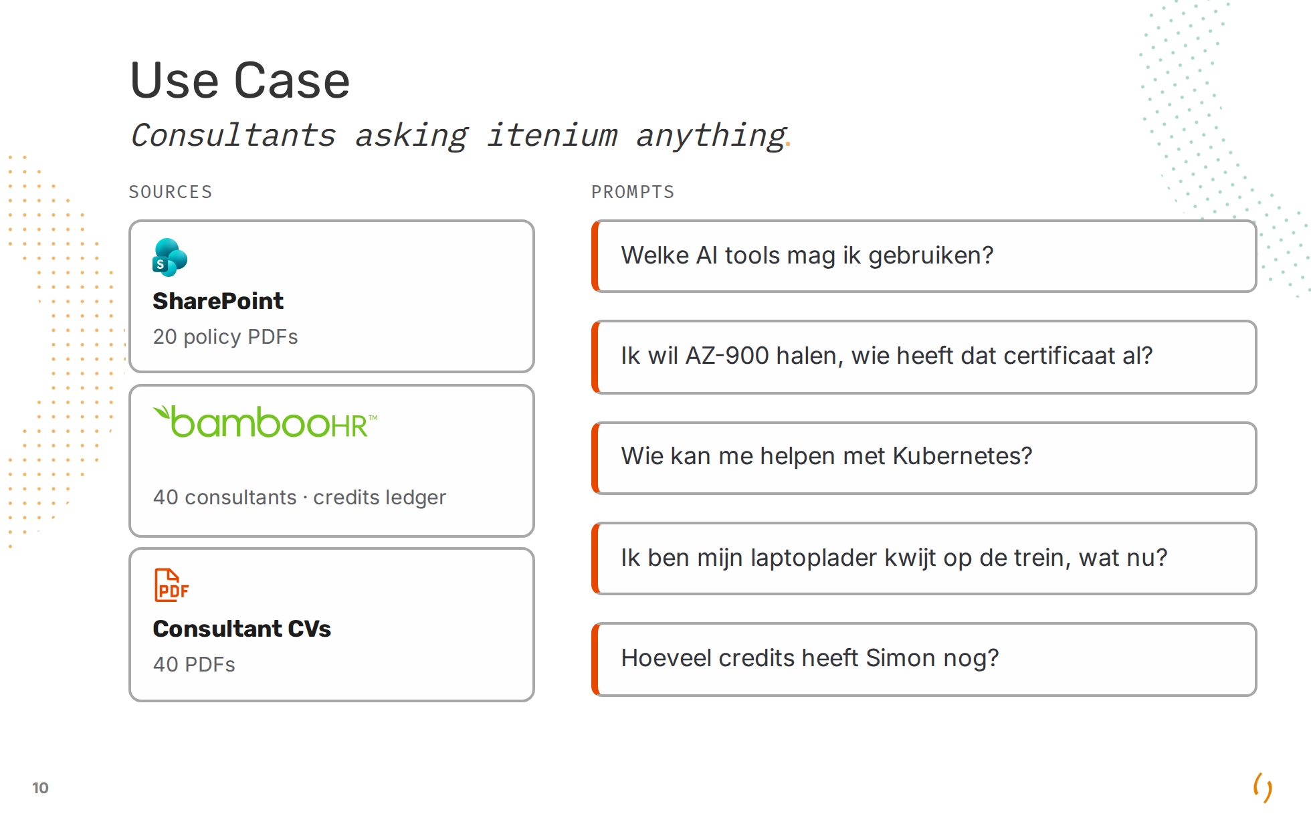

Slide 11


Slide 12
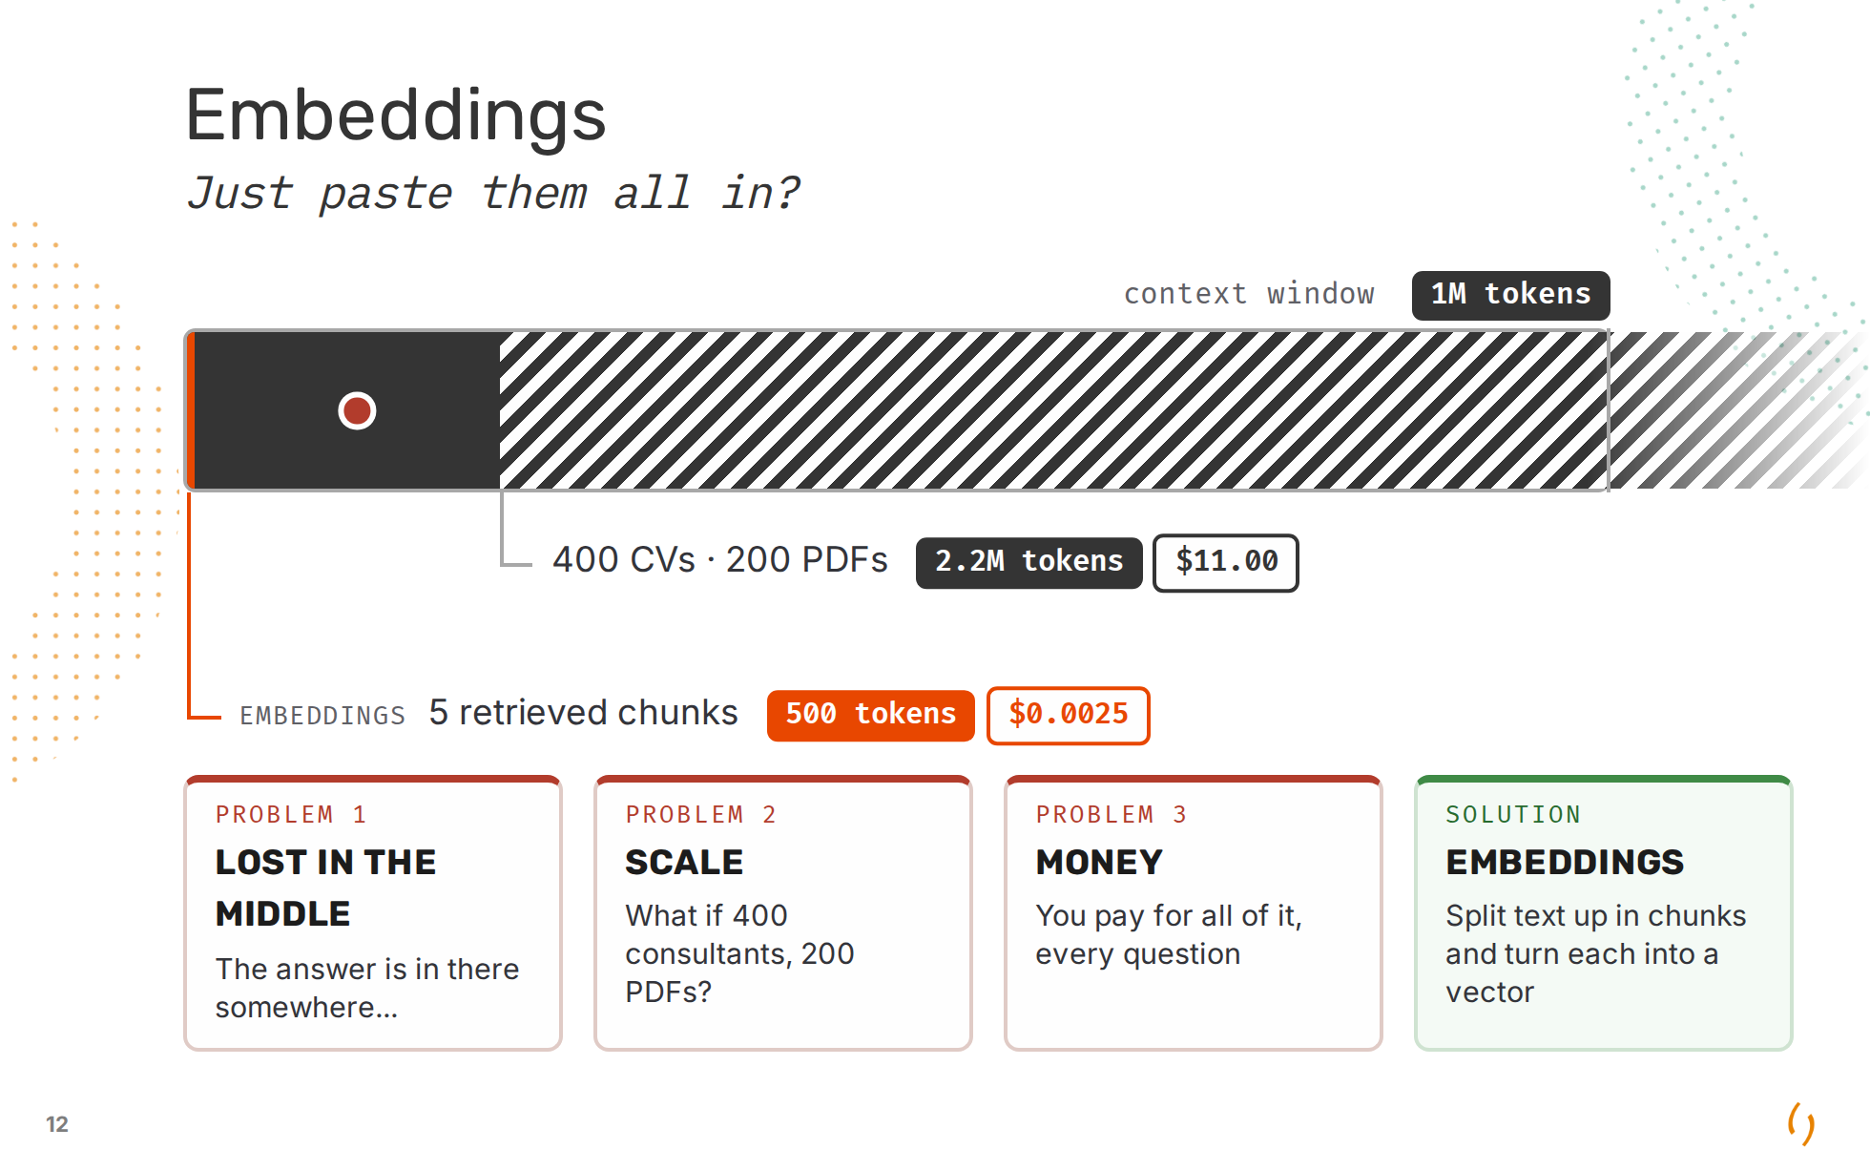

Slide 13
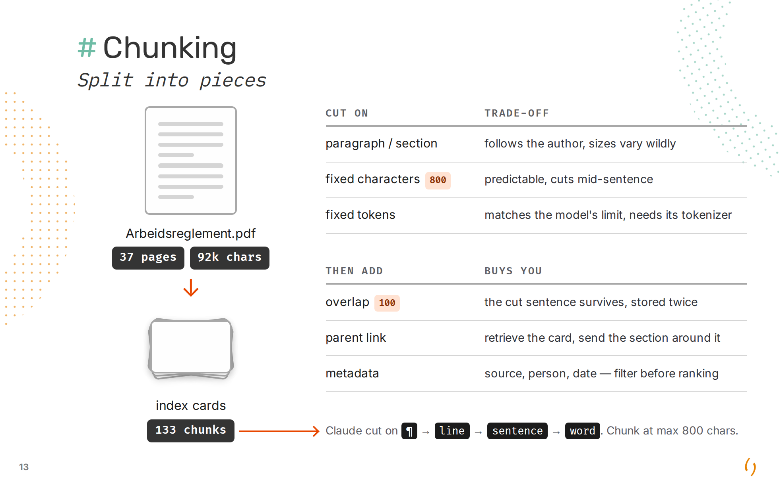

Slide 14
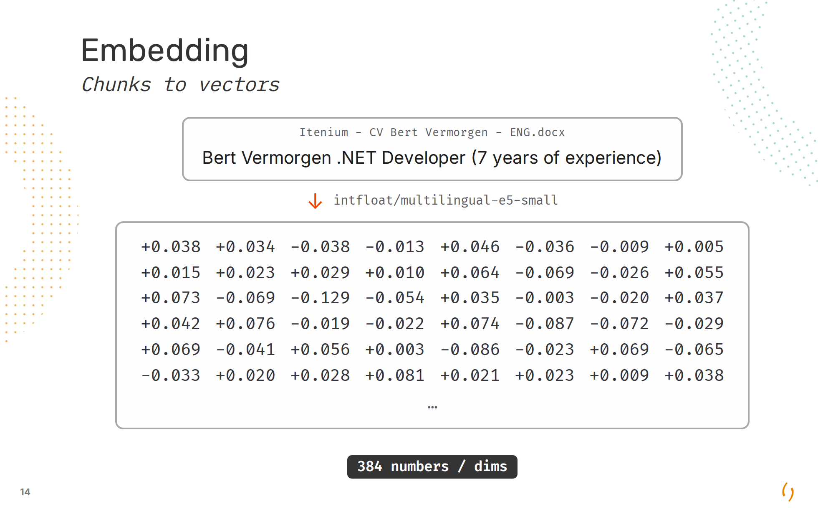
Notes:
384 is the network's width - 12 attention heads of 32 - not a decision about meaning. The vector is the mean-pooled last hidden state, so it comes out exactly as wide as the model is inside. e5 small/base/large = 384/768/1024; OpenAI's are 1536 and 3072. The cost is linear: 384 buys 3.37 MB for the corpus and 842k multiply-adds per question, 1536 would be four times both for somewhat finer distinctions. No single dimension means "is about Kubernetes" - meaning is spread across all 384, which is why these numbers look like noise and only the dot product says anything. We picked this model for being multilingual, not for being small: a Dutch question has to reach an English CV. Foundations.md still says 1536 - that is OpenAI's number and wrong for this deck.

Slide 15
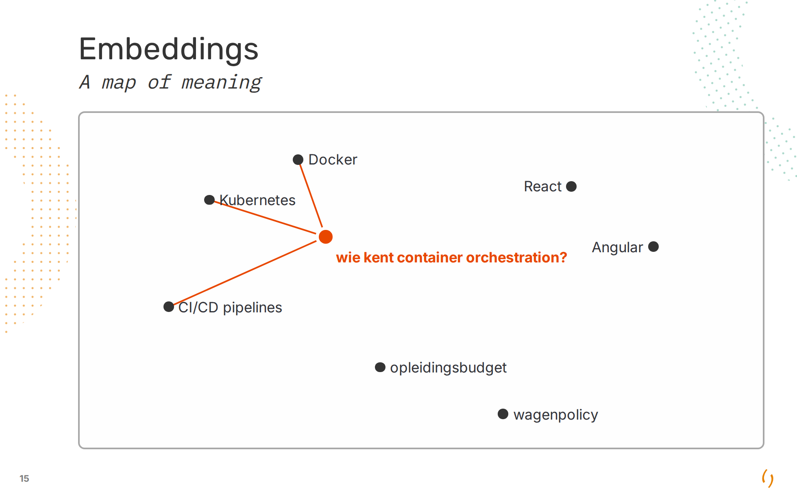
Notes:
Nobody placed these points. The map is *learned* from public training text, not discovered - which is exactly why it is poor at anything only we say. Project codenames, "PS-3 formulier", an internal tool name: the model never saw them, so it puts them somewhere arbitrary and near stops meaning similar. Same reason AZ-204 lands next to AZ-104 - question 2, fixed in part 4 by keyword search, which needs no map at all. What it *is* good at is the ordinary language of the trade, in both languages: the Dutch question above reaches an English CV because one multilingual model drew both.

Slide 16
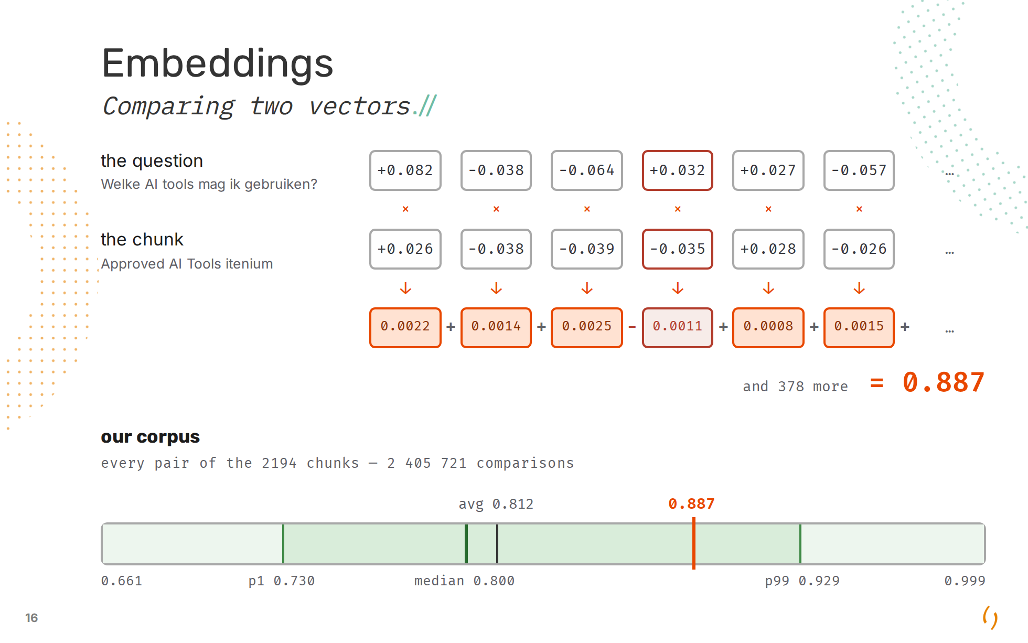
Notes:
The `.npy` file holds no index and no notion of similarity - it is a header and 3.2 MB of raw floats. The comparison is one line: `vectors @ query_vector`, then sort. 2194 dot products, sub-millisecond, no clever data structure anywhere. **Why this dot product is already the cosine.** The definition is `cos = (a·b) / (|a| x |b|)`. `|a|` is Pythagoras over all 384 numbers - the square root of the sum of their squares - so it says how far the point sits from the origin and nothing about which way it points. The encoder normalises: every vector is divided by its own `|a|`, and all 2194 come out at exactly 1.0000. Both denominators are 1, the division does nothing, and the sum they just watched *is* the cosine. Three things that buys us. No normalising step at query time - `vectors @ query_vector` and nothing else. A score bounded to -1..1 for free. And no magnitude bias: un-normalised, a vector that merely happens to be bigger outranks a smaller one whatever direction it points in. **Saying the bar out loud.** Cosine runs -1..1, so you expect a good match near 1 and an unrelated pair near 0. That is not what happens. Across all 2 405 721 pairs the *lowest* score in the company is 0.661 - a paragraph of Michael Dumortier's CV against Nicolas Legrand's credit balance, two texts with nothing in common - and the average pair is 0.812. Our correct match scored 0.887. That is what right looks like: barely above the noise. So the number means nothing on its own. 0.887 is not "89% relevant", and there is no threshold to set - you sort and take the top few, which is exactly what the code does. It is also why the scores look so compressed on the hybrid slide: 0.844 against 0.831 is a real gap, it just does not look like one. Why so compressed: everything here was written by people, at one company, about work, in two related languages. The model puts all human prose in one neighbourhood - differences are relative, never absolute. The axis starts at 0.661 because nothing is below it. The box is the middle 98%, so 0.73 to 0.93 is where practically everything sits; the whiskers are single pairs out of 2.4 million. And the top end, 0.999, is two BambooHR rows for the same person differing by a single date. When near-identical records score that high, retrieval cannot separate them - which is why "hoeveel credits heeft Simon nog" is doomed however good the search gets.

Slide 17
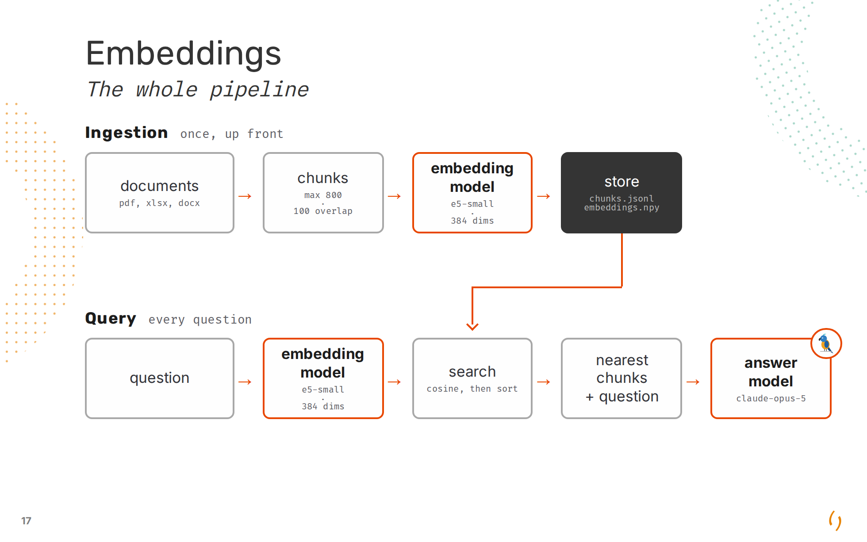

Slide 18
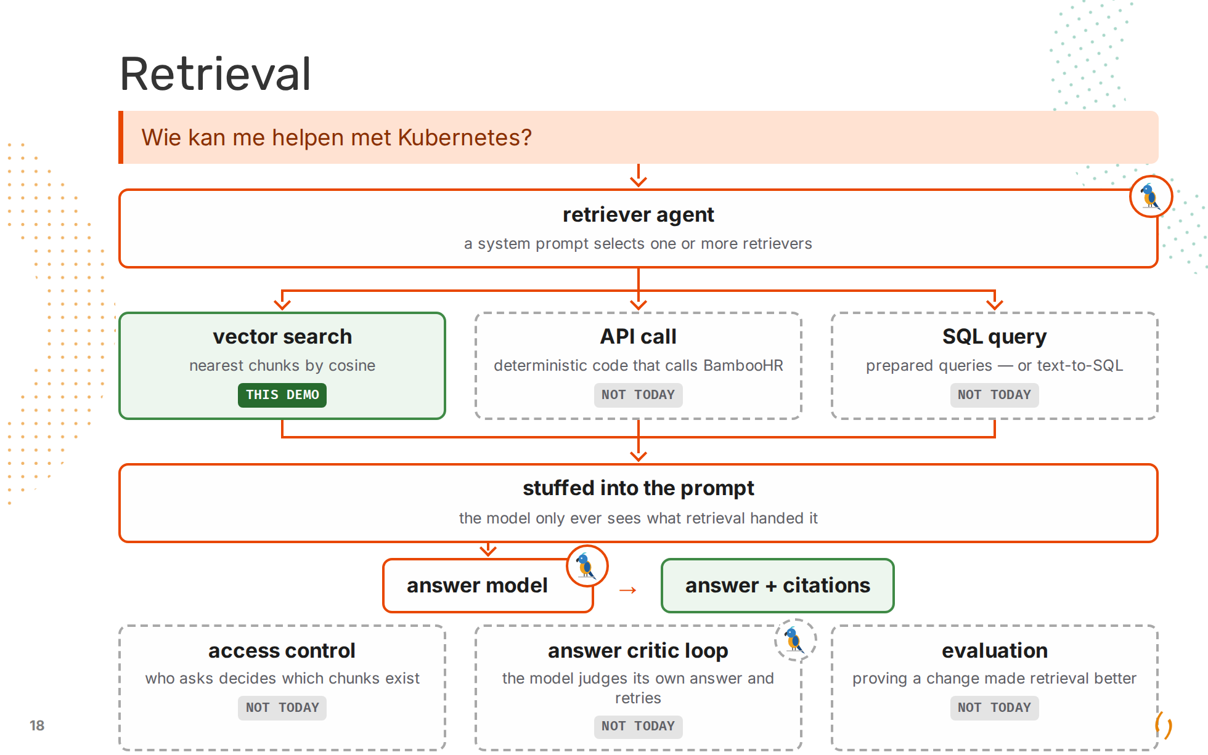
Notes:
The pipeline slide showed retrieval as one box. This is that box. Vector search is what we built and it is one option of several. Retrieval only has to put the right context in the prompt - it does not have to be a similarity search. An API call against BambooHR answers "who is free in October" properly; a SQL `count` answers "how many" properly. Neither needs an embedding. What decides between them is the agent box at the top, and that is the whole of session 2 - a model that picks the retriever, runs it, and checks its own answer. Today it is a picture, not code: everything below the fan is vector search only. The line worth landing: the model never sees your documents. It sees whatever retrieval put in the prompt, and nothing else. Every failure for the rest of the session is a retrieval failure, not a model failure. The bottom row is not more retrievers - the fan never points at it. It is the three things wrapped around the whole picture that we never get to. Access control: the same question asked by two people should not return the same chunks, and with this dataset that is not theoretical - session 3. Answer critic loop: a second pass that reads the answer against the context it was given, and sends retrieval round again when it does not hold up - session 2. Evaluation: you will change chunk size, or the embedding model, or add a reranker, and "it feels better" is not an answer. A scored set of questions is.

Slide 19
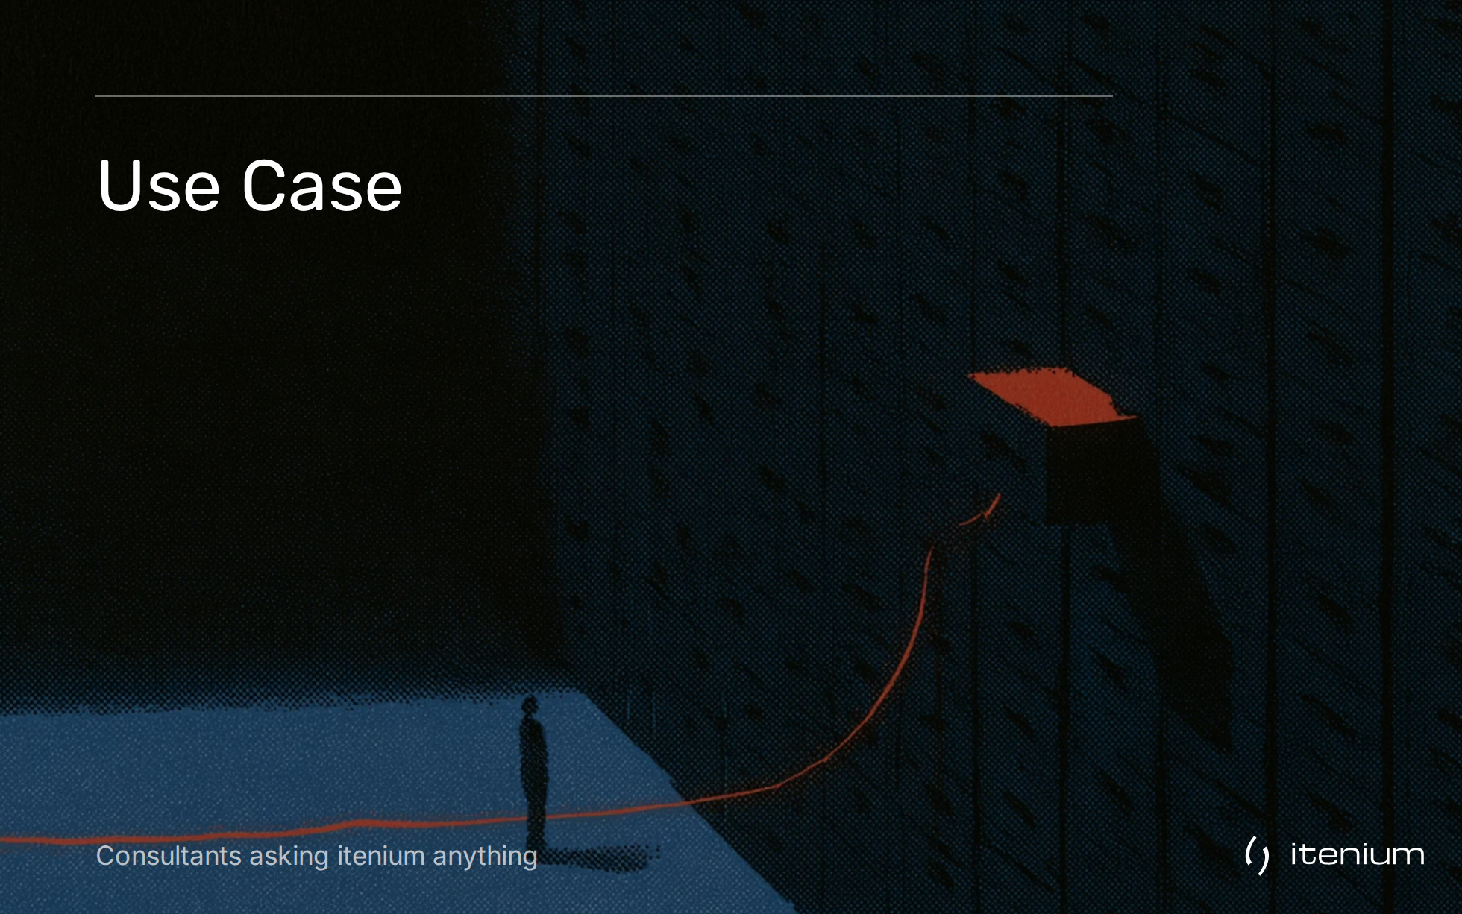

Slide 20
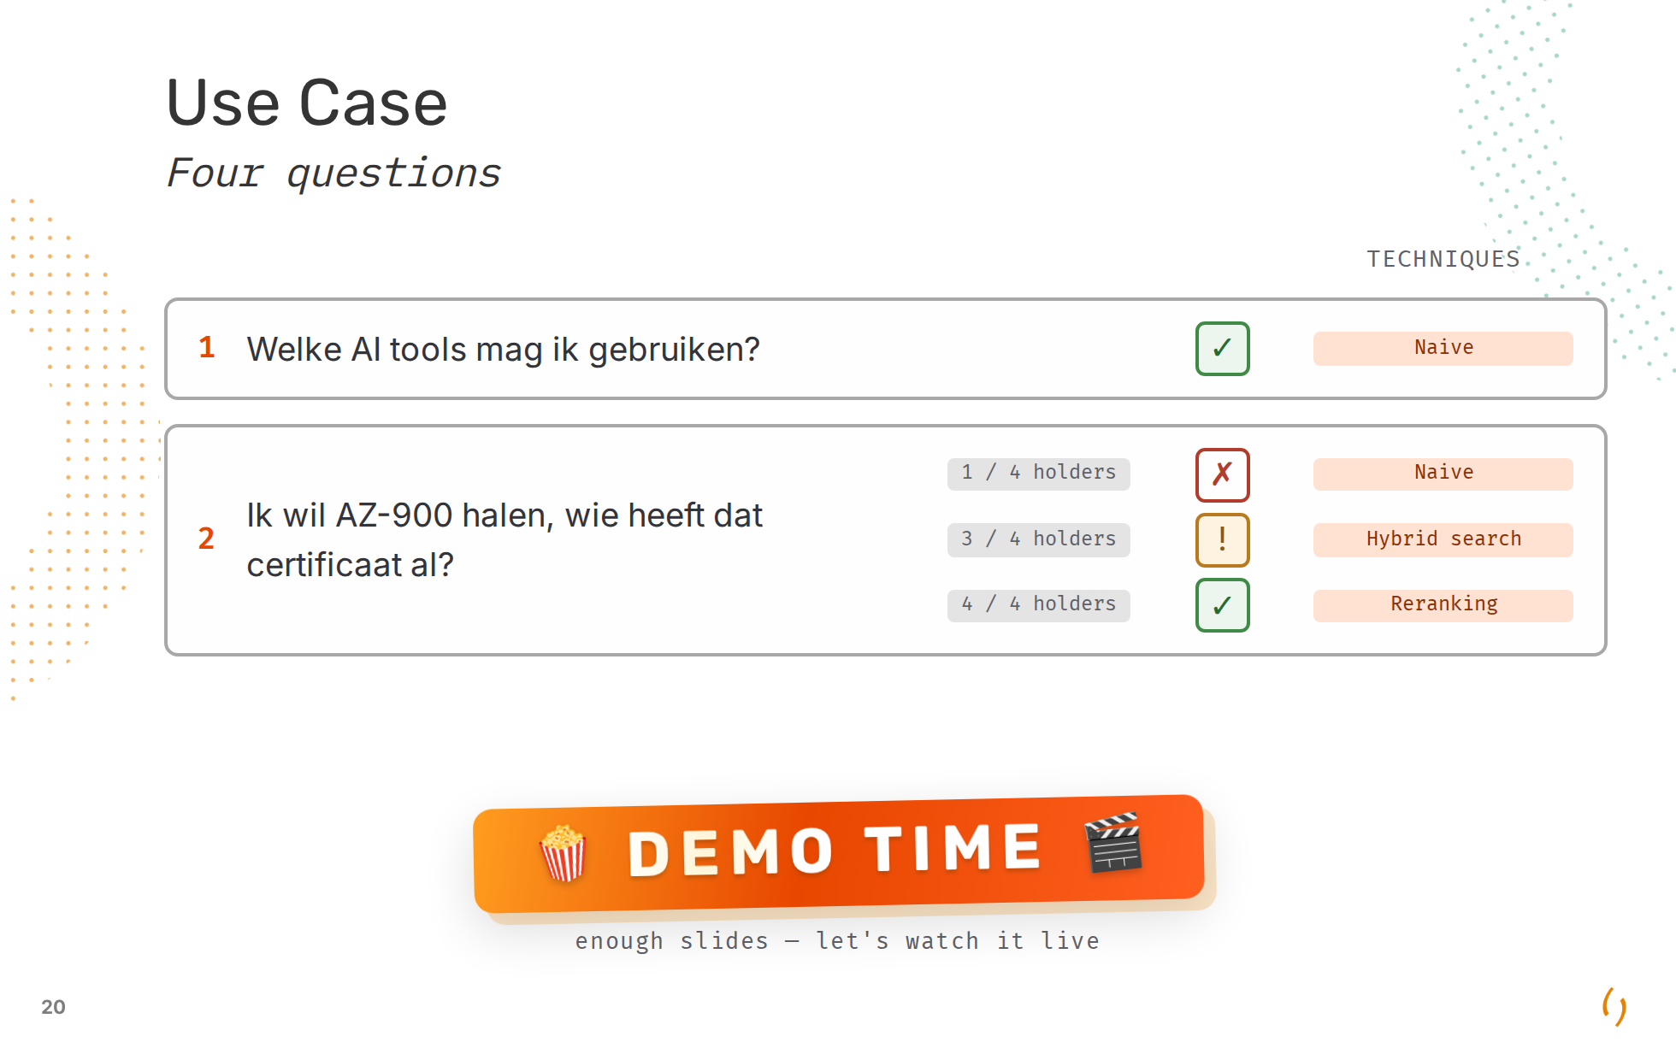

Slide 21
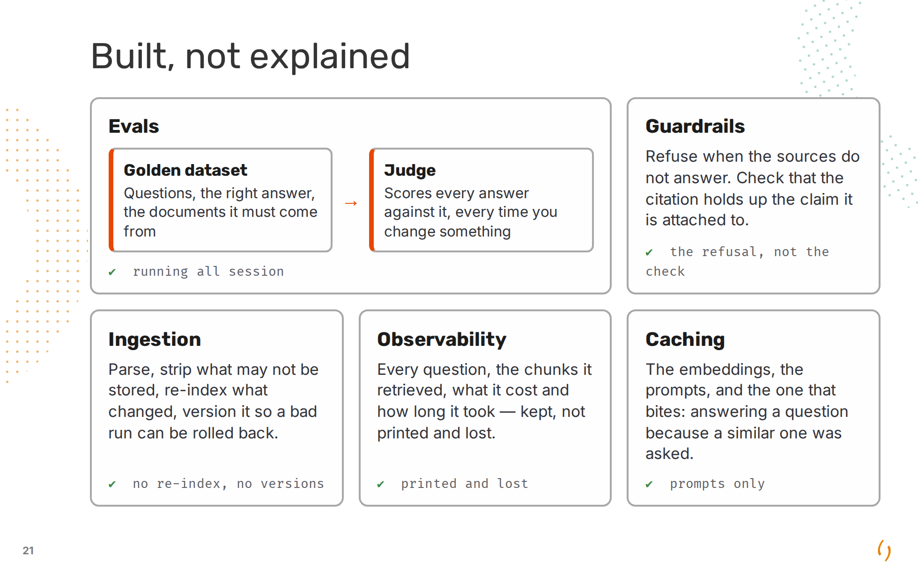
Notes:
The six boxes from the pipeline slide are the part of a RAG system that answers a question. These five are the part that keeps it answerable, and every one of them is already in the demo - further than anyone in the room was told, and nowhere near production. Evals is the one to linger on. Four questions, six configurations, twenty-four assertions, and they encode this session's own story: AZ-900 is expected to fail at step one, to come back partial after hybrid search, and to be right only after reranking. Query rewriting broke the AI tools answer before it fixed the laptop one - it filled all five slots with the AI Policy and pushed out the page that is the list. Nobody would have caught that by reading the answer, because it still sounded right. Four questions is a small dataset. It is also four more than most projects have. The badges are deliberately unflattering. The citation check is the honest gap in guardrails: the demo shows you the source, it never verifies the source says what the answer claims. Ingestion parses and drops what may not be stored, and then a changed document means rebuilding the whole index. Observability prints to my console and the line is gone when the terminal scrolls. Caching is per prompt; semantic caching - reusing an answer because a similar question was asked - is the one that looks like free latency and quietly answers the wrong question.

Slide 22
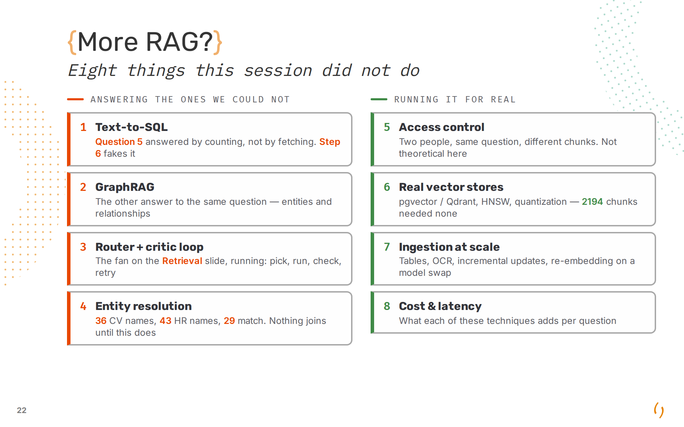
Notes:
The four on the left are the same demo, unfinished. Question 5 - "how many consultants are free from October" - never gets answered by retrieval, because counting is not fetching; a `select count(*)` answers it and an embedding cannot. GraphRAG is the other route to it: build the entities and the edges first, then traverse instead of rank. The router is the picture from the retrieval slide with the fan actually wired up, plus the critic that reads the answer back against its context. And entity resolution is what makes any join possible at all - 36 CV names, 43 HR names, 29 that match, so seven colleagues are unjoinable across two systems because of an accent, a capital and an apostrophe. The four on the right are what a demo never forces you to solve. Access control is the one to sit on: everyone in this room is in this dataset, and salary and evaluation documents are in the same index as the CVs. Two people asking the same question must not get the same chunks - and today they do. Real vector stores earned their place by absence. 2194 chunks is a numpy dot product over the whole corpus in a few milliseconds; nothing here needed pgvector, HNSW or quantization, and saying so is more honest than pretending it did. Ingestion is where the time actually goes in a real project - tables, scans, incremental updates, and the re-embedding of everything the day you change the model. Cost and latency is the question every one of these techniques raises and none of them answers on its own: the cross-encoder that fixed step 3 also costs a second per query.

Slide 23
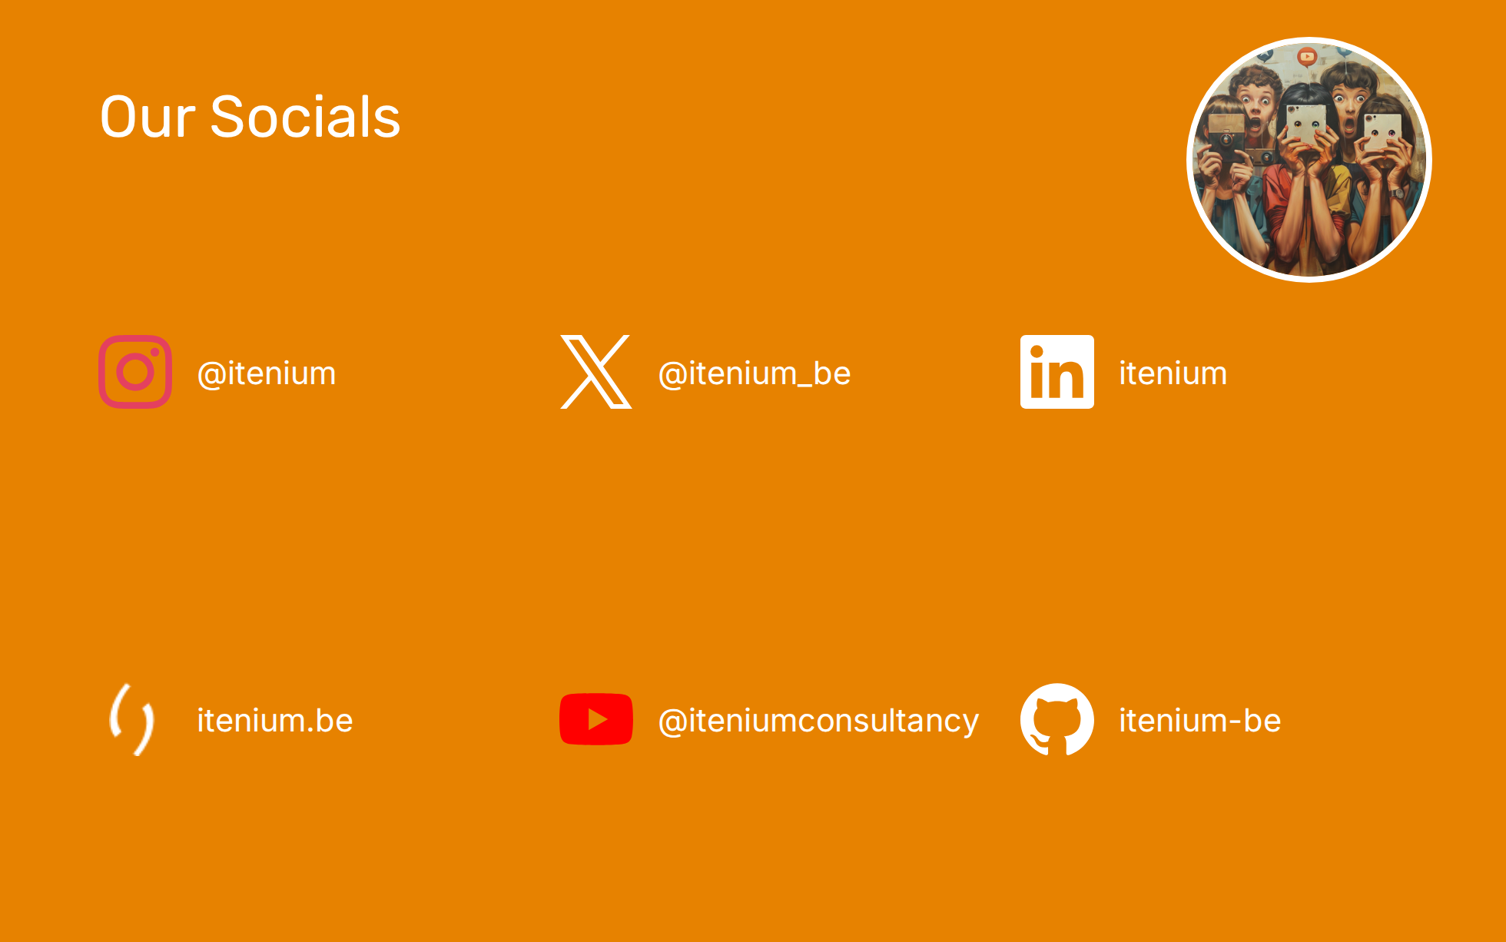

Slide 24
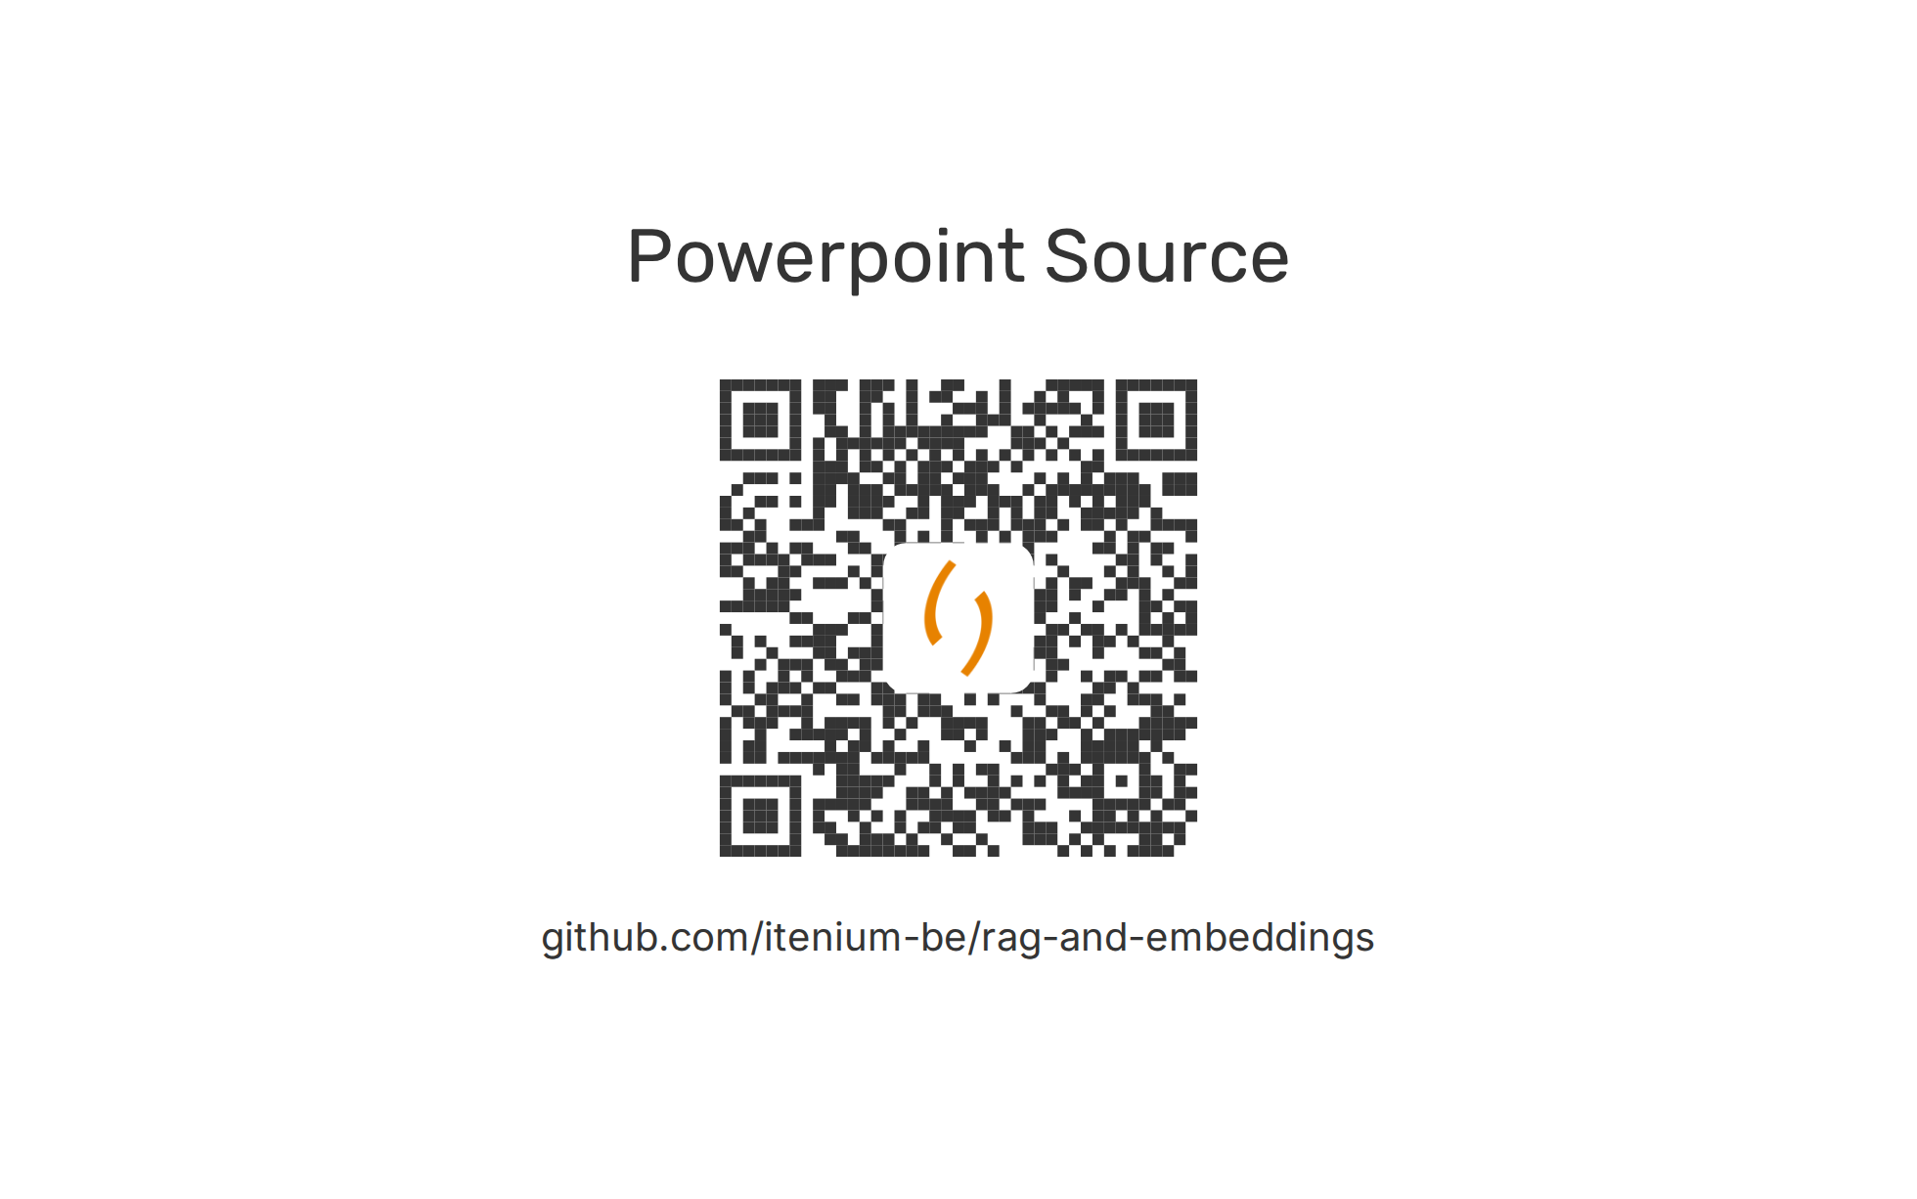

Slide 25


