Slide 1





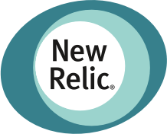







Safely promote winning version of your app/ML model
Use metrics from any provider
Automate A/B, A/B/n, Canary, and Conformance experiments

