Slide 1
Iter8 images for documentation

Slide 2
V0.2.5-pre for KFServing

Slide 3

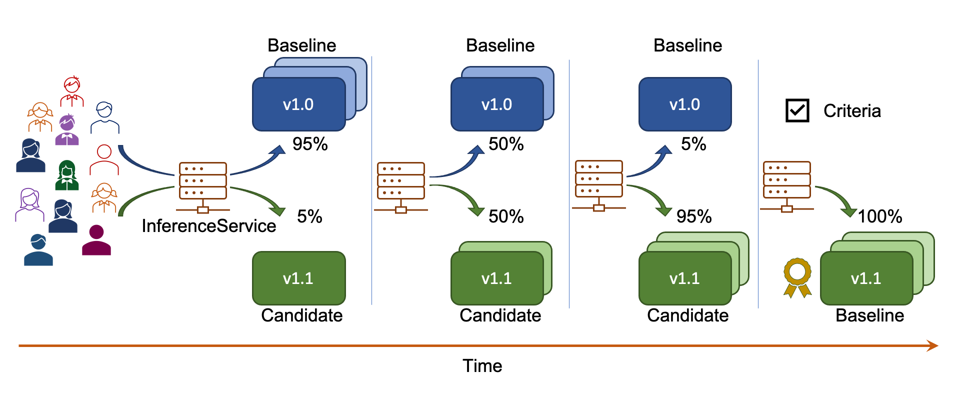




Monitoring
KFServing
Telemetry databases
AI-driven progressive delivery
Statistically robust promotion of winner
Multi-armed bandit-based traffic shifting
Iter8
Metrics

Slide 4
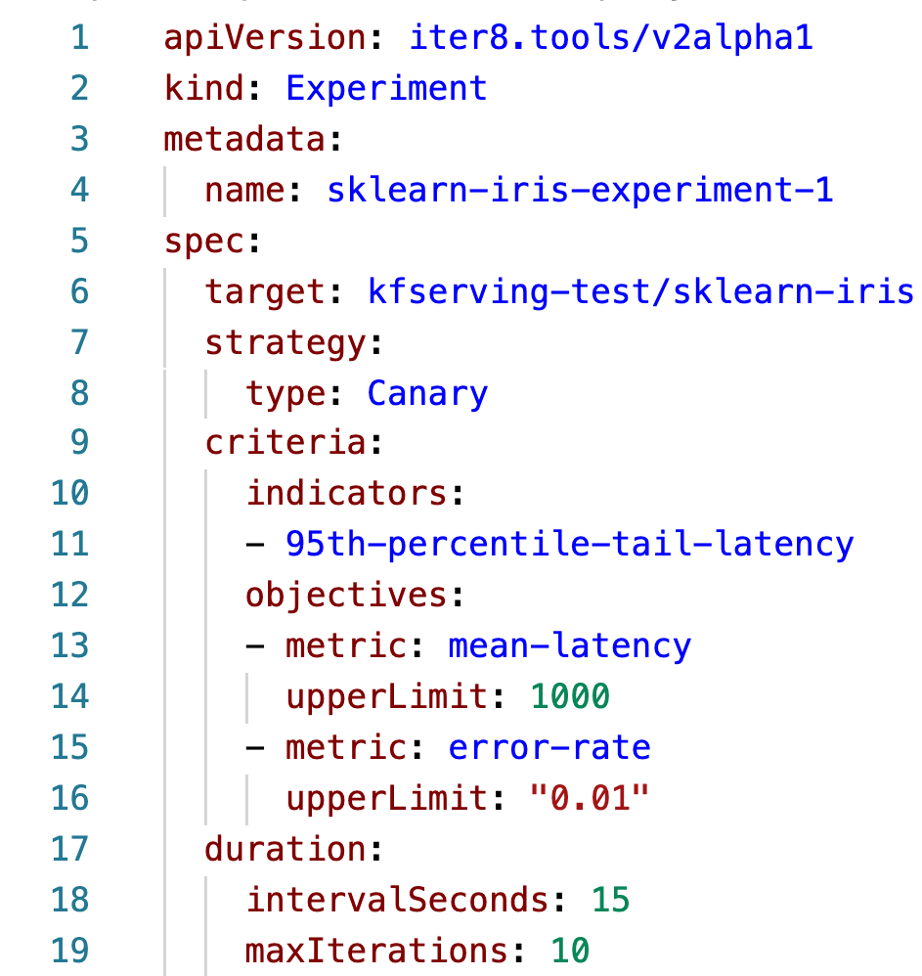
1. Namespaced name of the InferenceService
2. Experimentation strategy
3. Metrics-based criteria for evaluating versions
4. Duration of the experiment

Slide 5
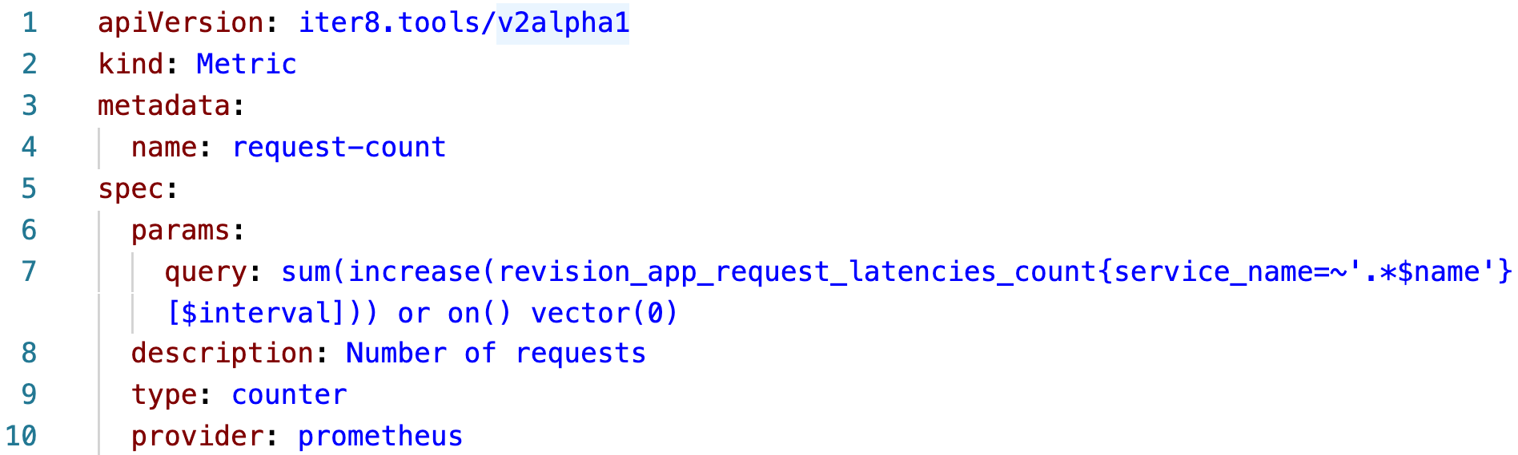
1. Parameters in the REST query to metrics database
2. Description of the metric
3. Type of the metric
4. Type of the metric database

Slide 6
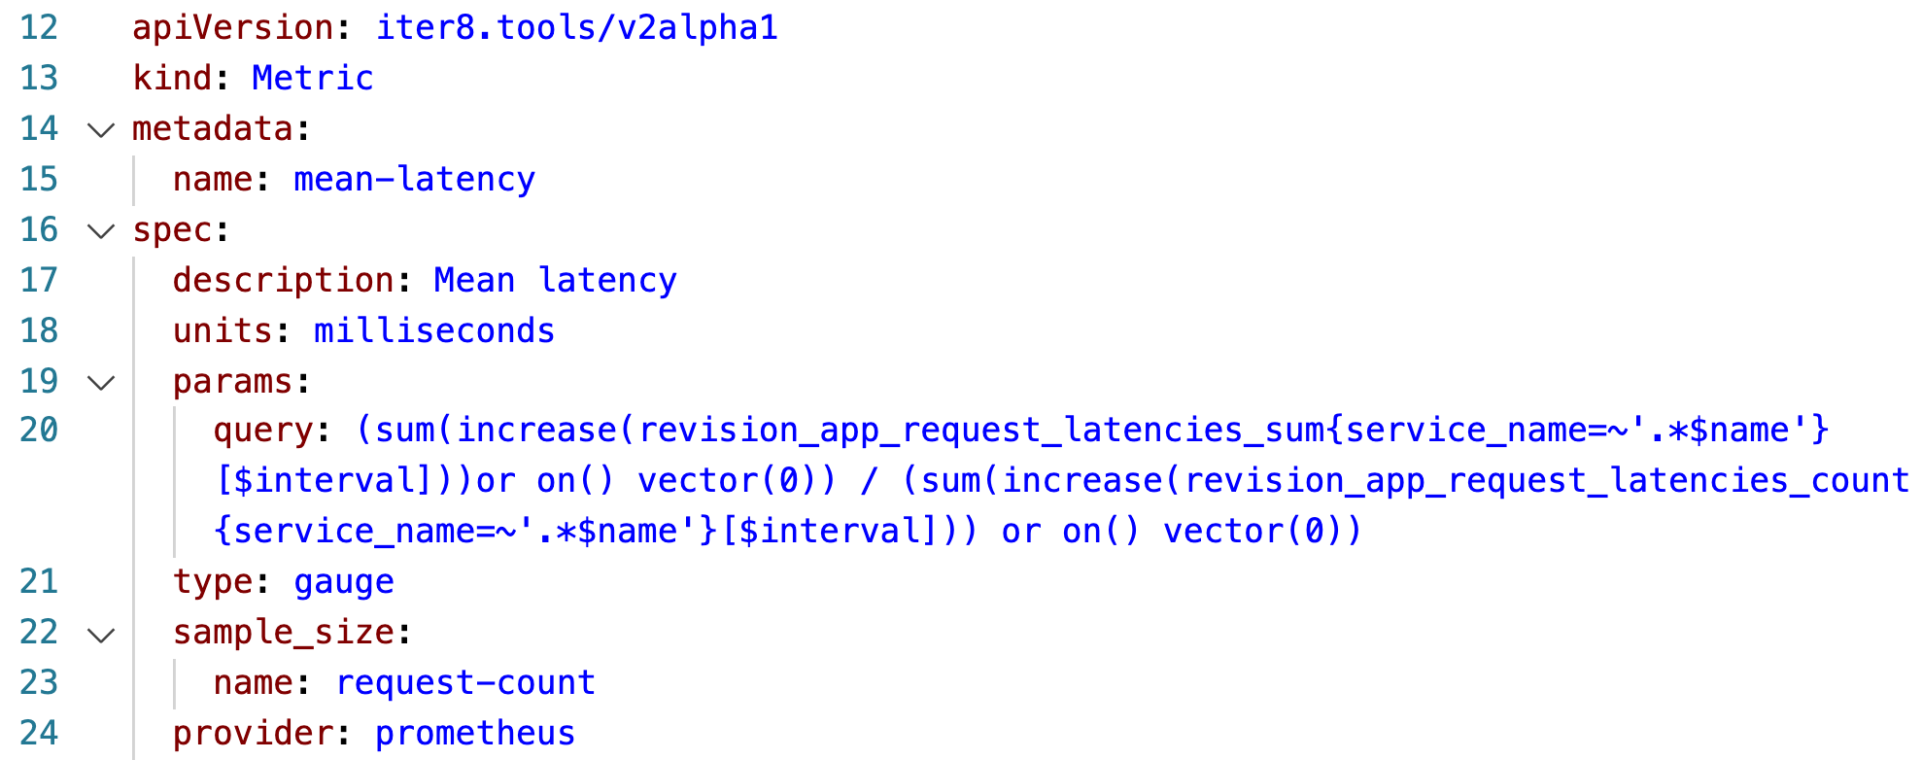
5. Units of measurement
6. Number of data points used to compute metric

Slide 7

KFServing
iter8
iter8
iter8
iter8-kfserving
iter8-kfserving
Inference Service
Experiment
iter8 controller
iter8 analytics
start handler
finish handler
Create
Create
Launch
Initialize traffic split
Provide object/field references for traffic splitting
Assess versions, compute winner and traffic split
Experiment iterations
Experiment iterations
Periodically update traffic split
Launch
Promote winning version as the new default and shift all traffic to it

Slide 8













Baseline
Baseline
Baseline
v1.0
v1.0
v1.0
Criteria
95%
50%
5%
InferenceService
5%
50%
95%
100%
v1.1
v1.1
v1.1
v1.1
Candidate
Candidate
Candidate
Baseline
Time

Slide 9

Baseline
Baseline
Baseline
v1.0
v1.0
v1.0
Criteria
75%
75%
75%
Reward
Webhook notification
InferenceService
25%
25%
25%
v1.1
v1.1
v1.1
v1.1
Candidate
Candidate
Candidate
Candidate
Time

Slide 10

Baseline
Baseline
Baseline
v1.0
v1.0
v1.0
Criteria
95%
50%
5%
Reward
Git push v1.1
InferenceService
5%
50%
95%
v1.1
v1.1
v1.1
v1.1
Candidate
Candidate
Candidate
Candidate
Time

Slide 11
Baseline
Baseline
Baseline
v1.0
v1.0
v1.0
Criteria
0%
0%
0%
InferenceService
100%
100%
100%
100%
v1.1
v1.1
v1.1
v1.1
Candidate
Candidate
Candidate
Baseline
Time

Slide 12
Baseline
Baseline
Baseline
Baseline
v1.0
v1.0
v1.0
v1.0
100%
100%
100%
100%
InferenceService
Criteria
Webhook notification
Time

Slide 13
Build Process
Deployment Pipeline
deploys
Application Versions
triggers
updates
Environment Repository
creates experiment
evaluates
Iter8
recommends traffic split, deployment & GitLoop configuration

Slide 14
Build Process
GitOps Operator
deploys
Application Versions
observes
updates
Environment Repository
creates experiment
evaluates
Iter8
recommends traffic split, deployment & GitLoop configuration

Slide 15






V1
V2
V3
Progressive delivery and rollout
Metrics
iter8

Slide 16
V0.2.5

Slide 17
Baseline
Baseline
Baseline
v1.0
v1.0
v1.0
Objectives
95%
50%
5%
kubectl apply –f …
Knative Service
5%
50%
95%
100%
v2.0
v2.0
v2.0
v2.0
Candidate
Candidate
Candidate
winner
Time

Slide 18
K8s/Openshift stack
iter8
iter8
iter8
iter8
iter8
app / model versions
experiment resource
etc3 controller
analytics service
start action in experiment
finish action in experiment
Create
Create
Launch
Initialize experiment
Periodically query metrics,
assess versions,
compute winner,
optimize traffic split
Experiment iterations
Experiment iterations
Periodically update traffic split
Launch
Promote winner. Clean up after experiment

Slide 19
Baseline
Baseline
Baseline
winner
v1.0
v1.0
v1.0
v1.0
100%
100%
100%
100%
Knative Service
Objectives
Time

Slide 20
Baseline
Baseline
Baseline
v1.0
v1.0
v1.0
Objectives
75%
75%
75%
kustomize build …
Knative Service
25%
25%
25%
100%
v2.0
v2.0
v2.0
v2.0
Candidate
Candidate
Candidate
winner
Time

Slide 21
Baseline
Baseline
Baseline
v1.0
v1.0
v1.0
Objectives
95%
50%
5%
helm upgrade …
Knative Service
5%
50%
95%
100%
v2.0
v2.0
v2.0
v2.0
Candidate
Candidate
Candidate
winner
Time

Slide 22
All other users
Baseline
Baseline
Baseline
v1.0
v1.0
v1.0
100%
95%
100%
75%
100%
55%
Objectives
25%
45%
Istio Virtual Service
5%
v2.0
v2.0
v2.0
v2.0
Users from Wakanda
Candidate
Candidate
Candidate
winner
Time

Slide 23

Baseline
Baseline
Baseline
v1.0
v1.0
v1.0
100%
100%
100%
Objectives
Istio Virtual Service
40%
40%
40%
v2.0
v2.0
v2.0
v2.0
Candidate
Candidate
Candidate
winner
Time

Slide 24
Min-scale / other annotations
Utilization metrics – add in CPU/Memory utilization based objectives
Scenario: Prometheus + New Relic data sources
All other users
Baseline
Baseline
Baseline
v1.0
v1.0
v1.0
v1.0
Reward
100%
95%
100%
75%
100%
55%
Objectives
Support
25%
45%
Istio Virtual Service
5%
v2.0
v2.0
v2.0
v2.0
Users from Wakanda
Candidate
Candidate
Candidate
winner
Time

