Slide 1
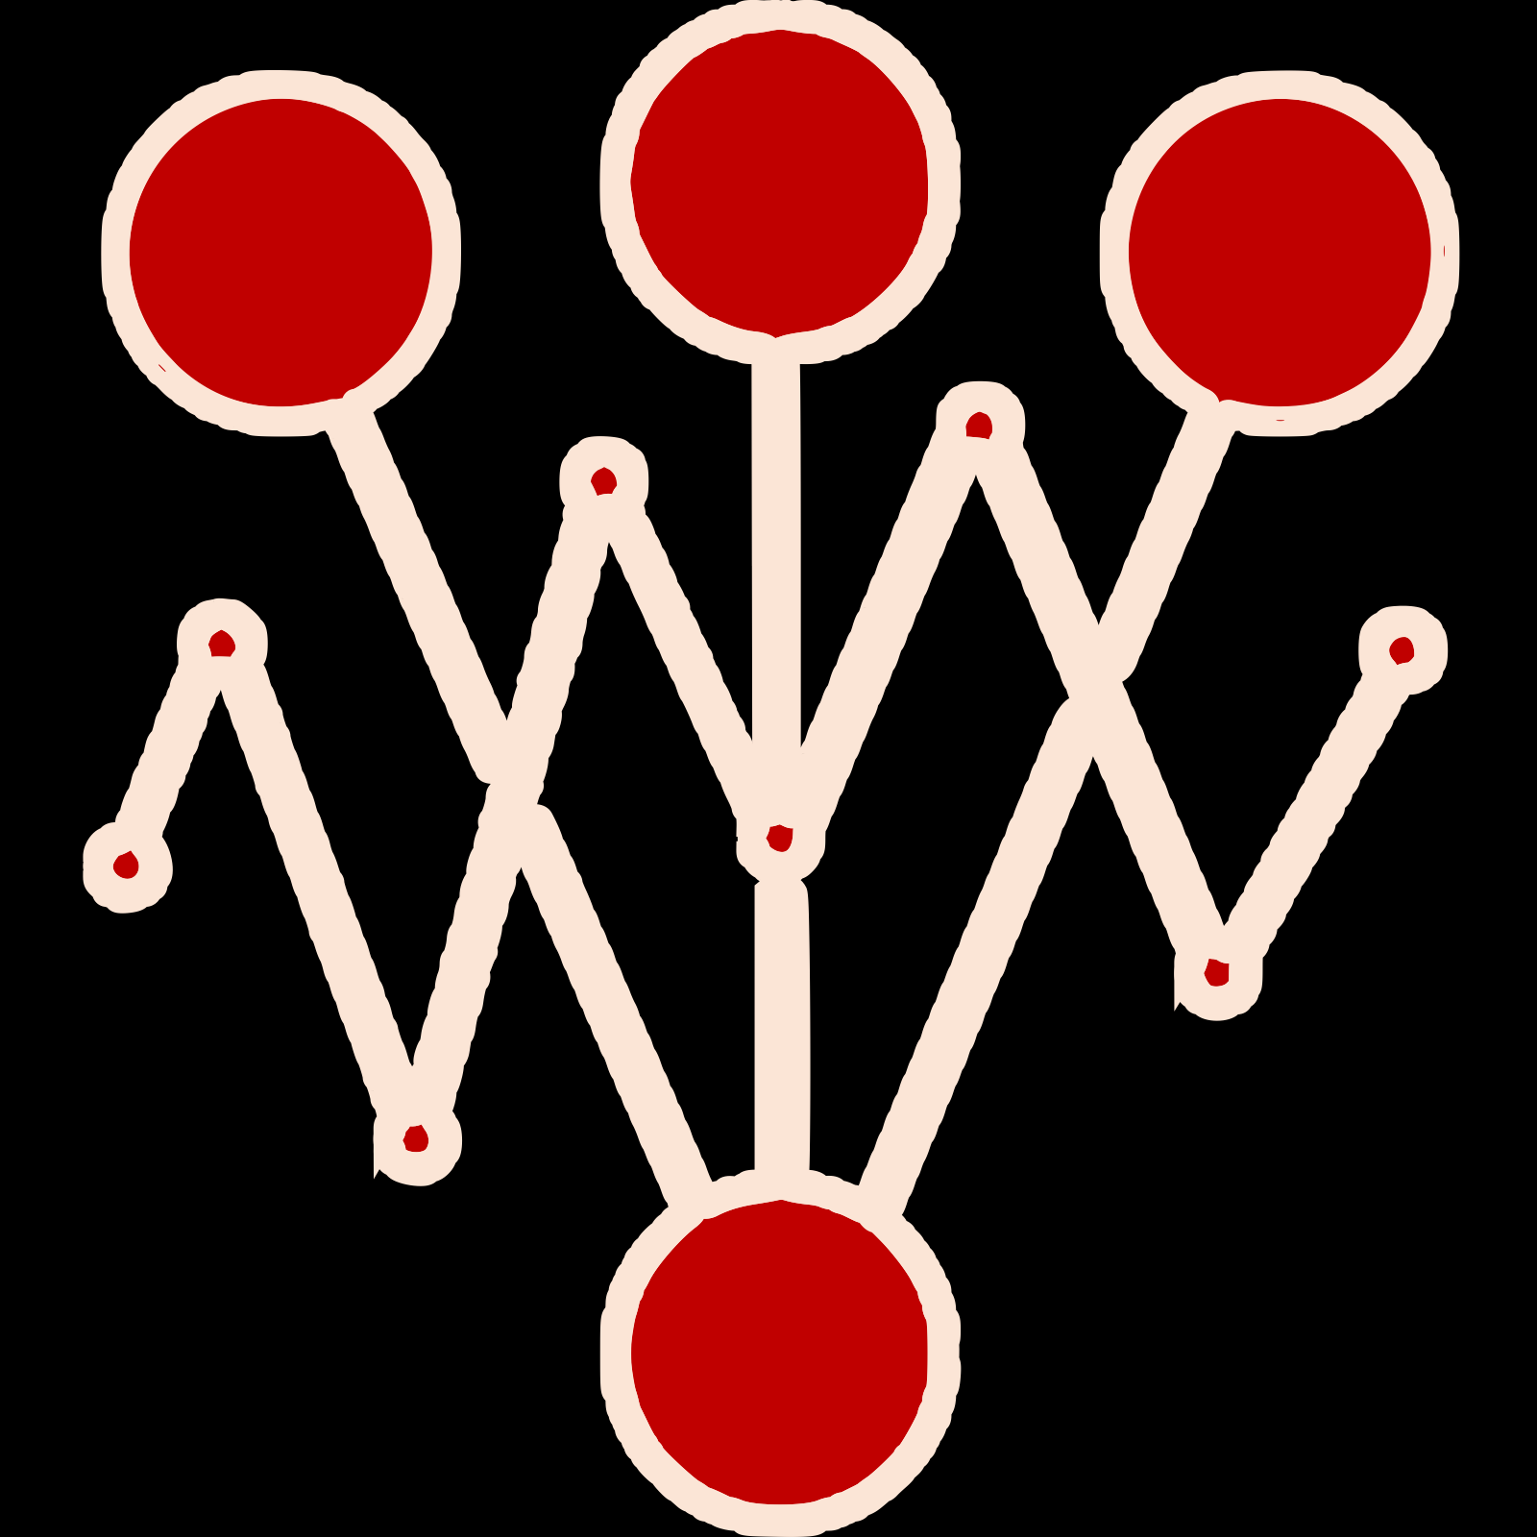
By generating load
Launch experiment
Get metrics
By querying backends like Prometheus, Elastic, …
Produce insights
Deploy new app version
Send notification, promote new version or rollback, shift traffic, create pull request, trigger CI/CD/GitOps workflow, …
Process automated by an Iter8 experiment

