Slide 1












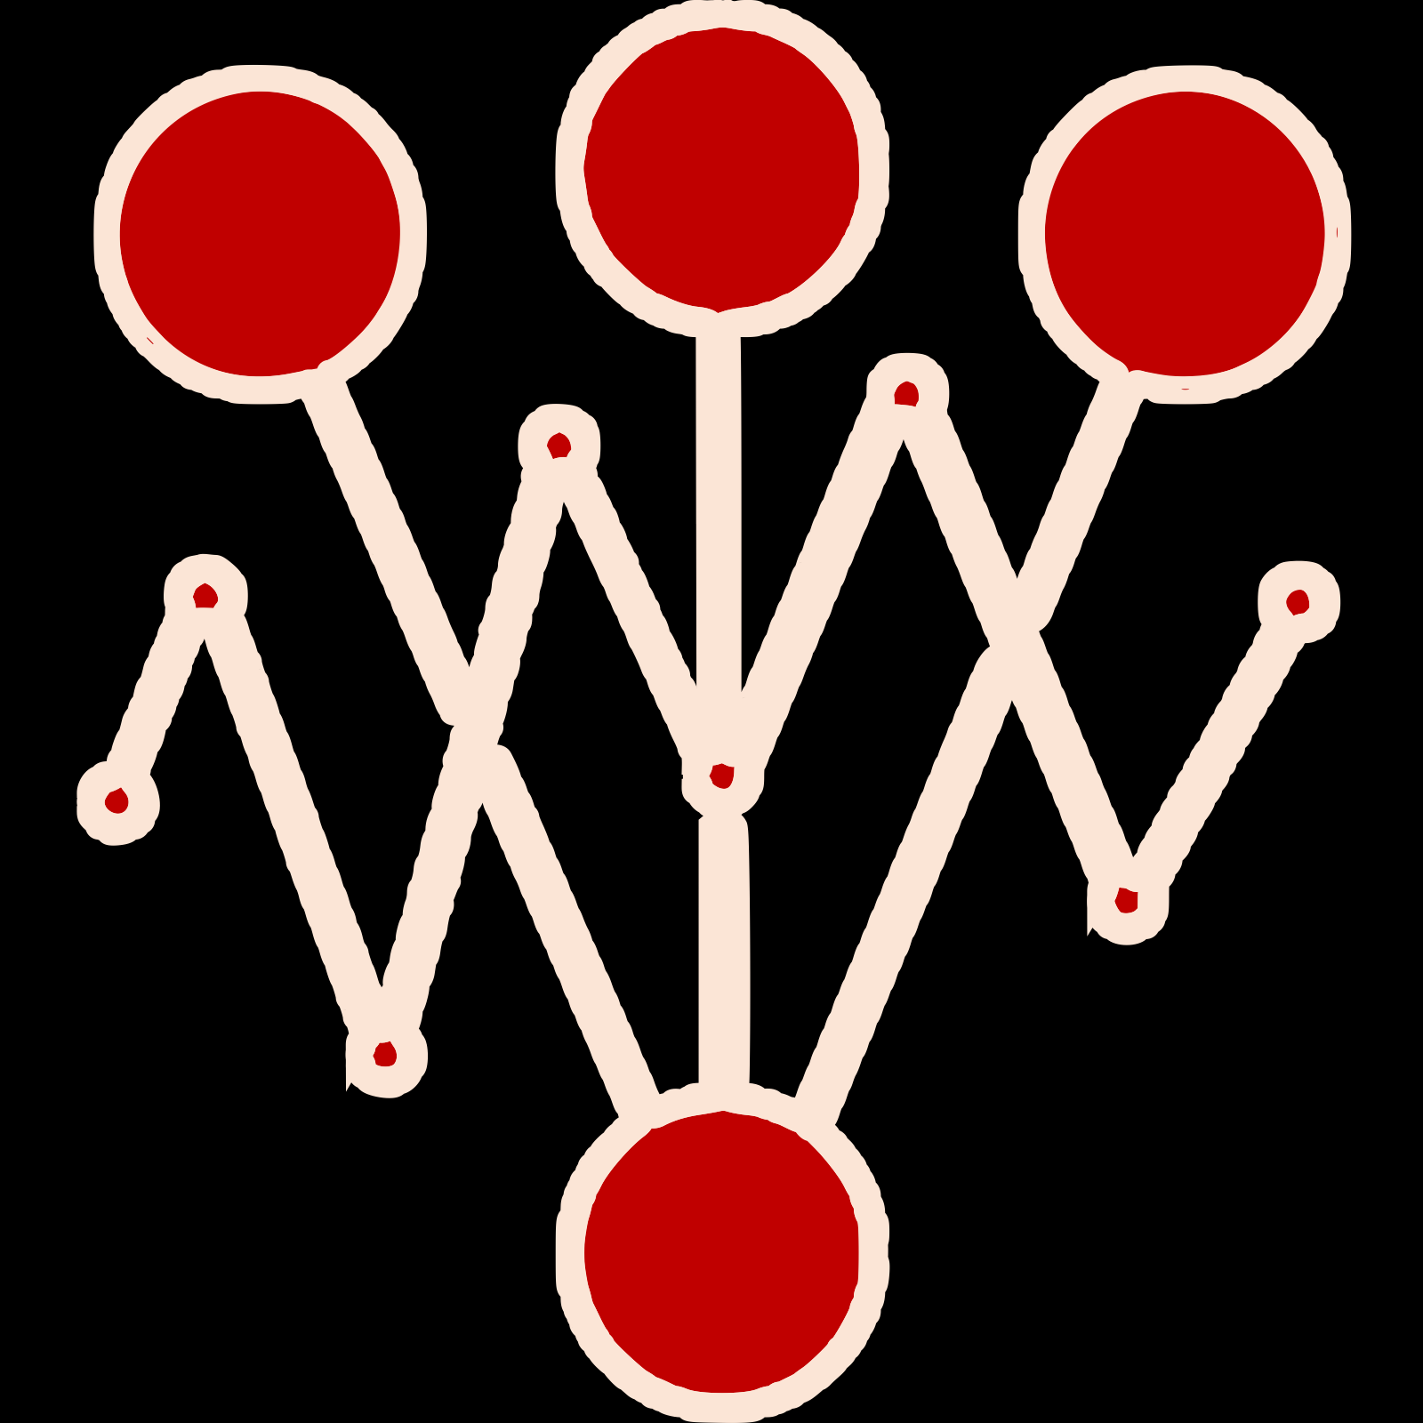
Winning version of your app/ML model
Metrics from any provider
Experiments over any Kubernetes stack

