Slide 1


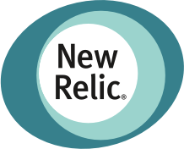











Find and safely promote winning version
Builtin metrics
Custom metrics from any DB
Metrics mock
AI-driven SLO validation & A/B testing
Progressive delivery + traffic engineering
Istio, KFServing, Knative, Seldon, …

