Slide 1





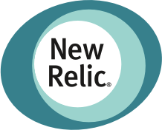





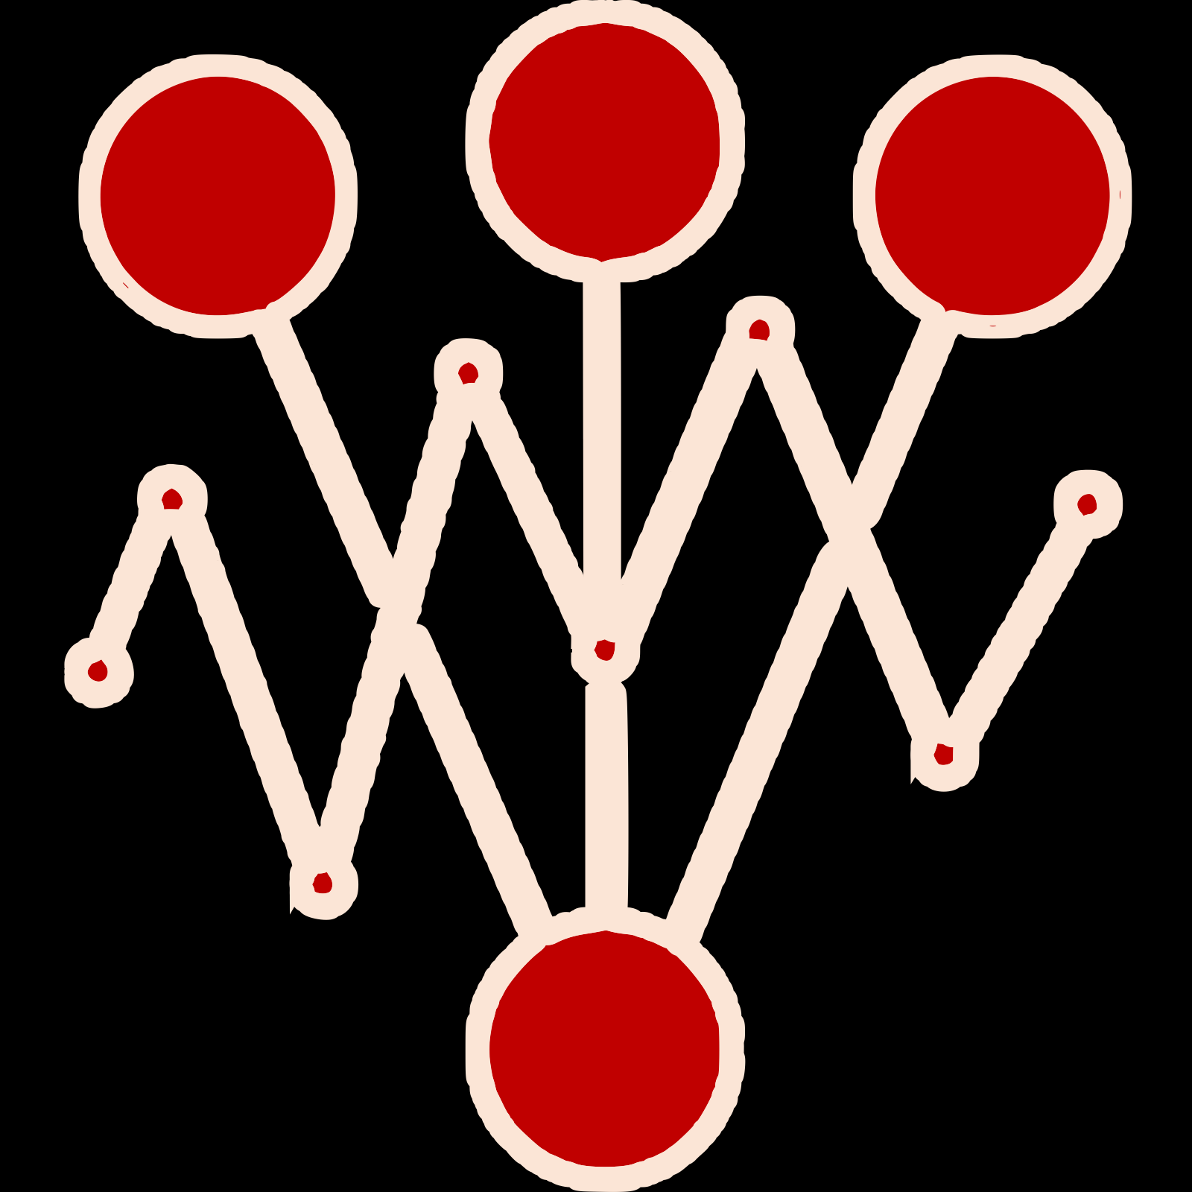

Find and promote winning version of your app/ML model
Use metrics from any provider
Automate A/B(/n), Canary, and Conformance experiments

