Slide 1












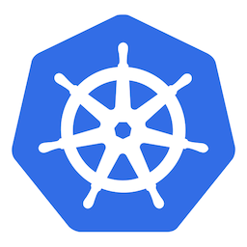






Assess and safely rollout winning version of app
Use built-in metrics collector or custom metrics from any DB
Use in any K8s environment

