Slide 1






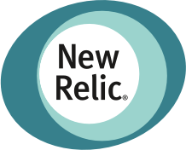



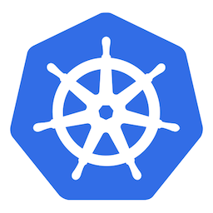









Assess and safely rollout winning version of app
Use built-in metrics collector or custom metrics from any DB
Use in any K8s environment. Use within any CI/CD/GitOps process.

