Slide 1












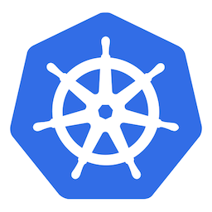






Safely rollout winning version
Use builtin metrics or custom metrics from any DB
Use in any K8s environment

