Slide 1
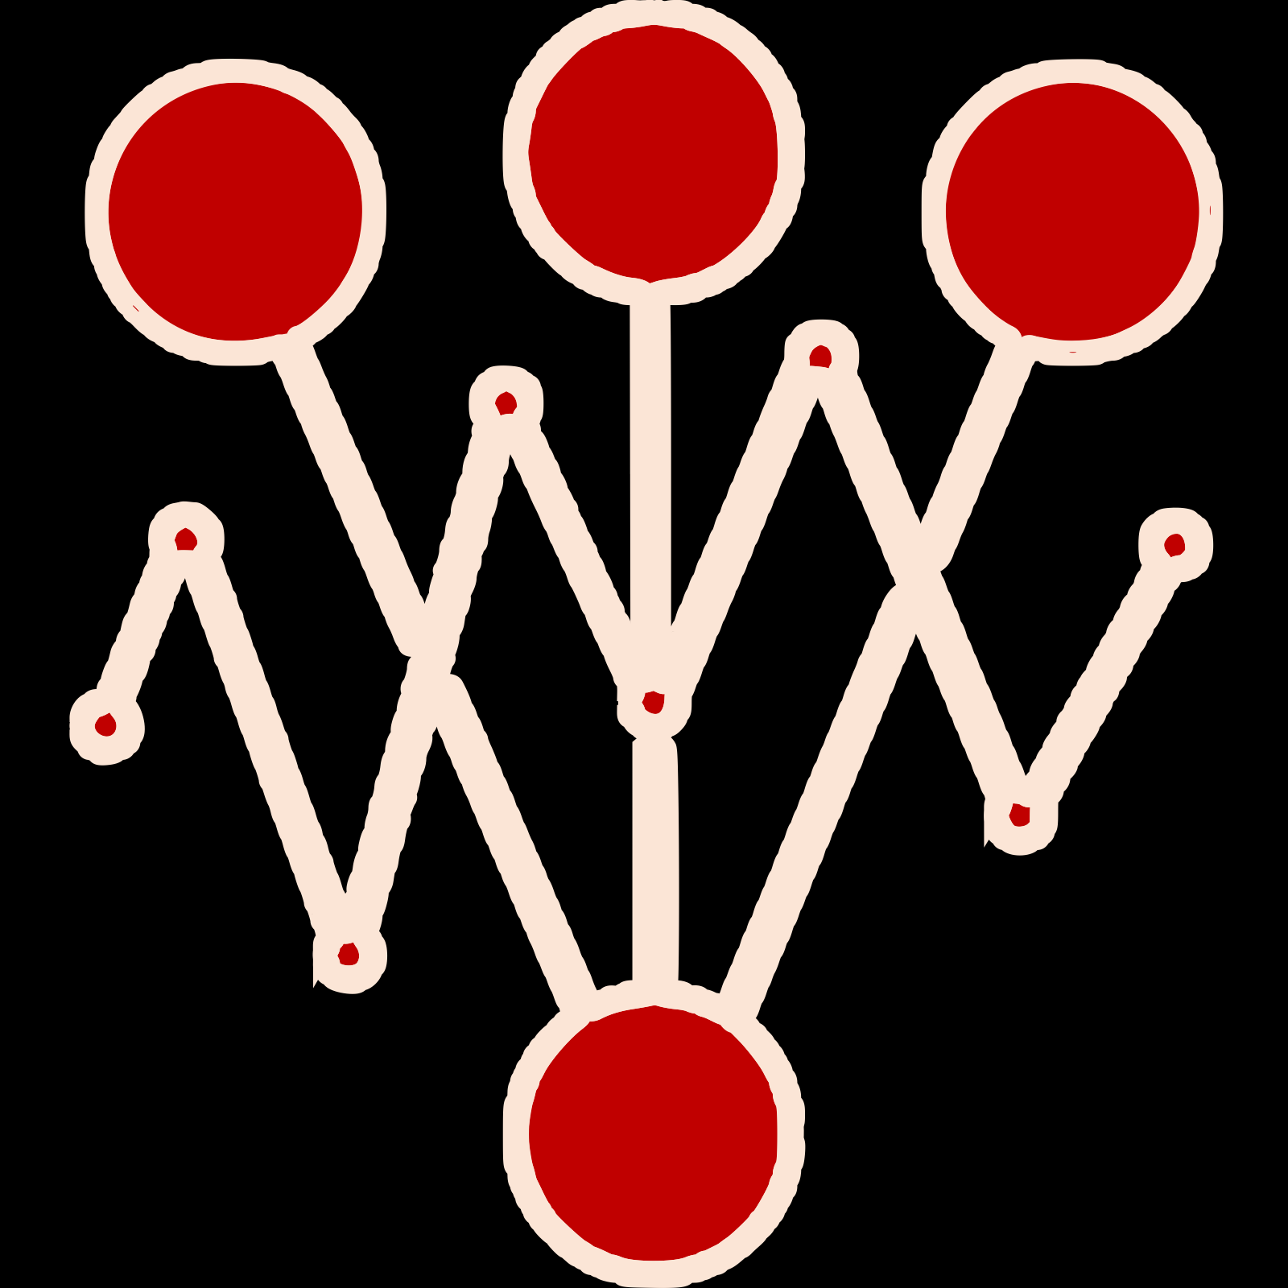
Declarative experiments
Diverse app frameworks
Built-in/Custom metrics
Advanced traffic engineering
CI/CD/GitOps
AI-driven & statistically robust

Slide 2
Declarative experiments
Diverse app frameworks
Built-in/Custom metrics
Advanced traffic engineering
CI/CD/GitOps
AI-driven & statistically robust

Slide 3
Progressive rollouts
A/B(/n) testing
SLO validation
Chaos testing
Load testing
State-of-the-art AI & statistical analysis

Slide 4
Progressive rollouts
A/B(/n) testing
SLO validation
Chaos testing
Load testing
State-of-the-art AI & statistical analysis

Slide 5
Progressive rollouts
A/B(/n) testing
SLO validation
Chaos testing
Load testing
State-of-the-art AI & statistical analysis

Slide 6
Easily integrate with any CI/CD/GitOps & app/ML framework
Traffic engineering patterns
Testing patterns
Mirroring
%-traffic split
User segmentation Session affinity Progressive rollout
Load, SLOs, A/B(/n), Chaos, Hybrid
Rigorous statistical foundations

Slide 7
Easily integrate with any CI/CD/GitOps & app/ML framework
Traffic engineering patterns
Testing patterns
Mirroring
%-traffic split
User segmentation Session affinity Progressive rollout
Load, SLOs, A/B(/n), Chaos, Hybrid
Rigorous statistical foundations

