Slide 1
FOX COMMERCE
DESIGN

Slide 2
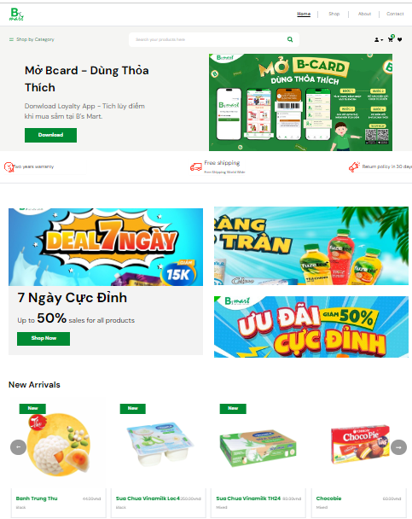
Layout
1. Header
2. Header bottom
3. Banner
4. Banner bottom
5. Sale off
6. New products

Slide 3
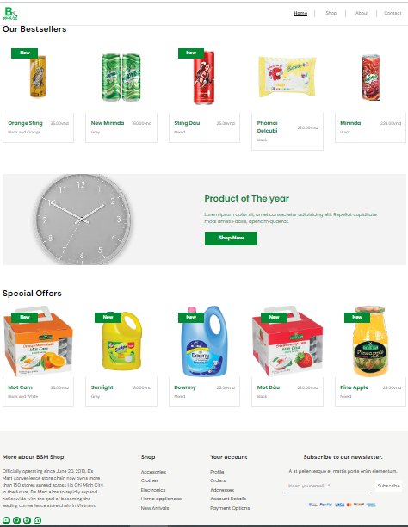
Layout
7. Best sellers
8. Year Product
9. Special offers
10. Footer

Slide 4
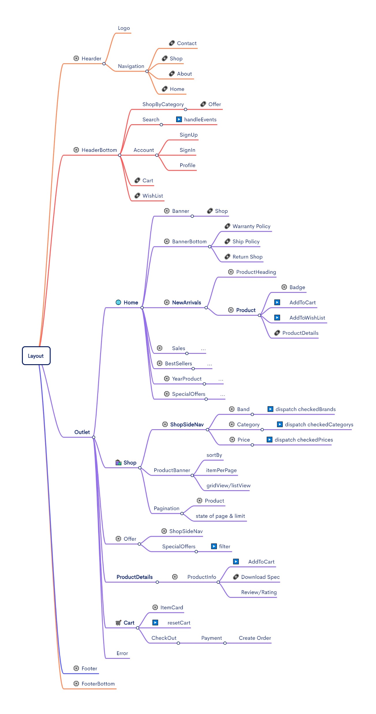
Code structure

