Slide 1

FOX COMMERCE PROJECT
MIS
June 2024

Slide 2

Table of contents
Layout design
Framework/Languages/Tools
Prototype
Code Structure

Slide 3
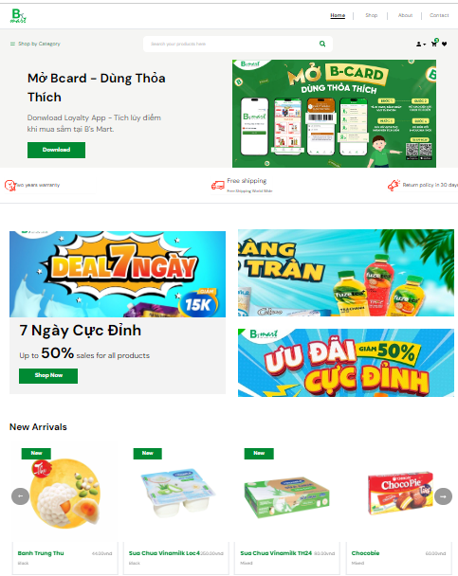
1. Layout 1/2
1. Header
2. Header bottom
3. Banner
4. Banner bottom
5. Sale off
6. New products

Slide 4
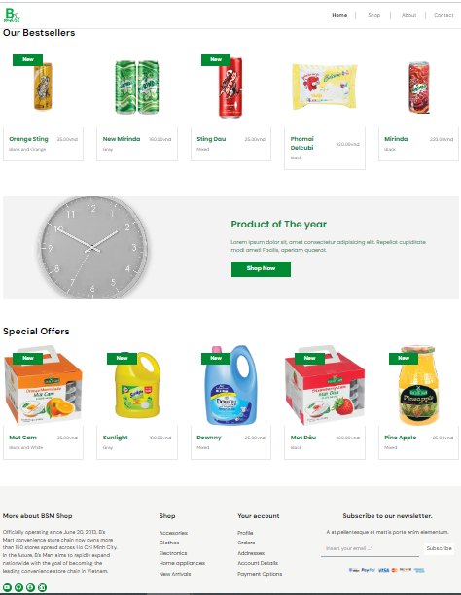
1. Layout 2/2
7. Best sellers
8. Year Product
9. Special offers
10. Footer

Slide 5





2. Frameworks, Languages, DB & Tools
Backend
Language (API)
Frontend language (Web)
CMS (Admin)
3. Click to view Prototype fox-commerce

Slide 6
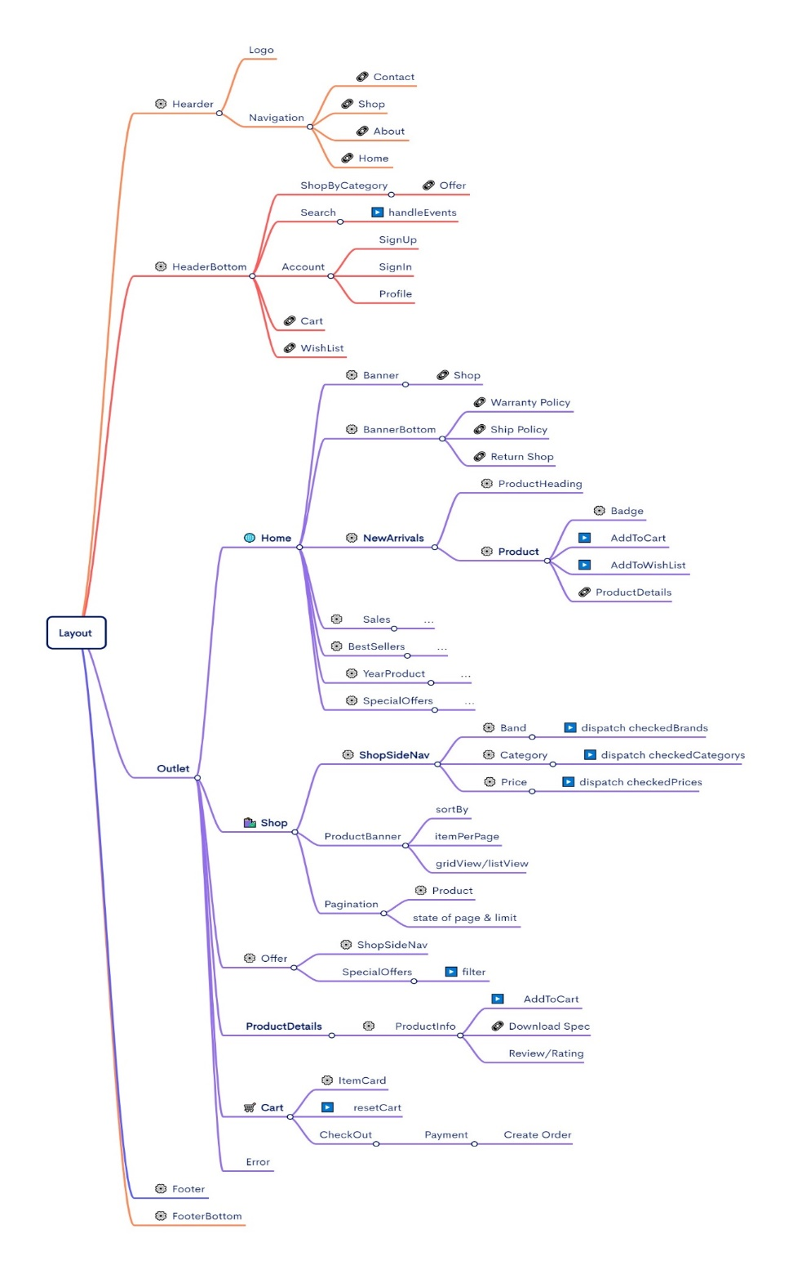
2. Code structure
Source code on Gitlab

Slide 7
The End

