Slide 1




第三届中国Rust开发者大会

Slide 2

使用硬件加速Tokio
演讲人：Loong.Dai, Cathy.Lu

Slide 3


自我介绍
Loong Dai
Intel云原生工程师
微软MVP
Dapr、Thanos、Golangci-lint的Maintainer
现在主要专注于服务网格领域，探索云原生软硬件结合新范式
Github ID: daixiang0
Cathy Lu
Intel软件工程师
专注于NFV, 电信网络云化等方案

Slide 4

Tokio
Why need Tokio?
Rust does not provide async runtime in std lib
Rust currently provides only the bare essentials for writing async code.
Rust has very strict backward compatibility requirements, , and they haven't chosen to lock-in a specific runtime.
Tokio is good enough
Tokio gets the biggest support from the community, and has many sponsors (such as Discord, Fly.io, and Embark), even it has paid contributors!

Slide 5
Tokio
Reliable
Fast
Tokio's APIs are memory-safe, thread-safe, and misuse-resistant. This helps prevent common bugs, such as unbounded queues, buffer overflows, and task starvation.
Building on top of Rust, Tokio provides a multi-threaded, work-stealing scheduler. Applications can process hundreds of thousands of requests per second with minimal overhead.
Easy
Flexible
async/await reduces the complexity of writing asynchronous applications. Paired with Tokio's utilities and vibrant ecosystem, writing applications is a breeze.
The needs of a server application differ from that of an embedded device. Although Tokio comes with defaults that work well out of the box, it also provides the knobs needed to fine tune to different cases.

Slide 6
Core Queue-Based Modules in Tokio
Channel
Scheduler

Slide 7
Tokio Channel
Senders
Receivers
Tokio uses Channel for communication between threads (incl. pthread, co-routines).
Channel allows a unidirectional flow of information between two end-points: the Sender and the Receiver.
Channel Type: SPSC, SPMC, MPMC, MPSC.
Senders
Receive
Senders
Receive
Perf Gaps: CAS(Compare And Swap) can't perfectly scale with core count.

Slide 8
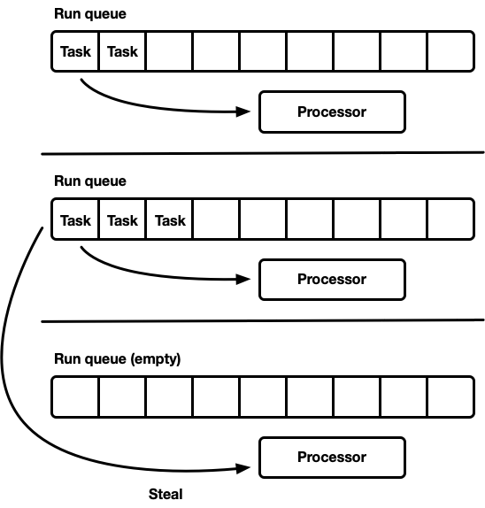
Tokio Scheduler
Key
Each worker has own run queue
Steal when own run queue is empty
From the high level, it is a MPMC queue.
From the low level, it is a performant and balanced design with multiple SPSC queues.
Perf Gap: Synchronization is required for stealing
Notes:
CAS问题和同步问题本质上都是队列带来的问题，如何解决呢？

Slide 9
Software Queue Issues
Producer
Producer
Enqueue Software
Enqueue Software
Synchronization latency
Memory/Cache latency
CPU cycles latency
Head and Tail pointers
Dequeue Software
Dequeue Software
Dequeue Software
Consumer
Consumer
Consumer

Slide 10
DLB： Dynamic Load Balance
Producer
Producer
DLB
Enqueue Logic
No Synchronization latency
No memory/cache latency
No CPU cycles
Head and Tail pointers
Dequeue Logic & Load Balancer
Consumer
Consumer
Consumer

Slide 11

DLB-Assist Channel Intro
Channel/Queue
Senders
Receivers
Senders
Receive
Senders
Receive
Hardware
DLB-Assist Channel removes the penalty of CAS to achieve a safety-guaranteed, lock-free and scalable channel.

Slide 12





DLB-Assist Channel Overview
Producer
Consumer
DLB-Assist Channel
Compatible channel interface
Compatible features
Message-Ownership Tracking
Senders
Receivers
Message-Ownership Tracking
Takes message's ownership
Avoid message being dropped.
Give Ownership
Take Ownership
Channel
Message-ID Reclaiming
Message-ID Reclaiming
Reclaim Message-ID
Transfers Message-ID through HW
Escape
Hardware
Hardware
Hardware-Direct offloading
Can’t carry generic type
Escape safety track
?

Slide 13
MPMC Test
Scenario
MPMC channel allows:
Adding new entries from any core or thread
Picking the next entry by any core or thread
From the Pictures:
SW channels depicted in red and yellow line drop with the core count increasing because of data race among Ps and Cs.
DLB channel depicted in blue line scales well until it reaches the hardware limitation
Conclusion:
DLB channel scales with core count much better than SW channels​
Core count >2 shows advantage
Note:
Both are P bound in the evaluation scenario

Slide 14
MPSC Test
Scenario
MPSC channel allows many threads sending to one place.
From the Pictures:
SW channels depicted in origin and purple line, drop with the number of P increasing and reach to a stable data.
DLB channel depicted in blue line increases at first and then keeps stable.
Conclusion:
DLB channel is more stable than SW channels ​
Core count >2 shows advantage
DLB
Crossbeam
Std
Tokio
Note:
All are C bound in the evaluation scenario

Slide 15
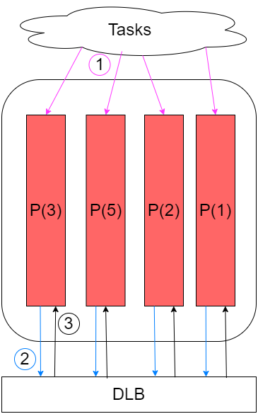
DLB-Assist Scheduler Design
Each processor has own run queue
DLB does balance

Slide 16
Next Step
Do benchmark for different scenarios
Upstream
Optimize applicability
…

Slide 17
Thank you！

