Slide 1




第三届中国Rust开发者大会

Slide 2




大家好！
应用waPC (rust) 做软件测试工具
Alan poon 潘泳权
@rustropy_gaming
ruito_89

Slide 3

什么是waPC?
WASM 外部函数接口 FFI | Input type | Return type | Platform
底层 | I32 | I32 | Unknown
waPC | &[u8] | Result<Vec<u8>,error> | Linux x86_64, macOS x86_64 ,Windows x86_64, …
Webassembly Procedures Call
PhoTto / image / chart
waPC 协议标准化了本机代码调用 WebAssembly 和 WebAssembly 调用本机代码的通信(messaging)和错误处理(error handling)。

Slide 4
waPC Host (Go)
waPC Guest Rust
Read wasm file
Select engine
Wazero
Wasmer-go
Wasmertime-go
Define hostcall capability
Instantiate
Invoke - command with data
cargo build —target wasm-unknown-unknown

Slide 5
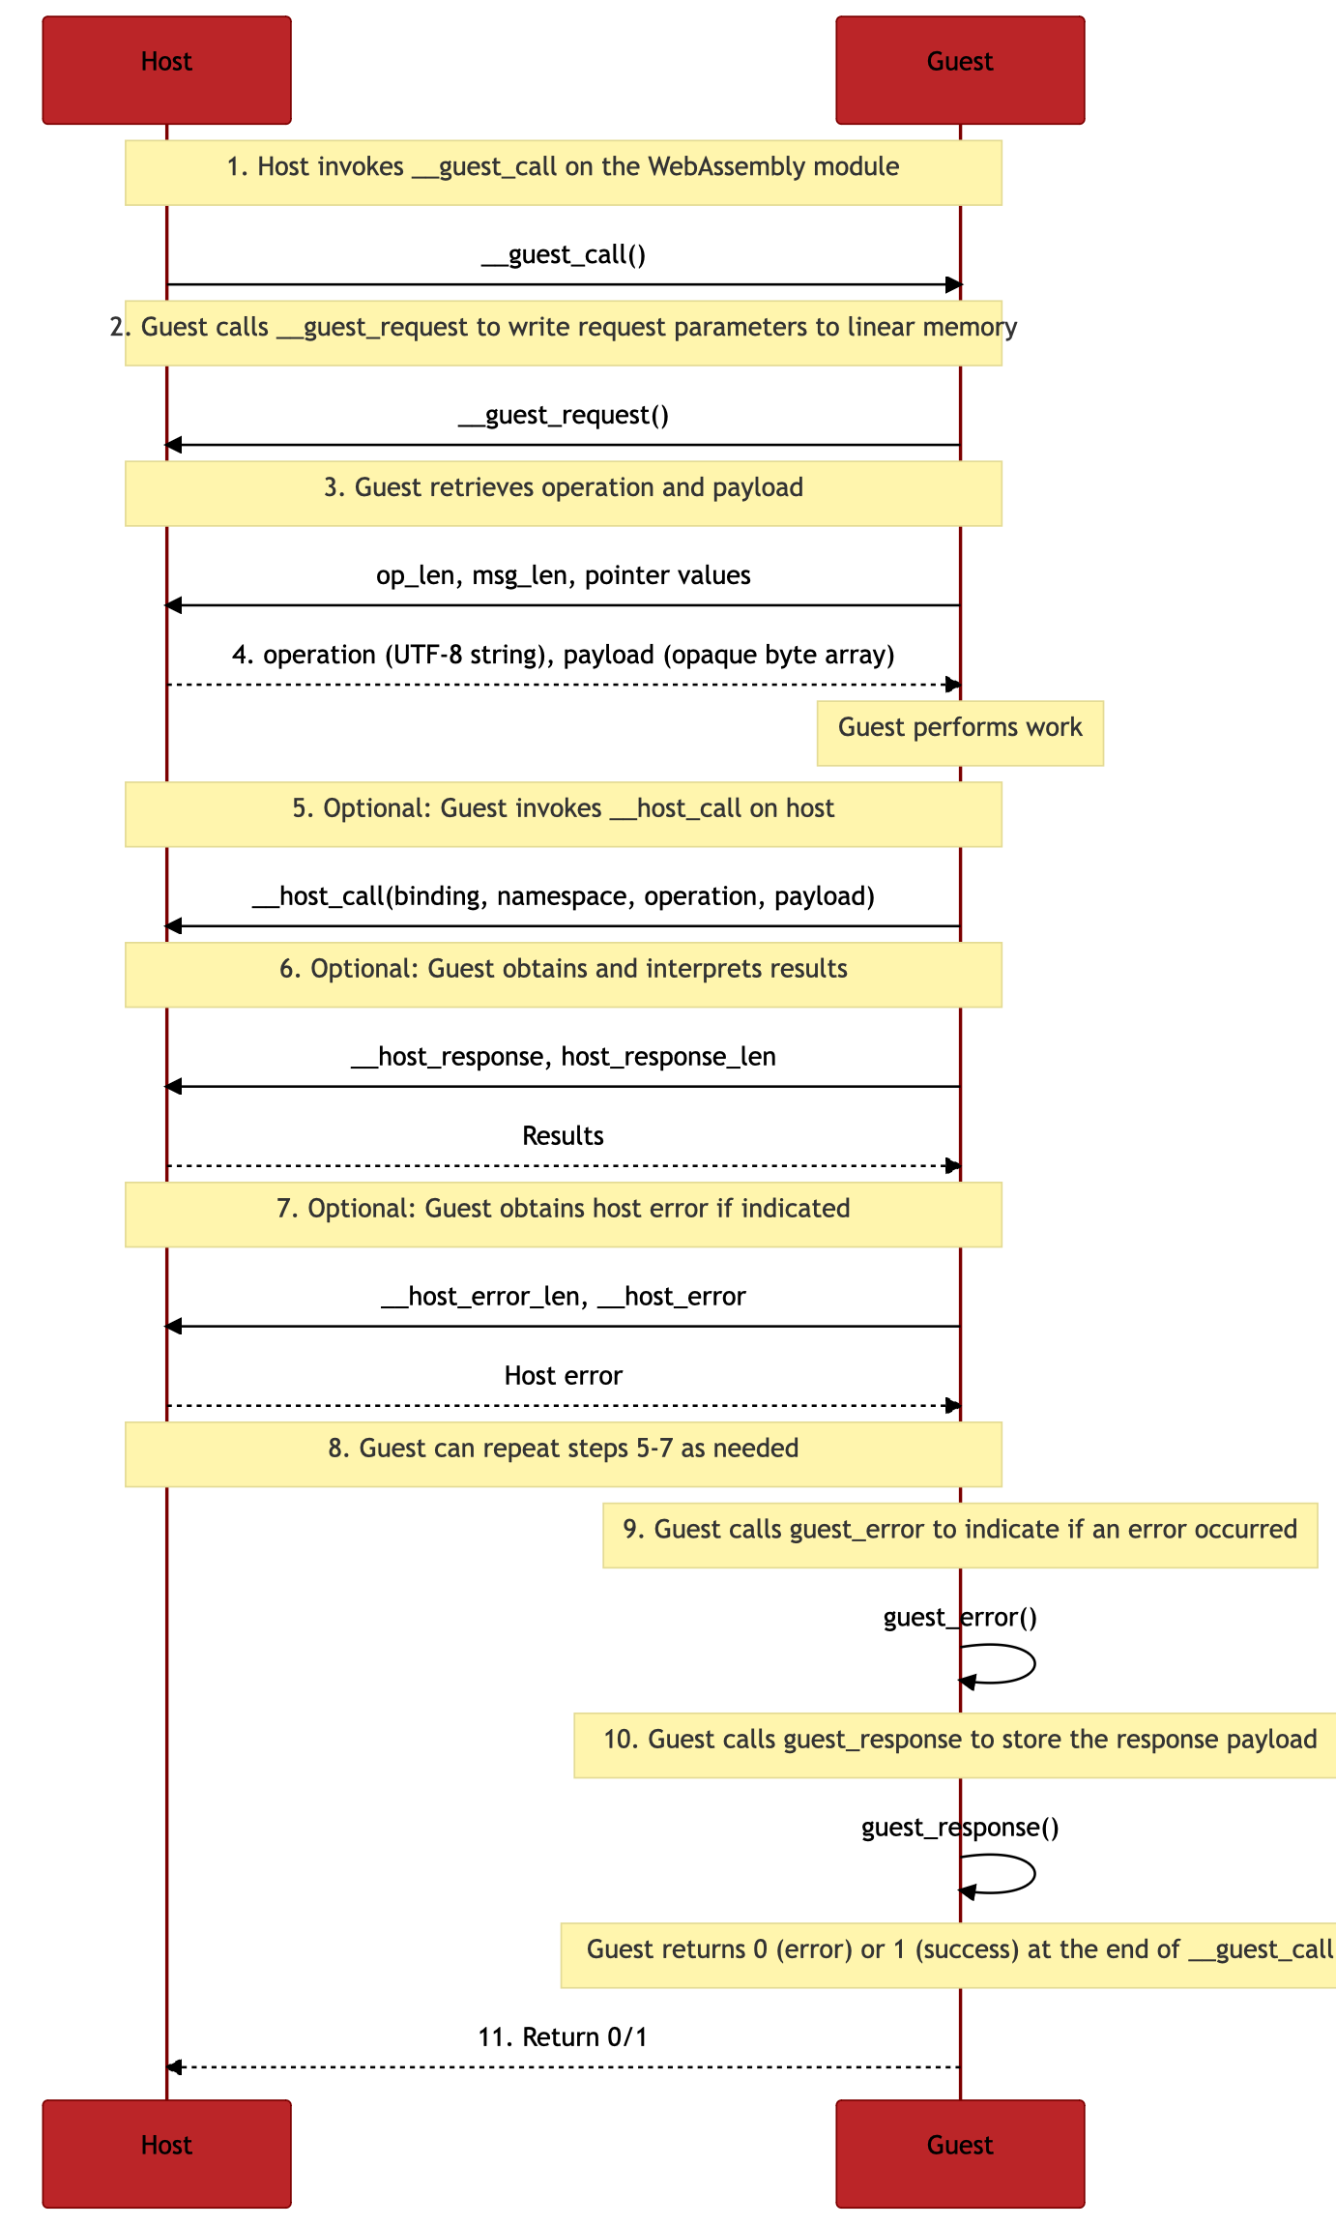
WAPC 流程
Invoke(ctx,operation,payload)
Guest 指wasm
Operation是我们要在wasm里注册命名
以数据的长度，设置wasm 的linear memory 的指针
Guest可执行任务
Guest也可返回请求host
Caption

Slide 6
WAPC 流程
res,err:= Invoke…
Uses Length of response and error to return result
Caption

Slide 7
waPC
waPC Guest Rust
Use wapc_init to register function
Register_function can only be used inside WAPC_init
Register_function cannot be called inside ping
#[no_mangle]
pub fn wapc_init() {
wapc::register_function("ping", ping);
}
fn ping(msg: &[u8]) -> wapc::CallResult {
….
Ok(msg.to_vec())
}

Slide 8
waPC
waPC Guest Rust
Use wapc_init to register function
_start also can
_start is meant to support tinygo’s wasm
waPC host will still run both "wapc_init" and "_start" during intialization
Util Lib uses wapc_init, users build on top of ”_start”

Slide 9
extern crate wapc_guest as guest;
extern crate Regex;
...
fn echo_req_json(msg: &[u8]) -> CallResult {
let mut req = foo_unmarshall::<RequestReceivedInMock>(msg)?;
let re = Regex::new(r”/v2/matches/([a-zA-Z0-9_-]+)/info").unwrap();
if let Some(cap) = re.captures(&req.HttpPath){
}
req.HttpProxyUrl = String::from(“localhost:8000");
req.HttpScheme = String::from("http");
let request = serde_json::to_string(&req)?;
Ok(request.as_bytes().to_vec())
}
fn do_nothing(msg: &[u8]) -> CallResult {
Ok(msg.to_vec())
}
#[no_mangle]
pub extern "C" fn _start() {
let mut reg = REGISTRY.lock().unwrap();
reg.insert(“\/v2\/matches\/.*\/info_modify_req”.into(),echo_req_json);
reg.insert(“\/v2\/matches\/.*\/info_modify_res”.into(),echo_res_json);
reg.insert(“\/v2\/matches\/.*\/info_fiddler_ab”.into(),do_nothing);
}
waPC in rust in HTTP(MITM)
curl -X POST “http://$MockServer:$Port/call/$Operation?targets=\/v2\/matches\/.*\/info" \
--header "Content-Type:application/octet-stream" \
--data-binary "@target/wasm32-unknown-unknown/release/examples/$3.wasm"
Mock rule based on path matching regex

Slide 10
waPC in rust in HTTP(MITM)
extern crate wapc_guest as guest;
#[macro_use]
extern crate wasm_mock_util;
#[macro_use]
extern crate serde_json;
use guest::prelude::*;
use wasm_mock_util::*;
fn echo_res_json(msg: &[u8]) -> CallResult {
let mut res = foo_unmarshall::<HttpResponse>(msg)?;
res.HttpBody = json!({"data":“hi"});
res.StatusCode = String::from("200")
let res= serde_json::to_string(&res)?;
Ok(res.as_bytes().to_vec())
}
Modify_res function

Slide 11
AB testing 方案
extern crate wapc_guest as guest;
...
fn fiddler_ab(msg: &[u8]) -> CallResult {
let fiddler_ab = foo_fiddler_ab(msg)?;
if !fiddler_ab.UrlPath.contains("flash_sale") {
let data_a = fiddler_ab.ResA;
let data_b = fiddler_ab.ResB;
foo_assert_eq!(data_a.HttpBody,data_b.HttpBody,String::from("data in echo"));
}
Ok(msg.to_vec())
}
#[no_mangle]
pub extern "C" fn _start() {
。。。
reg.insert(“\/v2\/matches\/.*\/info_fiddler_ab”.into(),fiddler_ab);
}
#[allow(non_snake_case)]
#[derive(Serialize, Deserialize, Debug)]
pub struct FiddlerAB {
#[serde(rename = "res_a")]
pub ResA: HttpResponse,
#[serde(rename = "res_b")]
pub ResB: HttpResponse,
#[serde(rename = "url_path")]
pub UrlPath: String,
}
ResA: Response corresponding to unmodified request
ResB: Response corresponding to modified request

Slide 12
Software testing tool
模拟数据规则
自动化测试
Wasm mock server
https://github.com/wasmmock/wasm_mock_server
用rust打包所有测试需求
Why use rust？

Slide 13
软件测试工具
模拟数据规则
自动化测试
大公司抓包工具的需求
Company's own protocol
Microservices
Multiple backend product line with complex upstream
Common testing platform

Slide 14
软件测试工具
抓包 - Wasm Mock Server
模拟数据规则
自动化测试
Supports http/https/tcp/websocket(MITM)
Can use rust to construct own protocol
Can MITM GRPC
Testing platform
Support HTTP POST wasm API
Support websocket stand in for wasm API
wasm工具does not invent the wheel

Slide 15
软件测试工具
Wasm mock server 用了 Google martian
模拟数据规则
自动化测试
ModifyRequest(req *http.Request) error{
…
req_,err:=wasm.Invoke(ctx,req.url.path, req_payload)
…
req = req_
}
ModifyResponse(res *http.Response) error{
…
res_,err:=wasm.Invoke(ctx,res.url.path, req_payload)
…
res = res_
}

Slide 16
extern crate wapc_guest as guest;
use guest::prelude::*;
...
fn _req(msg: &[u8]) -> CallResult{
let tcp_payload:TcpPayload = rmp_serde::from_read_ref(msg)?;
let c = |_c: &mut websocket_codec::Message|->CallResult{
Ok(vec![])
};
//change origin from 3334 to 3335 ( as the page is served in localhost:3334, but the mock server dial from port 3335)
handle_ws_req(&tcp_payload,"http://localhost:3335",c)
}
fn _res(msg: &[u8]) -> CallResult{
let tcp_payload:TcpPayload = rmp_serde::from_read_ref(msg)?;
let c = |c: &mut websocket_codec::Message|->CallResult{
*c = websocket_codec::Message::text("echo");
Ok(vec![])
};
handle_ws_res(&tcp_payload,c)
}
#[no_mangle]
pub extern "C" fn _start() {
let mut reg = REGISTRY.lock().unwrap();
reg.insert(“3335-:3334_modify_req”.into(),_req);
reg.insert(“3335-:3334_modify_res”.into(),_res);
}
模拟数据规则
Websocket TCP mitm例子
Example includes handshake, websocket codec, and message modification

Slide 17
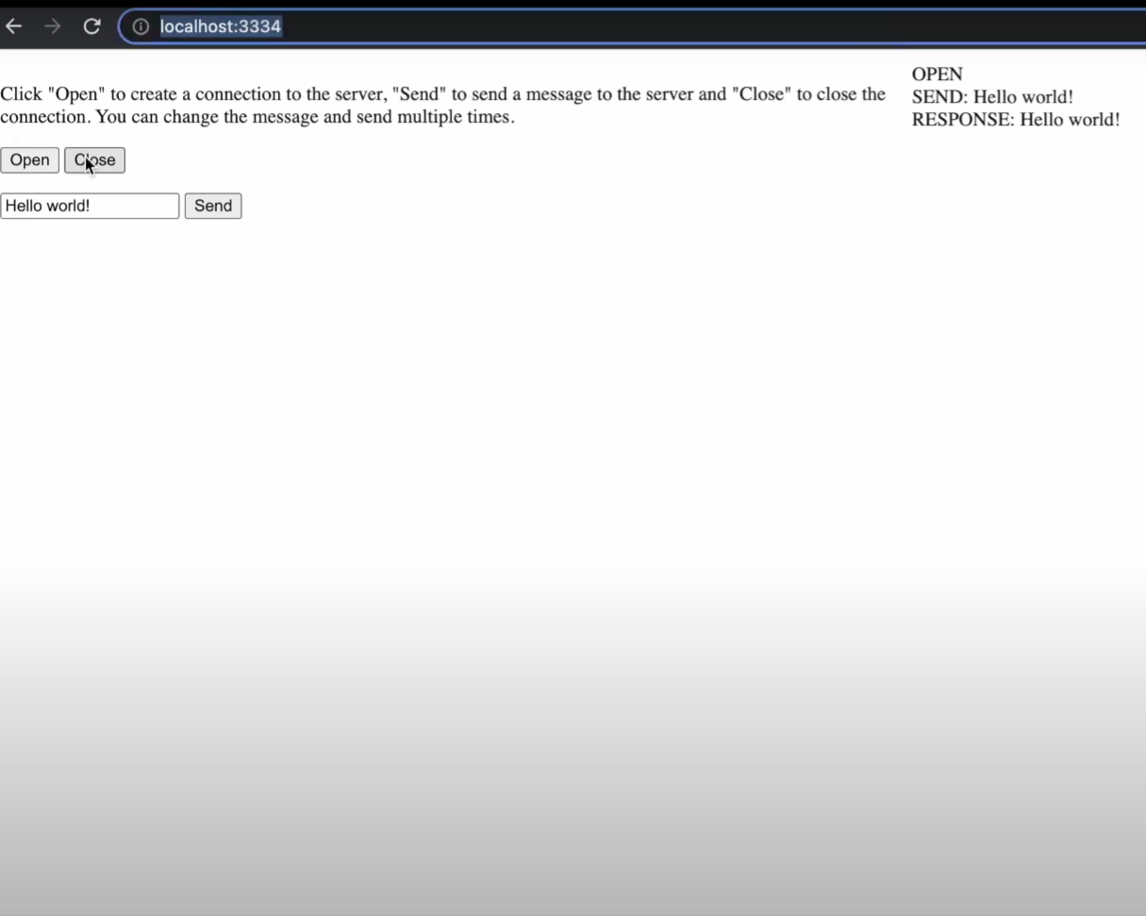
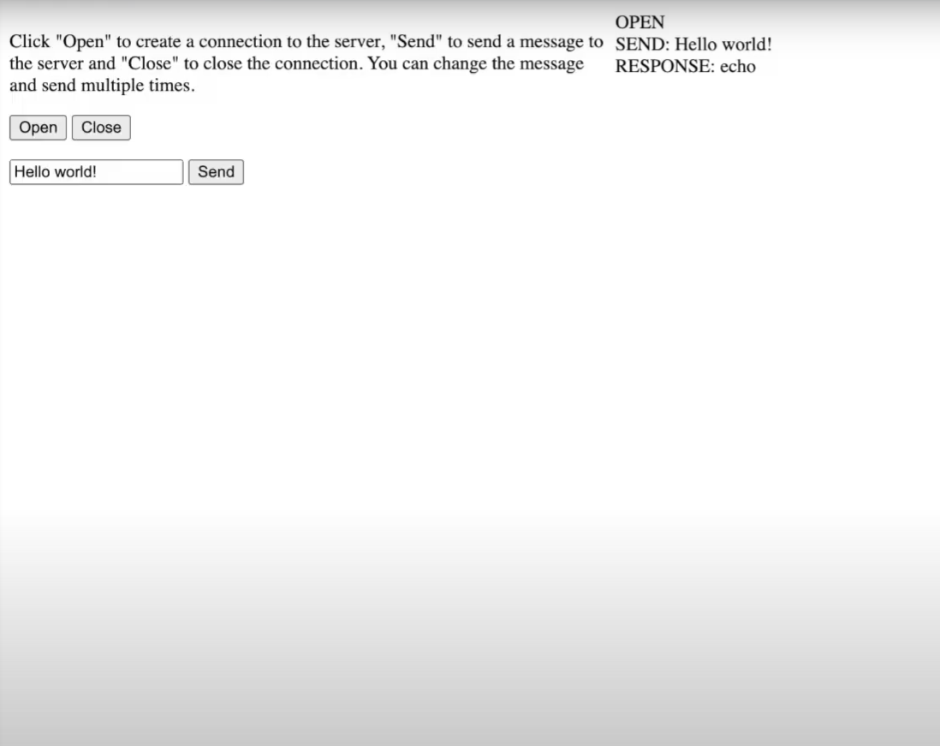
new Websocket(“ws://localhost:3335")
例子包括握手，数据解析，更改数据
模拟前 - before
模拟后 - after

Slide 18
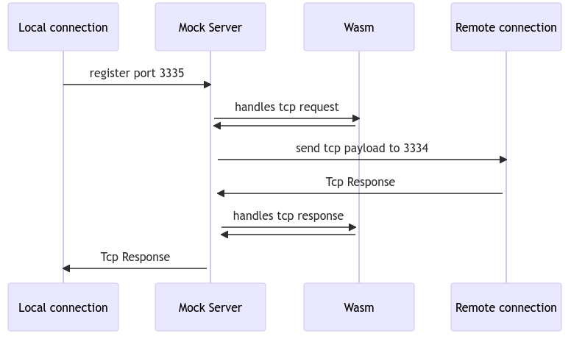
TCP MITM 例子
Wasm builds a req buffer
If wasm does not have enough bytes, send /continue back to host
Else send a list of TCP items

Slide 19
软件测试工具
Basic API testing requirement
模拟数据规则
自动化测试
验证功能 Assertion
稳定环境 Stable environment
报告能力（例如junit) Reporting
API测试也用rust

Slide 20
软件测试工具
大公司API测试的需求
模拟数据规则
自动化测试
Multiple QA teams
Upgrading common library issues
AT framework consumes more and more memory
One test case panics, crashes all the other AT jobs
High maintenance due to programming language

Slide 21
软件测试工具
API测试- Wasm Mock Server
Use rust to compile wasm and send to wasm mock server
Let Wasm Mock Server send http request
升级平台能解决不一致的问题
Each rust file can be compiled into wasm separately
Won’t exhaust memory
A test suite panic will not implicate the others
Can be compiled from many programming language
Store wasm files prevent maintenance issues
模拟数据规则
自动化测试
用rust,好处多

Slide 22
自动化测试以循环方式执行
extern crate wapc_guest as guest;
use guest::prelude::*;
extern crate wasm_mock_util;
use wasm_mock_util::*;
fn command(msg: &[u8]) -> CallResult {
let i = foo_index!();
let mut command = String::from("http://localhost:8000/t.json");
Ok(command.as_bytes().to_vec())
}
#[no_mangle]
pub extern "C" fn _start() {
let mut reg = REGISTRY.lock().unwrap();
reg.insert(“command”.into(),command);
reg.insert(“request”.into(),request);
reg.insert(“request_marshalling”.into(),request_marshalling);
reg.insert(“response_marshalling”.into(),response_marshalling);
}
Url param ?loop=2
index取_i
Command 定义是URL
自动化HTTP请求例子

Slide 23
fn request(_msg: &[u8]) -> CallResult {
//Change here
let index = foo_index!();
let mainHttpRes = match index{
0=>{
HttpRequest{
Http1x:format!("GET / HTTP/1.1\r\nHost: golang.org\r\nConnection: close\r\nUser-Agent: Mozilla/5.0 (Macintosh; U; Intel Mac OS X; de-de)\r\n\r\n"),
HttpBody:vec![],
ProxyUrl:String::from("")
}
}
_=>{.. }
};
let request = serde_json::to_string(&mainHttpRes)?;
Ok(request.as_bytes().to_vec())
}
fn response_marshalling(msg: &[u8]) -> CallResult {
let http_res = foo_http_response(msg)?;
foo_assert_eq!(http_res.HttpBody.get("data").unwrap_or(&mut NULL),&json!("hi"),"data is hi");
Ok(msg.to_vec())
}
自动化测试以循环方式执行
Request用了http1x
foo_index!里取_i
在response_marshalling里foo_assert_eq!()
自动化HTTP请求例子

Slide 24
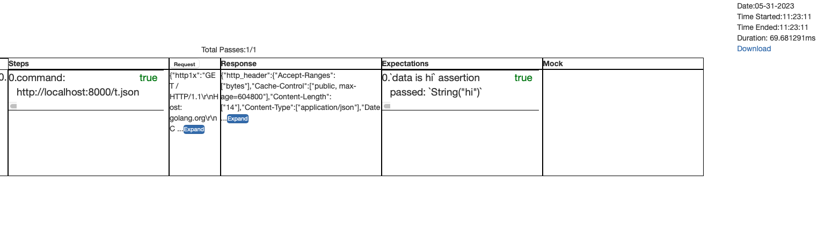
测验报告
HTML/ JSON 报告

Slide 25
Wasm Mock Server
Some of its’ Host call
http request
Tcp Request
Tcp Response
Redis
GET
SET
Memcache
Time
Sleep
now
模拟数据规则
自动化测试
模拟数据规则
自动化测试

Slide 26
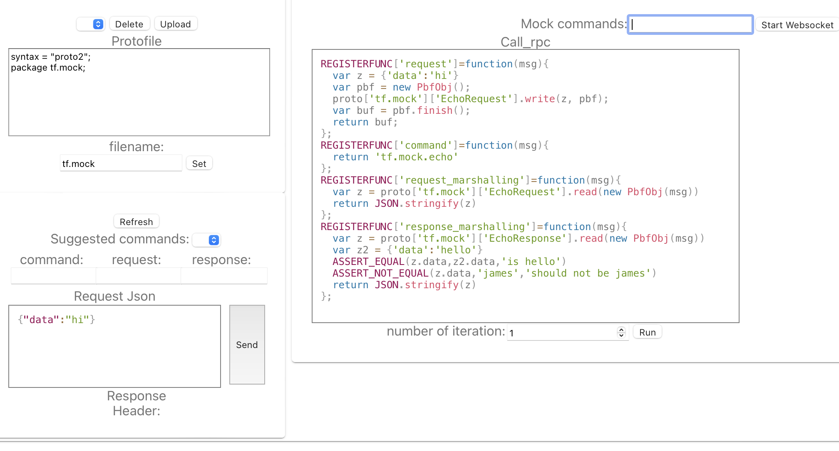
websocket standin for wasm
可用Javascript在游览器里面模拟数据
发RPC请求
可以上传proto文档
可以验证数据
前段链接Wasm Mock Server

Slide 27
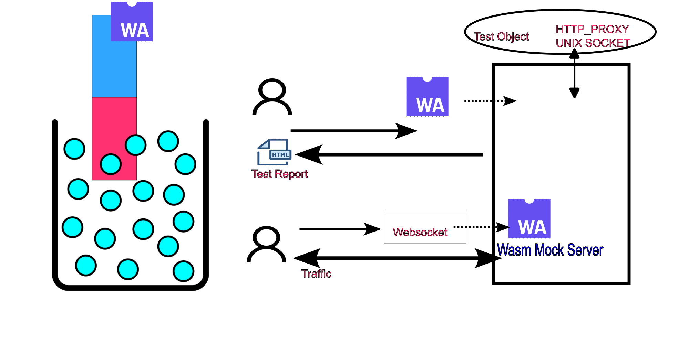
支持以websocket代替wasm协议
随机waPC注册逻辑
不可能为每个websocket链接编程新的wasm
流氓做法(fork) - waPC guest rust 可改编成让register_function在初始后使用
Using “invoke” to register more function
https://github.com/wasmmock/wasm_mock_server
Use wasm without fear

Slide 28
Rust VS TinyGo (Serialization)
Tinygo
Serialization in Rust is better
Protobuf (with modified generated pb)✅
JSON
string ❌

Slide 29

QnA

Slide 30
Thank you！

