Slide 1





第三届中国 Rust 开发者大会

Slide 2

Leveling Up in Rust
Learning by Contributing to Rust Compiler
Yukang github.com/chenyukang
Engineer @ Cryptape

Slide 3
My work experience
2011 ~ 2014 EDA startup C/C++
2014 ~ 2020 DJI Ruby, Lua
2020 ~ 2023 Microsoft C#, PowerShell
2023 ~ now Cryptape Rust

Slide 4
My experience
Strongly interested in programming languages implementation
My solutions to EOPL

Slide 5
My Rust experience
2014 ~ 2018
Some small projects
2020 ~ 2021
More open-source projects, gomoku, youki, dapr-wasm
2022 ~
Regular contributions to Rust

Slide 6
How I started hacking Rustc
A real case Remove duplicated diagnostics
Issue #100000, Rust is beautiful

Slide 7

Some PR stories
parser, diagnostics,
ICE, Infra tools,
code refactor,
algorithms improvements
[100+ Prs]

Slide 8
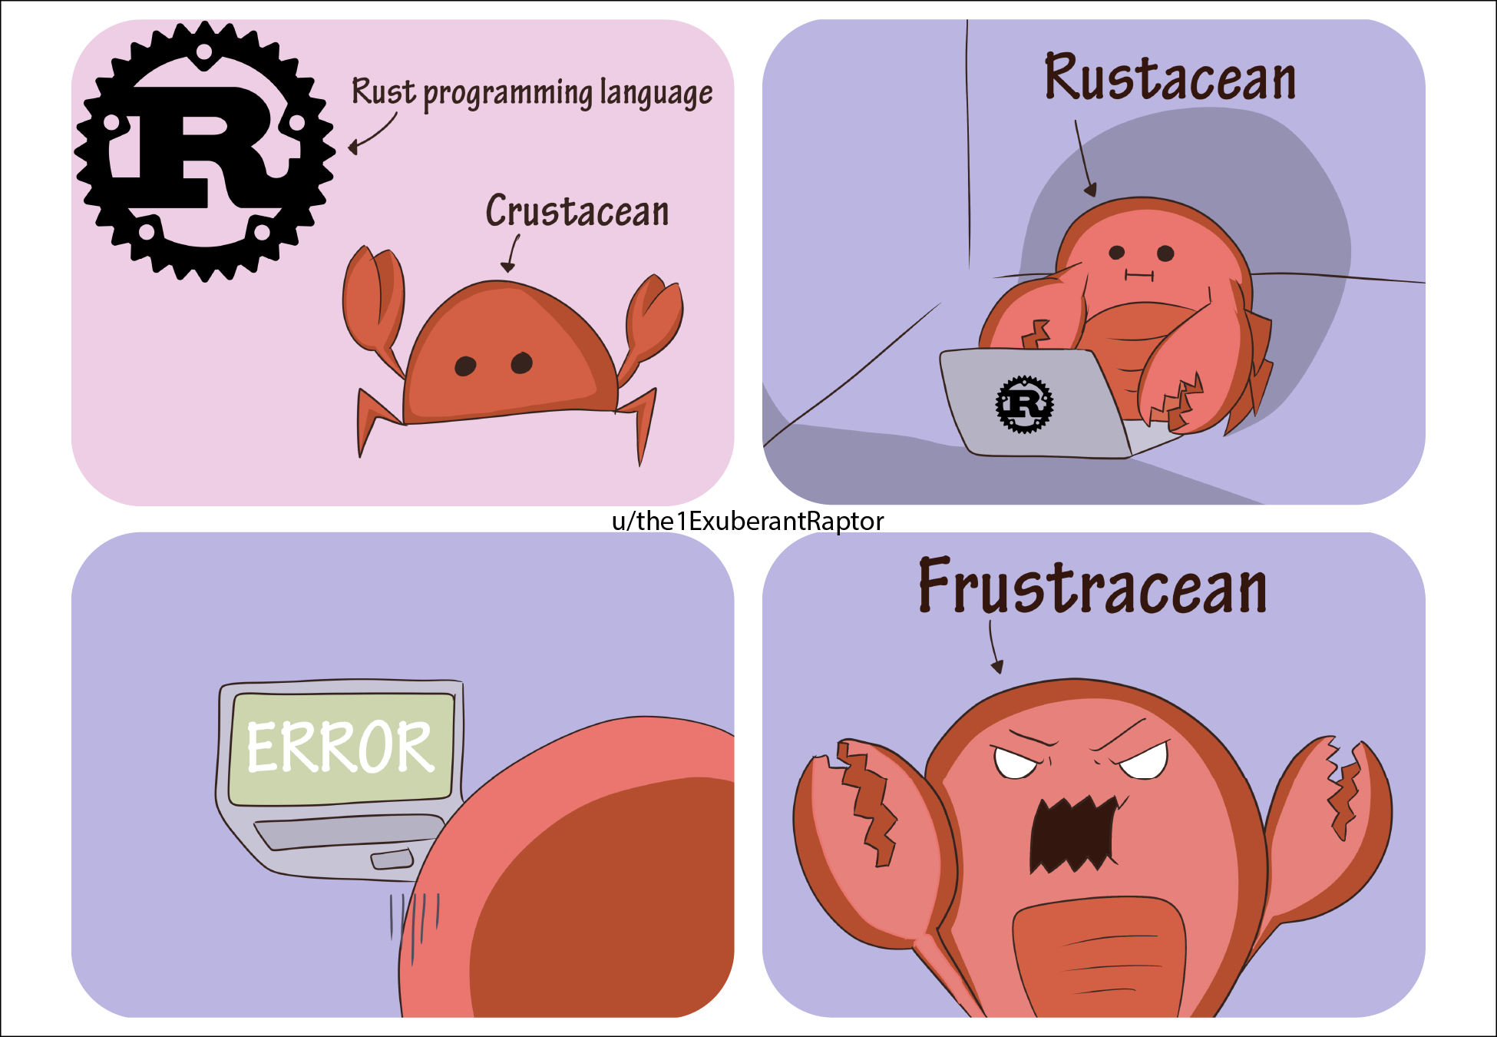
Diagnostic is an art
Rust cares about error messages
We are building a sufficiently empathetic compiler
It’s a trade-off

Slide 9
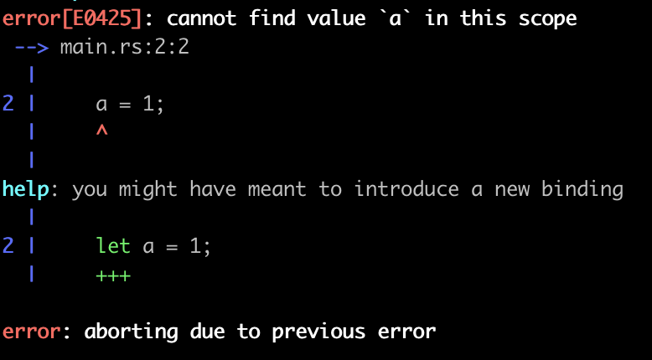
Simple diagnostic is a good start

Slide 10
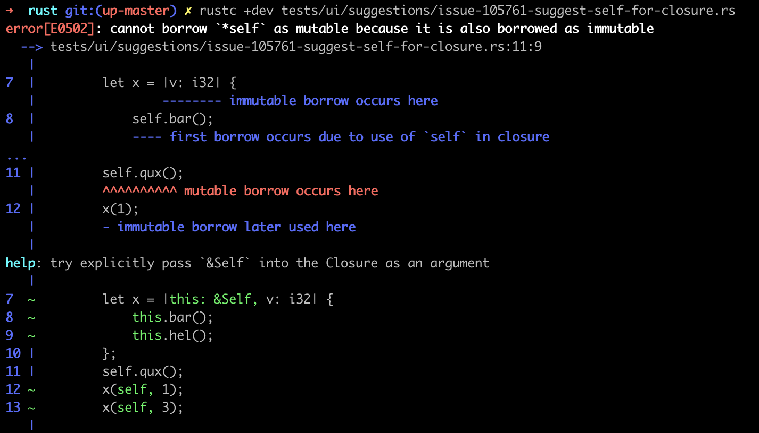
Compiler is a teacher/friend

Slide 11
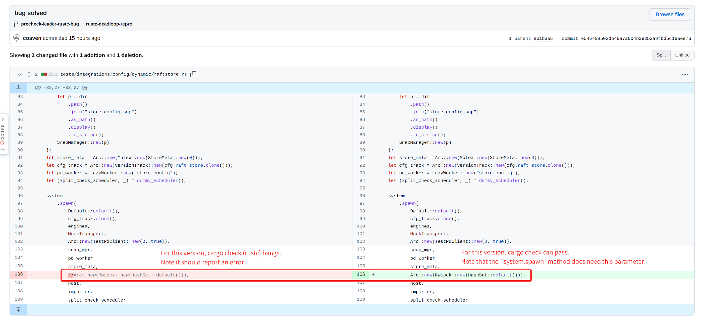
A trivial fix may require a lot of time 🐌
[# 100502 Avoid infinite loop in function arguments checking]

Slide 12
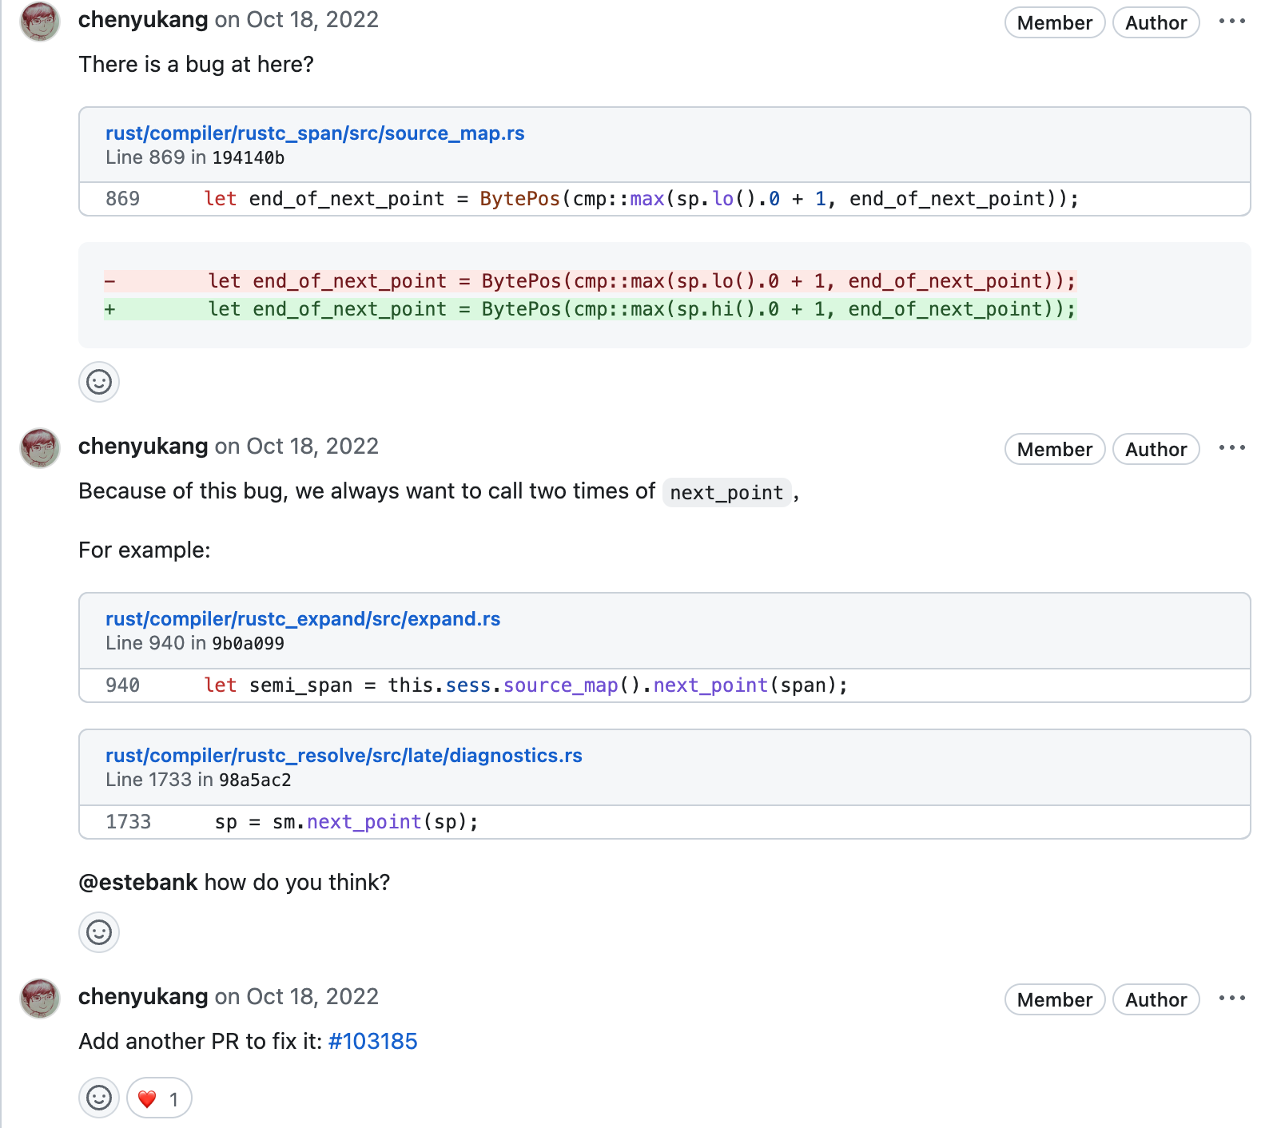
It's a closet bug! 🐛
Fix the bug of next_point in source_map

Slide 13
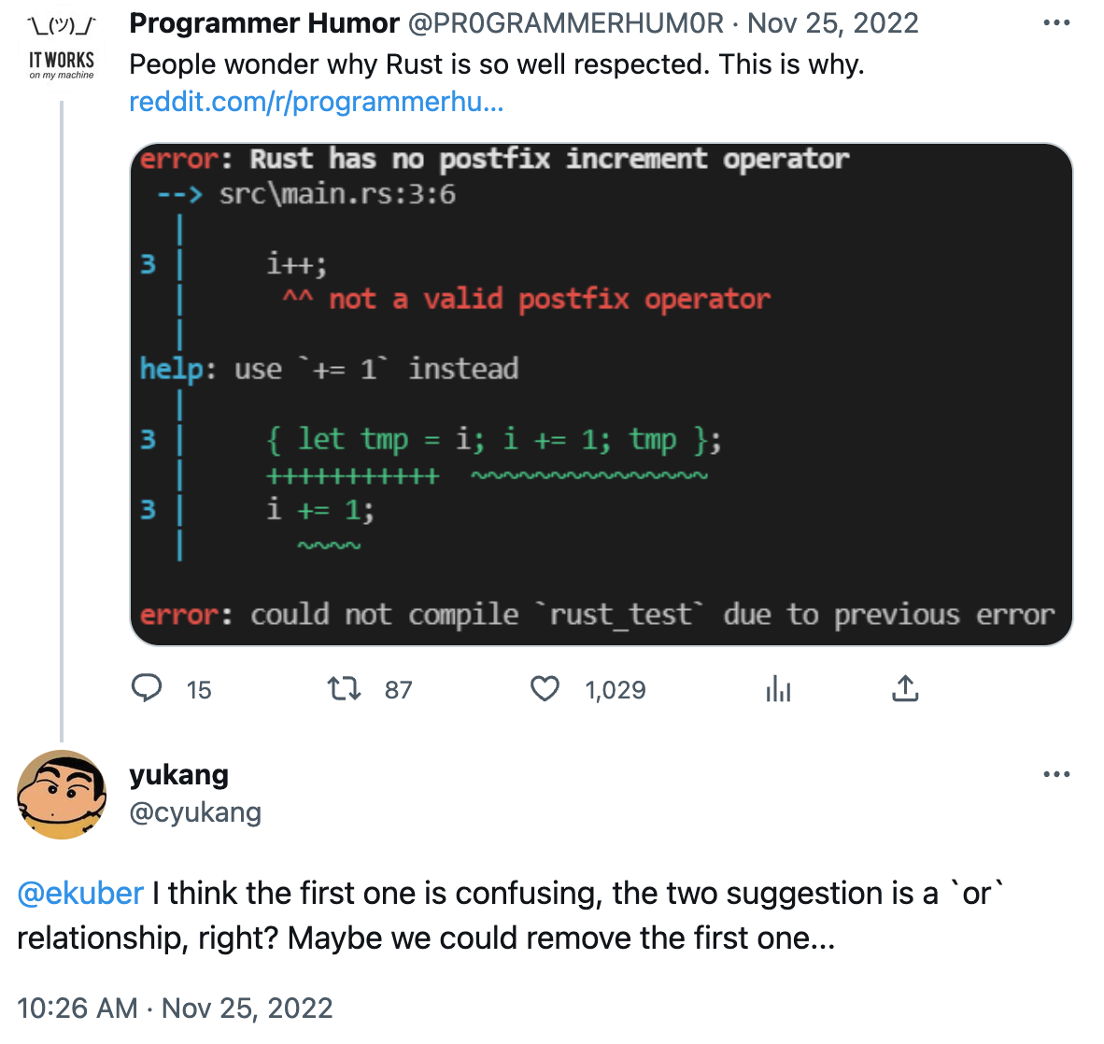
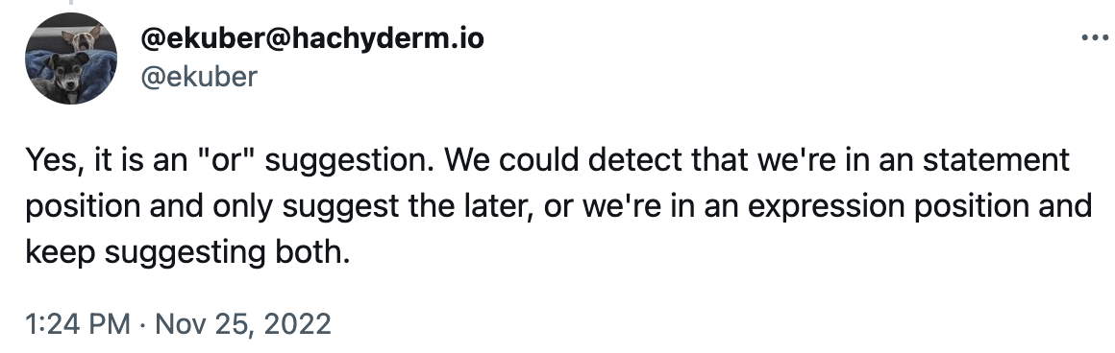
Twitter-Driven Development

Slide 14
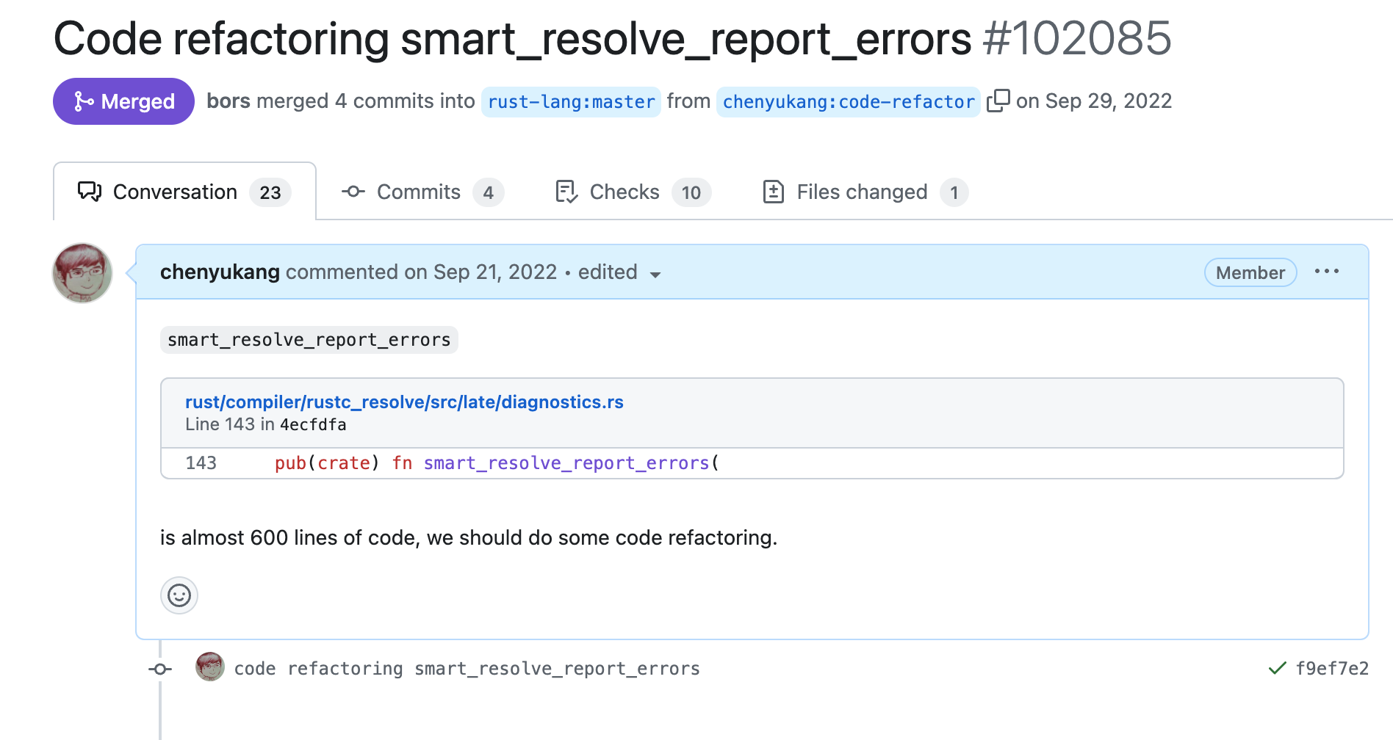
Refactoring

Slide 15
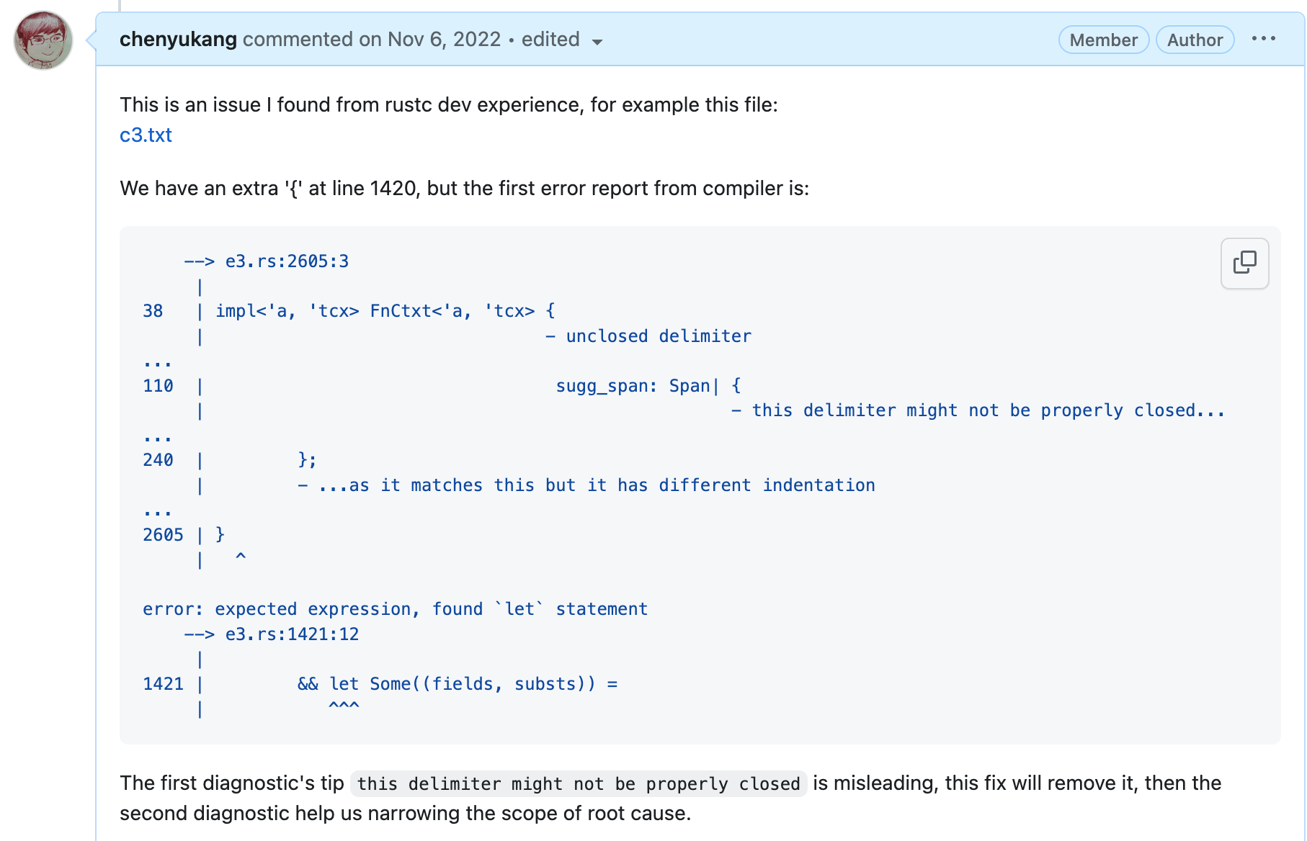
Aha Moment!
Find the correct mismatch delimiter pairs

Slide 16
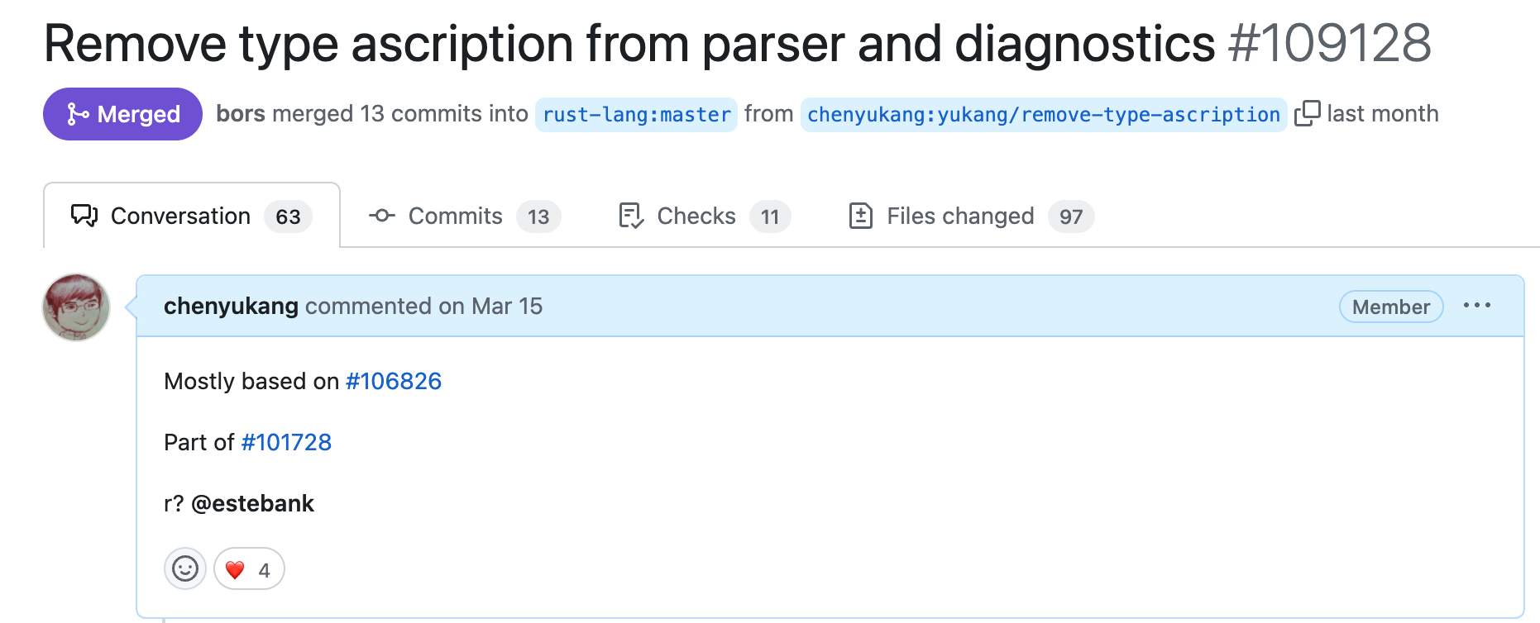
It's sad, but we need to remove feature

Slide 17
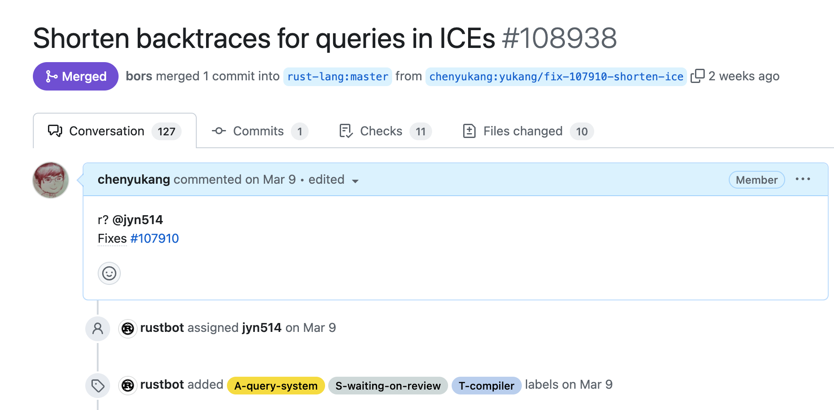
We care about performance and dev experience

Slide 18
What I’ve earned
A lot of fun! A lot of open-source experience
2023 Rust Foundation Project Grants
A member of rustc compiler team contributors

Slide 19
What I’ve learned
Rust has almost solved the memory issue in development phase
Rust is good for software with a long lifetime
Rust is open, but it may lead to a lot of chaos at the same time
Be the worst player in the best team

Slide 20
Want to have a try?
Stay curious, learn by doing
You don't need to master Rust; learning Rust by hacking Rust compiler is a great way
Treat it as a game, have fun, remain patient
Ask for help on Zulip if needed

Slide 21
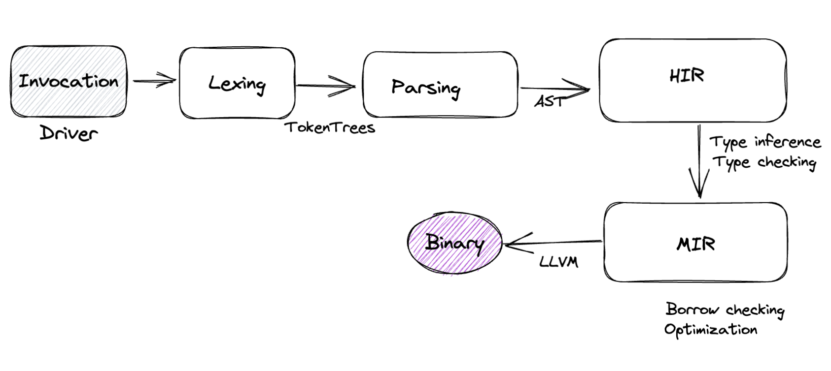
Rust compiling phase

Slide 22
Great resources for programming languages
花 10 年写一本编程语言实现的书
Crafting Interpreters
Essentials of Programming Languages
rui314/9cc: A Small C Compiler

Slide 23
Thank you！

