Slide 1
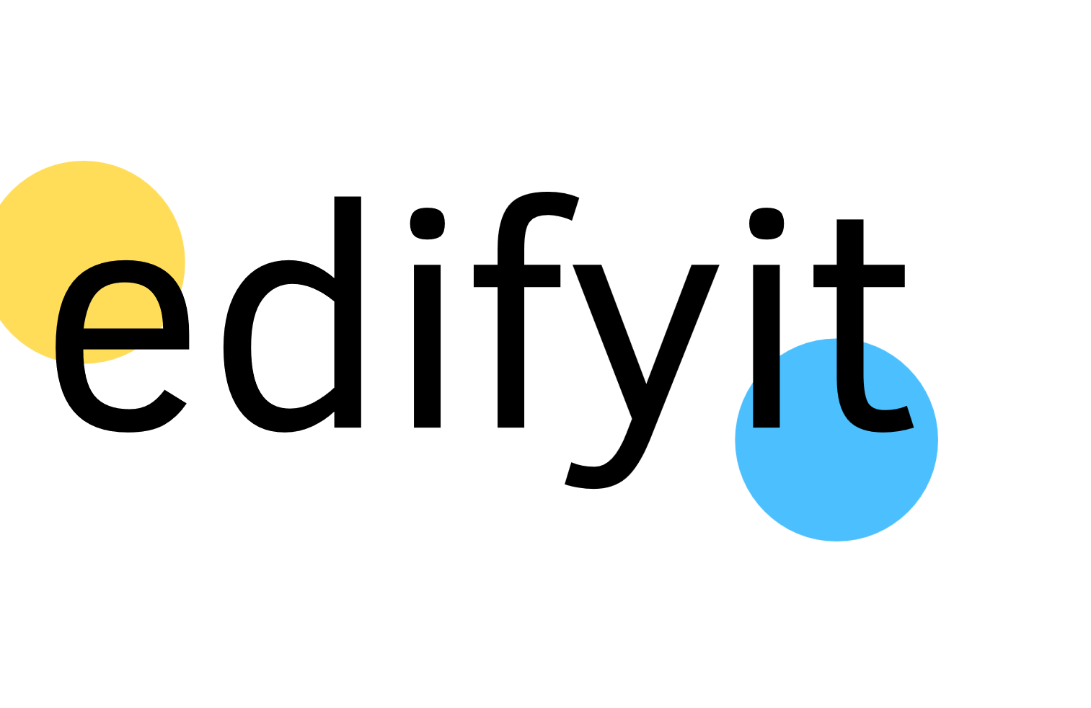
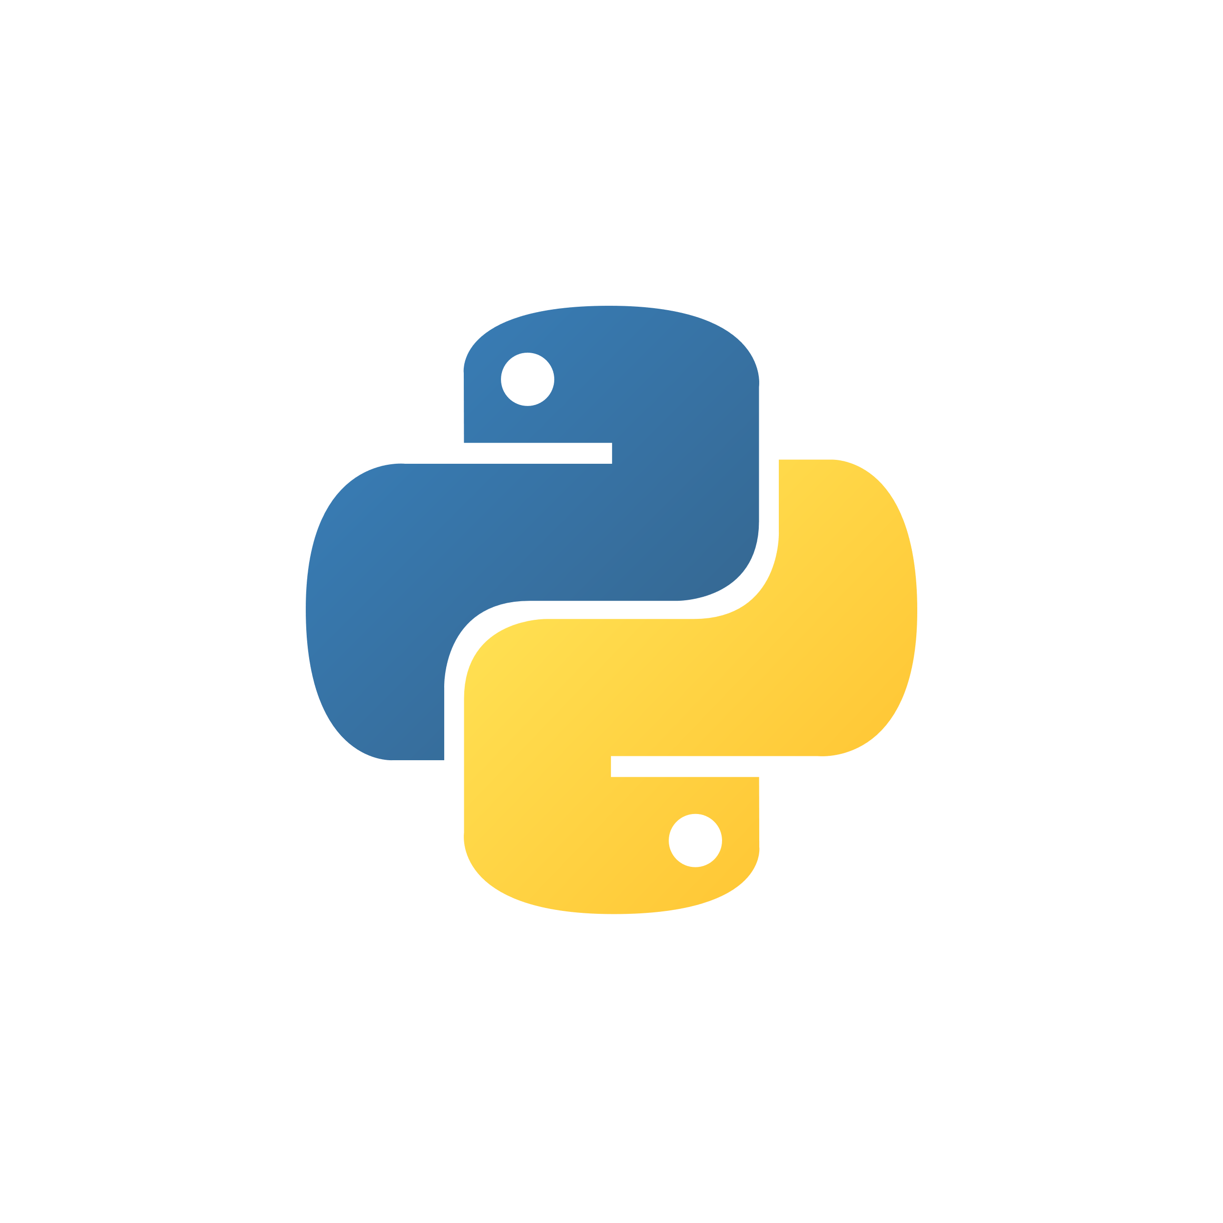
Becoming a Python Professional: Mastering the Art of Coding
Essential skills and resources for Python mastery
Presenter: Ankit Singhal
Notes:
AI-generated content may be incorrect. --- This presentation will guide you through the journey of becoming a Python professional. We will explore essential concepts, best practices, and resources that will enable you to master Python coding and enhance your professional development in the tech industry.

Slide 2
Python Pro Roadmap
Learn Python Basics
Start by learning Python basics, including syntax, data types, and control structures to establish a strong foundation.
Master Libraries and Frameworks
Progress to mastering essential libraries like NumPy and pandas, and frameworks such as Django or Flask for advanced development.
Build Practical Projects
Work on various projects to build practical skills and gain real-world experience in Python programming.
Contribute to Open-source
Contribute to open-source Python projects to enhance your skills, collaborate with other developers, and improve your portfolio.
Prepare for Interviews and Certifications
Prepare for job interviews and obtain certifications to showcase your expertise and stand out in the professional field.
Notes:
To gain professional experience in Python, start with learning the basics, such as syntax, data types, and control structures. Progress to mastering libraries like NumPy, pandas, and frameworks like Django or Flask. Work on projects to build practical skills, and contribute to open-source. Finally, prepare for interviews and certifications to showcase your expertise.

Slide 3
FEW POINTS TO REMEMBER
Dedication and Commitment
Becoming a Python professional requires a strong dedication to learning and honing your coding skills over time.
Continuous Learning
To succeed in Python programming, it is essential to adopt a mindset of continuous learning and improvement in your skillset.
Mastering Essential Skills
Focusing on essential Python skills and applying them effectively is key to advancing your coding career.
Notes:
In conclusion, becoming a Python professional requires dedication, practice, and a commitment to continuous learning. By focusing on essential skills and leveraging resources effectively, you can master the art of coding and advance your career.

Slide 4
Python Foundation Course
Notes:
This section covers the core programming constructs in Python. These foundational concepts are crucial for writing effective code and understanding more complex topics later on.

Slide 5
Session 1: Start with Jupyter Notebook Learn Basic Syntax
Python Fundamentals
Control and conditional statements structure
Loops : While, For loop
User Input
Data Types and Variables
Typecasting
Notes:
In conclusion, becoming a Python professional requires dedication, practice, and a commitment to continuous learning. By focusing on essential skills and leveraging resources effectively, you can master the art of coding and advance your career.

Slide 6
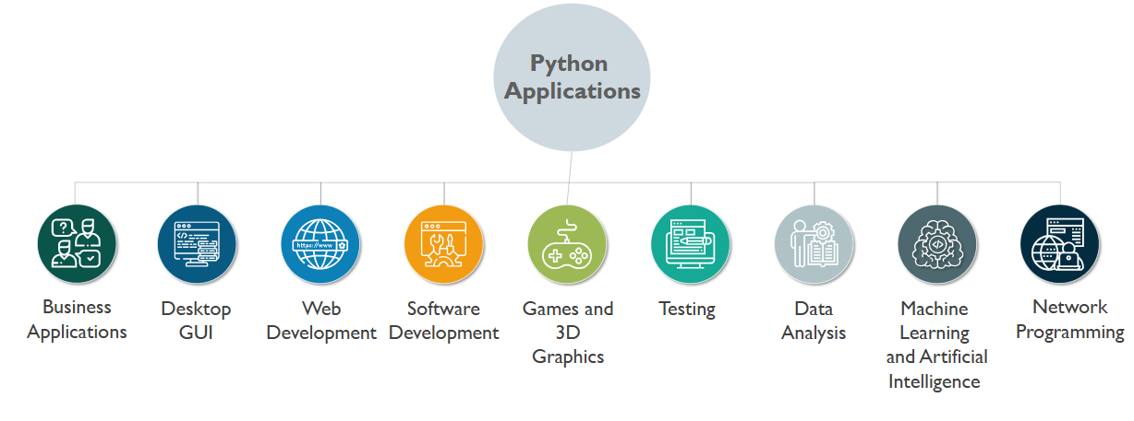
What is Python?
Notes:
In conclusion, becoming a Python professional requires dedication, practice, and a commitment to continuous learning. By focusing on essential skills and leveraging resources effectively, you can master the art of coding and advance your career.

Slide 7
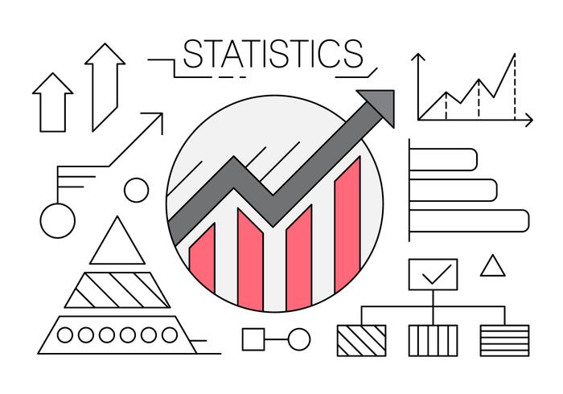
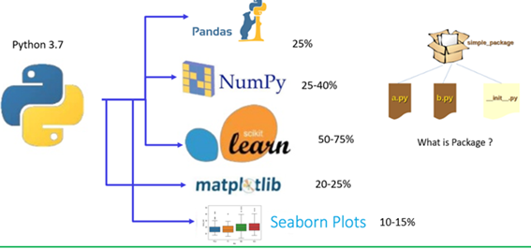

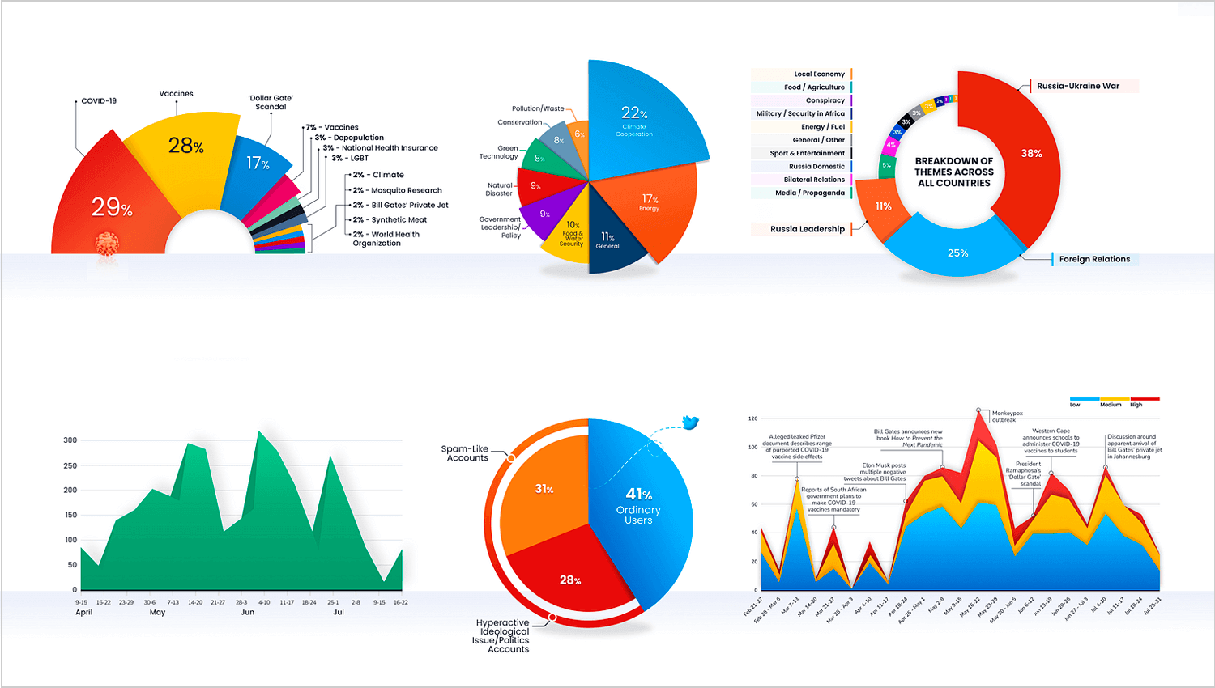

Python - Features
Statistical Support
Mature system of packages for data analysis
Data Manipulation
Data Visualization
Notes:
In conclusion, becoming a Python professional requires dedication, practice, and a commitment to continuous learning. By focusing on essential skills and leveraging resources effectively, you can master the art of coding and advance your career.

Slide 8
Fundamentals of Python Syntax
Python is case sensitive, “Hello” Is not equal to “hello”
Python does not have command terminator like c or C++
The number of spaces in the indention is variable, but all statements within the block must be indented the same amount
Each line will have one statement, for multiple statements in one line use ;
Comments in python start with #, for multiple line comments use ”’
No braces to indicate blocks of code, class or function, can be denoted by line indention which is rigidly enforced
Notes:
In conclusion, becoming a Python professional requires dedication, practice, and a commitment to continuous learning. By focusing on essential skills and leveraging resources effectively, you can master the art of coding and advance your career.

Slide 9
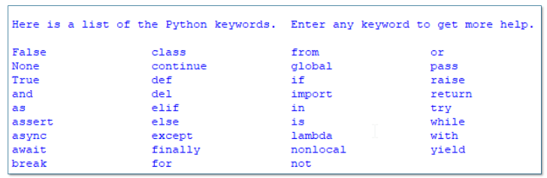
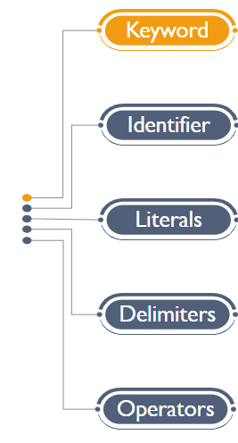
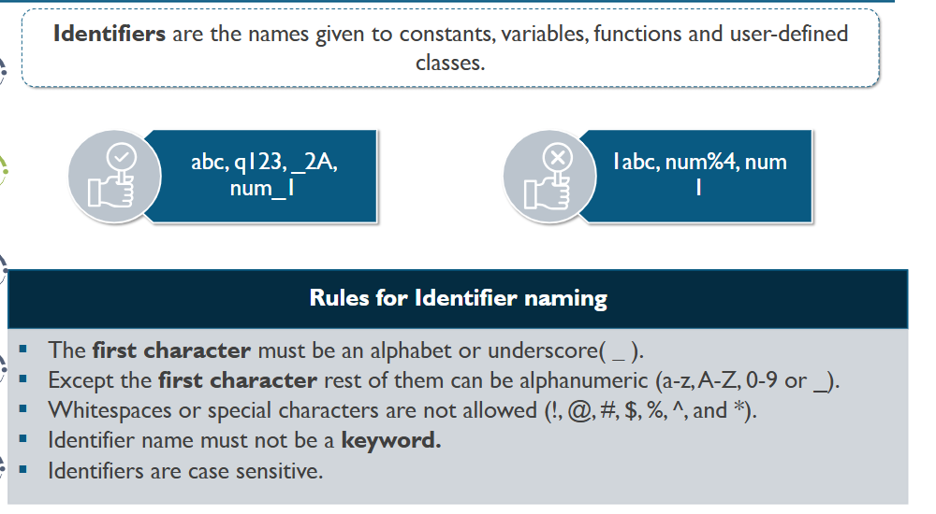
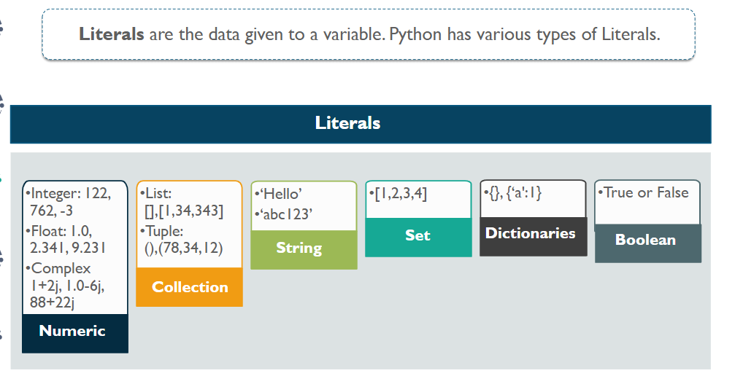
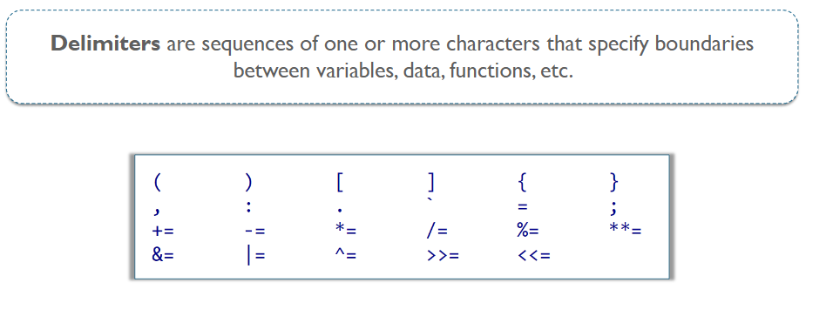
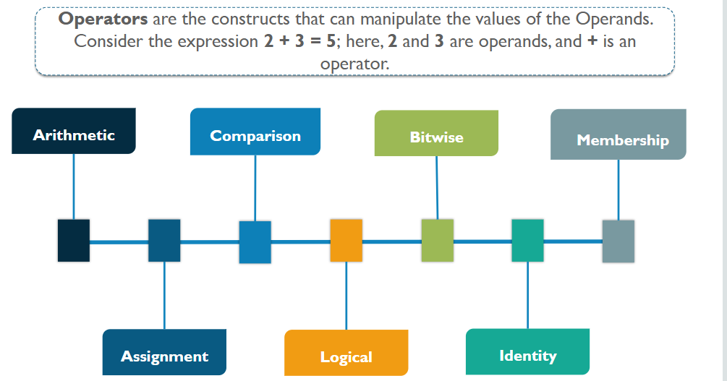
Fundamentals of Python Syntax
Keywords are reserved words that have special meaning of function in Python.
Identifiers are the names given to constants, variables, functions and user defined classes
Literals are the data given to a variable. Python has various types of literals.
Delimiters are sequence of one or more characters that specify boundaries between variables, data, functions etc.
Operators are the constructs that can manipulate the values of the operands. Like 2+3=5; here + is an operator.
Notes:
In conclusion, becoming a Python professional requires dedication, practice, and a commitment to continuous learning. By focusing on essential skills and leveraging resources effectively, you can master the art of coding and advance your career.

Slide 10
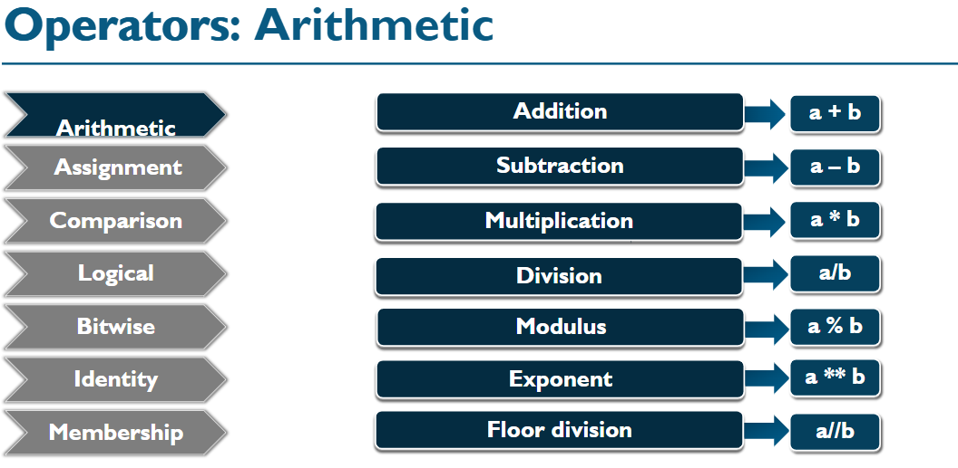
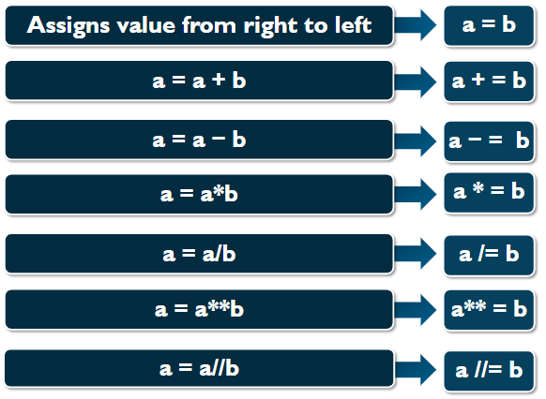
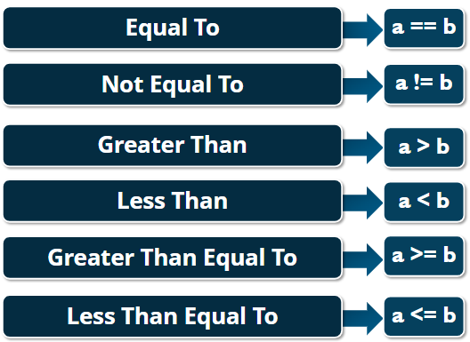
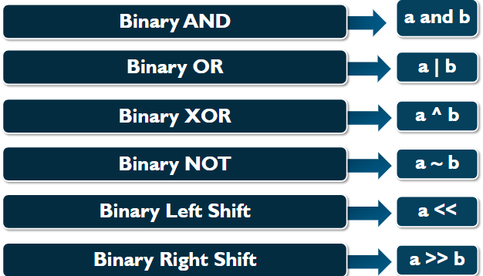
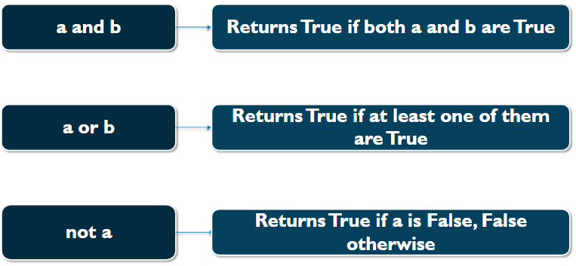
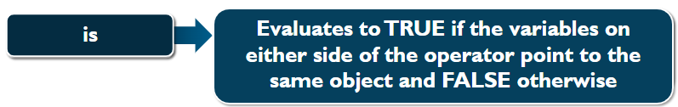
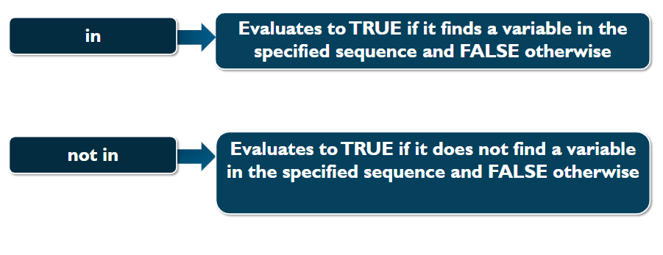
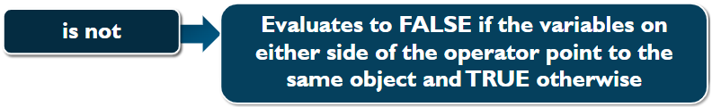
Fundamentals of Python Syntax
Variables are nothing but reserved locations to store values. This means that when you create a variable you reserve some space in memory.
A=16
B=20
C=‘edifyIT’
A=16
Memory
A=16
B=20
C=‘edifyIT’
Print(A,B)
B=16
16 edifyIT
Memory
C=‘edifyIT’
Memory
Arithmetic Operators
Assignment Operators
Comparison Operators
Binary Operators
Bitwise Operators
Identity Operators
Membership Operators
Notes:
In conclusion, becoming a Python professional requires dedication, practice, and a commitment to continuous learning. By focusing on essential skills and leveraging resources effectively, you can master the art of coding and advance your career.

Slide 11
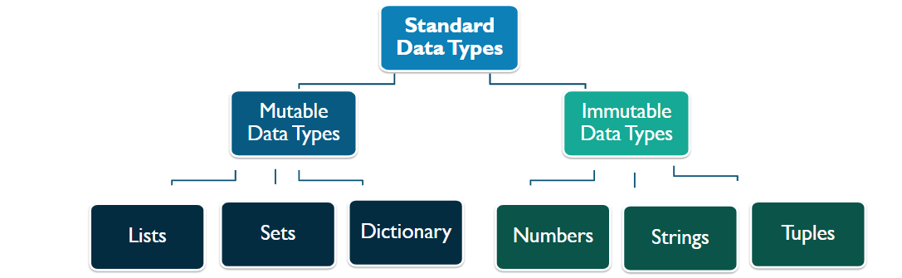
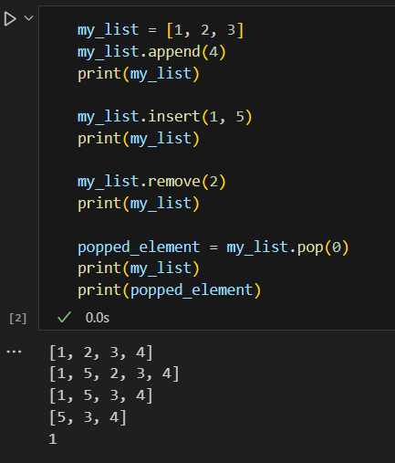
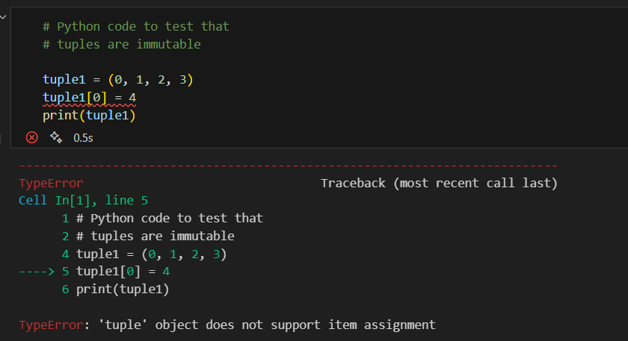
Python Datatypes
Mutable Datatypes
Mutable Objects are of type Python list, Python dict, or Python set. Custom classes are generally mutable.
Immutable Datatypes
Immutable Objects are of in-built datatypes like int, float, bool, string, Unicode, and tuple. In simple words, an immutable object can’t be changed after it is created.
Notes:
In conclusion, becoming a Python professional requires dedication, practice, and a commitment to continuous learning. By focusing on essential skills and leveraging resources effectively, you can master the art of coding and advance your career.

Slide 12
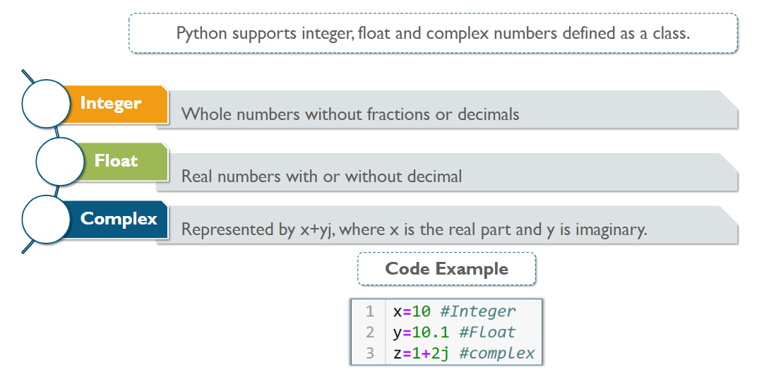
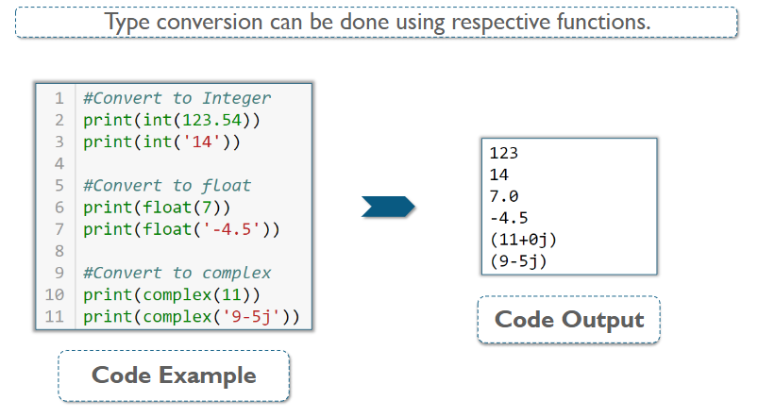
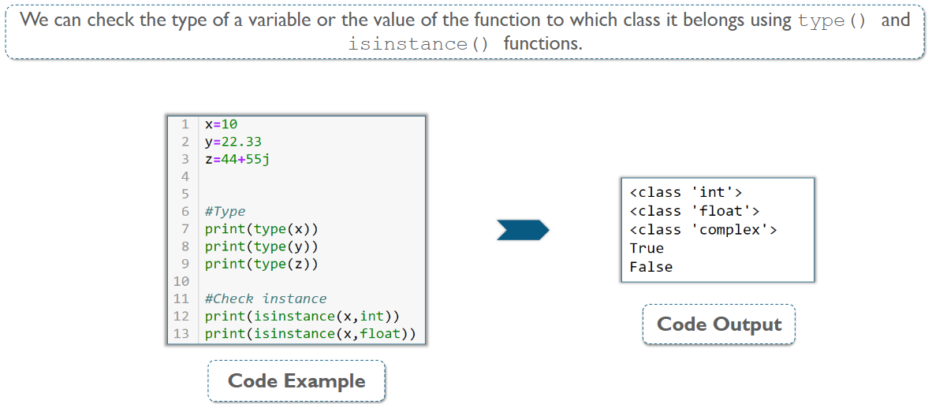
Numbers, Integers, Float & Complex
Notes:
In conclusion, becoming a Python professional requires dedication, practice, and a commitment to continuous learning. By focusing on essential skills and leveraging resources effectively, you can master the art of coding and advance your career.

Slide 13
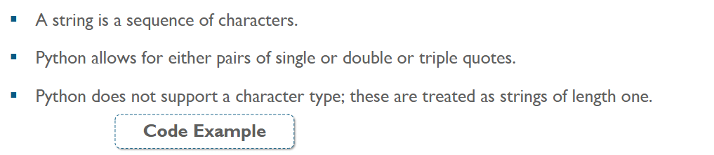
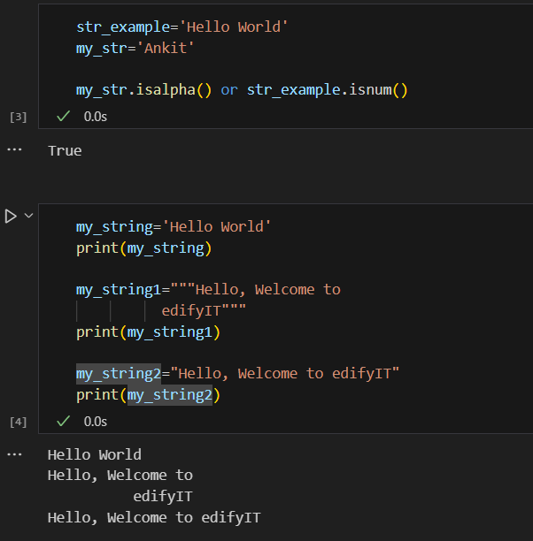
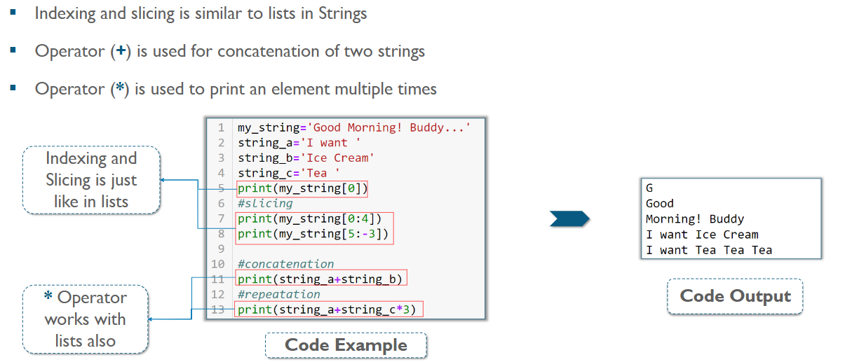
Strings
Notes:
In conclusion, becoming a Python professional requires dedication, practice, and a commitment to continuous learning. By focusing on essential skills and leveraging resources effectively, you can master the art of coding and advance your career.

Slide 14
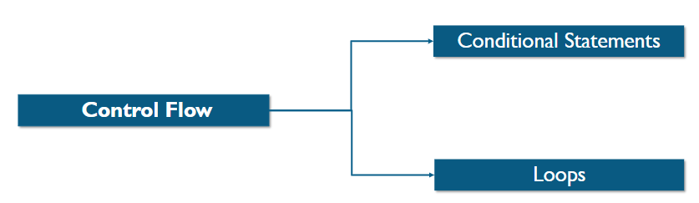
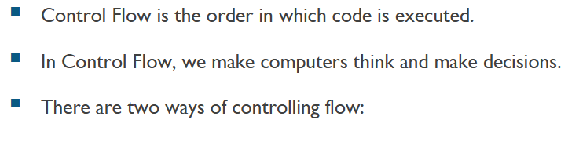
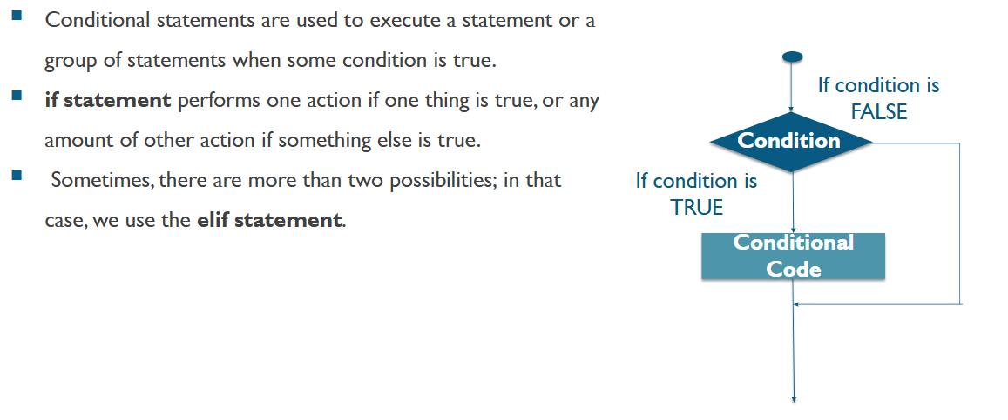
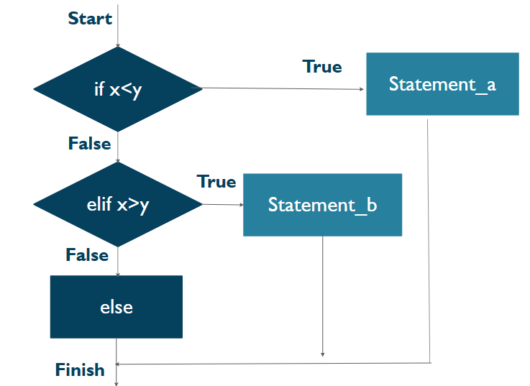
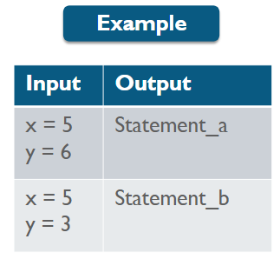
Control Flow in Python
Notes:
In conclusion, becoming a Python professional requires dedication, practice, and a commitment to continuous learning. By focusing on essential skills and leveraging resources effectively, you can master the art of coding and advance your career.

Slide 15
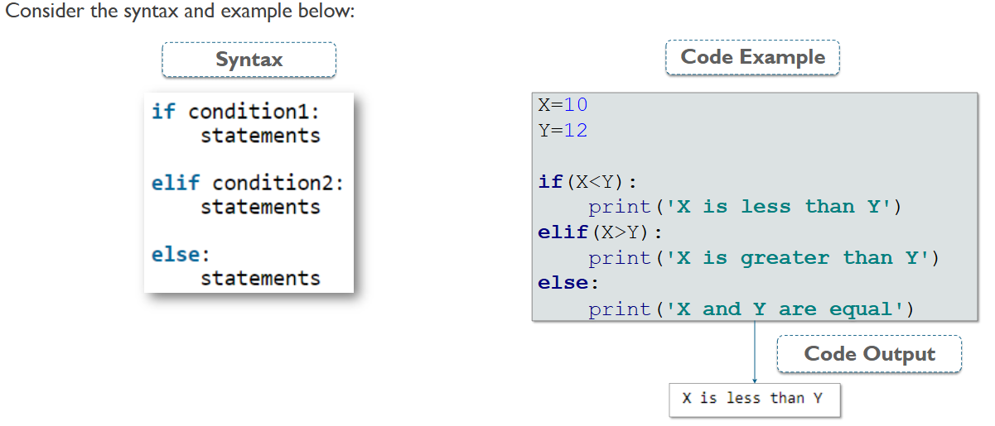
Control Flow in Python
Notes:
In conclusion, becoming a Python professional requires dedication, practice, and a commitment to continuous learning. By focusing on essential skills and leveraging resources effectively, you can master the art of coding and advance your career.

Slide 16
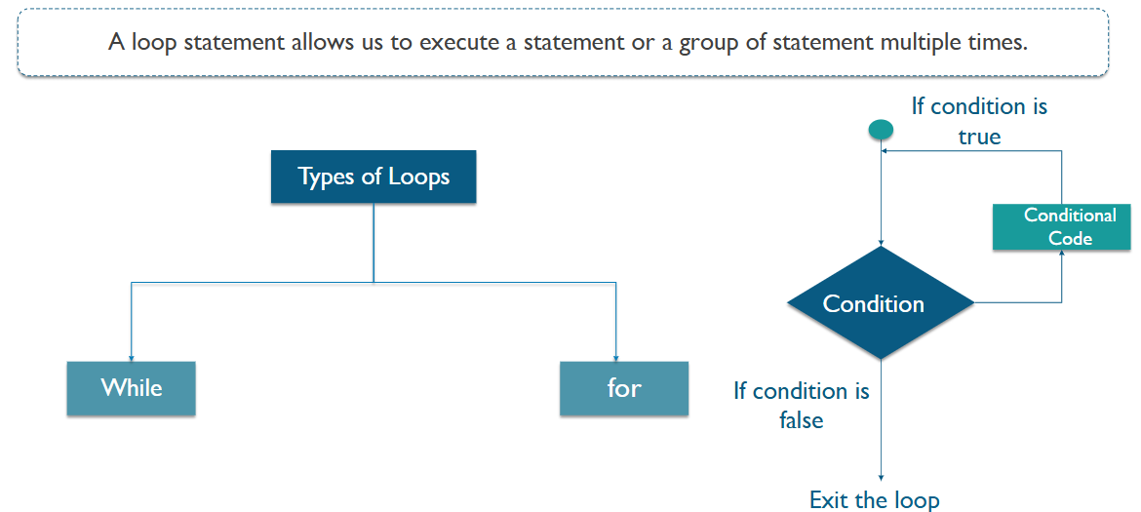
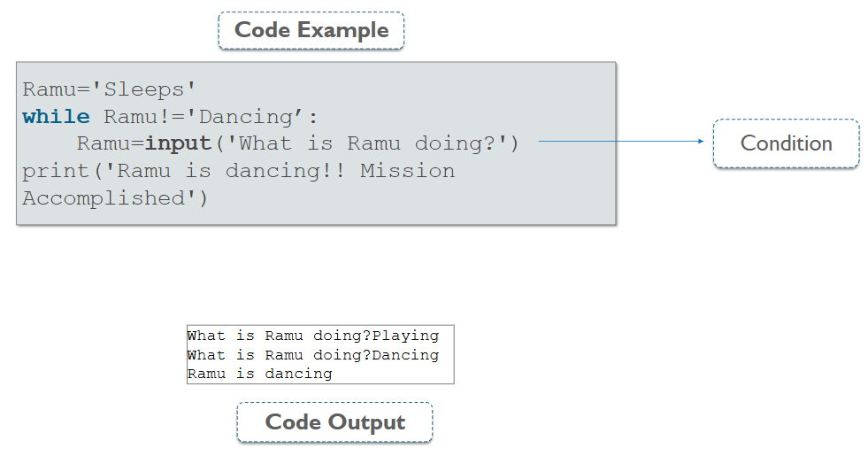
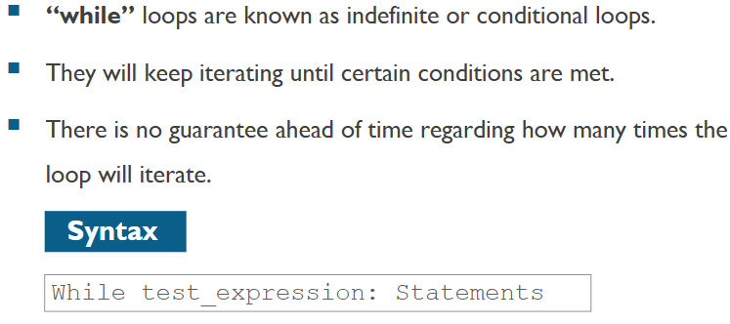
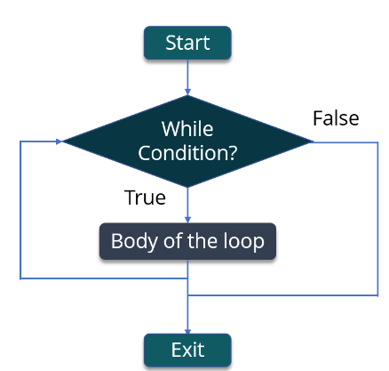
Control Flow in Python
Notes:
In conclusion, becoming a Python professional requires dedication, practice, and a commitment to continuous learning. By focusing on essential skills and leveraging resources effectively, you can master the art of coding and advance your career.

Slide 17
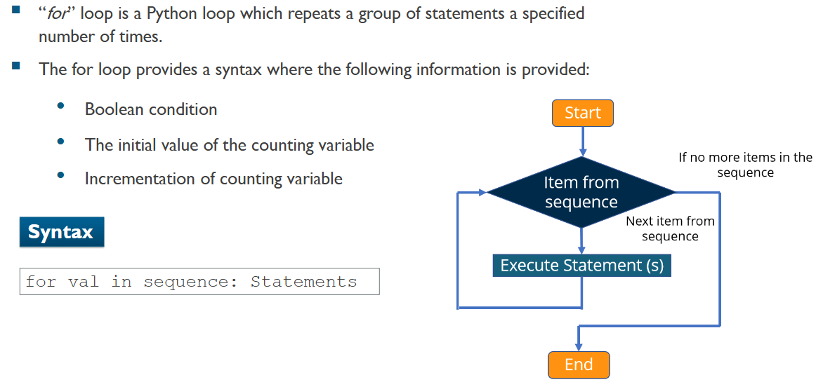
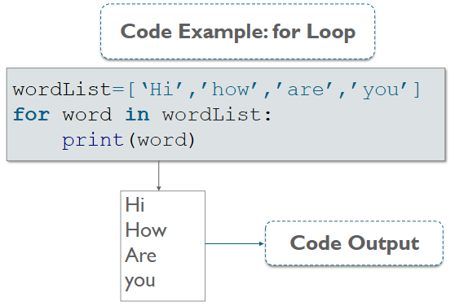
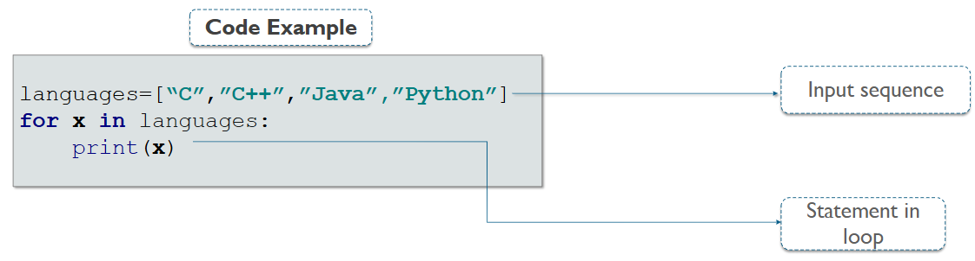
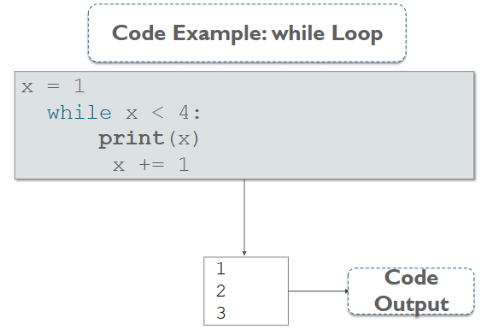
Control Flow in Python
Notes:
In conclusion, becoming a Python professional requires dedication, practice, and a commitment to continuous learning. By focusing on essential skills and leveraging resources effectively, you can master the art of coding and advance your career.

Slide 18
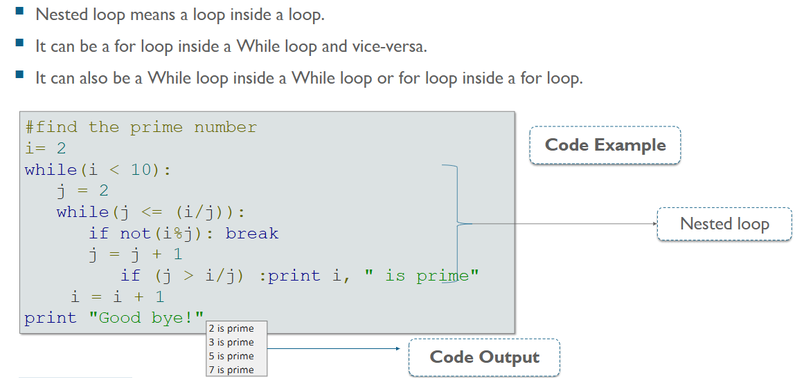
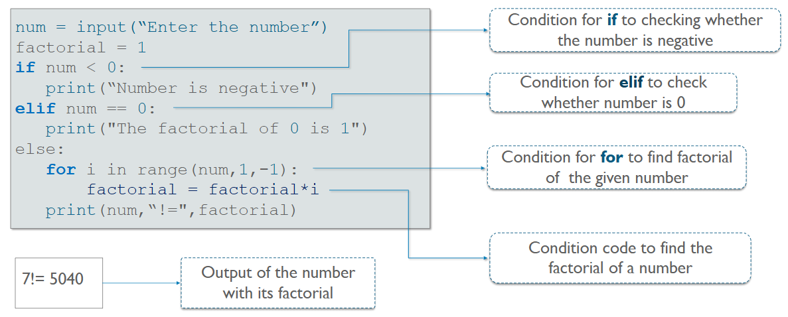
Control Flow in Python
Nested loops
Factorial Program
Notes:
In conclusion, becoming a Python professional requires dedication, practice, and a commitment to continuous learning. By focusing on essential skills and leveraging resources effectively, you can master the art of coding and advance your career.

Slide 19
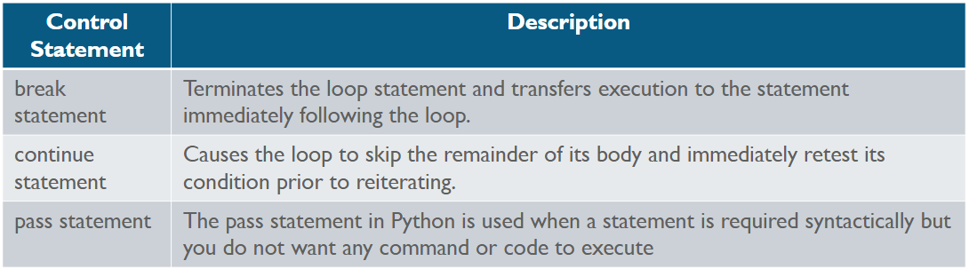
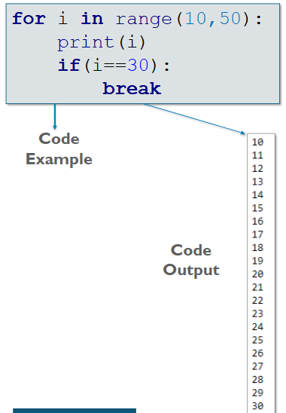
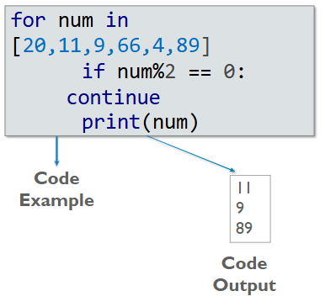
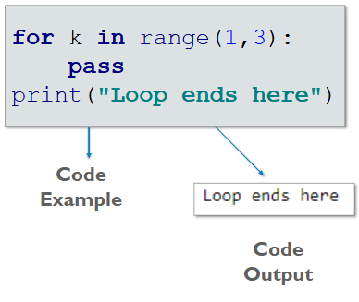
Control Flow in Python
Loop Control Statements
Notes:
In conclusion, becoming a Python professional requires dedication, practice, and a commitment to continuous learning. By focusing on essential skills and leveraging resources effectively, you can master the art of coding and advance your career.

Slide 20
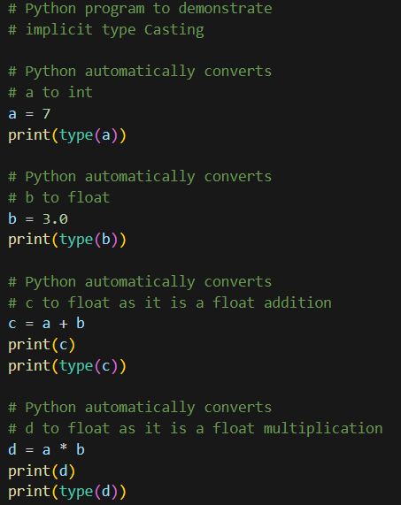







Control Flow in Python
Type Casting
Type Casting is the method to convert the Python variable datatype into a certain data type in order to perform the required operation by users. In this article, we will see the various techniques for typecasting. There can be two types of Type Casting in Python:
Python Implicit Type Conversion
Python Explicit Type Conversion
Implicit Type Conversion in Python
In this, method, Python converts the datatype into another datatype automatically. Users don't have to involve in this process.
Explicit Type Conversion in Python
In this method, Python needs user involvement to convert the variable data type into the required data type.
Notes:
In conclusion, becoming a Python professional requires dedication, practice, and a commitment to continuous learning. By focusing on essential skills and leveraging resources effectively, you can master the art of coding and advance your career.

Slide 21




Python Basics
User Input
Packages & Modules
Notes:
In conclusion, becoming a Python professional requires dedication, practice, and a commitment to continuous learning. By focusing on essential skills and leveraging resources effectively, you can master the art of coding and advance your career.

Slide 22





Python Basics
Packages & Modules
Sys Module provides access to some variables used or maintained by the interpreter and to functions that interact strongly with the interpreter.
Math Module provides access to mathematical functions.
Random Module implements pseudo-random generators for various distributions.
OS Module includes codes that let python work with OS and run some OS commands.
DATETIME Module includes tools working with date, time and combinations.
Notes:
In conclusion, becoming a Python professional requires dedication, practice, and a commitment to continuous learning. By focusing on essential skills and leveraging resources effectively, you can master the art of coding and advance your career.

Slide 23
Session 2: Data Structures & Functions
Strings and Inbuilt Functions
List and Boolean Variables
Sets
Dictionaries
Tuples
Functions
Lambda Functions
Iterators and Generators
Exceptional Handling
Notes:
In conclusion, becoming a Python professional requires dedication, practice, and a commitment to continuous learning. By focusing on essential skills and leveraging resources effectively, you can master the art of coding and advance your career.

Slide 24
List, Dictionary, Sets & Tuples
Lists
A list is a data structure in Python that is a mutable, or changeable, ordered sequence of elements. Each element or value that is inside of a list is called an item. Just as strings are defined as characters between quotes, lists are defined by having values between square brackets [ ]
SETS
A Set is an unordered collection data type that is iterable, mutable, and has no duplicate elements. Python's set class represents the mathematical notion of a set. This is based on a data structure known as a hash table
Dictionaries
A dictionary is a collection which is unordered, changeable and indexed. In Python dictionaries are written with curly brackets, and they have keys and values.
Tuples
Tuples is also an ordered collection of Python objects. The only difference between a tuple and a list is that tuples are immutable. Tuples cannot be modified after it is created.
Notes:
In conclusion, becoming a Python professional requires dedication, practice, and a commitment to continuous learning. By focusing on essential skills and leveraging resources effectively, you can master the art of coding and advance your career.

Slide 25
Session 3: Data Structures & Functions
Class & Objects
Method
OOPS Concepts
Python Libraries
NumPy
Notes:
In conclusion, becoming a Python professional requires dedication, practice, and a commitment to continuous learning. By focusing on essential skills and leveraging resources effectively, you can master the art of coding and advance your career.

Slide 26
Python Specialization Couse
Notes:
This section covers the core programming constructs in Python. These foundational concepts are crucial for writing effective code and understanding more complex topics later on.

Slide 27

Session 4: Data Structures & Functions
Python Libraries
NumPy
Pandas
Matplotlib
Seaborn
SciPy
Notes:
In conclusion, becoming a Python professional requires dedication, practice, and a commitment to continuous learning. By focusing on essential skills and leveraging resources effectively, you can master the art of coding and advance your career.

Slide 28






Session 5: Python Frameworks
Web Development Framework
Desktop Application Framework
Notes:
In conclusion, becoming a Python professional requires dedication, practice, and a commitment to continuous learning. By focusing on essential skills and leveraging resources effectively, you can master the art of coding and advance your career.

Slide 29
Python Advance Couse
Notes:
This section covers the core programming constructs in Python. These foundational concepts are crucial for writing effective code and understanding more complex topics later on.

Slide 30

Session 6: Advance Libraries for Data Science
Libraries for Machine Learning
Libraries for Deep Learning
Notes:
In conclusion, becoming a Python professional requires dedication, practice, and a commitment to continuous learning. By focusing on essential skills and leveraging resources effectively, you can master the art of coding and advance your career.

