Slide 1
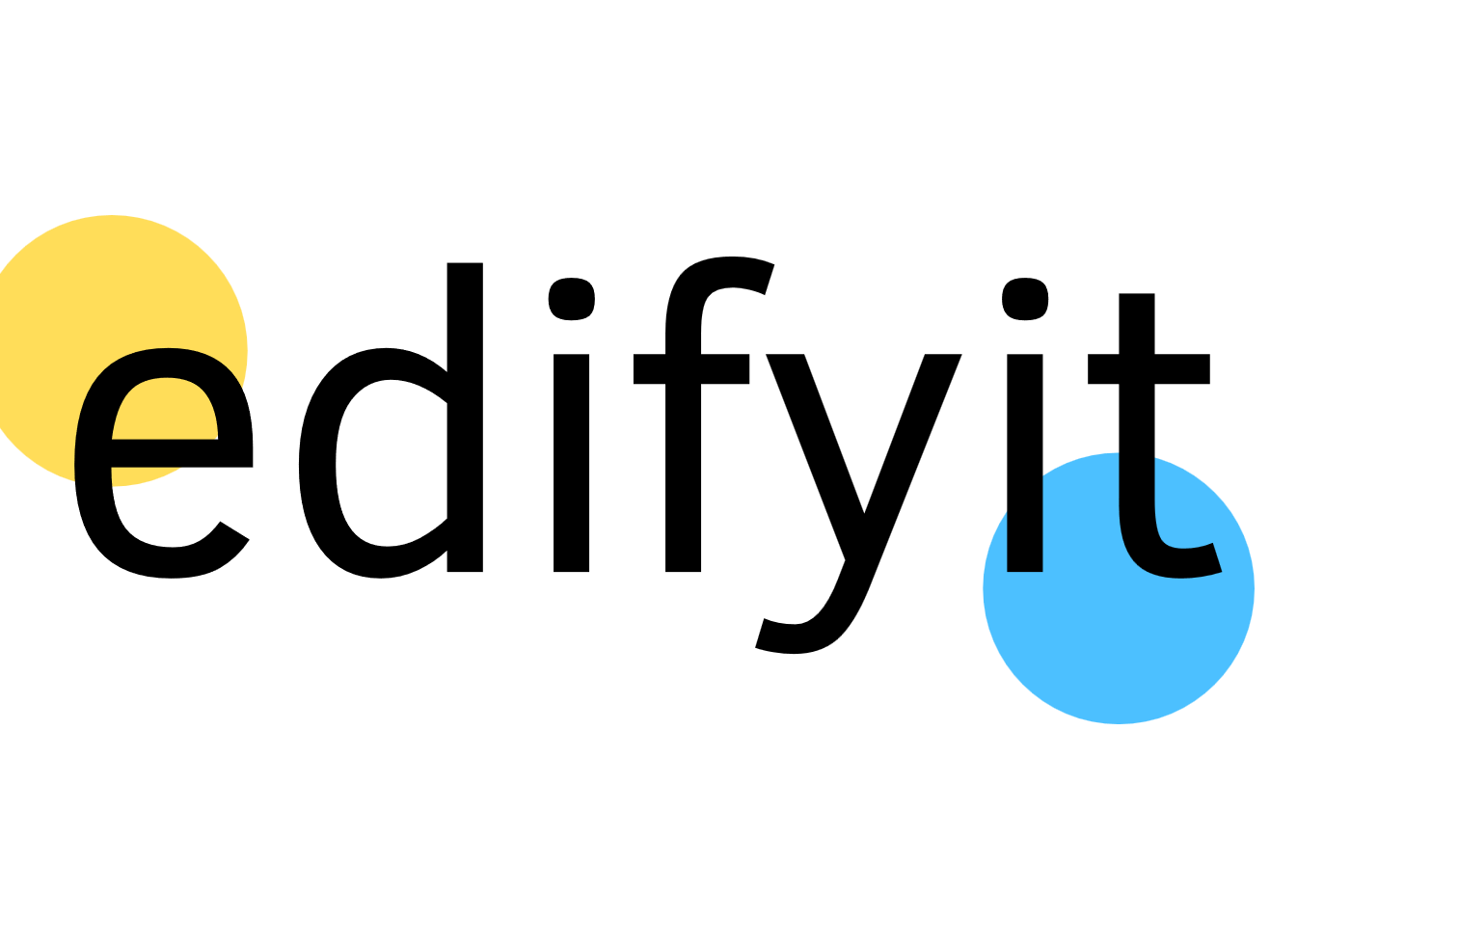
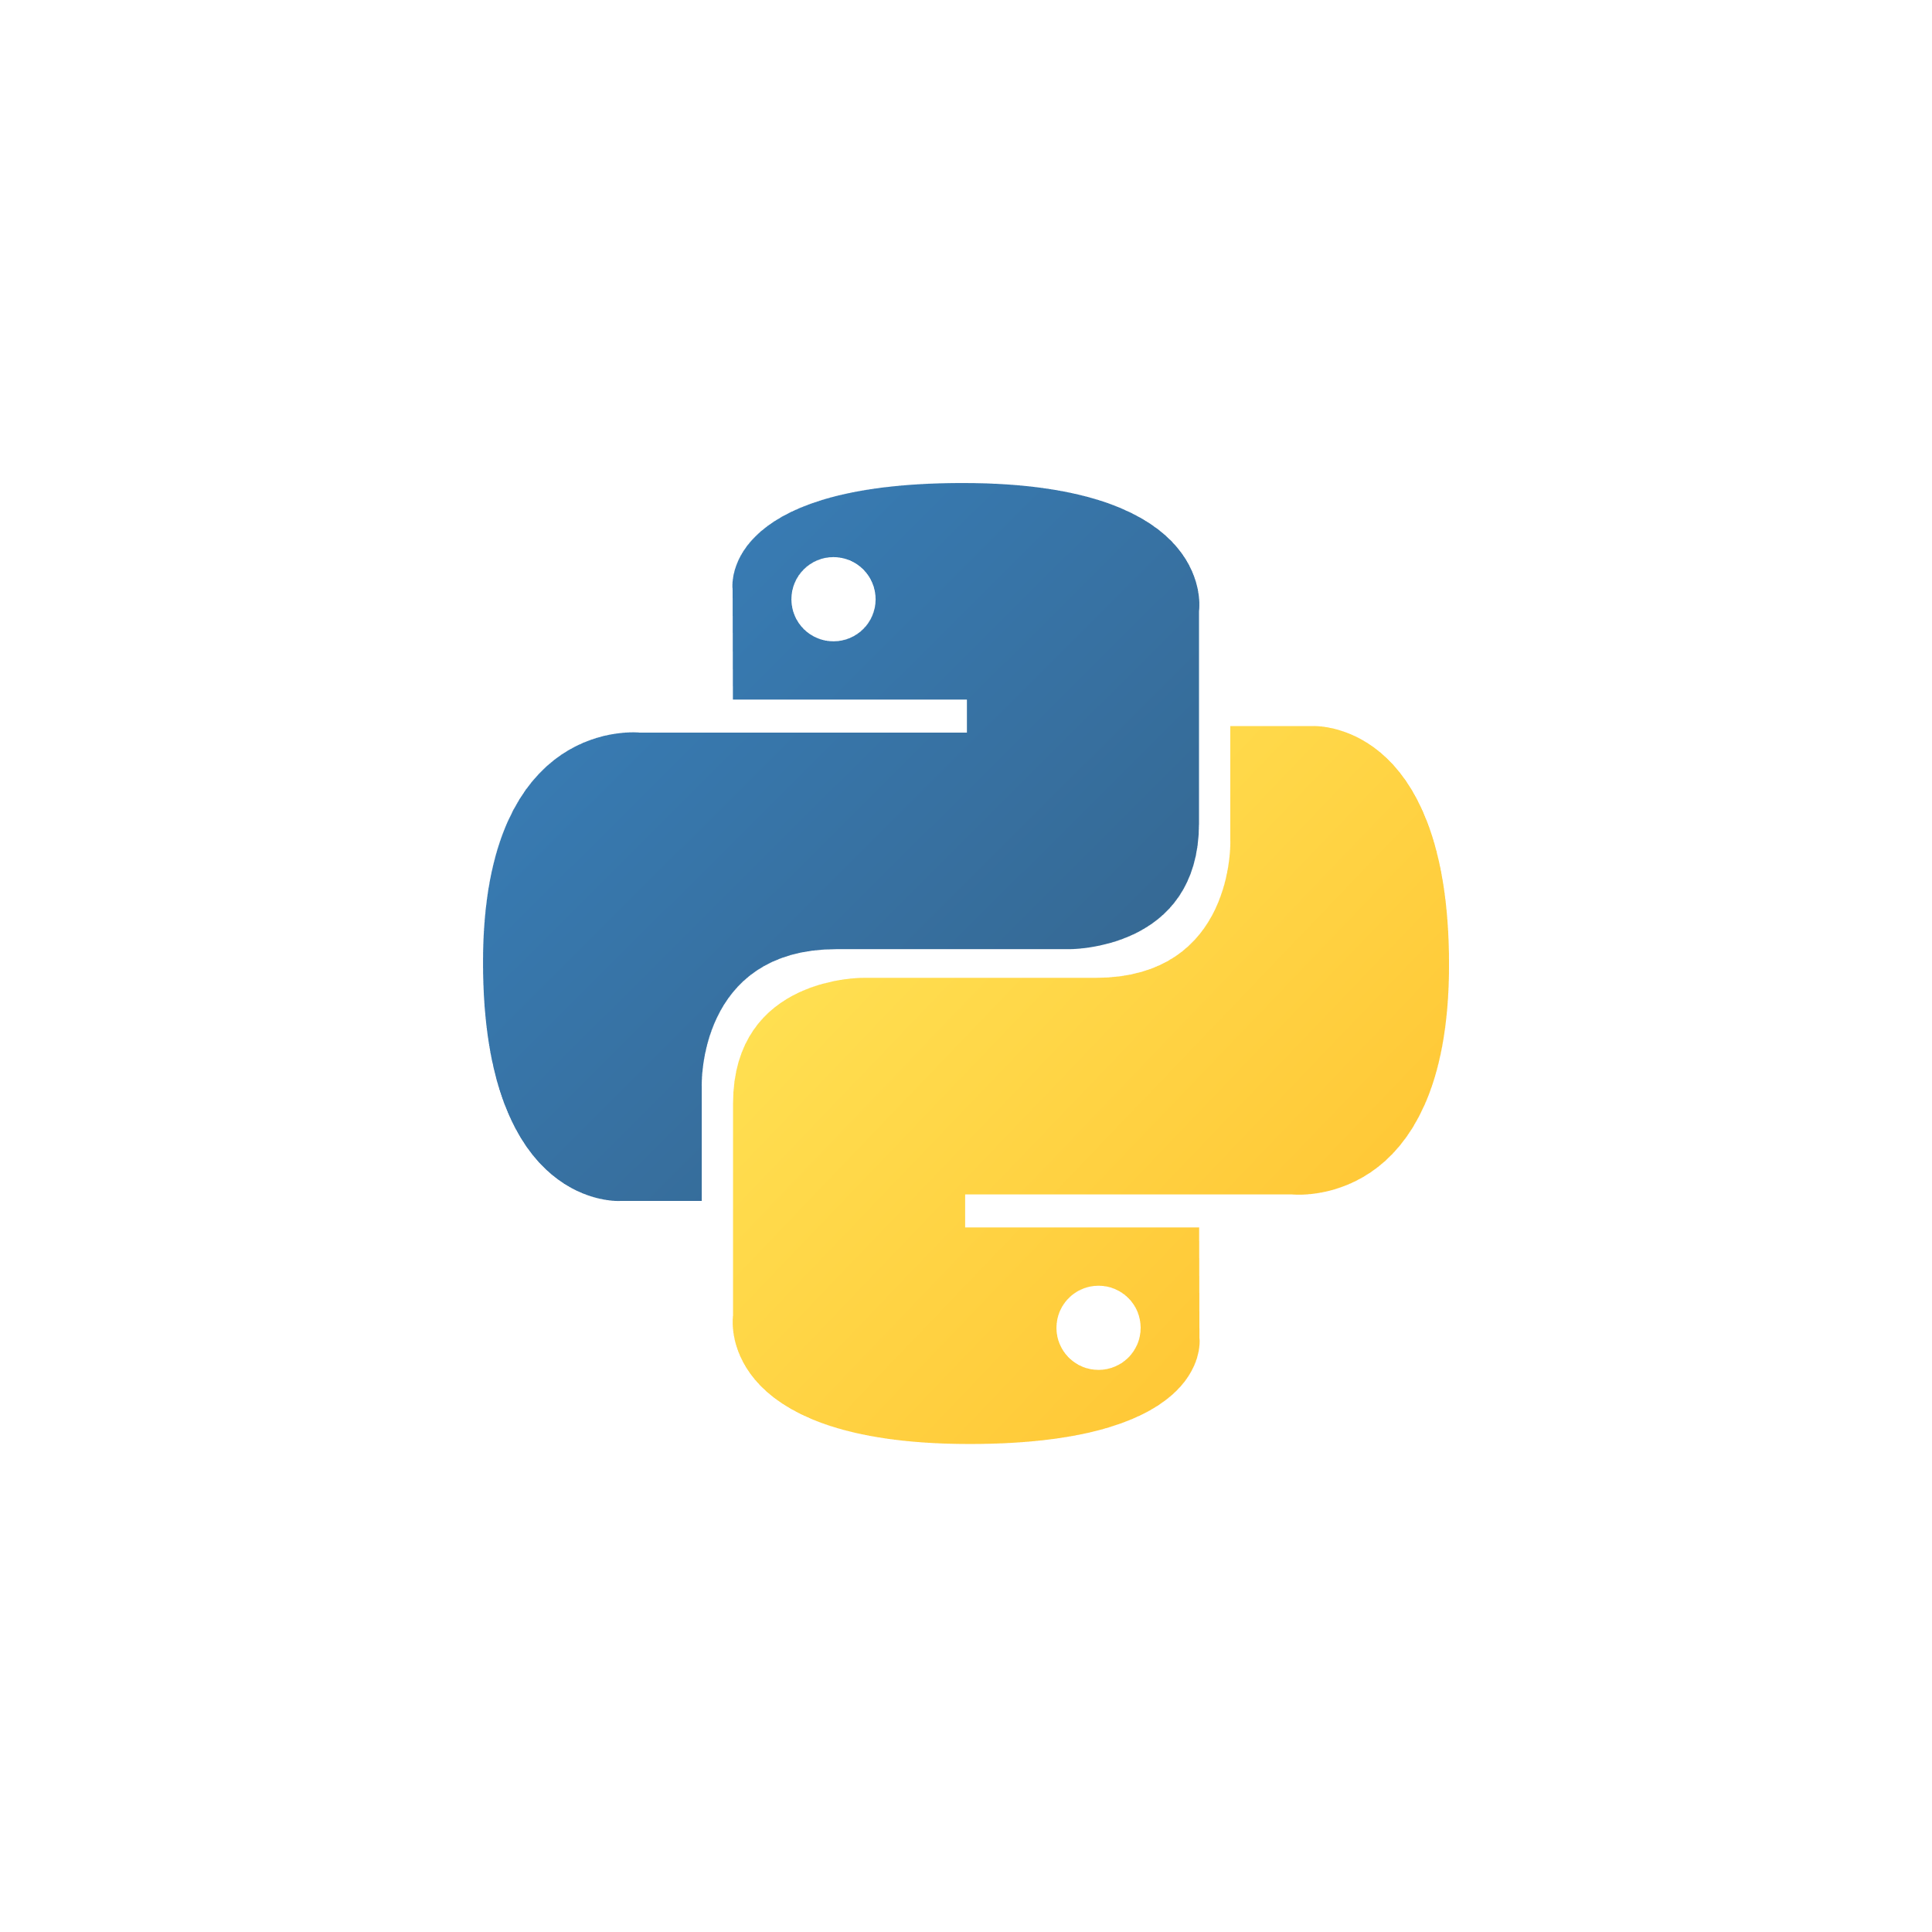
Becoming a Python Professional: Mastering the Art of Coding
Essential skills and resources for Python mastery
Presenter: Ankit Singhal
Notes:
AI-generated content may be incorrect. --- This presentation will guide you through the journey of becoming a Python professional. We will explore essential concepts, best practices, and resources that will enable you to master Python coding and enhance your professional development in the tech industry.

Slide 2
Python Pro Roadmap
Learn Python Basics
Start by learning Python basics, including syntax, data types, and control structures to establish a strong foundation.
Master Libraries and Frameworks
Progress to mastering essential libraries like NumPy and pandas, and frameworks such as Django or Flask for advanced development.
Build Practical Projects
Work on various projects to build practical skills and gain real-world experience in Python programming.
Contribute to Open-source
Contribute to open-source Python projects to enhance your skills, collaborate with other developers, and improve your portfolio.
Prepare for Interviews and Certifications
Prepare for job interviews and obtain certifications to showcase your expertise and stand out in the professional field.
Notes:
To gain professional experience in Python, start with learning the basics, such as syntax, data types, and control structures. Progress to mastering libraries like NumPy, pandas, and frameworks like Django or Flask. Work on projects to build practical skills, and contribute to open-source. Finally, prepare for interviews and certifications to showcase your expertise.

Slide 3
FEW POINTS TO REMEMBER
Dedication and Commitment
Becoming a Python professional requires a strong dedication to learning and honing your coding skills over time.
Continuous Learning
To succeed in Python programming, it is essential to adopt a mindset of continuous learning and improvement in your skillset.
Mastering Essential Skills
Focusing on essential Python skills and applying them effectively is key to advancing your coding career.
Notes:
In conclusion, becoming a Python professional requires dedication, practice, and a commitment to continuous learning. By focusing on essential skills and leveraging resources effectively, you can master the art of coding and advance your career.

Slide 4
Python Foundation Couse
Notes:
This section covers the core programming constructs in Python. These foundational concepts are crucial for writing effective code and understanding more complex topics later on.

Slide 5
Session 1: Start with Jupyter Notebook Learn Basic Syntax
Python Basics
Control and conditional statements structure
Loops : While, For loop
User Input
Data Types and Variables
Typecasting
Notes:
In conclusion, becoming a Python professional requires dedication, practice, and a commitment to continuous learning. By focusing on essential skills and leveraging resources effectively, you can master the art of coding and advance your career.

Slide 6
Session 2: Data Structures & Functions
Strings and Inbuilt Functions
List and Boolean Variables
Sets
Dictionaries
Tuples
Functions
Lambda Functions
Iterators and Generators
Exceptional Handling
Notes:
In conclusion, becoming a Python professional requires dedication, practice, and a commitment to continuous learning. By focusing on essential skills and leveraging resources effectively, you can master the art of coding and advance your career.

Slide 7
Session 3: Data Structures & Functions
Class & Objects
Method
OOPS Concepts
Python Libraries
Numpy
Notes:
In conclusion, becoming a Python professional requires dedication, practice, and a commitment to continuous learning. By focusing on essential skills and leveraging resources effectively, you can master the art of coding and advance your career.

Slide 8
Python Specialization Couse
Notes:
This section covers the core programming constructs in Python. These foundational concepts are crucial for writing effective code and understanding more complex topics later on.

Slide 9
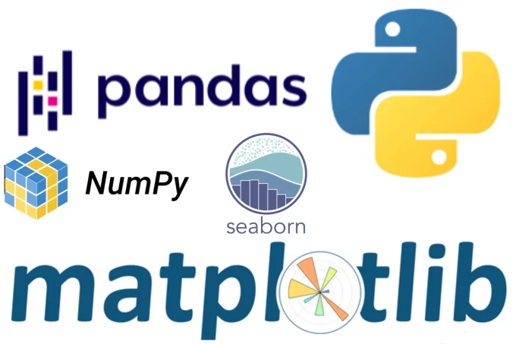
Session 4: Data Structures & Functions
Python Libraries
NumPy
Pandas
Matplotlib
Seaborn
SciPy
Notes:
In conclusion, becoming a Python professional requires dedication, practice, and a commitment to continuous learning. By focusing on essential skills and leveraging resources effectively, you can master the art of coding and advance your career.

Slide 10
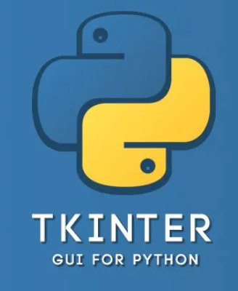

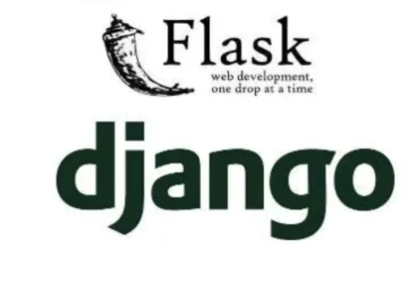
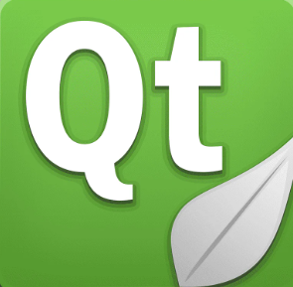
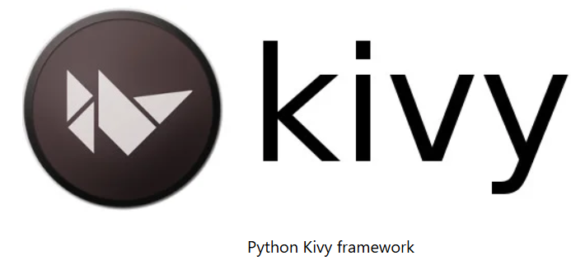
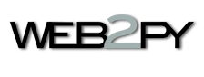
Session 5: Python Frameworks
Web Development Framework
Desktop Application Framework
Notes:
In conclusion, becoming a Python professional requires dedication, practice, and a commitment to continuous learning. By focusing on essential skills and leveraging resources effectively, you can master the art of coding and advance your career.

Slide 11
Python Advance Couse
Notes:
This section covers the core programming constructs in Python. These foundational concepts are crucial for writing effective code and understanding more complex topics later on.

Slide 12
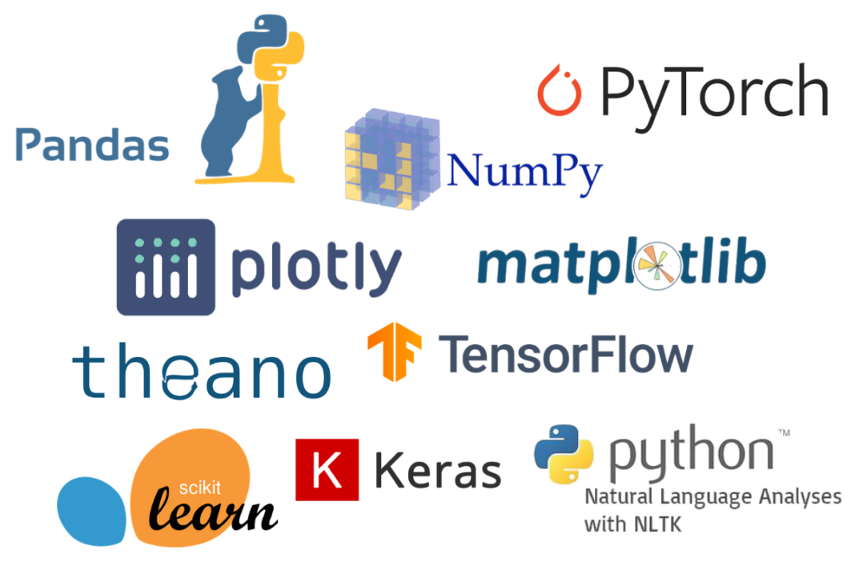
Session 6: Advance Libraries for Data Science
Libraries for Machine Learning
Libraries for Deep Learning
Notes:
In conclusion, becoming a Python professional requires dedication, practice, and a commitment to continuous learning. By focusing on essential skills and leveraging resources effectively, you can master the art of coding and advance your career.

