Slide 1
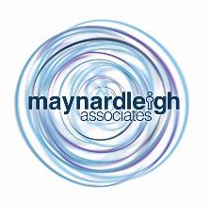
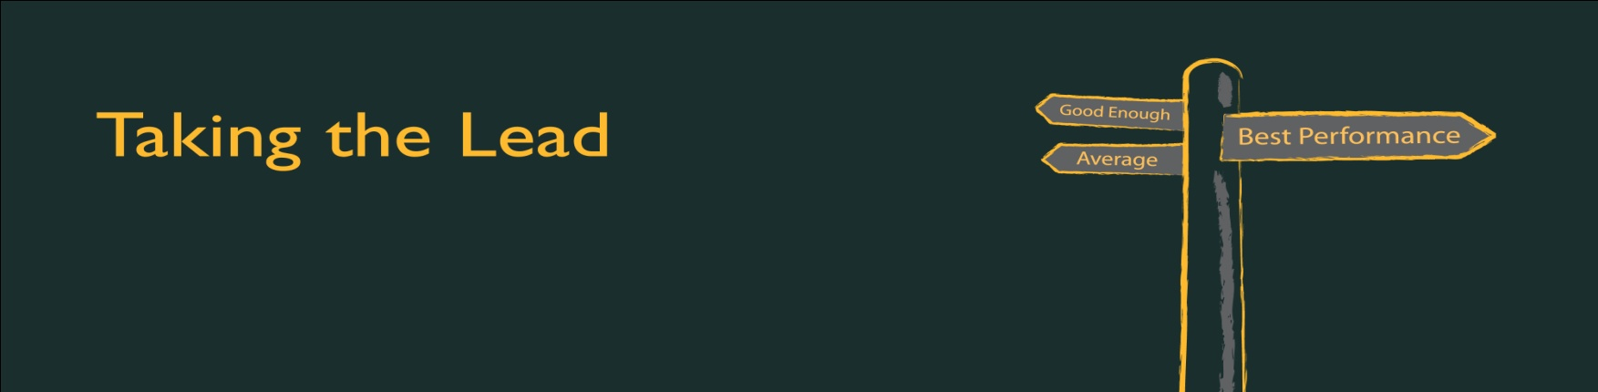

Connecting with Clients – The VISIT
Making an impact during client visits to build, deepen and sustain trusted client relationships.
September, 2017 (V.0.2)

Slide 2
Your need as we understand
The Energy & Utilities group is one of the fastest growing groups within Cognizant. One of the beliefs is that the Groups ability to manage Customer visits really well is a differentiator. This is bolstered by the feedback received from Customers /Potential Customers who regularly mention their visit as a high point regardless if the business was won or not.
Currently the champion of these customer visits is the BU head Ganesh. From the moment the customers land to the time they leave, Ganesh’s attention to detail and attention on the customer and their needs helps create a trusted environment for the visitors.
Situation
As the BU grows and hopefully more customer visits take place, Ganesh would love to see his top 30 also lead customer visits in a way that is impactful, engaging, appreciated and add to the probability of winning business. There is an opportunity for these SM / AD / Directors to develop their impact and ability to connect with clients on a deeper level. This will open up possibilities for the BU to win more business while Ganesh not having to be involved in every Customer visit from beginning to end.
Opportunity
Implication
If the current state is not bettered, then there will remain high dependency on Ganesh to connect on visits and win business. This keeps the bandwidth low in terms of this key differentiator. It also works to be a block to creating a key pipeline of leadership in this BU.
Need
You require a two workshops, of two days each, one in Chennai and one in Pune for 15 participants per workshop. In our conversations what came out clearly was that you would like to see that activities and practice in the workshop should mostly be anchored around customer visits. The ability to build rapport, work the room, attention on people, attention to detail, ownership to create the same high level experience with each customer, high sense of demeanor, looking at ourselves as an extension of the brand – are all areas that you would like to see worked upon.

Slide 3
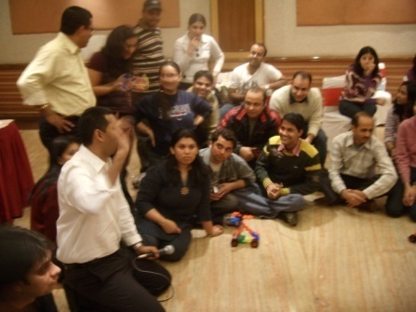
Connecting with Clients – The VISIT
Initiative Idea
How to build, deepen, extend and sustain strong client relationships during client visits
This highly experiential programme that focuses on how an individual is seen by the customer on a visits, how they see the customer and how they represent themselves with impact.. It brings the formal systems that companies use to life by putting each person’s ability to come across attractive, engage, question, listen, and envision. Through continual learning and practice, combined with insightful feedback from highly experienced MLA consultants, you emerge more realistic, yet confident about developing your client relationships as they visit more creatively.
Why are we a great fit for delivering this need?
Over 25 years, we have pioneered the use of techniques from drama therapy, experiential facilitation, performing arts, and applied them to business. So, we have some special technology for changing people’s behavior.
This mix of methodologies for us is not just exercises that create a highly engaging learning environment, it is also our source of philosophies for increasing performance. We will be using some of those techniques while working with the leaders at the Energy & Utilities BU.
Because we’ve been in business for over a quarter of a century & worked with all sorts of companies, we’re unusual in knowing how to apply these techniques strategically —that is, helping individuals understand how different clients state needs differently.

Slide 4
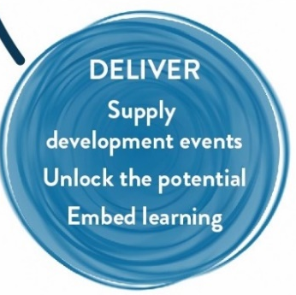
Objectives – This is our first take on Objectives based on the conversation we have had. If you think these correctly reflect your expectations, then we will start customizing the workshop.
Post the workshop participants will:
Think :
To sustain my relationship with clients, I need to be able to continuously provide them delightful experiences.
Whether I know it or not, I am constantly selling myself and need to work on my brand and impact.
I need to be proactive in planning/ preparing when customers visit.
Building personal connect & rapport with the clients is the key to long term relationship
A trusted relationship starts when I am attractive to my clients in my being & brand.
Feel:
Ownership towards making client visits successful
Present & Alive to my conversation with the customers
Willing & prepared to connect at a deeper level with the clients
Confidant to be able to communicate with purpose.
Be more able to:
Be a opportunity Seeker- What can I offer to my customer’ visit as value-add
Sustain productive working relationships with my customers
Move out of my comfort zone and take more ownership for my client
Probe better for deeper understanding of client needs.
Go beyond “the scripted” standard connects and be more comfortable & fluid

