Slide 1




Slide 2
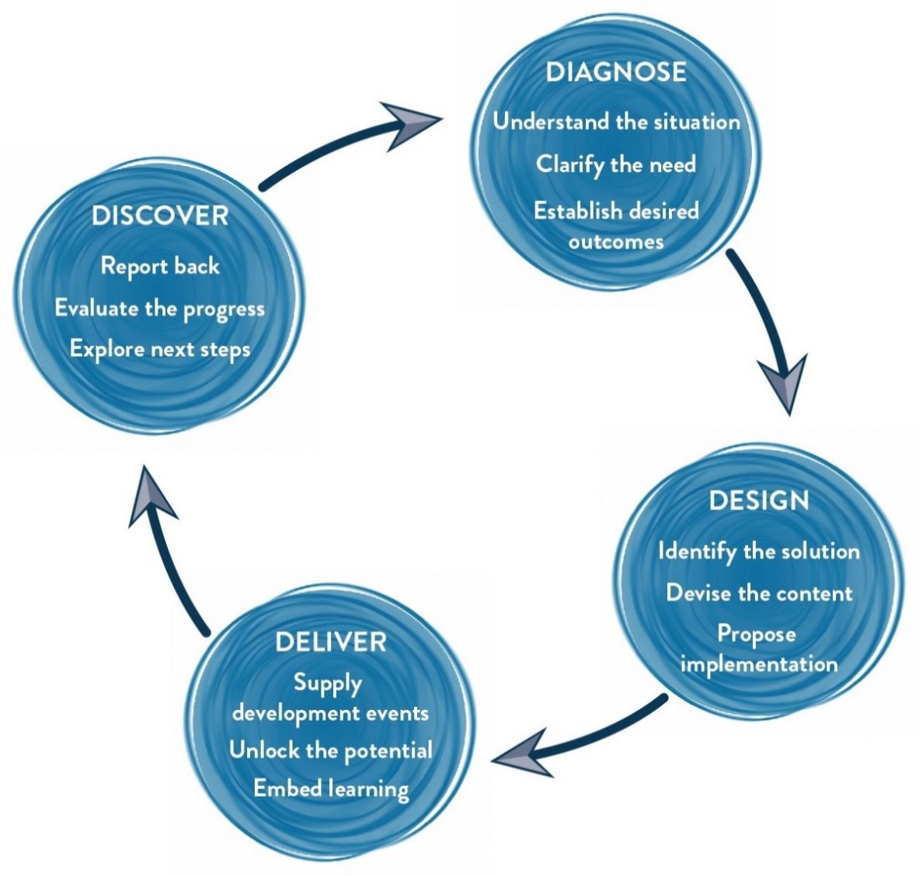
Our Approach
Methodology
We use Interactive theatrical exercises along with Psychological and L & D tools

Slide 3
Tentative Design – ACE Teams
Narrative | Session | Session details | Methodology
Getting acquainted with Maynardleigh | Introduction | Welcome and a warm up, setting the context Maynardleigh & facilitator Introduction | Theatre exercise
Starting the workshop by answering a few questions | Syndicate Exercise | An exercise to ask group of learners to withdraw to a room with flipchart papers and pens and answer the questions posed by the consultant | Trainer led activity
In the moments of stress, pressure how do we react? Do we take ownership and responsibility of our work and enact like a creator or do we start blaming and acting like a victim? | Victim V/s Chooser | Thinking positively, like a creator. One can control how he thinks about and perceive changes! The more positively the person thinks about change the more positive is his reaction to it. | Embodying a Philosophy using Psycho-Drama
Assuming positive intent in people is imperative. We create a lot of obstacles ourselves when there aren’t any. Most often it’s the inability to assume positive intent that comes in the way reaching our destination. | Spy | Teams will be competing with each other. Job is to replicate the model that has been kept in the cupboard in 15 minutes. Powerful way to uncover that we live in assumptions and our subjective reality may be guided by our perceptions. A total shake up experience for participants. | Facilitator led activity
Finalizing the 3 behaviors to be followed as a team | Trust Contract | Team democratically vote and choose the top 3 behaviors that they will live and demonstrate together for at least a year. | Summarizing the learning
 | Closure | Participants fill in their stop, start and continue sheet | Facilitator led

Slide 4
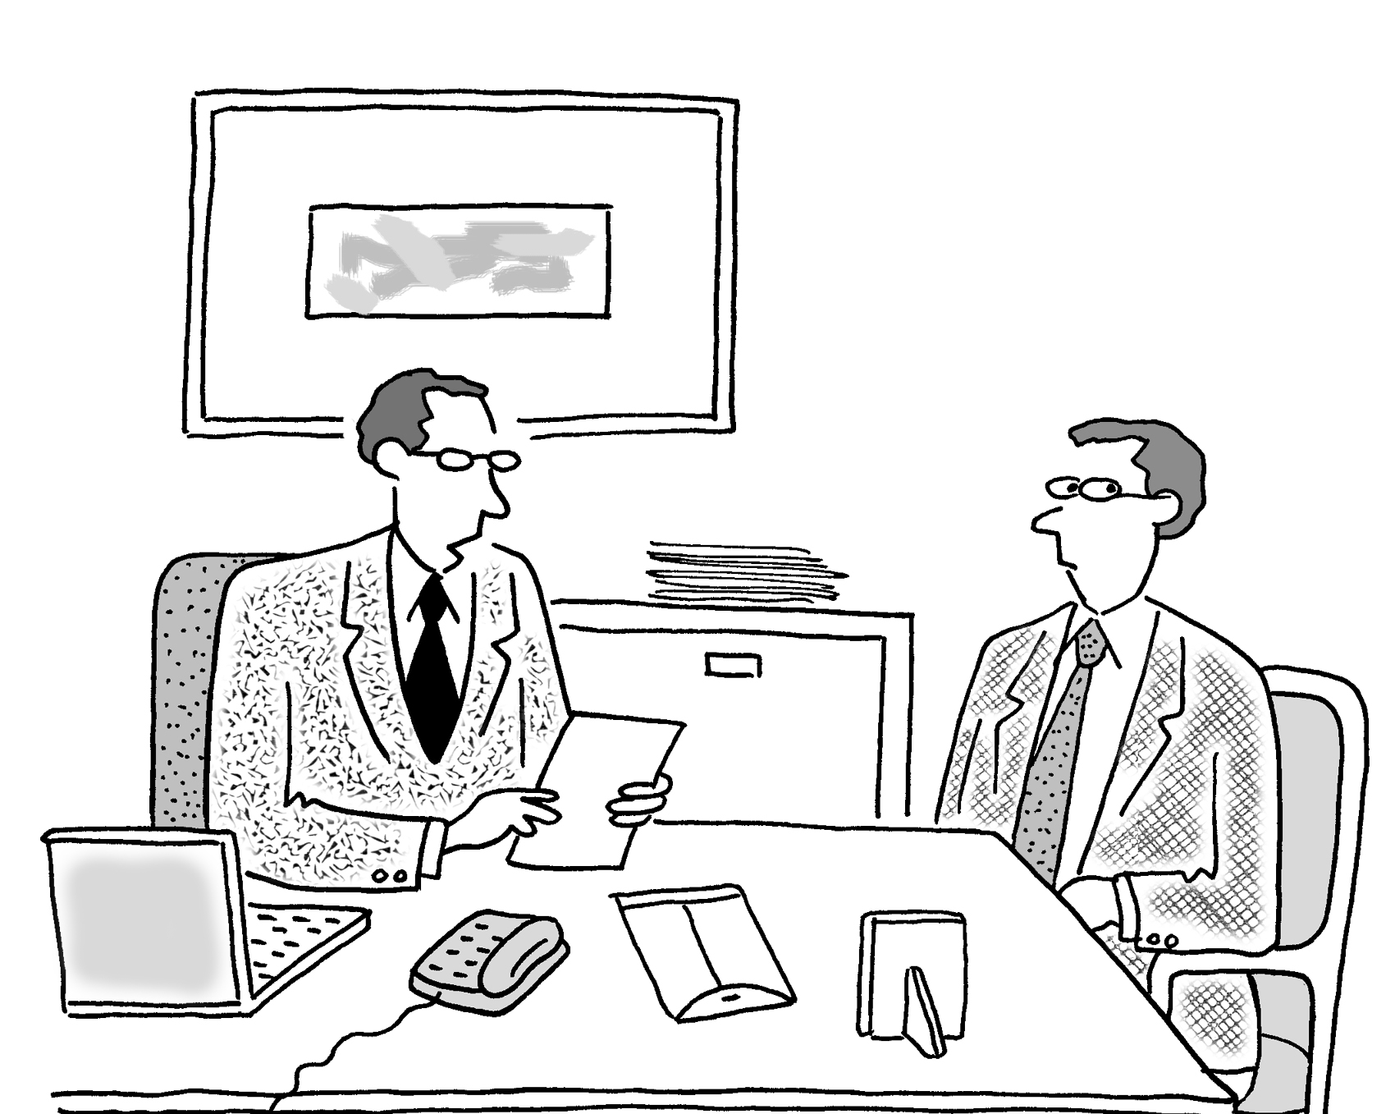
Discovery Meeting Post-Workshop
We shall hold a one to one meeting with HR stakeholders after the workshop to take feedback on the intervention and how it was received and to determine the next action steps.

Slide 5
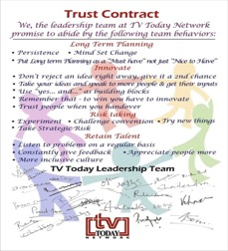

Sustaining the Change
Trust Contract
The team at MLA will ensure that the behaviours the team agrees to adhere to at the end of the event are captured in a ‘ TRUST Contract’. This contract will be provided as a soft copy that may be printed as a poster in A3 size.
Dipstick Survey
Question 1: | Do you talk 'to' people, not 'about' people?
Rating | Response
Never | 0
Rarely | 1
Sometimes | 1
Mostly | 4
Always | 4
Post this, 3 months later, the team at MLA can also design a “dipstick” survey based on the contract so the team can check how they are doing on the behaviours
5

Slide 6
Your Investment for the intervention
Diagnosis and Design |  | INR 21,000/-
Delivery
Activity | Investment | Total
Professional fee for half day delivery | INR 44,000/- per half day per consultant X 1 half day X 1 consultant | INR 44,000/-
Dipstick Survey | INR 500 per participant | Optional
Total investment |  | INR 65,000/-

Slide 7
Commercial Terms & Conditions
Client is responsible for providing venue, conference facilities, AV equipment.
Travel outside Delhi NCR - Air tickets & airport cab transfers to be taken are by the client
Maynardleigh Associates to take care of stay arrangements
Travel inside Delhi NCR - at Rs. 12.00 Per Km
Total investment not inclusive of applicable taxes (GST@ 18.00%)
A commercial contract will be signed before the execution of the project
50% of cancellation fee will be charged on any cancellation or postponements that occur within 3 to 20 working days of the confirmed date of delivery
100% of cancellation fee will be charged on any cancellation or postponements that occur within 0 to 2 working days of the confirmed date of delivery
The above commercials are valid till the 31st March, 2018
Any learning material given to the participants during the course of journey would be charged on actuals
Contracts, legal & accounting paperwork (including billing & payments) will be in the name of “Life Strategies Humancare Pvt. Ltd.”

Slide 8
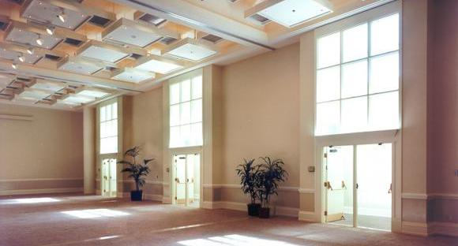
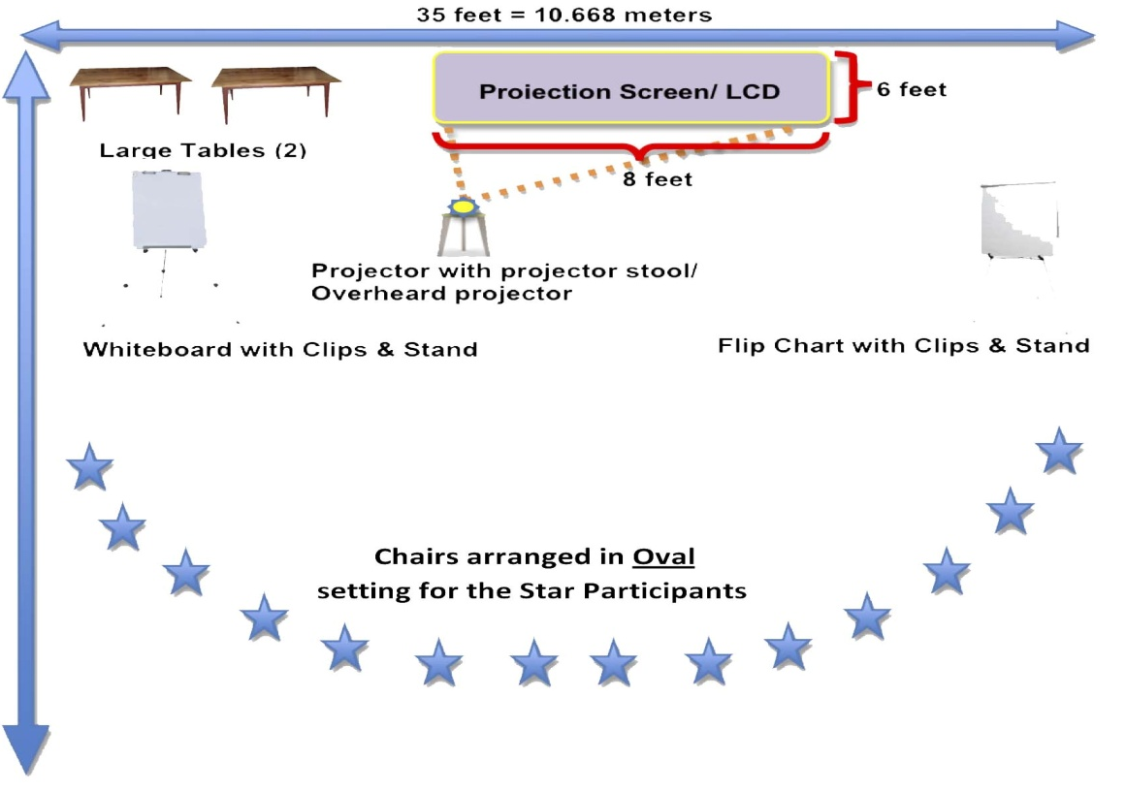
Ambience & Room Layout Required
We love alternative ways of setting up a workshop! Creating an atmosphere where the participants feel absolutely comfortable, yet challenged. In this workshop, the use of theatre, team games and experiential methodologies are essential ingredients, hence we’d require ample place to move around and make noise.
Please book a space with ample natural light (Yes, we want sunlight streaming in) and no fixed furniture for the participants to work with one Maynard Leigh consultant.

Slide 9
Things Required at the Venue
For the workshop, we will need the below mentioned:
LCD projector and projection screen
UPS Power Back-up for Laptop, LCD projector & Laptop speakers
External speakers (for laptop connectivity). The external speakers should be loud enough for music playback
White board & White board markers (2 blue, 2 black, 2 green)
Flip chart and Flip chart stand with suitable clips
Color pens (Normal sketch pens - about 30)
Notepads and pens (for participants)
Blu-Tac (This substance is used to stick things, posters or paper on the wall)
20 A4 Size normal and drawing sheets
2 tables for the consultant (one will be used for the projector and the other for keeping the handouts)

Slide 10

Next Steps
Contract and PO: Once we close on the commercials, let us begin the process to close the contracts and get the PO

Slide 11

Let’s work in partnership to create impact & unlock potential
For further information please connect with:
Contact – Jigyasa Sharma I Vivek Arora
Email - jigyasa@maynardleigh.in I Vivek@Maynardleigh.in
Telephone - +91 9717922445 I +91 9810811385

