Slide 1



Slide 2
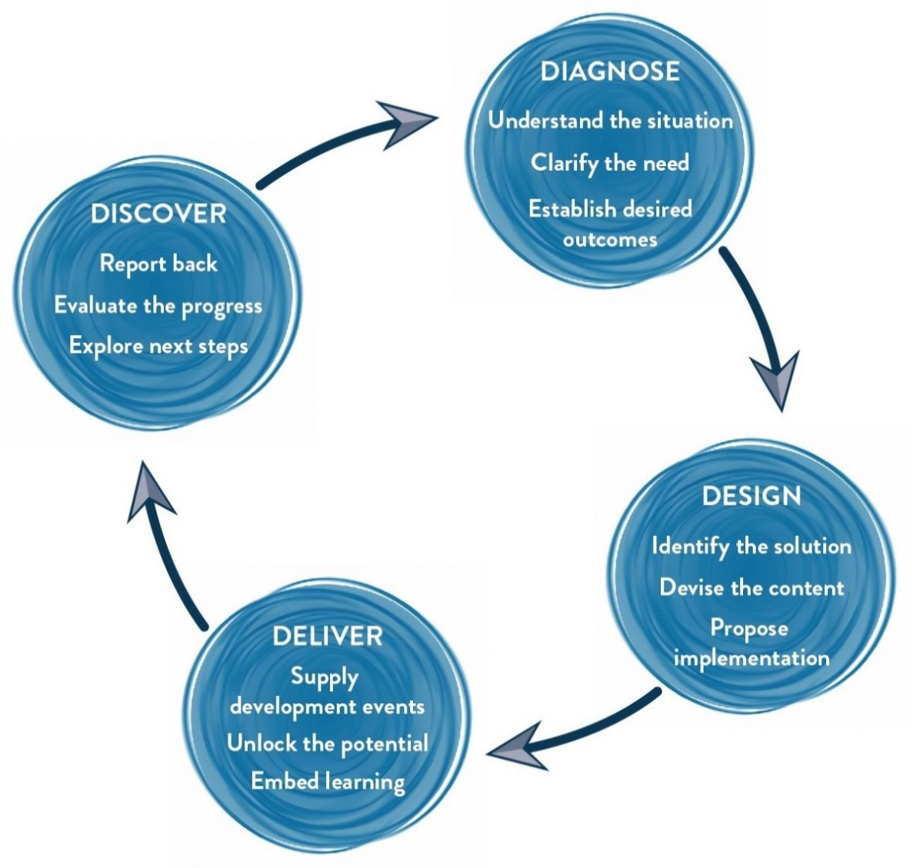
THE
APPROACH
The Methodology
We use Interactive theatrical exercises along with Psychological and L & D tools

Slide 3
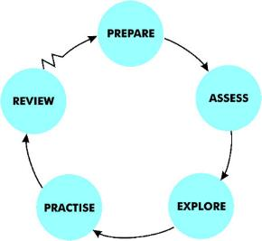
EXECUTIVE COACHING FROM
MAYNARD LEIGH’S LENS
The Maynard Leigh performance coaching experience resembles the relationship between a theatre or film director and an actor. The director’s job in rehearsal is to unlock the actor’s potential in order to deliver outstanding performance. They do this in many ways using insightful feedback, suggesting exercises, encouraging experimentation and working in a creative partnership. This is why actors will always expect to get up on their feet and try things out in the rehearsal stage of a production.
People who come to us for coaching would expect this to be the case. They would think it self-evident that a coaching session to prepare for a conference speech, for instance, would not simply be a question-based conversation, exploring barriers to high performance. No - they would expect to get on their feet and try things out – to rehearse. This is how people change their behaviour and discover new ways of doing things and expand their range and capability.
Whilst some of the session will crucially involve an in-depth conversation exploring the dimensions of the issue, its ramifications and the person’s thinking about it, it will also take the client into the realm of experience. It will explore their emotional states and expression. It will, more than likely, provide opportunities for them to experiment with alternative behaviours and rehearse anticipated situations. Whatever else, it will certainly be an experience – one that comes out of the dynamic creative partnership between the coach and the client.

Slide 4

THE
JOURNEY
01. TRIPARTITE
AGREEMENT
03. PROGRESS IT -
online goal tracking
03. ONE-ON-ONE
COACHING
SESSIONS
02. HANDSHAKE CALL

Slide 5

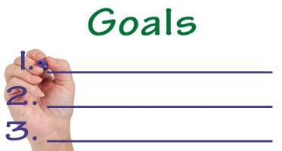
01. TRIPARTITE
AGREEMENT
This session will be conducted between the Maynard Leigh coach and stakeholder involved.
This is a 90 minute session where Priyam and Raman come together to establish 3 learning goals for the participant. These are established basis the observations from the Professional Impact journey as well as Priyam’s conversation with Raman.
These goals are firmed up and signed off to mark a start of the executive coaching journey
On basis of the 3 goals decided during the Tripartite Agreement, participant and coach work together to clearly define tangibles which would be entered in Progress IT

Slide 6
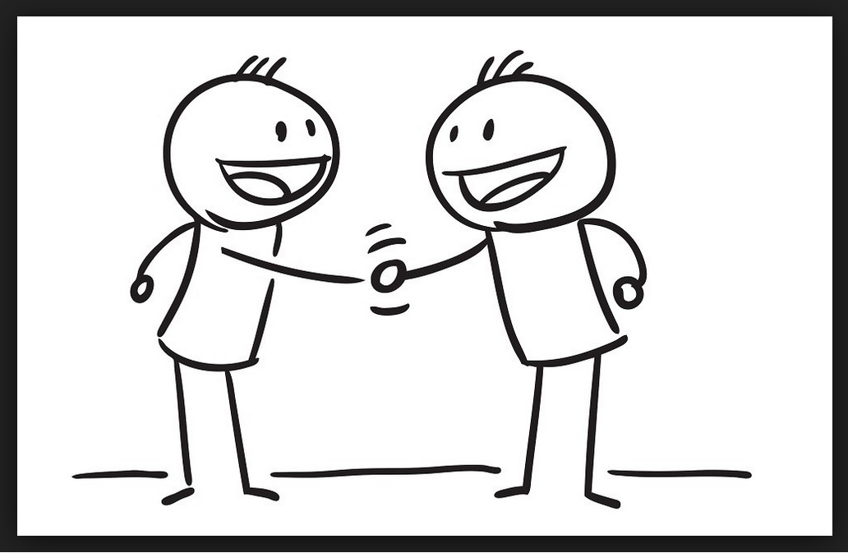
02.
HANDSHAKE CALL
Post the Tripartite Agreement session, Priyam and Adamya will connect over a brief call before the coaching journey begins.
Objectives: Introductions, sharing thoughts and feelings
Duration: 30 minutes

Slide 7
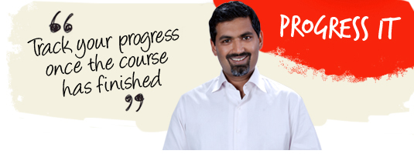
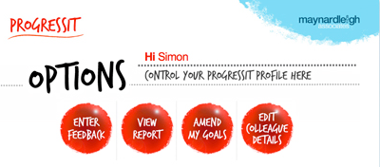
03.
PROGRESS IT
Progress IT ® is a powerful on-line support system that provides follow through after a course, a workshop or learning event. We use this innovative service to:
Finalize three goals which the participants will work on, on the basis of the bottom 3 competencies in their PI Profile.
Show line managers what their colleagues have learned and report on the business results from their new learning
Enable Human Resources departments to offer evidence of specific business gains stemming from a particular learning experience.
Assign supporters to these participants who will give feedback for a period of nine weeks.
Progress IT ® tackles these with a nine-week support service and a report at the end summarizing progress.

Slide 8
IMPLEMENTATION
DAY
04. COACHING
SESSIONS
Participant embarks on the Executive Coaching Journey. For this particular coaching partnership we suggest:
12 coaching sessions, 1 session weekly of one and a half hours each
The participant will get assignments, reading tasks and action steps to do between two sessions
He/she will also upload videos on ‘Mirror’ (explained in the next slide), the feedback of which will be discussed in these coaching sessions
The objectives, themes and scenarios of these sessions will be broadly laid out during the Tripartite Agreement using observations & anticipations relevant to the participant’s need. For example: university interviews, social interactions, etc.
These sessions will allow the coach & the executive to delve deeper into the area of development and as the sessions progress they will be better suited to practice the learning and revisit what worked & what could be better when the learnings were implemented.

Slide 9

VIDEO UPLOADS
ON MIRROR
Mirror: Reflecting Your Potential
Maynard Leigh has a cloud based feedback software that supports learners seek feedback. It is an easy, convenient and effective tool to seek inputs from a consultant at your own time!
Participants upload videos on the system while trying out the learning from their workshops and get feedback from our consultants on the same. This is a powerful tool, especially when presenting, pitching or sharing a communication with your teams.
Mirror allows for:
- Recording and sharing moment-to-moment feedback
- A play-pause facility which makes it easier to comprehend feedback
- Storing analysis for future reference

Slide 10
YOUR
INVESTMENT
Delivery
Activity | Investment
TRIPARTITE AGREEMENT | INR 10,000 per session X 1 session | INR 10,000/-
PROGRESS IT | INR 500 per participant X 1 participant | INR 500/-
ONE ON ONE COACHING SESSIONS | INR 10,000 per session X 12 sessions | INR 1,20,000/-
Total investment ( approx.) |  | INR 1,30,500/-

Slide 11
COMMERCIAL
T&C
Not inclusive of applicable taxes (GST @18%).
A commercial contract will be signed before the execution of the project.
50% of cancellation fee will be charged on any cancellation or postponements that occur within 3 to 20 working days of the confirmed date of delivery.
100% of cancellation fee will be charged on any cancellation or postponements that occur within 0 to 2 working days of the confirmed date of delivery.
The above commercials are valid till the 31st March 2019
Contracts, legal & accounting paperwork (including billing & payments) will be in the name of “Life Strategies Humancare Pvt. Ltd.”

Slide 12
PROPOSED
TIMELINE
Session | Date | Time | Location | Participants | Status
Meeting with the Stakeholder | 8th May | 10 AM - 11:30 AM | MLA Office | Priyam & Raman
Handshake Call with Adamya | 9th May | 10 AM - 10:30 AM | On Call | Priyam & Adamya
Session 1 | 15th May | 10 AM - 11:30 AM | MLA Office | Priyam & Adamya
Session 2 | 21st May | 10 AM - 11:30 AM | MLA Office | Priyam & Adamya
Session 3 | 29th May | 10 AM - 11:30 AM | MLA Office | Priyam & Adamya
Session 4 | 4th June | 10 AM - 11:30 AM | MLA Office | Priyam & Adamya
Session 5 | 11th June | 10 AM - 11:30 AM | MLA Office | Priyam & Adamya
Session 6 | 18th June | 10 AM - 11:30 AM | MLA Office | Priyam & Adamya
Session 7 | 25th June | 10 AM - 11:30 AM | MLA Office | Priyam & Adamya
Session 8 | 2nd July | 10 AM - 11:30 AM | MLA Office | Priyam & Adamya
Session 9 | 9th July | 10 AM - 11:30 AM | MLA Office | Priyam & Adamya
Session 10 | 16th July | 10 AM - 11:30 AM | MLA Office | Priyam & Adamya
Session 11 | 23rd July | 10 AM - 11:30 AM | MLA Office | Priyam & Adamya
Session 12 | 30th July | 10 AM - 11:30 AM | MLA Office | Priyam & Adamya

Slide 13

IMPLEMENTATION
DAY
Get in touch:
Contact:
Email:
Telephone:
Jigyasa Sharma | Vivek Arora
jigyasa@maynardleigh.in | vivek@maynardleigh.in
+91 9717922445 | +91 9810811385

