Slide 1


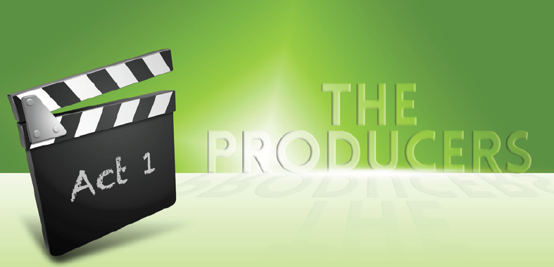
Handling work pressure, getting work life balance, managing complaints
Approach note- 20th December 2017

Slide 2
Index
Title | Page Number
Your Need As We Understand | 3
Why Maynardleigh? | 4
Our Approach | 5
Diagnosis | 6
Design | 7
Learning Outcomes of the Workshop- The producers | 8
Learning Outcomes of the Workshop- ACE teams | 9
Tentative workshop design- ACE Teams | 10-12
Room Layout & Things Required | 13-14
Commercial Investment- The producers | 15
Commercial Investment- ACE Teams | 16
Terms and Conditions | 17
Next Steps | 18

Slide 3
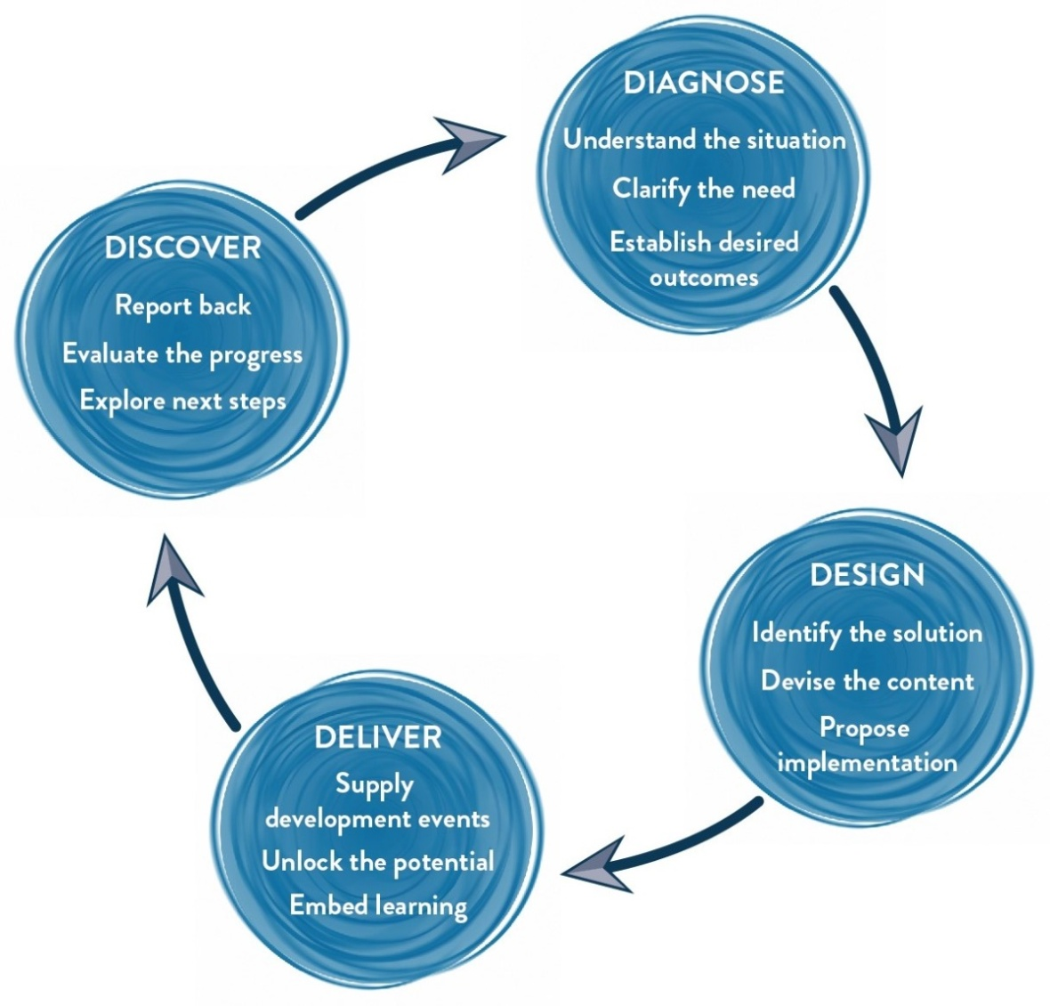
Our Approach
Methodology
We use Interactive theatrical exercises along with Psychological and L & D tools

Slide 4

Diagnosis
We would be getting on a call with Rubi to understand the target audience, their current state, gather a couple of examples on the objectives provided by them. Then we delve deeper into the issues faced by the business and the participants:
We would want to connect with a sample of the target participants, the HR stakeholders and business stakeholder to collect information about the business, objectives, possible gaps, and expectations from the lens of this population.
This shall be done in person or phone calls and our curiosity shall be the following:
From the participants:
Their work flow and job responsibilities
Perspective on the current state: work pressure, handling complaints and feeling of a thankless job
Understanding from them their expectations looking at the current state
According to them, what would help build their work life balance? Why are they not able to do it now?
Gathering examples around feeling like a punching bag and thankless job
From the business stakeholder/managers
Their point of view on the current state
Their Expectations from the workshop
For them as leaders, what would they like to see happen for the target audience
Gathering examples around the mandate
HR Partner: ( 30 minute conversation)
Getting brief on the participants
Getting their point of view on the situation
Org structure of the team
Any important documentation around the mandate

Slide 5

Design
Post the diagnosis, we get into the design phase of the learning intervention.
Here are 3 things we will do:
Diagnosis report: A report is generated which would reflect the outputs from Diagnosis (The identity of the participants would be confidential).
Design Customization: The consultant will design the final objectives and customize the content of the learning intervention. Modules of the workshops are designed, activities are mapped to the examples, new handouts are drafted based on the content.

Slide 6

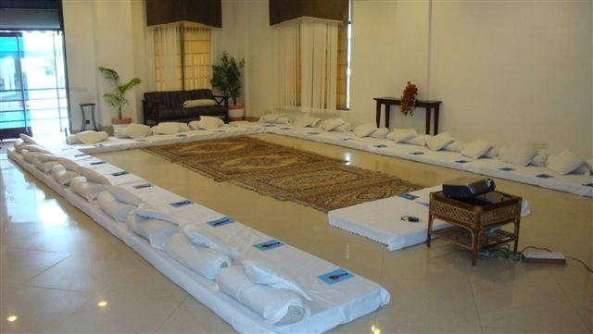
Room layout
The Setting
We love alternative ways of setting up a workshop! Creating an atmosphere where the participants feels absolutely comfortable and yet challenged. In this workshop, the use of theatre, team games and experiential methodologies are essential ingredients, hence we’d require ample place to move around and make noise.
Please book a space with ample natural light (Yes, we want sunlight streaming in) and no fixed furniture for the participants to work with one Maynard Leigh consultant.

Slide 7





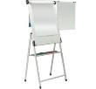


Things required at the venue
For the workshop, we will need the below mentioned:
LCD projector and projection screen
UPS Power Back-up for Laptop, LCD projector & Laptop speakers
External speakers (for laptop connectivity). The external speakers should be loud
enough to play music for the team.
White board & White board markers (2 blue, 2 black, 2 green)
Flip chart and Flip chart stand with suitable clips
Colour pens (Normal sketch pens - about 50)
Notepads and pens (for participants)
Blu Tac (This substance is used to stick things, posters or paper on the wall)
50 A4 Size normal and drawing sheets
2 tables for the consultant( one will be used for the projector and the other for keeping the handouts)

Slide 8
Your Investment- The producers
Diagnose & Design (For the whole Intervention) – ONE TIME COST
One Day Diagnostic Interviews One day Design ( creating report, customizing design, presentation of design) | INR 65,000 INR 65,000
Delivery (for 40 participants)
Activity | Investment
Professional fee for delivery of two day The Producers workshop Learning Material certificates and folders | INR 65,000 per day per consultant X 2 days X 2 consultant INR 150 per participant X 40 participants | INR 2,60,000 /- INR 6,000 /-
Total Investment for journey covering 40 participants |  | INR 3,96,000/-

Slide 9
Commercial terms and conditions
Client is responsible for providing venue, conference facilities, AV equipment.
Travel outside Delhi NCR - Air, stay & airport/ venue cab transfers to be taken care by the client.
Travel inside Delhi NCR - at Rs. 12.00 Per Km.
Not inclusive of applicable taxes (GST@ 18%)
A commercial contract will be signed before the execution of the project.
50% of cancellation fee will be charged on any cancellation or postponements that occur within 20 working days of the confirmed date of delivery.
100% of cancellation fee will be charged on any cancellation or postponements that occur within 0 to 2 working days of the confirmed date of delivery.
The above commercials are valid till the 31st March, 2018
Contracts, legal & accounting paperwork (including billing & payments) will be in the name of “Life Strategies Humancare Pvt. Ltd.”

Slide 10
Program Timeline
Sr. No. | Activity Description | Brief description | Date | Ownership
1 | Diagnosis & Design | Tentative diagnosis schedule to be shared by MLA | 5th January 2018 | Maynardleigh Team
 |  | Confirmed diagnosis schedule to be shared by Maxlife | 15th January
 |  | Full Day Diagnosis | 18th January
 |  | Full Day Design | 19th Janaury
2 | Full Day Workshop | Logistics Mail for workshop arrangements (including participants list outline structure) will be sent by MLA | 10th January | Maynardleigh Team
 |  | Logistics Confirmation mail will be shared by Maxlife | 29th January | Maxlife
 |  | Delivery Date | 9th & 10th February | Maynardleigh Team & Maxlife

Slide 11

Next Steps
Contracting and PO: Once we close on the commercials, let us begin the PO process
Call/ meeting set up: We need to meet Rubi to understand the current state and get clarity on the mandate
Book: Let us block the dates for the Diagnosis and Design right away so that we have consultants available for you. Also please share a confirmation on the date of delivery

Slide 12

Let’s work in partnership to create impact & unlock potential
For further information please connect with:
Contact Jigyasa Sharma
Email jigyasa@maynardleigh.in
Telephone +91 9717922445

