Slide 1



An Expresso session on EXECUTIVE PRESENCE
Increasing our ability to make an impact by looking at our internal & external reality
Approach note- 17th October 2017

Slide 2
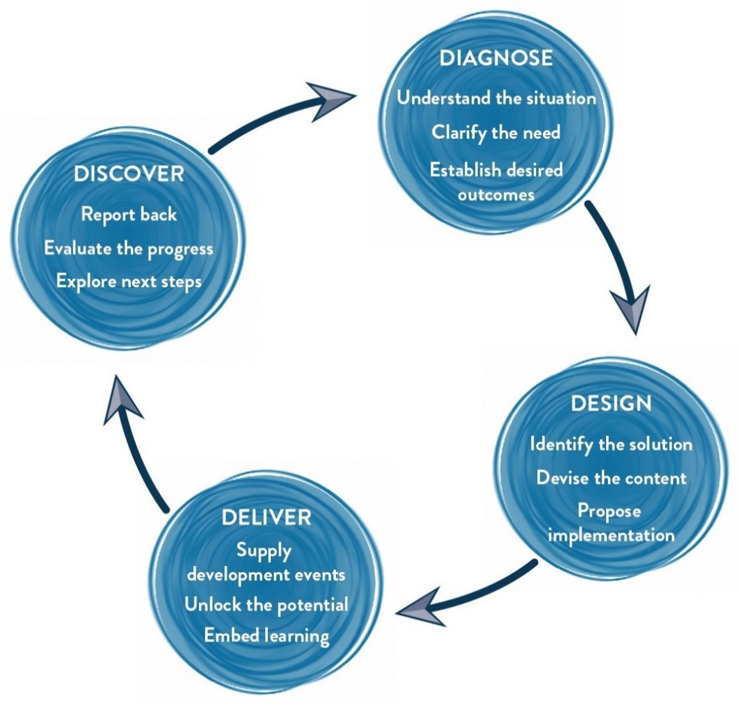
Our Approach
Methodology
We use Interactive theatrical exercises along with Psychological and L & D tools

Slide 3
Tentative Learning Outcomes of the Workshop
Think
I now understand the importance of executive presence
By clarifying the impact I want to have, I have more chance of meeting it
I will use my personal impact be more inspirational and influential.
Feel:
Confident in leading conversations
Emotionally intelligent to communicate what I feel
Be more able to:
Convey gravitas and natural authority
Convey quality in their personal message
Create personal chemistry and rapport
Build relationships with Clients, seniors and peers

Slide 4
Tentative Design ( 2.5 hours with 60 people per consultant)
Session | Session Details | Methodology | Outcome
Hello and introduction | Welcome and theatrical warm up | Facilitator Led | Participants and MLA consultants get acquainted with each other
Party Mingling | Participants move around having conversations around what is Personal Impact and what it means to them. | Experiential | Getting Comfortable, understanding the scope of PI
Brief Encounters | A series of questions are asked which participants share the answer in pairs. An “informal looking” discussion to touch upon the aspects of the workshop. | Group Exercise | Building a dynamic learning environment by asking a series of questions leading to introspection
Context setting | Facilitator sets the context of the workshop and creates buy in from the participants for the session | Facilitator led | Creating buy in from the participants around the workshop
AIM | Clarifying objectives.What is the purpose of any communication?What would a positive outcome look like? Working with purpose and performance objectives. Structuring communication for Impact | Facilitator led, Participant exercises. | Be Precise and Impactful in delivering message. Structure Communication .
Emotional Expression | The importance of being able to emotionally express ourselves & convey a message appropriately | Participants in pairs expressing around 20 - 25 emotional statements (based on sad, glad, mad & afraid). | Being able to identify the emotions they lack/or not able to express comfortably.
Finding Commonalities | Mirroring and developing sensitivity to others, Developing empathy, Understanding the other person. | Facilitator psychodrama Participant exercises | Building rapport with stakeholders
Choosing Goals & Closing | •Participants finalize what they will START doing, STOP doing & CONTINUE doing. •Finalizing the Goals to work on. •Goodbyes | Finalizing goals that each participant would work on.

Slide 5
Your Investment
Delivery (for 60 participants)
Activity | Investment
Professional Fee for delivery of workshop Learning Materials: folder, handouts | INR 75,000 per consultant per day X 1 Day X 1 Consultant INR 100 X 60 | INR 75,000/- INR 6,000
Total Investment to cover 60 participants |  | INR 81,000/-

Slide 6
Commercial Terms & Conditions
Client is responsible for providing venue, conference facilities, AV equipment.
Travel outside Delhi NCR - Air, stay & airport/ venue cab transfers to be taken care by the client.
Travel inside Delhi NCR - at Rs. 12.00 Per Km.
Not inclusive of applicable taxes (GST)
A commercial contract will be signed before the execution of the project.
50% of cancellation fee will be charged on any cancellation or postponements that occur within 3 to 20 working days of the confirmed date of delivery.
100% of cancellation fee will be charged on any cancellation or postponements that occur within 0 to 2 working days of the confirmed date of delivery.
The above commercials are valid till the 31st March, 2018
Contracts, legal & accounting paperwork (including billing & payments) will be in the name of “Life Strategies Humancare Pvt. Ltd.”

Slide 7

Next Steps
Vendor Empanelment: Since this is the first time we are working for you, let us start the process of vendor empanelment for smooth processing
GST information: to expedite the commercial contract and PO, we would require the GST information
Travel: since this workshop would be held on the 25th of October, we would need to arrange for the consultant’s travel. Kindly confirm if we can book the air tickets

