Slide 1

Line Managers’ Journey – Day Two
Shake up – wake up!

Slide 2
Your Mandate
Situation:
HSBC is conducting a 3 days workshop for its line managers, covering 315 line manager of GCB 5 AND 6 level. You’ve invited Maynardleigh to partner on the second day of this intervention to cover:
People Management
Stakeholder Management
Communication
Problem:
While you’ve created a deck detailing some of the behaviours you want us to work on, Etienne and Supriya have helped us with some specific examples to identify areas to focus. Some are-
Taking Ownership,
Handling difficult conversations.
Building trust.
Communicating effectively to give the message rather than just information
Implication:
The gaps in managing people, performance, feedback and effective communication may result in people loosing accountability and trust.
Need:
You want us to deliver a high impact, shake-up, on the feet experiential workshop that leads to better people management, stakeholder management and effective communication and feedback.

Slide 3
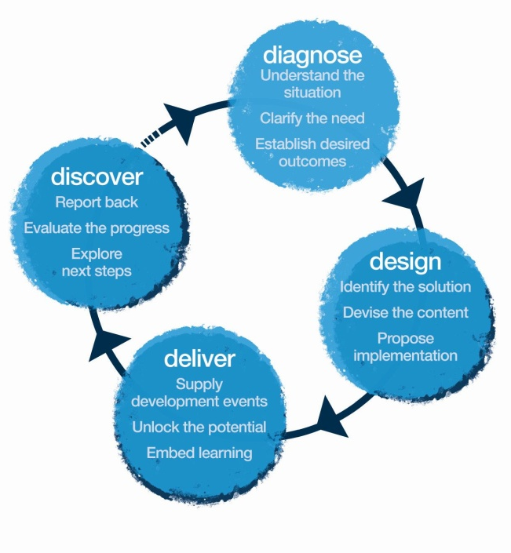
Our Approach
Methodology
We use Interactive theatrical exercises along with Psychological and L & D tools

Slide 4
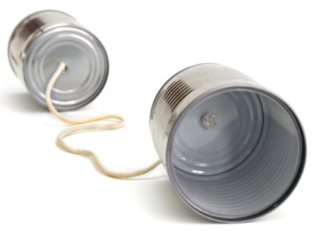
Diagnostics
We spent a day talking to the L&D team, target participants, supervisors, and direct reportees.
We specifically gathered information on-
The current state of people management
The current state of feedback mechanisms
The current state of coaching
Leadership identities
b) We also spent time with Anand and Paritosh to align on the content.

Slide 5
Sample Verbatims – Leadership Identity
Learning and Development Team
There is a lot of hard work, however, people need to develop better leadership styles.
GCB 4
The focus is on maximising entitlements. These expectations are not supported by their outcomes.
DRs need to be able to see their leaders walking the talk.
People are not treated as emotional creatures, but as commodities that can just be moved around.
People manage how they were managed
We are going through a transformation, and there are very few contributing to it. That requires courage, and courage is lacking. People are only focused on their work.

Slide 6
Sample Verbatims – Stakeholder Management
Learning and Development Team
Once work is delegated, ownership is often abdicated.
GCB 4
I know someone who has been an AVP for 3-4 years and still doesn’t consider him/herself as a people manager.
Target Audience
Direct Reportees
Messages are passed on to DRs without complete internalisation – so messages reach people half baked and without a clear purpose.
There is a lack of solution orientation.
Skill sets of those reporting to me is a huge challenge.
I don’t have a real people manger. My manager handles a different team.
Messages are not cascaded down to GCB 7 & 8. There are too many gaps. AVPs are unable to communicate the bigger picture to their teams.
People don’t listen. Keep speaking for a large chunk of the meeting team without realising that no one else has had space to talk.
People are often extremely deferential to those they report to.
People are promoted to be line managers, however, they keep working in the same way.
I did not feel welcomed when I joined. Didn’t even have a desk.

Slide 7
Sample Verbatims - Feedback
Learning and Development Team
Difficult conversations are avoided. Especially those about performance management. Reasons for bad ratings are instead blamed on the HR or Management.
GCB 4
Difficult conversations are always sugar coated. Everyone wants to play safe.
Target Audience
Direct Reportees
On a 4 point scale, they hesitate to mark people as developing or unacceptable.
Lack insight, and are thus unable to foresee situations that are already simmering.
People don’t ask the right questions. Everyone just jumps into solution mode.
People keep referring to the past. How will we move forward if we keep talking about the past?
There is a lot of negativity. There is a lot of gossip.
Everything depends on how friendly you are with your senior. My promotion has been skipped for the second time because my manager wanted to promote those who were close to him/her.
Even when I want to give feedback I don’t give it negatively. I have received feedback that I am very harsh.
People are so deferential. You only give feedback to those who report to you. Never to your boss. The boss is still king.
Nobody asks for feedback. No one gives it either. It’s a huge problem.
Negative feedback is interpreted as low rating
There is no real feedback.
I don’t give feedback. I keep things to myself and then escalate.

Slide 8
Sample Verbatims - Coaching
Learning and Development Team
There is a need for a realisation that there are emotions attached to the people that they are working with. They need to be able to see from their DRs’ perspective.
GCB 4
I coach on many things, we have a mentor-mentee system working on business writing, articulation and presentation skills.
Target Audience
Direct Reportees
People management often seems to be the last priority for the line managers. Perhaps because the metrics don’t focus on people management.
I am coaching people in my team extremely passionately. It’s my succession planning. However, I struggle with time.
I don’t have a developmental plan.

Slide 9
Inferences
Stakeholder Management
The most stark observation was that only one out of all the target participants and even GCB 4 level interviewees, no one mentioned their reportees as their stakeholders.
Giving Feedback
Only two interviewees said they give and/or receive regular feedback. Even these two people said they don’t follow a structure.
Coaching
There is advice mode of coaching.
Coaching is also widely confused as technical training.
Leadership Identity
This seems to be the biggest gap. They target audience needs to first of all recognize and accept themselves as leaders.

Slide 10

Think
“It is possible to develop a wide spectrum of colours in our leadership styles palette. We all have all the colours, it’s just a matter of unlocking them.”
“I have a responsibility towards my team”
“If I don’t set a culture of accountability I will not be able to manage.”
“I must change some of my patterns of behaviour to grow as a leader”
“Communication is not repeating or forwarding”.
Feel:
Ready to use my whole being to create more impact in communication.
Challenged to ask when I don’t know
Ready to own up to my word
I am aligned to my audience needs
Transparency is the key.
Be able to:
Handle difficult conversations.
Create a culture where there is permission to fail.
Motivate my team.
Ask, if I am not sure.
Create a culture of transparency.

Slide 11
 | Narrative | Session | Methodology | Outcome
Session 1 9.30 -11.00 | Let’s get to know each other a little better. Why are we here? | Brief Encounters, | Theatrical Warm Up Context Setting | To bring everyone into a state of play and become learning ready
 | We have all the leadership traits within us, today is about accessing new areas, | Leadership Moments | Group Activity | It is possible to develop a wide spectrum of colours in our leadership styles palette. We all have all the colours, it’s just a matter of unlocking them as apart from yourself you have a responsibility towards your team.
 | Let’s pause and check what are DNA says about our ability to lead people and way we communicate. (It’s an experience that really shakes people up into self realisation.) | Communication DNA | A wake up-shake up game! | We have set patterns of leadership behaviors- some functional, some dysfunctional. The need is for us to be flexible to adapt to different situations, people and change.
Session 2 11.15-1.00 | A leader accepts, seeks, and creates from opportunities. Thinking positively like a creator can control how a leader thinks about and perceive changes! The more positively the person thinks about change the future holds, the more positive is his reaction to it and the more comfortable is that leader in percolating down that change to its team and manage all stakeholders | Victim & Chooser | Interactive theatre, Role Plays | Proactive behavior being ready with the solutions. A prime competency required of leaders for stakeholder management

Slide 12
 | Narrative | Session | Methodology | Outcome
Session 3 2.00 –3.30 | Are we owning up to the way our messages land on people? How do we work in our teams? How we communicate verbally and non verbally- and what’s the impact? Why constant, factual and developmental feedback is essential. A culture of permission to fail cannot spawn results without creating a culture of accountability. What are your non-negotiables. | Skip Game | A game that reveals your patterns of dealing with mistakes. | It is imperative to create a culture where there is permission to fail. The activity also brings out the natural feedback pattern of the leader and provides good opportunity for them to communicate effectively to manage the team. If you don’t set accountability you cannot manage
 | Giving constructive feedback. + victim chooser: Let’s practice giving feedback. | Handling Difficult Conversations- Feedback Formula | Role Play | Learn how to handle difficult conversations. You need to use your whole being in my communication to create effectiveness in your feedback. Communicating is not repeating or forwarding. You need to explain in words your audience understands
Session 4 3.45-5.30 | . Feedback is only the beginning of the process. Situational leadership requires the ability to spot the need for motivating our people and coach them to grow on the basis of their skill and will levels. Let’s practice coaching. | Coaching | Role Plays (coaching) | If you don’t know, ask. You have a responsibility towards your team, keep their motivation up.

Slide 13
Synergies with Day One
Change Curve
You can only move on the change curve by being a chooser.
Change requires active intervention – feedback!
Power Vs Influence
Influencing through engaging audiences.
It is more often than not about being able to create a buy-in from our stakeholders rather than the hierarchies that make great leaders.
Trust
Attention on building relationships is absolutely crucial to build trust.
Consistency demands a certain degree of objectivity – begin feedback with facts.
The ability to move between the functional parent, the functional child, and the adult is imperative to situational leadership, feedback, as well as stakeholder managements. We must have all the colours!
Transactional Analysis

Slide 14
Your Investment for the intervention
Diagnose & Design Consulting for Diagnosis & Design (Includes customization and design charges for the whole intervention) One Day- Interviews and Customization for Krakow | Rs. 65,000/- Rs. 65,000/-
Delivery (One consultant per 20 participants) Professional Fee for delivery of workshop in India Professional Fee for Delivery of workshop in Krakow | Rs. 65,000 Per Day per consultant X 1 Day * 5 consultant * 4 workshops Rs. 2,25,000 Per day per consultant X 2 Consultants X 1 workshop
Terms and Conditions
Client is responsible for providing venue, conference facilities, AV equipment.
Travel outside Delhi NCR - Air, stay & airport, Visas Processing, venue cab transfers to be taken care by the client.
Travel inside Delhi NCR - at Rs. 12.00 Per Km.
Not inclusive of applicable taxes (service tax @ 15.00%).
A commercial contract will be signed before the execution of the project.
50% of cancellation fee will be charged on any cancellation or postponements that occur within 3 to 20 working days of the confirmed date of delivery.
100% of cancellation fee will be charged on any cancellation or postponements that occur within 0 to 2 working days of the confirmed date of delivery.
The above commercials are valid till the 31st December, 2017
Contracts, legal & accounting paperwork (including billing & payments) will be in the name of “Life Strategies Humancare Pvt. Ltd.”

Slide 15
