Slide 1




Slide 2
Index
Title | Page Number
Your Need As We Understand | 3
Proposed Solution | 4
Our Approach | 5 – 7
Rolling Out – The Learning Journey | 8 – 15
Commercials | 16
Terms & Conditions | 17
Room Layout Required | 18
Things Required at the Venue | 19

Slide 3
Your Need As We Understand
The participants’ profile consists of 10 – 12 professionals of Level 1 & 2 i.e. at the AGM/GM/VP/P positions, who head clusters with 15-20 reportees. The average age of the target audience is between 35-43 years with a professional experience range of 10-18 years. Most of them are post graduates in role-specific technical functions with 40% of them being civil/mechanical engineers. While these leaders are technically proficient, their current state in skills of public speaking and effective communication needs improvement.
Situation
On the basis observation and feedback from senior leaders, issues being faced by the target audience are:
Lack of impactful communication
Nervousness while addressing internal stakeholders and vendors
Absence of assertiveness
Paucity of confidence in social gatherings and groups
Problem
If the above mentioned issues are not looked into, the following implications might arise:
Low morale of participants
Impact on company growth
Possibilities of slow career growth
Under-utilization of resources and bandwidth
Implication
Need
Lodha Group wants Maynard Leigh to provide them with a solution to help address these areas of concern. The learning intervention should be one-day long and focus on improving their communication skills with a focus on their executive presence.

Slide 4
Proposed Solution – Personal Impact Workshop
The current scenario demands engaging the participants in a workshop that shall help unlock their potential and address the problem areas that have been discovered. We thus recommend a 2 day personal impact workshop during which the participants can hope to learn the following:
Handle Nerves: Become better equipped to handle group/public situations
Build Confidence: Convey your ideas with conviction and quality
Effective Communication: Be able to deliver clearly and concisely and hold effective meetings
Personal Effectiveness: Understand how to best use your own communication style
Be Assertive: Create personal rapport and end encounters positively

Slide 5
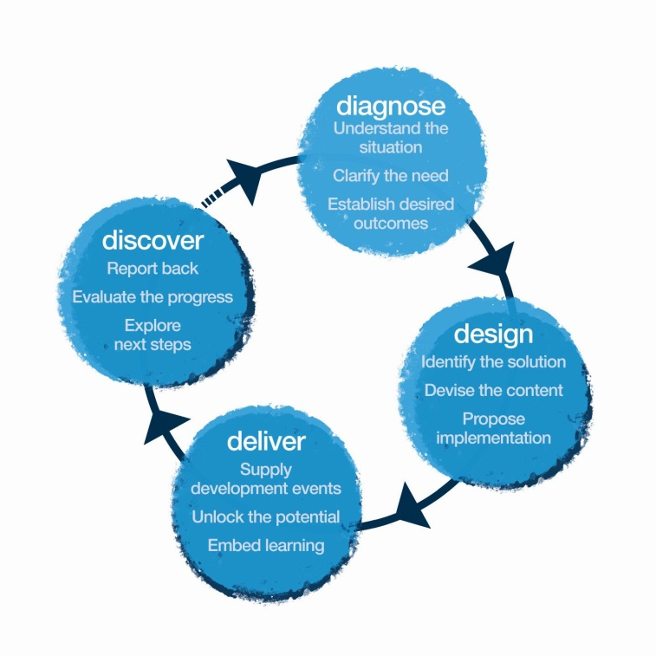
Our Approach – The 4D Model
We would start with a further diagnostic conversation with different participants in your organization . We may also run an online profile to gauge the feedback for individuals to then design experiences delivered using theatre methodologies in the workshop along the lines indicated in this proposal.
The experience for the leaders would be delivered by an experienced MaynardLeigh facilitator. We pride in creating unique experiences which would help the team connect back to their behaviour's at work and otherwise.
We would recommend a discovery meeting with you after the workshop has been completed in order to get feedback on the themes and issues that were uncovered.

Slide 6
Our Approach – The 4D Model – Diagnose
Diagnose
We would want to spend time to undertake some pre-work in conversing with the participants, which would enable us to customize the solution for your exact needs:
Requirements:
Telephonic conversation with a minimum of 3 participants – half hour sessions each
Telephonic conversation with at least 1 group leader (Level 1B) – half an hour session
Our Curiosity:
Current State - what’s working, areas of strengths, challenges, etc.
Current scenarios of their interactions with the stakeholders, customers/vendors
Gather anecdotes, examples & situations relevant for the workshop
Get to know their work flow and day to day responsibilities

Slide 7
Our Approach – The 4D Model – Design
Design
Post the diagnosis we shall get into designing a customized delivery solution for your participants and we shall aim to provide the following 2 things:
Diagnosis report: A report is generated which would reflect the outputs from Diagnosis (The identity of the participants would be confidential).
Design Customization: The consultant will design the final objectives and customize the content of the learning intervention. Modules of the workshops are designed, activities are mapped to the examples, new handouts are drafted based on the content.

Slide 8
Rolling Out – The Personal Impact Journey
Progress IT- The 9 Week Goal Tracking System
One to One Coaching Call
Attend The 2-day Personal Impact Workshop
1
2
3

Slide 9



At the end of the journey participants should…
Think:
People notice my impact, no matter when & where I am
I know what I need to work upon in my interactions and how to overcome nervousness
I am making an impact at every moment- consciously and unconsciously
Everything makes an impact- my dress, entrance, body language, voice
Every interaction/presentation is a moment of impact & I will make them count
Feel:
Comfortable with interacting in social situations
More aware & assured about themselves
More present and engaged during meetings
Equal while interacting with my stakeholders
Be more able to:
Handle group/public situations
Articulate messages concisely and with conviction
Assert my reasoning for the actions that I shall undertake
Communicate by developing my own personal style
Gain buy-in and create impact through increased personal charisma

Slide 10
Personal Impact Journey – The Workshop – Day 1
1
Time | Session | Session Details | Methodology | Outcome
9:30-9:45 | WELCOME AND CONTEXT SETTING | What’s the PURPOSE of Personal Impact Introduction of Maynard Leigh Associates Getting playful and mingling – Move, clap etc. | Trainer Led | Introduction to course Context Warm Up- Building Energy
9:45 – 10 | Entrances | The entrance can create a Personal Impact! An assessment of the instant judgements people make about us. | Get up & do activity. | What governs how people see us?
10-10:30 | First Impressions | How individuals want to be seen? How they fear they are seen? Appearance, posture, stature, speech, image and style. | Participant Sharing with the leader | Self Awareness on their first Impressions
TEA BREAK 10:30 – 10:45am
10:45 – 11:15am | Personal Branding & Impact Introductions | Creating a Personal Brand. Personal image gets portrayed inside out. Re-doing the entrances and introductions to create specific Personal Impacts. | Group Discussion | Be aware of one’s personal brand
11:15 – 12:00pm | ON-OFF Modes | ON = When you know you’re being seen and having to represent your personal brand. OF = Those unguarded moments when you are being watched and you’re not aware of it. | Leader & participants offer insight | Awareness of what works and what needs Improvement People notice the impact everywhere
12: 00 – 12:30pm | Style Audit | Impact comes from Care, Flair and Aware Care = Demonstrate that you value yourself Flair = Express your self, be creative, voice quality, personal style Aware= Make sure your clothes are appropriate | Discussion leading to Role Plays | Appreciating differences in style and how appearance impacts on our audience
12:30- 1:00pm | Prepared Presentations | “Sell yourself in 60 seconds” Utilize whatever you have learnt till now Video graphed feedback | Video Playback in the room | Self awareness Vulnerability Validation of feedback

Slide 11
Personal Impact Journey – The Workshop – Day 1 Cont’d
1
Time | Session | Session Details | Methodology | Outcome
LUNCH BREAK 1-2pm
2 – 3pm | A = AIM | What is your AIM/ Purpose? (To realize the importance of being clear about our AIM. The clearer and more specific we are, the more likely we are to achieve it.) | Leader & participants offer Insight | Communicate to involve others. Be more confident and assured
3 to 4:15pm | B = Be Yourself | It’s not only about WHAT we communicate. It’s also about HOW we communicate. Preparing all your resources to create a Personal Impact – MIND – Centering Technique and building awareness BODY – Preparatory exercises for keeping the energy flowing BREATH – Taking care of anxiety VOICE – Helps in pitching with impact and EMOTIONS – Supports in getting along with variety of people | Rehearsals Coaching Experiential activity | Knowing what to work on in my interactions and how to do it More aware & assured about ourselves.
TEA BREAK 4:15 – 4:30
4:30 to 5:00pm | Status | It creates a Personal Impact while interacting with others Recognizing the status of others | Role Plays. | Exhibiting high self esteem
5:00 to 5:20pm | Overnight work to come prepared for Day 2 | Come dressed professionally on Day 2 to represent your Brand that will create Personal Impact | Discussion
5:30 Wrap Up Day1

Slide 12
Personal Impact Journey – The Workshop – Day 2
1
Time | Session | Session Details | Methodology | Outcome
9:30-10 | WHAT IS PERSONAL IMPACT | What are the factors that contribute to making an impact and creating the appropriate impression on others? | Trainer led | Context……..RECAP from DAY1
10-10:30 | Emotional Expression | How important it is to be able to emotionally express ourselves & convey a message appropriately | Participants in pairs expressing around 20 - 25 emotional statements (based on sad, glad, mad & afraid). | Being able to identify the emotions they lack/or not able to express comfortably.
10:30-11:30 | Expanding your range of emotions | Rehearsing the emotional statement & trying to take it to the next level while being coached by the facilitators. | Dividing the space into 4 corners in regards to the 4 basic emotions. Being done in groups. | Being aware of the emotions not easily expressed Going within & working towards it.
11:30-11:45am Tea Break
11:45-12:15 | Chemistry Interdependence | Working creatively in partnership and collaboration with others. Improvising and ‘thinking on your feet’. | Theatre Games. | To practice working with another person where success is dependent on both parties working together.
12:15-1:15pm | Attention on others | Choosing where to focus. Focusing attention on the other person or people. | Light Hearted Improvisations | To practice focusing attention on the other person.
1:15 – 2 | Rapport Building | Social Situations Reading the audience Engaging the audience | An exercise to explore how we can ‘read’ an audience through observation. Each participant, with the support of a partner, now devises a communication encompassing all that they’ve learnt. | To practice communicating with another person in order to establish a genuine rapport. How can we establish rapport quickly?

Slide 13
Personal Impact Journey – The Workshop – Day 2 Cont’d
1
Time | Session | Session Details | Methodology | Outcome
2-2:45pm LUNCH
2:45 – 4:15 | Performing Inspirational Pieces | They present a 2-3 min inspirational piece i.e. song, poem, prose, speech from a play etc. ( asked to come prepared ). They need to choose a piece they find inspiring. | Coaching in creative partnership Insightful feedback . | Creates a climate of trust in which people want to do their best.
4:15-4:30 Tea Break
4:30-5:00 | Personal Qualities | Participants go through their first impression sheets. Get feedback on what new qualities people see in them. | Feedback leading to discussion. | Identifying 3 new qualities.
5-5:30pm | LEARNING TRANSFER | Taking time to coach each person in his or her next developmental steps and on how to apply their learning from the course back in the workplace. | Participant Sharing Paper and color based activity | Work on their development plan Live the learning's from the program
Wrap Up

Slide 14
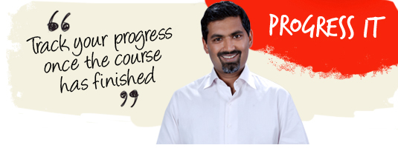
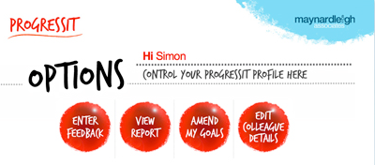
Progress IT – 9 Week Goal Tracking System
2
Progress IT ® is a powerful on-line support system that provides follow through after a course, a workshop or learning event. We use this innovative service to:
Help participants reach their self selected behavioral goals
Show line managers what their colleagues have learned and report on the business results from their new learning
Enable Human Resources departments to offer evidence of specific business gains stemming from a particular learning experience.
Assign supporters to these participants who will give feedback for a period of nine weeks.
Progress IT ® tackles these with a nine-week support service and a report at the end summarizing progress.

Slide 15
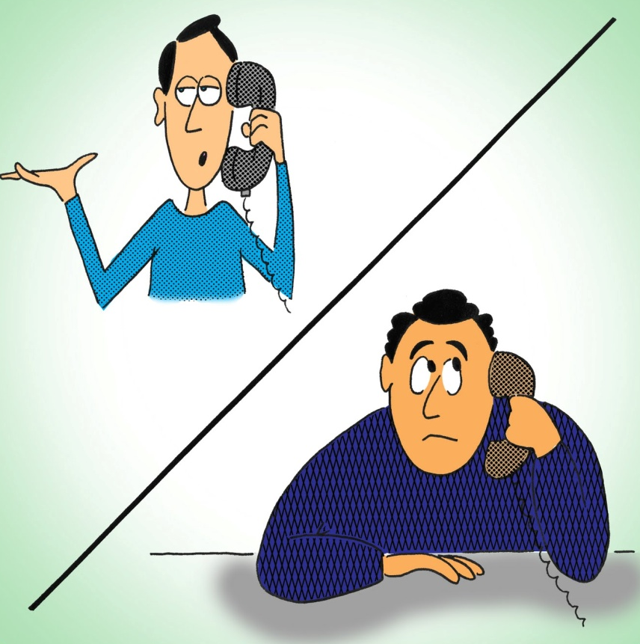
One on One Coaching Calls
3
Every participant will have a 45 minute conversation with the consultant to anchor the learnings and arrive at concrete areas on what has changed in their personal impact after the complete journey has been delivered.

Slide 16
Commercials
Diagnose & Design (For the whole Intervention)
Half Day Diagnostic Interviews + Half Day Design (creating report, customizing design) - 1 day worth of investment |  | NIL
Delivery (for each batch of max 10 leaders)
Activity | Investment | Total Cost
Professional Fee for delivery – Personal Impact Workshop | INR 75,000 Per Day per consultant X 2 Days X 1 Consultant | INR 1,50,000/-
Progress IT | INR 500 Per Participant x 10 Participants | INR 5,000
One on One Coaching Calls | INR 6500 Per Participant (45 Mins Each) x 10 Participants | INR 65,000
Learning Material, Folders, Books, DO IT NOW cards | INR 1000 X 10 | INR 10,000/-
Total Investment for 10 leaders |  | INR 2,30,000
Cost per leader |  | INR 23,000/-

Slide 17
Terms & Conditions
Client is responsible for providing venue, conference facilities, AV equipment.
Travel outside Delhi NCR - Air, stay & airport/ venue cab transfers to be taken care by the client.
Travel inside Delhi NCR - at Rs 12.00 Per Km.
Not inclusive of applicable taxes (service tax @ 15.00%).
A commercial contract will be signed before the execution of the project.
50% of cancellation fee will be charged on any cancellation or postponements that occur within 3 to 20 working days of the confirmed date of delivery.
100% of cancellation fee will be charged on any cancellation or postponements that occur within 0 to 2 working days of the confirmed date of delivery.
The above commercials are valid till the 31st March 2018
Contracts, legal & accounting paperwork (including billing & payments) will be in the name of “Life Strategies Humancare Pvt. Ltd.”

Slide 18
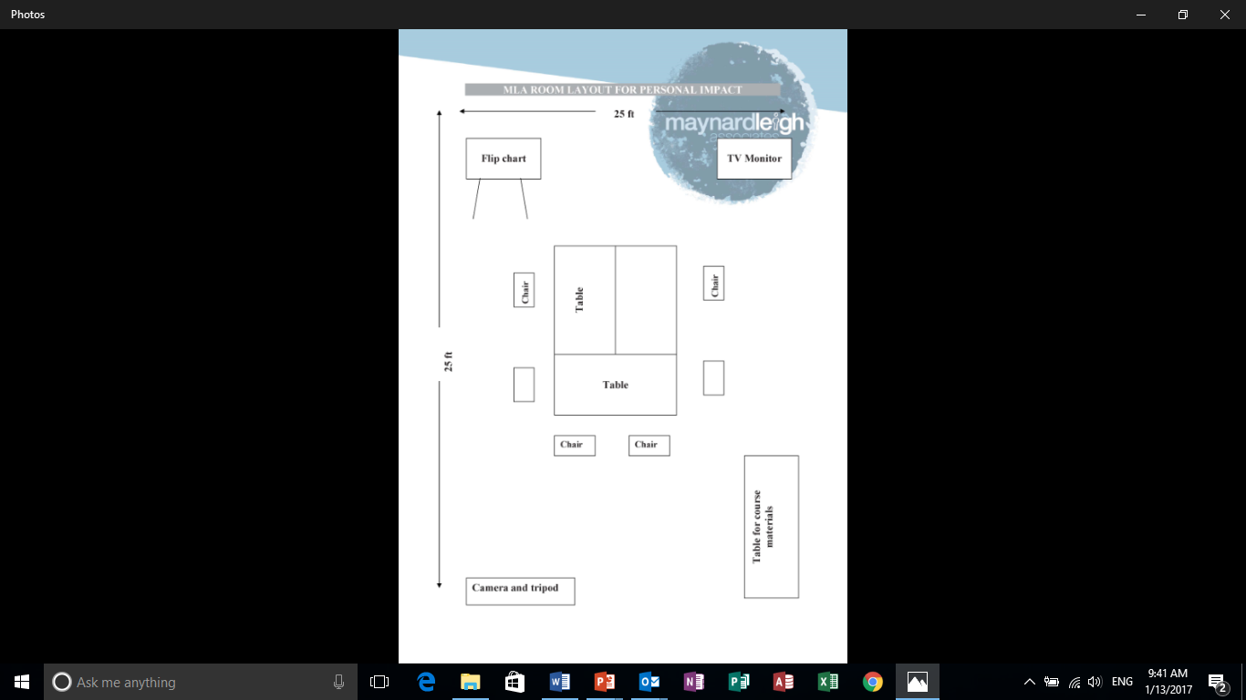
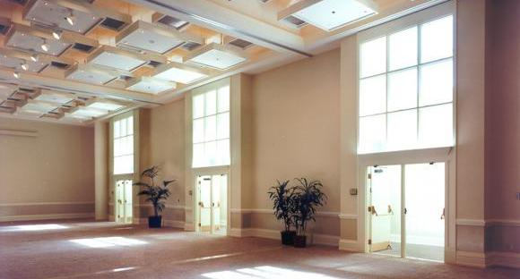
Room Layout Required
We love alternative ways of setting up a workshop! Creating an atmosphere where the participants feel absolutely comfortable, yet challenged. In this workshop, the use of theatre, team games and experiential methodologies are essential ingredients, hence we’d require ample place to move around and make noise.
Please book a space with ample natural light (Yes, we want sunlight streaming in) and no fixed furniture for the participants to work with Maynard Leigh consultant.

Slide 19
Things Required at the Venue
For the workshop, we will need the below mentioned:
LCD projector and projection screen
UPS Power Back-up for Laptop, LCD projector & Laptop speakers
TV with Remote for Video playback (Day 1)
External speakers (for laptop connectivity). The external speakers should be loud enough for music playback
White board & White board markers (2 blue, 2 black, 2 green)
Flip chart and Flip chart stand with suitable clips
Color pens (Normal sketch pens - about 30)
Notepads and pens (for participants)
Blu-Tac (This substance is used to stick things, posters or paper on the wall)
20 A4 Size normal and drawing sheets
2 tables for the consultant (one will be used for the projector and the other for keeping the handouts)

