Slide 1

Line Managers’ Journey – Day Three
Re-align and reconnect!

Slide 2
Your Mandate
Situation:
HSBC is conducting a 3 days workshop (2 days in Oct/Nov +1 day in Feb/March) for its line managers, covering 315 line manager of GCB 5 AND 6 level. Maynardleigh had partnered with you on the second day of this intervention to cover:
People Management
Stakeholder Management
Communication
This document is to share ideas for Day-3, on how we could re-connect with the learning from the workshop.
Problem:
Post the diagnosis, design and delivery of the workshops. Some of the problem statements that exist currently are-
Leading Self-
Ownership (Truly accepting the changes in GFC)
Take responsibility on self and avoid blame game
Look at your own leadership patterns- functional and dysfunctional
Leading their team
Constantly communicating with the team on their performance/expectations
Regular, factual feedback
Coaching and engaging their teams
Seeing the big picture- Aligning with the organization
Realise why the changes are happening
Communicate proactively, if you see something not going right- point it out.
Looking at team’s deliverable rather than just self
Implication:
While some work has started around being aware of their patterns. The gaps in managing people, performance, feedback and effective communication still exist resulting in people loosing accountability and trust.
Need:
While we would do a more intense intervention in the coming year, the need now is to reconnect post day-2 to see how the learnings where applied and the challenges faced.

Slide 3

Workshop Objectives
Think
“It is possible to develop a wide spectrum of colours in our leadership styles palette. We all have all the colours, it’s just a matter of unlocking them.”
“I need to challenge the perceptions I might be holding against HSBC/ some of my stake-holders”
“I have the tools to change my productivity, relations and quality. I need to now get on it”
“I can try new ways of getting through to people”
Feel:
Ready and charged to try new ways of doing things.
Surprised and responsible- I am cause of my challenges.
Ready to own up to my word.
Be able to:
Handle difficult conversations.
Build positive and trusting working relations.
Shed my inhibitions/egos to accept newer ways of operating

Slide 4
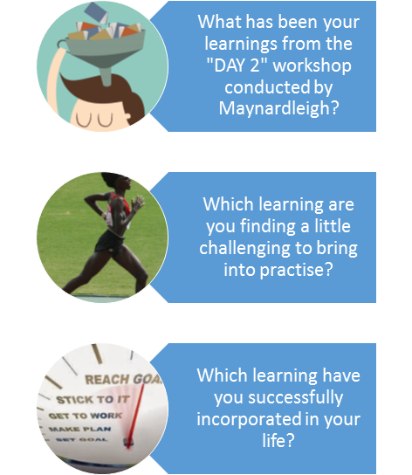
Pre-Workshop Assignment
Before Day-3, participants answer 3 questions and bring it to the workshop-

Slide 5
Tentative workshop Design (15 participants per consultant)
Narrative | Session Title | Session Details | Methodology | Timings
Introduction | • Welcome and context setting | Theatrical warm ups |  | 10 minutes
 | • Permissive Encouragement – Play & Express yourself. A quick recap of Day-2.
Participants start by articulating what has worked and what’s not post Day-2. We give these characters different names to be able to see them objectively. | Working on self- The Inner Cast of characters | We have all traits and characteristics in us, Identify one’s that are most functional in the given scenario and gels well with the Purpose/AIM & cast them. | Facilitator led activity | 30 minutes
 |  | Identify the inner character most suitable for the situation.
Realize that different characters have different impact on situations/ people.
We often blame the circumstances/ people for the situation we are in. We use a hard hitting experience to realize that somewhere the ownership is ours to take. This will help set the context for the creative problem solving to follow, allowing the participants to look at themselves while exploring a solution to their difficult situation. | Working on relations- Experiential Game “SPY” | We often blame the people/situations around for the state of affairs. This is a powerful way to uncover that it is our subjective reality- and it may be guided by our perceptions. A total shake up experience for participants. | Experiential Activity | 60 minutes
 |  | Assuming positive intent- How we build trusting relations and take ownership for not.
Tea Break (15 Minutes)
The participants bring in challenging cases in working with stakeholders. They use props to display their current state, their successes and challenges from the last MaynardLeigh workshop | Creative Problem Solving | The 40 members would be divided into 3 batches of 13-14 member each. These small groups will work with 1 facilitator. We use role-plays, psycho drama, personal coaching and rehearsals to practice tough scenarios and discover solutions. MaynardLeigh uses creative facilitation to uncover and unearth personal challenges that individuals face. | Experiential Facilitation. Group coaching, role plays, forum theatre and Psychodrama. | 90 minutes
Closing | The consultant hands participants- “Admit cards” These suggest the workshops they must attend in the coming year. Each participant also makes a learning plan for themselves. | Action Planning Completion |  | 10 minutes

Slide 6
Synergies with Day Two
Blood Test
We realised the different characters in play while doing the blood test. Let’s now name them and realise their impact.
Our relations with team members and peers are guided by our perceptions of them.
Victim Chooser
Taking responsibility is the basis of being a chooser.
I am the cause of my results/ relations. I can make happen what I want.
Giving Feedback
Assuming positive intent is the basis of giving feedback. If I don’t trust the intent, it will show.
We will practice scenarios of giving feedback.
Practicing scenarios of working with team members. Coaching and motivating them.
Coaching

Slide 7
The way ahead- Plan for next year.
Need to sustain the change-
Our work this year with the leaders at GFC, was to just start a conversation. We have created an awareness in GCB- 5 and 6 around their patterns and a need to bring about a change.
In the coming year, we hope to work in depth on the issues we’d uncovered in the diagnosis meetings and observed during the workshops.
Regular touch points
Over the next year, we propose to do 1 workshop every quarter for all the line managers. These are topics which are essential for anyone to be a manager at GFC. The shortlisted topics are-
Talent engagement- Valuing, Involving, Developing and Inspiring your teams
Influencing (will cover blaming v/s owning, being assertive, collaboration & collaborative mindset)
Managing stress- Being emotionally intelligent to manage self, people and situations.
Prioritization- Managing expectations and bring your peak performance at work.
Personalized learning journey
We would schedule a series of expresso sessions over the year. These are short and quick 2 hour sessions which the line managers can nominate themselves to as the need arises.
MaynardLeigh consultants will also hand participants “Admit cards” on day 3, these are cards suggest workshops that the managers should be a part of in the coming year. The consultant decides this basis their observations of individual participants. Some of the expresso sessions suggested are-
What to do when feedback doesn’t work (Herein advanced techniques of giving feedback are covered. Things like people not receiving feedback, crying during feedback, emotional outbreaks, or taking no action post feedback)
Psychology of peak performance.
How to convert victim to chooser
Motivating others
Motivating self(with change/scale of work coming)
High stake Coaching-Challenging Coach.
We also recommend one coaching connect for the line managers every quarter. This could be with their GCB- 4 leaders or with MaynardLeigh consultant.

Slide 8
Your Investment for the intervention
Investment for Day-3 Line Managers Journey (15 Participants per consultant)
1st Day workshop | 2 leaders in Europe (Poland) Susie and Steeve | £4,050
2nd and 3rd Day workshop | 1 leader in Europe (Susie): Day @ £2,550 TOTAL (Indian Currency) | £5,100 £9,150 (INR 7,56,980)

Slide 9
Terms and Conditions
Client is responsible for providing venue, conference facilities, AV equipment.
Travel outside Delhi NCR - Air, stay & airport/ venue cab transfers to be taken care by the client.
Travel inside Delhi NCR - at Rs. 12.00 Per Km.
Not inclusive of applicable taxes (service tax @ 15.00%).
A commercial contract will be signed before the execution of the project.
50% of cancellation fee will be charged on any cancellation or postponements that occur within 3 to 20 working days of the confirmed date of delivery.
100% of cancellation fee will be charged on any cancellation or postponements that occur within 0 to 2 working days of the confirmed date of delivery.
The above commercials are valid till the 31st March, 2017
Contracts, legal & accounting paperwork (including billing & payments) will be in the name of “Life Strategies Humancare Pvt. Ltd.”

Slide 10
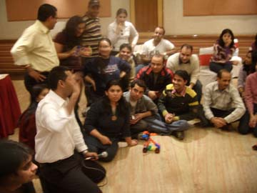
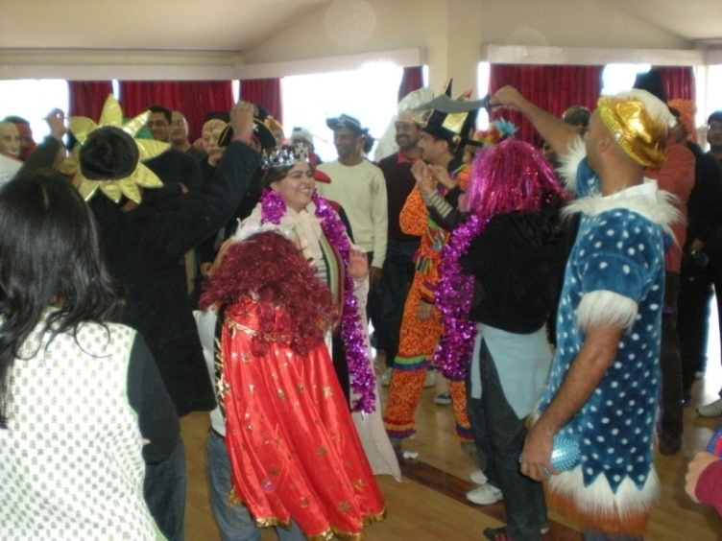
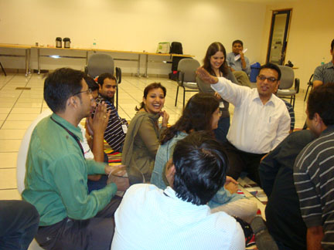
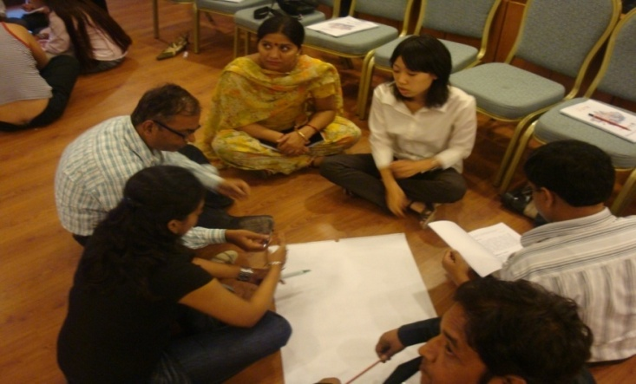
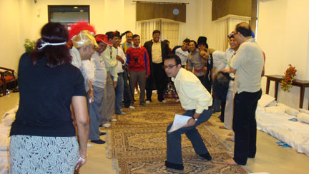
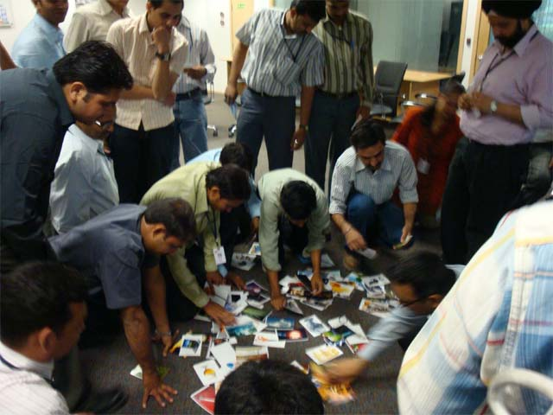
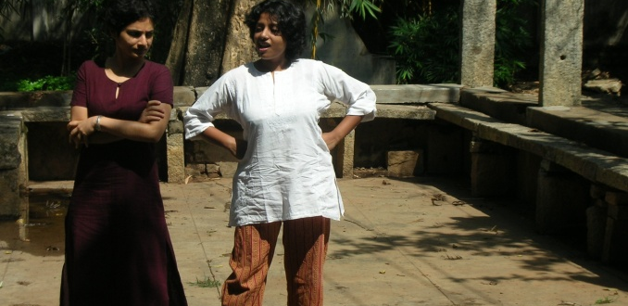
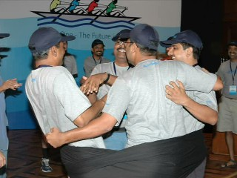
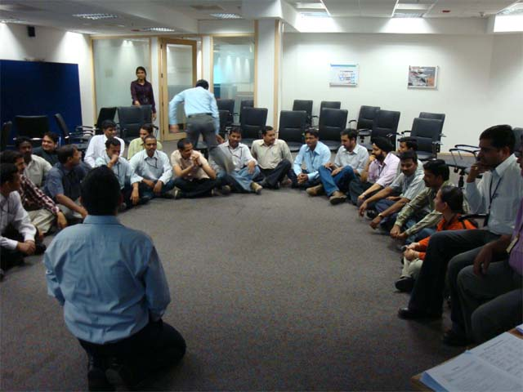
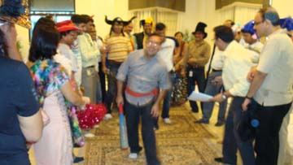

Slide 11


For further details, please contact:
Varun Gupta
Tel: 91 9560192443
varun@maynardleigh.in
Jigyasa Sharma
Tel: 91 9717922445
jigyasa@maynardleigh.in
We look forward to working with you.

