Slide 1



Create first impressions, engage in purposeful conversations, build trust with internal and external clients and coach, motivate & develop your teams
Approach note: Ver2.0/ 28th November’16

Slide 2




Solution:
How to build, deepen, extend and sustain strong client relationships
Client engagement starts from how an individual understands customer needs, articulates it for the team, solves the client query and proceeds towards building a lasting relation. It brings the formal systems that companies use to life by putting each person’s questioning, listening, envisioning and consulting skills under the spotlight. We will also include the ability of leaders to motivate, develop and inspire team members to deliver the services. The model is a red thread to the learning journey-
CLARIFY: Have a distinctive look and feel
EMBODY: Align to the company, show integrity
CONTACT: Be proactive , transmit energy, first impression count
FIRST DATE: Discover the other person, make a lasting impression
FLIRTING: Build rapport, encourage chemistry
COURTING: Work together, add value
COMMITMENT: reach for another level
DEVELOPING
TRUST: -Developing credibility, reliability, intimacy and self orientation
-Troubleshooting
PARTNERSHIP : Develop and involve team
WITH TEAM members who enable service to
MEMBERS the client
LOYAL FRIEND: Mutual commitment, the client’s first choice and port of call.

Slide 3
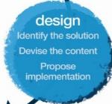
Sample Learning Objectives: Impact and Influence. Post the workshop, participants will:
Think
First impressions are important, I need to be consciously aware of my impact on others
Every interaction, presentation is a moment of impact, I will make them count
I need to be clear with my aim to have purposeful conversations
To collaborate with my team, I need to increase my level of communication and build relationships
Building personal connect with the clients is the key to their experience with Cognizant
I can only delivery good results if I consciously motivate and develop my team members.
Feel:
Confident about making an impact in communication
Excited about unlocking others potential
Prepared to have purposeful conversation
In control of my nerves
Motivated to develop others in my team.
Be more able to:
Build trust and increase confidence
Have compelling conversations
Talk effectively and persuasively
Create impact in communication
Use listening, probing and rapport with internal and external clients
Manage performance gaps and act as a coach

Slide 4
Sample workshop design : Impact and Influence: Day 1 ( with 14 participants per consultant per batch)
Narrative | Session | Session details | Methodology
Participants get ready and energized for the day. The purpose is to ensure that they are comfortable in their skin. MLA facilitator and participants get acquainted with each other. | Warm up exercises Brief Encounter | Welcome Love Game will be played to divide the participants in 4 group Maynardleigh & participant Introductions | Theatrical warm ups
 | Context Setting | 1 Billion $! How would you reach there? What skills will become relevant in order to reach this? This workshop will focus on your and your team’s ability to Impact & Influence! Participants share experiences where they were able to extend relationships with a service provider. Introduce ACT! | Experiential Context setting
ATTRACT
We are always being seen and present our personal brand. | Party Mingling On and Off modes Masks | ON = When you know you’re being seen and having to represent your personal brand. OFF = Those unguarded moments when you are being watched and you re not aware of it. | Experiential activity Group insight
First impressions are important. We need to be constantly aware of our impact on others during our first interaction. | The first impression | What creates the first impression How internal customers or clients see you on first meeting. How we would like to be seen; how we fear we are seen; and how we are actually seen. Feedback on first impressions ( connection to DISC) | Facilitator led
We all have our own personal brand we communicate. Who am I? what do I stand for to attract client/stakeholder? | Personal Brand | People are expected to have distinctive individuality that has a special contribution to make. So we Explore: Why you? What’s your point of view? What are your opinions. What’s the point of you? What’s your purpose. Where do you take a stand? Participants prepare a point of view presentation( what do I care about? What is important to me?) | Worksheet exercise Individual presentations.

Slide 5
Sample workshop design: Impact and Influence: Day 1 continued….
Narrative | Session | Session details | Methodology
We are constantly selling ourselves, why not start doing consciously. We need to be cognizant of our demeanor to come across credible | Style Audit | Impact comes from Care, Flair and Aware Care = Demonstrate that you value yourself Flair = Express your self, be creative, voice quality, personal style Aware= Make sure your clothes are appropriate | Discussion leading to Individual Feedback.
CONNECT
Understanding the consultative approach. What does it take to truly become a partner versus a service provider. | SPIN Model Introduction | Understand what’s the story- Get to know the situation, problem, implication and need to provide the Solution. Having consultative approach. | Facilitator led presentation. Participant exercises.
To be able to add value to the client, another level of interaction is required where we listen, probe carefully to be able to get past the generic tone of pitching. | Listening, Probing & Developing Rapport | Share a routine Story! What am I listening for: to respond, OR to help & understand? Bridges and Barriers to listening. Human Library The only way this book will open, if you ask the right questions. Mirroring Mirroring in thoughts, feelings, action, tone and status. | A series of quick exercises led by the facilitator.
The kind of questions we ask in the first meeting, establishes the relationship and opens up business opportunities | SPIN | Participants work in pair and role-play a short first meeting between a possible client and consultant. | Facilitator led presentation. Participant exercises.
Homework | SPINS / PPSAAO Pitch | Participants prepare a pitch - using SPINS ( Situation, Problem, Implication, Need and Solution) OR PPSAAO ( Push, Pull, Support, Anticipate, Answer and Offer). | Facilitator led presentation. Participant exercises.

Slide 6
Sample workshop design : Impact and Influence: Day 2.
Narrative | Session | Session details | Methodology
Participants get ready quickly reviewing what they have learnt from the previous day | Recap from Day 1 | Theatrical warm up Play & Express yourself
CONNECT
 | SPINS / PPSAAO Pitch | Participants pitch - using SPINS ( Situation, Problem, Implication, Need and Solution) OR PPSAAO ( Push, Pull, Support, Anticipate, Answer and Offer). | Facilitator led presentation in groups.
TRUST
To create TRUST amongst the team, we need to establish, credibility, reliability, intimacy and keep our self orientation flexible | TRUST formula | The foundation of any new relationship is trust. How does one build a solid foundation? | Team Activity. Group Presentations
How do we work in our teams. How we communicate verbally and non verbally- and what’s the impact? | Skip Game | Why constant, factual and developmental feedback is essential. It is imperative to create a culture where there is permission to fail. The activity also brings out the natural feedback pattern of the leader and provides good opportunity for them to communicate effectively to manage the team. | Experiential
How do you give feedback to your team without emotional vomiting? Forming partnerships with the team. | Feedback formula | A simple tool to give feedback to your team members | Done in pairs
As a leader we need to constantly look out for our team and be able to coach, motivate & develop them. This would help in managing performance gaps | Coaching | Coaching for motivation GROW question model Listening & asking questions Nine goals to lead – motivating through helping people achieve their personal goals. | Theatrical base Practical exercise Participant practice Participant personal goal setting
People record their commitment videos sharing the goals they will complete |  | Commitment videos Goodbyes

Slide 7
Notes:
There is a possibility that there’s a session with the leader & Dr. Ved in the morning. In that case the workshop will start by 11am instead of 9.30 am.
In case that happens –
Aim to finish Day 1 @ Listening, Probing & Mirroring.
Do 1st impressions in groups.
Do Style Audit in groups.
Do the SPINS pitching in groups of 4 with the facilitator roving.

Slide 8

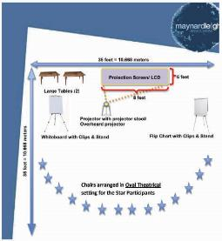
Ambience
We love alternative ways of setting up a workshop! Creating an atmosphere where the participants feels absolutely comfortable and yet challenged. In this workshop, the use of theatre, team games and experiential methodologies are essential ingredients, hence we’d require ample place to move around and make noise.
Please book a space with ample natural light (Yes, we want sunlight streaming in) and no fixed furniture for the leaders to work with one MaynardLeigh consultant.

Slide 9
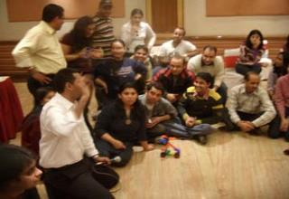
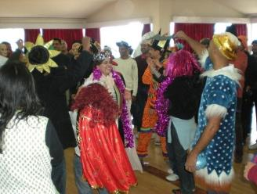
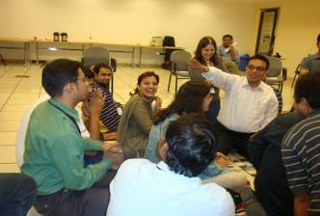
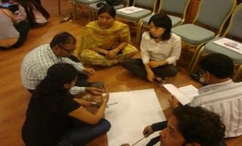

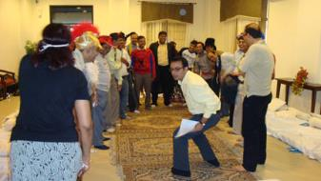
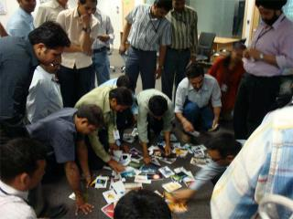

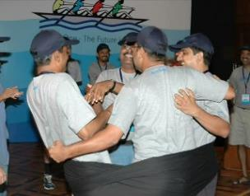
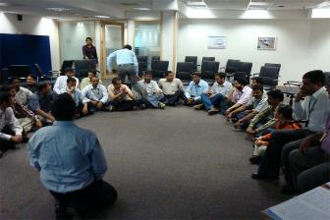
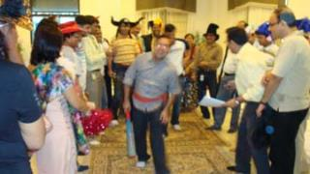

Slide 10






















































Our Clients
Notes:
10

Slide 11

Let’s work in partnership to create impact & unlock potential
For further information please connect with:
Contact Jigyasa Sharma/ Varun Gupta
Email jigyasa@maynardleigh.in / varun@maynardleigh.in
Telephone +91 9717922445/ +91 9560192443

