Slide 1


Make a high impact in presentations, meetings, calls, presenting & communicating
Communicate like future leaders, and lead conversations
Attract Attention by using multiple colors of your personality. Gauge audience and build presence!

Slide 2
What is covered in this approach paper?
Initiative Set-up
Our consulting process . . . . . . 3
PWP in a nutshell . . . . . . . . . . 4
Diagnosis Steps . . . . . . . . . . 5
Delivery & Design
The Learning Journey . . . . . . . 6
Steps in the journey . . . . . . . . 7-10
Next Steps
Learning Collaterals . . . . . . . . 11
Progress IT . . . . . . . . . . . . . 12
Our Picture . . . . . . . . . . . . . . 13
Our Clients . . . . . . . . . . . . . . 14
Thank You. . . . . . . . . . . . . … 15

Slide 3
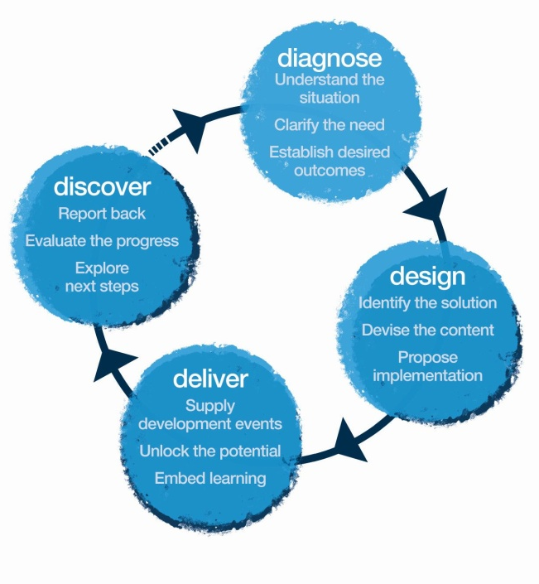

OUR CONSULTATION PROCESS
In this approach note, we propose suggested ways of going about these stages. We will share the final workshop design only after the Diagnosis and Design phase.
Methodology: Theatre. Psychology. Learning & Development Tools

Slide 4





PRESENTING WITH PRESENCE Workshop
In a nutshell –
Being on a high-stake negation table in front of a decision maker to sometimes reporting to senior stakeholders to handling a global client can be a daunting experience and it can inhibit the most gifted people. You are effectively entering a foreign territory to people who are more senior than you with power and influence beyond your sphere and who aren’t your regular colleagues. If you succeed, your reputation is in the ascendant; fail and it will be hard to recover.
In preparation for such encounters, our programme could focus on five key areas of:
Preparation Work
Participants are asked to bring a short (3 Minute) piece from a live presentation, which they might have presented or are about to present. We emulate a live scenario by acting out as the target audience of the presentation.
Personal Work
Our work in the workshop will be centred around individual-insightful feedback, uncovering what’s happening beneath the surface for the leaders which might be inhibiting their ability to make an impact. For the same, we limit to 8 participants in a workshop.

Slide 5

Diagnose:
Before we deliver our first workshop with you, we would want to meet (or speak over the phone) with the target participants, stakeholders and business stakeholders to collect information about the business, target participants, possible gaps, expectations & objectives.
We specifically gather information on-
What do the presentations and communication currently look like, what do we want him/her to Think, Feel and Do differently?
What are the situations where they need to step up their game to appear as future leader?
Gather anecdotes, examples & situations where there was need to give skillful presentations and what are the impediments for making that impact on audience.
Understand the current communication standards and the steps being taken to improve those.
Understand the personal impediments in attitude, behavioral and Communication gaps.
6.

Slide 6

DELIVERY
We believe performance occurs when we can impact one’s thinking, feeling and as a result their actions. At the end of this intervention, these shall act as our guiding principals.
Think
I will get into a meeting/interaction with a clear aim of what I want to convey and what I expect at the end of the interaction.
My communication impacts my results- I need to prepare and structure my thoughts before an important interaction
Preparing mind, body and voice is key to making an impact
I need to anticipate the challenges, feelings and the reaction that my message can have on the audience.
Creative structuring are a key to memorable presentations
I can field hostile questions- as I am fully prepared
I can present myself as future leaders.
Sample
Feel:
Confident and equipped to handle high pressure encounters
Rehearsed and ready- I know how to deal with different scenarios/stake-holders
Capable and assured to influence outcomes of meetings/discussions
Excited to present
Better equipped to handle presentations in front of visitors
Be more able to:.
Prepare and Structure my thoughts/flow of the meeting
Be present to the audience- listen to the said and the unsaid.
Move an audience to think/feel and act the way I want
Take ownership
Increase ability to gain buy-in from others because of the impact I create.

Slide 7
Tentative Workshop Content – Day 1 – Presenting with Presence
Preparation work: Prior to the workshop, participants are asked to prepare a short (maximum 3 minute) presentation. This is used as a vehicle for assessment of current strengths, personal style and development areas. The presentation is recorded on video and used for analysis and feedback.
Time | Session Title | Session details | Methodology | Outcome
9:30 am | OUTLINE & PURPOSE OF THE DAY | - Leader introduces the day, including: • Principles - An exploration of the principles behind our approach to Inspirational Presence • Format - Outline of the shape of the day and how exercises will be used to practice each area of presence | Trainer led | Introduction to course Context Permissive encouragement
9:45 am | INTRODUCTIONS & PERSONAL ISSUES | • Outlining personal learning objectives | Participant sharing | Focus on learning objectives
10:30 am Break at 11:00 am | PREPARED PRESENTATIONS | • Each participant delivers their 3-minute prepared presentation. These are recorded | Presentation by participants | Practice and self introspection
11:15 am | FEEDBACK | • Each person receives feedback from the group and the leader, focusing on clarity of message, structure, authenticity, use of visual aids, effect on audience • Analysis of each person’s strengths and areas for improvement Introduction to 5 P’s of Inspirational Presence | Leader & participants offer insight | Awareness of what works and what needs improvement Openness in group Practice in giving and receiving feedback
12:30 pm Lunch break from 1:00pm-2:00pm | VIDEO FEEDBACK | Participants get a chance to see themselves and consolidate learning points from feedback. They evaluate themselves thru the filter of 5 ps | Video play back in the room | Self awareness Vulnerability Validation of feedback Focus on areas of development Self realization
Sample

Slide 8
Tentative Workshop Content – Day 1 Cont. – Presenting with Presence
Time | Session Title | Session details | Methodology | Outcome
2:00 pm Tea break from 3:15-3:30pm | PREPARING YOURSELF | Making sure you are fully prepared to deliver the presentation/speech/pitch/meeting • Preparation section • Preparing your physical self: body, Breath, Mind , Relaxation and voice exercises Preparing the content - Right / Left Brain concept Story boarding/ story spine Start taking ownership | Physical Trainer led activity Paper and color based activity | Warmed up Body and Mind ; Ease and comfort in delivery Energy balance Enhancing the visual appeal of the message Learn Structure and story telling
3:30pm | COMMUNICATING WITH PURPOSE | • Defining the purpose and desired outcome of a presentation/speech/pitch/meeting • Extending the range of expression - vocal variety and body language - to affect your objective and taking responsibility that it lands on the audience A short section of original vignettes/scenes focusing on specific purpose • Feedback & coaching Overall purpose and moment to moment purpose Define agenda | Scene work Rehearsals Coaching in creative partnership | clear statement of objective clarity of think , feel and what will my audience do ( ACT) writing active Aims responsibility for ensuring that the message lands and bring congruence in body and words
5:15pm | OVERNIGHT TASK | • There is some work to do in preparation for the next day. Overnight work What did I learn Creative presentation
Sample

Slide 9
Tentative Workshop Content – Day 2 – Presenting with Presence
Time | Session Title | Session details | Methodology | Outcome
9:30am | PRESENTATIONS | Consolidating learning & Feedback on development | Participant activity | Recap Gain confidence about using creative ways to communicate
10:30am Tea break 11:30-11:45am | PRESENCE | Exercises to develop presence Exude confidence and be leader like How to command attention Relaxation and dealing with 'stage-fright' | Experiential activity Participant Presentation Debrief of exercise | Awareness of the surrounding and self habits Alertness Alive and present to the needs of audience, self and business
11:45am | SPEAKING WITH INSPIRATION PASSION | • Communicating the belief , experiences, power of narrative, and importance of storytelling Speeches that moved the world Devising a presentation, with a tight deadline, about a change idea Refining the content with support from others | Participant presentation Videos of great speeches | connect with the audience passion and ability to convince realization of power of truth Spontaneity
2:00pm | PERFORMANCE OF SPEECHES | • Final performance Delivery of conviction • Feedback and direction to improve performance | Feedback on Delivery | Confidence Achievement Feedback
Sample

Slide 10
Tentative Workshop Content – Day 2 Cont. – Presenting with Presence
Time | Session Title | Session details | Methodology | Outcome
3:00pm Tea Break: 3:30pm-3:45pm | HANDLING QUESTIONS | • How to deal with questions • How to get your essential message across despite a possibly hostile audience | Interview Method Practice , coaching in creative partnership | Ability to deal with hostile audience Balancing energy when you are questioned Personality feedback
3:45pm | BUILDING RAPPORT | Rapport Building Techniques Developing rapport in meetings. | Trainer led discussion | Ability to care for results , quality and emotions
4:15pm | FINAL FEEDBACK | Each person receives feedback from the group | Participant Presentations & Feedbacks | Final Presentations & feedback
5:00pm | RECAP & ACTION PLANNING | • Review learning points of the course • Identifying next steps | Recap Action planning | To be able to take action How to sustain the learning buddy
Sample

Slide 11


Learning Collaterals
The Perfect Presentations and Perfect Communications Book
Each participant receives a copy of the “Perfect Presentations” book by Andrew Leigh & Michael Maynard. To get them started on Impact and influence and to consolidate the learning from the first session.
The books can also supplemented with tests throughout the journey to ensure participants are reading the collaterals.
Click to look inside
Do-It-Now Cards
At the end of the journey, each participant receives a Do-It-Now cards set which offers inspiring and practical ideas on presenting and communicating.
This is a handy tool to ensure the learning are practiced post the journey.

Slide 12
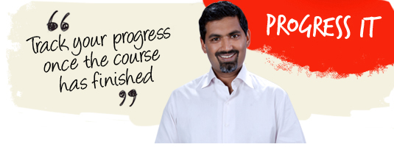
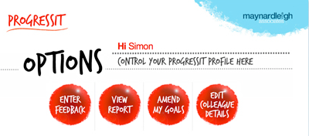
6
9- Week Goal tracking system
ProgressIt ® is a powerful on-line support system that provides follow through after a course, a workshop or learning event. We use this innovative service to:
Help participants reach their self selected behavioural goals
Show line managers what their colleagues have learned and report on the business results from their new learning
Enable Human Resources departments to offer evidence of specific business gains stemming from a particular learning experience.
Assign supporters to these participants who will give feedback for a period of nine weeks.
ProgressIt ® tackles these with a nine-week support service and a report at the end summarizing progress.

Slide 13























































Our Clients
Notes:
13

Slide 14
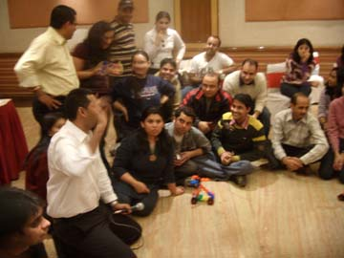
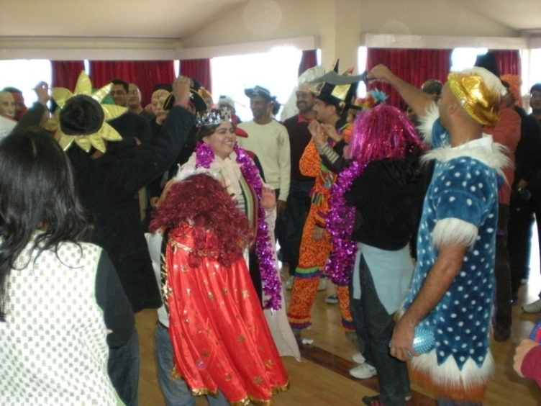
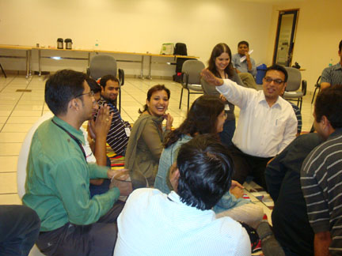
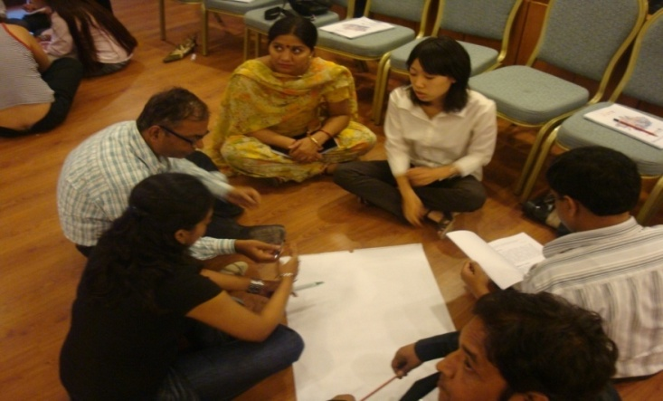
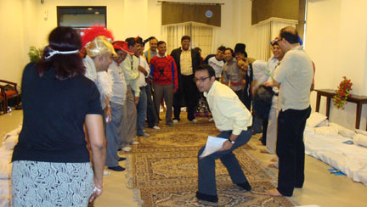

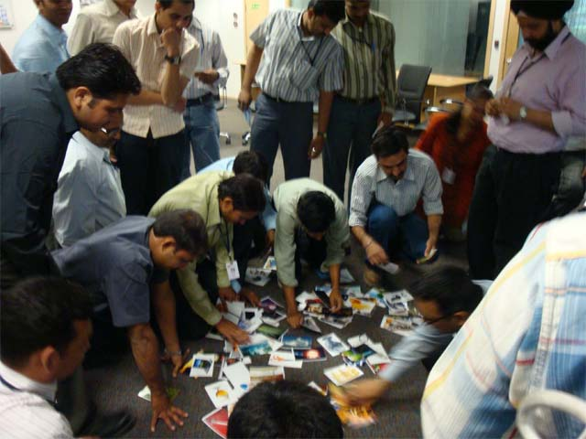
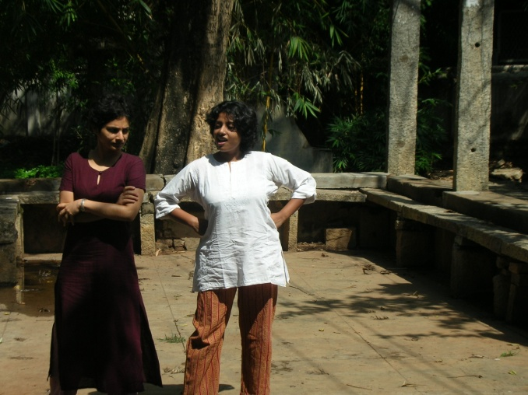
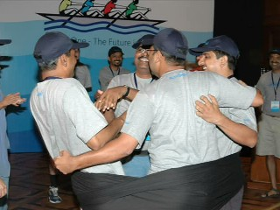
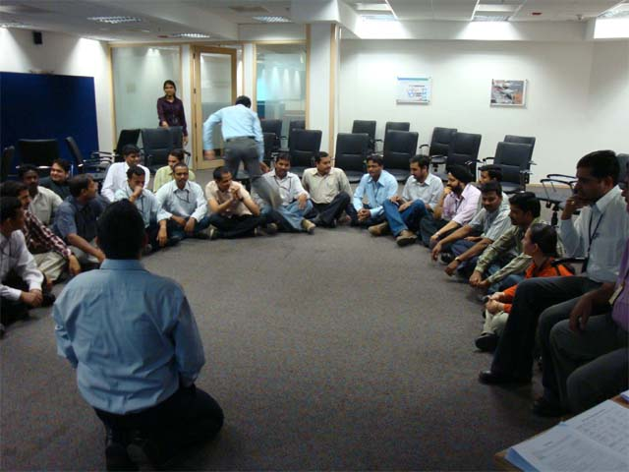
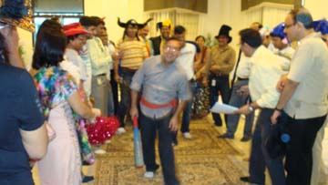

Slide 15

For further details, please contact:
Varun Gupta
Tel: 91 9560192443
Varun@maynardleigh.in
Rohit Parewa
Tel: 91 9717922446
rohit@maynardleigh.in
We look forward to working with you.
15

