Slide 1


Giving & Receiving Feedback
Diagnosis and Design for Mckinsey&Company
JULY 15, 2016

Slide 2
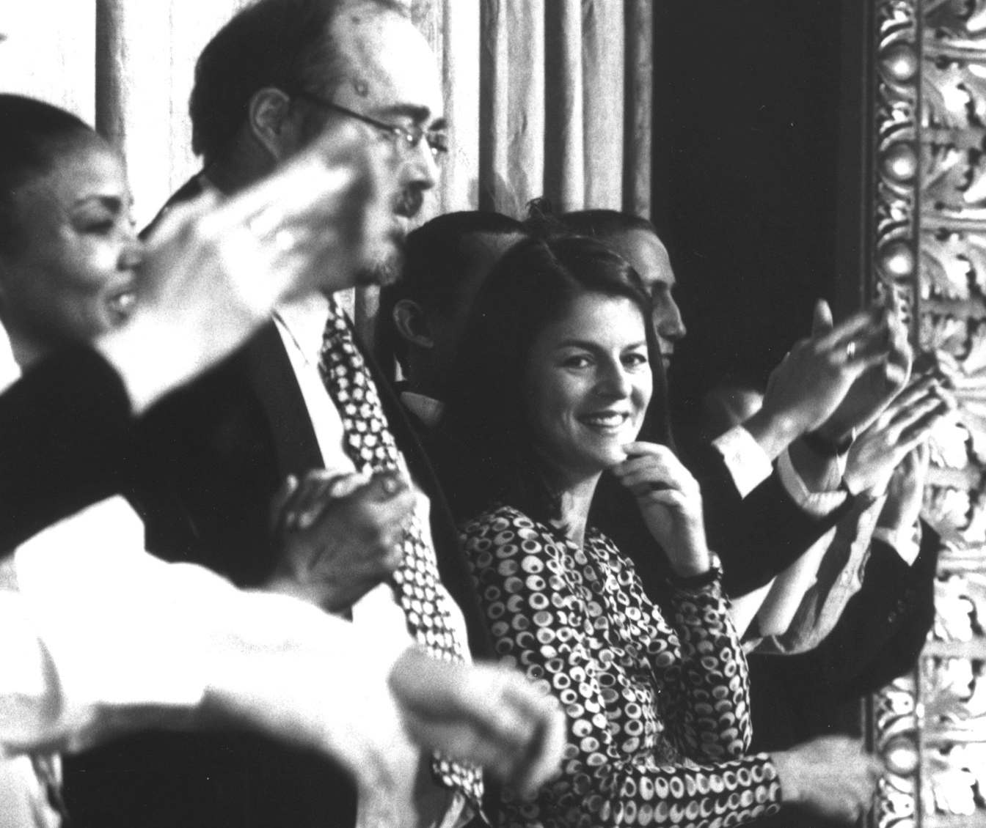
Your need as we understand it
This development initiative is for the CSSA team at McKinsey. You would like us to design & deliver an experiential, wake-up shake-up learning event to enable participants around the following –
Around Giving and Receiving Feedback
Ability to use coaching as a management tool in order to reach performance goals
Manage Tough Conversations
Offering Peer to peer feedback
Managing emotional energies while offering feedback

Slide 3
Research Methodology
Interviews with stakeholders and a few participants were done
to investigate the mandate further
Sample for Pre work interviews : 5 managers and 1 Learning
and Development Specialist
Stakeholders Covered from each group:
Learning and Development - 1
Manager – 5

Slide 4

Our Curiosity : Basis of Inquiry
The Pre work agenda was prepared based on the
mandate by the management and explored more
about the following areas :
1) Formal and informal feedback mechanisms at Mckinsey
2) Obstacles faced while receiving feedback
3) Obstacles faced while giving feedback
4) What would the ideal scenario look like
5) Expectations from the workshop

Slide 5
Inferences from Pre Work
Workshop design should address the following reoccurring themes –
Feedback should be seen as a developmental tool not as a process to fear, feedback is a gift
Invest in people’s growth – help them see their strengths and areas of development while offering feedback.
Have constructive developmental conversations while offering feedback
Some people especially the ones who are new to the organization have low trust in the process – they need to understand that the giving feedback is done through collecting data extensively – 360*- have trust in the process and the person who is giving the feedback
Person who is giving the feedback needs to have techniques to build relationship with the person
Ability to listen and empathize while giving feedback
Do your homework – present facts and examples to support the feedback
Coaching for Motivation
Offer feedback year around – informal feedback
Managing emotional energies while giving and receiving feedback

Slide 6
Participant Description
15 participants from CSSA team who belong to senior level band 2 will be a part of the workshop.
Since McKinsey looks at feedback as a necessary developmental tool this workshop is requested to help the participants learn more about the most effective psychological and behavioural tools involved in giving and receiving feedback
Thus the workshop should be a balance to address both the art and science of giving constructive developmental feedback as well as the attitude with which one receives this tool.

Slide 7

Outcomes At the end of the workshop, the participants should:
Think
“ Putting attention on the person will help them to be more receptive during feedback conversations”
“Offering observations and facts helps to make our feedback land on the receiver ”
“Feedback is a gift”
“I am going to trust the process and the person offering feedback ”
“I am equipped to handle tough conversations while offering feedback”
Feel:
Confident about giving helpful and constructive feedback
Open about giving and receiving feedback
Trusting towards the process of feedback
Aware about my strengths and areas of development while giving feedback
Be more able to:
Give feedback instantly, constantly and factually
Have difficult conversations with ease
Focus on Aim for any feedback or performance communication
Win trust with peers and teams
Receive feedback without excess emotional energy
Coach the receiver to move towards motivation

Slide 8
Design of the workshop- Day 1
Session Details | Session | Outcome | Methodology
To emphasize that a Performance conversation is actually a dialogue with two way feedback by putting attention on others to : Understand, motivate & recognize people. | Tai Chi Sticks | “ Putting attention on the person will help them to be more receptive during feedback conversations” | Participant lead experiential exercise
Facilitator Introduction Getting to know each other (Brief Encounters with last two questions eliciting participant strengths and challenges while managing performance conversations) Road map of the whole day | Introduction and Context Setting | Ensure participants feel comfortable, informed of the objective to be achieved and are ready to learn | Facilitator led; Storytelling
Coaches – Coachee pairs to address individual needs and learn from peer coaching. Each participant will put down difficult scenarios while giving and receiving feedback on anonymous chit after having a dialogue with their buddies | Buddies | Aware about my strengths and areas of development while giving feedback | Individual reflection
Sometimes we are unable to achieve all that we want to because we believe that others are out there to pull us down. Is that really true. What is the importance of assuming positive intent. What happens when we let go of mistrust in the process and receive other’s feedback openly | Spy | Open about giving and receiving feedback Trusting towards the process of feedback I am going to trust the process and the person who is offering feedback | Group activity
Tea Break :
A game that creates a stressful situation to bring out latent behavioural traits in participants. This is to check for behaviours that participants struggle with while offering peer to peer feedback. | 1 to 100 game | Give feedback instantly, constantly and factually | Experiential Game

Slide 9
Design of the workshop- Day 1 (continued…..)
Session Details | Session | Outcome | Methodology
An experiential game to understand the need to have purposeful, goal oriented clear communication | Bucket Game | Confident about giving helpful and constructive feedback | Experiential Game
To be able to give fact based vs perception based feedback, participants learn how to do their homework and structure the feedback | Feedback Formula | “Offering observations and facts helps to make our feedback land on the receiver ” | Practice Sessions
Lunch
To be able to motivate others we need to understand what drives us and why its important to strive for excellence | Understanding Motivation/ The Psychology behind Peak Performance | Putting attention on the person will help them to be more receptive during feedback conversations | Facilitator led Session
Coaching as a skill. Advise vs. coach Asking the right questions | Coaching for motivation | Coach the receiver to move towards motivation | Video, Practice, Peer Coaching
Tea Break
The problem statements written in the morning are put into a bowl. Random situations are picked out and enacted while the group helps in offering feedback and problem solving | The Fish bowl Problem Solving | Have difficult conversations with ease | Role Plays
Facilitator will out various tools such as yes anding, accept and build, chemistry with the person, defence mechanisms, Trust formula etc depending upon the themes that come out of group problem statement to address the same | The Arsenal | Confident about giving helpful and constructive feedback Open about giving and receiving feedback Trusting towards the process of feedback Aware about my strengths and areas of development while giving feedback | Facilitator Tool Box
Let's plot our learnings and key take aways from the day. Stop-start-continue sheets and commitment videos | Closing | Action Planning | Facilitator led

Slide 10
Things Required for workshop
For the workshop, we will need the below mentioned
LCD projector and projection screen
UPS Power Back-up for Laptop, LCD projector & Speakers
External speakers (for laptop connectivity). The external speakers should be loud enough to play music for the team.
White board & White board markers (2 blue, 2 black, 2 green)
Flip chart and Flip chart stand with suitable clips
Colour pens (Normal sketch pens - about 50)
Notepads and pens (for participants)
Blu Tack (This substance is used to stick things, posters or paper on the wall)
40 A4 Size normal and drawing sheets
1 regular size table and 1 small size table for the trainer (small table for the LCD projector and the other regular size table to keep the props, papers and other material). No fixed chairs or table required for the participants.

Slide 11
Things Required for the workshop
Facilitator will bring his own laptop
Facilitator will reach the venue at 8:30 am on the day of the session.
Kindly arrange for someone to be available at that time to give access to the training venue and an IT person to help with the set-up. Kindly share their contact information with us.
The workshop will start at 10:00 am and finish around 6:00 pm. Please make sure the participants are ready for the workshop and enter the training room by 9:45am.
Please ensure that venue for the workshop is air-conditioned, has natural lighting and has enough space for participants to do exercises. If an open space is available next to the venue, then the facilitator may chose to use the space for a game (weather permitting).

Slide 12
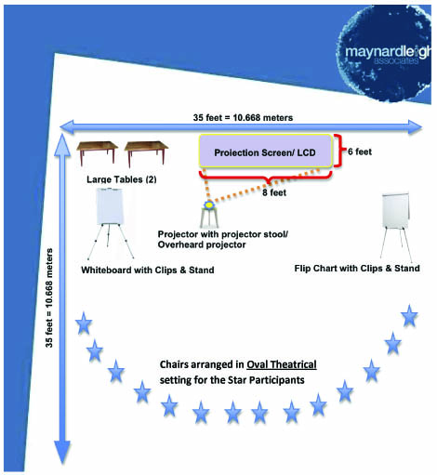
Room Layout

Slide 13

For further details, please contact:
Varun Gupta +91 9560192443 (Varun@maynardleigh.in)
Jigyasa Sharma+91 9717922445(Jigyasa@maynardleigh.in )
We look forward to working with you.

