Slide 1

Disruptive Execution Regional Heads’ Meet

Slide 2
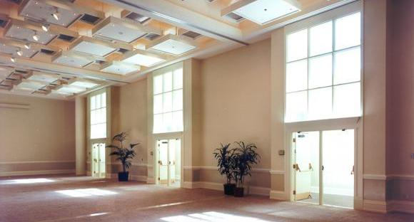
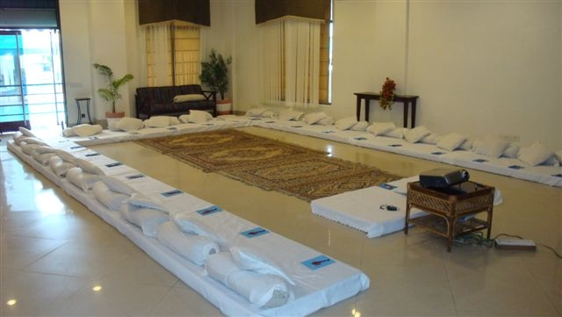
Room Layout
The Setting
We love alternative ways of setting up a workshop! Creating an atmosphere where the participants feels absolutely comfortable and yet challenged. In this workshop, the use of theatre, team games and experiential methodologies are essential ingredients, hence we’d require ample place to move around and make noise.
Please book a space with ample natural light (Yes, we want sunlight streaming in) and no fixed furniture for the participants to work with four Maynard Leigh consultants.

Slide 3
Commercial Investment
Diagnosis & Design (For the whole Intervention – one time cost)
Half-day diagnostic Interviews Half-day design ( creating report, customizing design, presentation of design) |  | INR 70,000/-
Delivery (for 80 participants)
Activity | Investment | Total Amount
Professional fee for delivery of half – day workshop Learning material, folders | INR 70,000 per day per consultant X half day X 3-4 consultants (For main delivery – to be decided by Maynard Leigh post Diagnosis & Design) + INR 70,000 per day per consultant X one day X 1 consultant (For 13th sit through) INR 150 per participant X 80 participants | INR 2,41,600/- INR 12,000/-
Total Investment for learning event covering 80 participants |  | INR 3,23,600/-
Discount offered (For sit through + diagnosis) |  | INR 1,13,600/-
Final investment for for learning event covering 80 participants |  | INR 2,10,000/-

