Slide 1



Don’t be the same! Be better!!
A Diagnostics Report: towards building better teams and stronger leaders . . .

Slide 2
Your Mandate
Company Overview
SRF Limited is a manufacturing company located in Gurgaon, India. The company has manufacturing plants in India, South Africa and Thailand. The company was established in 1970, as Shri Ram Fibres Limited, by DCM Limited as a wholly owned subsidiary. Over the years, the company diversified its product offerings into technical textiles, engineering plastics, chemicals and packaging films. In 1990, it changed its name to SRF Limited. SRF has R&D team and Engineering teams and the output of one team is usually the input of the other teams. SRF limited has Band O for its blue collar workers and Band A,B,C, D for its white collar workers. Maynardleigh Associates has worked with Band C & D and delivered “Leading the team” workshop.
Situation:
The R&D and Engineering team of SRF is looking for a dynamic journey for its 50 members. Few participants are from bands L4 and L5 and most of the participants are from L1, L2 and L3. Currently there is a lot of confusion, uncertainty, non cooperation, non collaboration and frustration. The situation has resulted in heated arguments between subordinates and leaders. Calls have been made on Sundays and it seems like there is a level of arrogance and non communication between teams.
Problem:
The teams have gaps in collaboration amongst leaders and team. The teams need to come together to avoid the blame game. SRF identified this gap through its process life management project discussions amongst teams, EES survey, performance appraisals, people issues and informal feedbacks. SRF has already conducted one outbound training for 100 people together.
Implication:
The current situation is leading to attrition, unclear communication and information flow. It’s further leading to low engagement scores with respect to working environment and working relationship. People are also not feeling recognised.
Need:
You want us to deliver a 3 month journey to enable the participants to achieve great teamwork and collaboration. People need to be energetic and passionate in teams. They should have the emotional intelligence to get the best out of the teams.

Slide 3
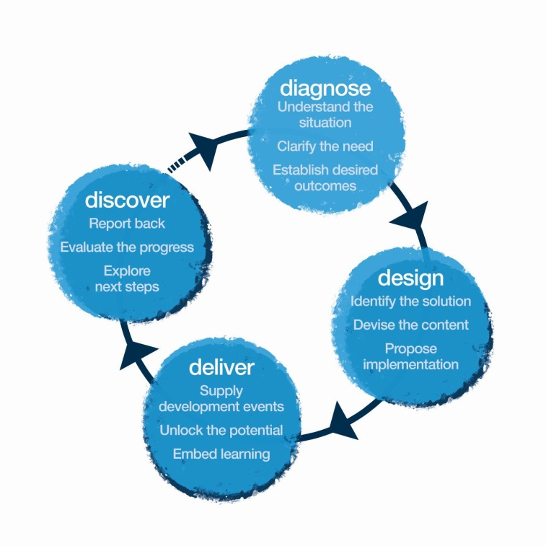

Our Consultation Process
In this approach note, we propose suggested ways of going about these stages. We will share the final workshop design only after the Diagnosis and Design phase.
Methodology: Theatre. Psychology. Learning & Development Tools

Slide 4

Diagnose
While we have received a broad mandate from Snigdha for this journey, we propose to spend one day in your office-
Meeting target participants and key stake-holders
Observing some live interactions within teams and with teams and managers.
These would help us collect information about-
Current State - what’s working, areas of strengths, challenges, etc.
How are their current interactions with the stakeholders, customers?
Gather anecdotes, examples & situations relevant for the workshop.
Identify the behavioral patterns.
.

Slide 5
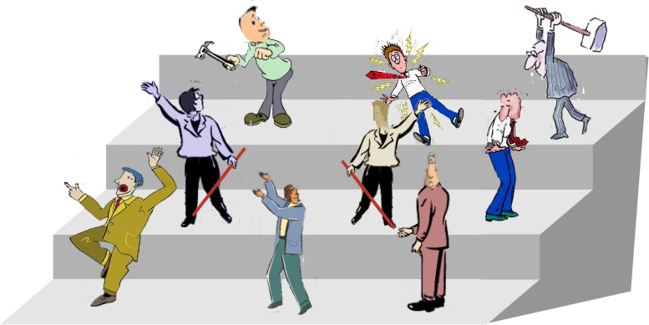
Let’s find you a solution that will get you from this …
Damn!! Am so confused….I don’t know what's going on amongst all the teams
Well!! The other team are so non cooperative
I am so frustrated with my managers and all the teams!!

Slide 6
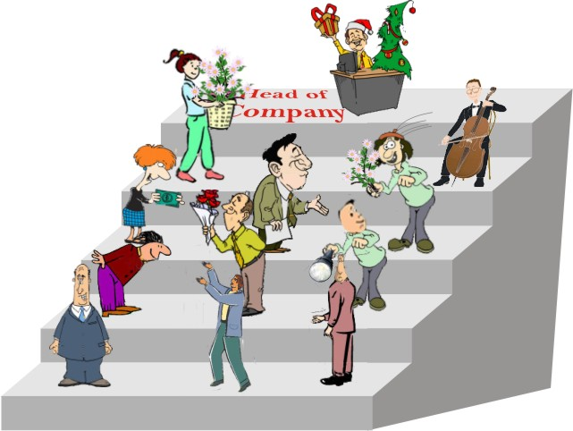
To this!! ☺
I love working with all the teams in perfect harmony
We exist to cooperate with each other
I am passionate about my team!!

Slide 7
Summary Findings from Conversations with HR
Collaboration
Results are highly dependent on cross-functions, however, there are many communication lags because of which work suffers.
Need to be able to see team members as important people who are emotional creatures.
Managing People
Attention isn’t on people. The same kind of work is given repeatedly. People’s levels of interest in the work dips. The focus needs to be on engaging people
Often delegation isn’t done properly. Tasks are handed over without any proper support or handholding.
Communication
During high stress situations, people are not able to communicate properly.
There is a lack of consistency in the way people come across to different people.
Time Management
There is a lot of stress and struggle with deadlines. The implication is that there is further negative impact on collaboration.

Slide 8
Leadership Journey – L3-L5
2 Day Vital Leader Workshop
Talent Engagement Month
2 day Ace Teams Workshop
Coaching Calls
Wrap Up and Share!
Face-to-Face Coaching
Leading the Way
The focus of the workshop will be on leading to create culture change. The participant will be exposed to leading with the big picture in mind.
Talent Engagement
The participant will identify one card and implement its objectives in the workplace and meetings and make a video of one such meeting and send it to the consultant who will then give feedback
Ace Teams
In these 2 days, we will deliver the workshop, which is made based on the objectives of teams and customer Euphoria for managers.
Coaching
JUICE
Coaching
Participants will meet consultants.
These sessions will allow the coach & the executive to delve deeper into the areas of development.
Participants will get on scheduled coaching calls with consultants.
These sessions will allow the coach & the executive to delve deeper into the areas of developments.
A wrap up workshop for all the participants from L1 – L5, to spend the day sharing learnings and playing collaboratively.
Day 1 & 2
Day 30-60
Day 65 & 66
Day 80 & 81
Day 90
Day 25 & 26

Slide 9
Overall Outcomes: L3-L5
Think
“I can create a culture shift in the company that is supportive of a collaborative workspace.”
“I need to be able to look at processes holistically to make an impact in the company’s culture.”
Feel
Enthusiastic about coaching and mentoring my team members to keep them engaged.
Ready to create a culture of collaboration and cross-functional engagements.
Be more able to
Look at the bigger picture while making decisions or reacting to various situations.
Lead with a complete understanding of the 7i model.
“As a leader, I must take decisions based on a birds-eye view of any situation.”
Willing to explore different leadership styles for different situations.
Motivate teams to align themselves across functions.
Recognize and acknowledge people wholeheartedly

Slide 10
Leadership Journey – L1 & L2
2 Day Leading the Way Workshop
ACE Teams Month
Wrap up and Share!
2 Day Ace Teams Workshops
Vital Leader
The focus of the workshop will be on leading to create culture change. The participant will be exposed to leading with the big picture in mind.
Ace Teams
The participant will identify one card and implement its objectives in the workplace and meetings and make a video of one such meeting and send it to the consultant who will then give feedback
JUICE
Talent Engagement
In these 2 days, we will deliver the workshop, which is made based on the objectives of teams and customer euphoria for managers.
A wrap up workshop for all the participants from L1 – L5, to spend the day sharing learnings and playing collaboratively.
Day 1 & 2
Day 30-60
Day 65 & 66
Day 90

Slide 11
Overall Objectives: L1 and L2
Think
“To grow in my career I must practice working across functions in all aspects of work.”
“A core leadership quality is to be able to look at processes holistically while simultaneously engaging with those I work with at the micro level.”
Feel
Excited about the possibilities that collaboration can pen up in terms of long term aspirations.
Ready to take more ownership of processes and deliverables beyond immediate spheres of influence.
Be more able to
Recognize and acknowledge people wholeheartedly.
Build bridges with the other teams and find synergies.
Reciprocate to the needs of other teams to live a culture of collaboration
Willing to make others shine instead of playing the blame game.
“I need to engage all my stakeholders because I can only grow as an individual if I help the collective grow.”

Slide 12

Details of Workshops

Slide 13

Vital Leader– The Journey

Slide 14
What is the need for the Vital Leader Workshop?
From the HR
There needs to be a culture shift in the way we work right now. Everyone is existing in silos.
Should be able to accept members of their teams as emotional, thinking creatures who need to be acknowledged and appreciated.
From Target Participants
We are never ahead of time. We are always running behind our plans.
We are working with very diverse groups and there are multiple stakeholders. It is challenging to handle it all.
Our Inferences
The focus of the senior leadership should be wide. It needs to be beyond the micro-managerial level.
It is this level of leaders that ought to bring about a culture shift in terms of creating a collaborative space, being able to see the process as one rather than isolated units.
Adopt a LEAN way of working.

Slide 15
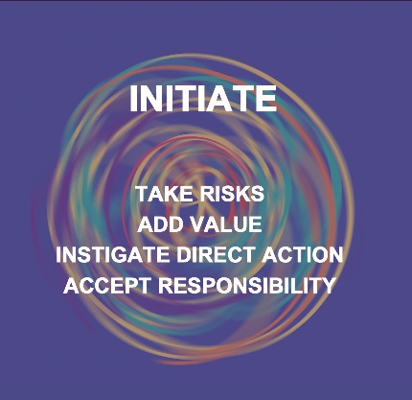
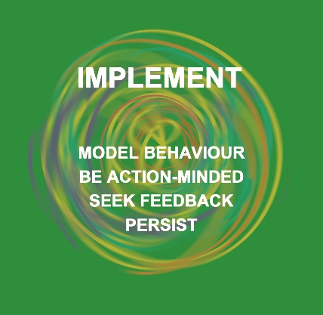
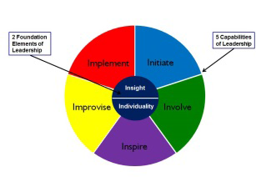
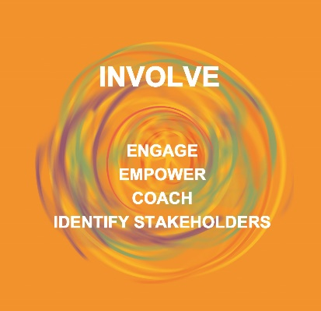
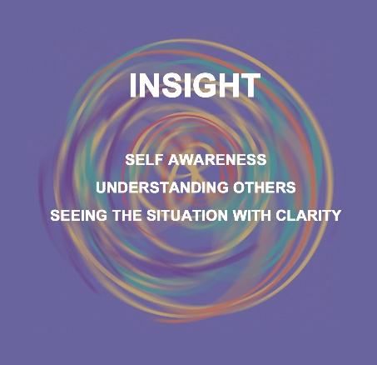
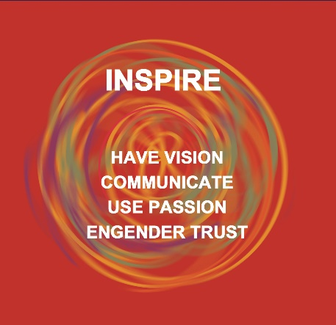

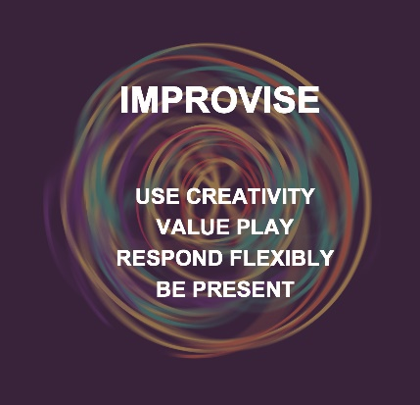
The 7-i Methodology to Leading for Culture Change

Slide 16
Vital Leader: Expected Outcomes
Think
“Interdepartmental communication is essential to meet deadlines. “
“I must spend time with my team and motivate them”
Be more able to
Take ownership of any new situation that comes up so that I can spot and act on opportunities.
Empathise with other departments.
Feel
Energized to make a difference.
Aware and ready about change.
Excited about new opportunities.
Responsible for the growth of my people.
Go beyond what is expected of me – unleash my potential.
“I must increase my risk appetite to come out of my comfort zone.”

Slide 17
Design of the workshop- Day 1
Session | Session details | Methodology | Outcome
Hello! | Quick facilitator & MLA intro followed by loosening exercises. Tight circles, Columbian hypnosis | Actor prep exercises | Building rapport, space for safe sharing
Brief encounters | Building a dynamic learning environment by asking a series of questions leading to introspection | Group exercise | Energized to make a difference
Context Setting | Why we are here? Clarity on learning objectives Purpose – Leading through change. Principles – the responsibility is yours. What it takes – INSIGHT, INTIATE, INVOLVE, INSPIRE & IMPROVISE. | Facilitator led discussion | Clarity on the workshop
Tea Break
INSIGHT SELF - Business Transformation Scenes | Assessment of current business situation, viewed from a creative perspective of each participant. A chance for each person to tackle a tricky situation in the business and change it. Each participant gets support from the fellow participants for the change. | An Inspiring group exercise. | Aware & ready for the change Excited about the new opportunities
INSIGHT OTHERS – Seeing the potential | Leading by looking at the invisibles in a person. Looking beyond our perceptions & judgments about people to find their real potential and then helping them develop that. Napoleon slide. | Facilitator led exercise. Participant work. | Responsible for growth of my people
Lunch
Getting ready | Leaders work in groups to define INTIATE, INVOLVE, INSPIRE & IMPROVISE. They create actionable behaviors around each and work on creating theatre. |  | Theatre prep
Tea Break
INITIATE | Theatre from INITIATE Team. What stops us from initiating? Victim Vs Observers Vs Chooser - The pillow fight | Froum theatre, Discussion & Psychodrama | Take ownership and be flexible to change.– look at the opportunities coming my way
Homework | Overnight homework on inspiration

Slide 18
Design of the workshop- Day 1
Session | Session details | Methodology | Outcome
INVOLVE | Involve group performs theatre, forum theatre happens afterward. Coaching skills. Working on people. | Theatre, Forum discussion, Group exercises | Interdepartmental communication is essential to meet deadlines. Empathetic towards other departments.
INVOLVE - | Constant communication without emotional vomiting. Creating permissive encouragement. Feedback is a gift | Group exercise 1-100 | Spend time with my team and motivate them
Tea Break
IMPROVISE | Involve group performs theatre, forum theatre happens afterward. | Theatre, Forum discussion, Group exercises | I need to take ownership and be flexible to change
IMPROVISE – Creative collaboration | Learning what it takes to create an environment where people feel involved. The rules of creative collaboration with team members. | Improv theatre followed by real life application | I need to take ownership and be flexible to change
Lunch
INSPIRE | Involve group performs theatre, forum theatre happens afterward. | Theatre, Forum discussion, Group exercises | Go beyond what is expected of me – unleash my potential
INSPIRE - Inspirational Pieces What inspires Me? | Participants present a 2-3 min inspirational piece i.e. song, poem, prose, speech from a play etc. ( asked to come prepared ). They need to choose a piece they find inspiring. | Coaching in creative partnership | Increase my risk appetite to come out of my comfort zone
Tea Break
Inspirational pieces continued. | Participant performances and insightful individual feedback | Coaching in creative partnership | Increase my risk appetite to come out of my comfort zone
Action planning & commitment videos | Participants create their own commitment videos and finalize their “Stop Start Continue” | Goal setting

Slide 19
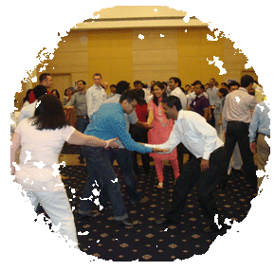
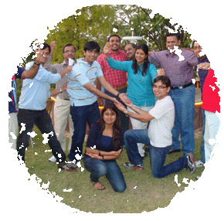
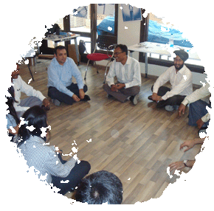
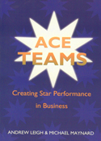
DELIVERY
Information
A today workshop with upto 15 participants per MaynardLeigh consultant.
Style
This will be a totally interactive learning experience. We believe people learn by doing, so there will be many opportunities to express, play, act, debate, explore & experience.
We also believe learning should be fun, so the experience is meant to be enjoyable as well as instructive. Most of all, it is intended to be of practical use; thus we will continually relate the learning back to real-live issues in the workplace, and ensure that the skills can be directly applied to the business.
Methodology
Interactive theatrical exercises. Experiential exercises. Participant led discussions. Practice. Coaching.
Supported by
Handouts & study material designed specifically for the modules being covered in the workshop and our booklet “ACE Teams” on creating STAR performance in Teams

Slide 20
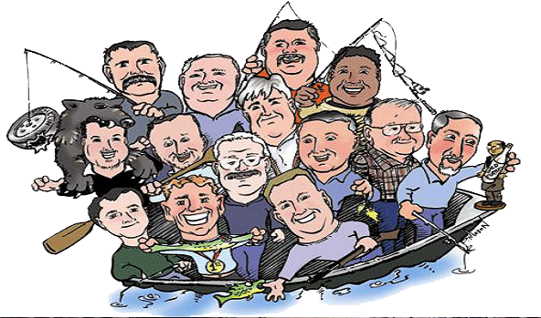
ACE Teams

Slide 21
What is the need for the Ace Teams Workshop?
From the HR
There is a culture of blaming the others. Productivity is falling because there are too many gaps in communication and processes.
Pe0ople are not seeing each other as emotional creatures. They need to be aligned with each other at a very human level.
From Participants
The other team just does not understand our constraints, especially with regards to time.
Everyone guards their priorities fiercely.
Our Inferences
Teams need to be able to feel aligned to be able to create together and explore the possibilities that lie in collaboration.\

Slide 22
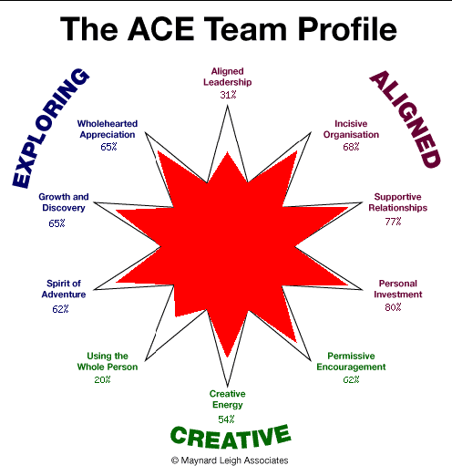
ACE: Aligned, Creative & Exploring

Slide 23
Ace Teams: Expected Outcomes
Think
I can produce better results by collaboration and seeking assistance/ expertise
Be more able to
Bonded to work & collaborate in a more exciting way
Feel
I need to up my game to be able to take the team to greater heights.
I don’t need to get aggressive to make my point
The other teams are my clients too.
Be more able to be action and objective oriented.
Be more able to give and receive feedback productively.
Use my emotional intelligence to deal with team members and cross functional members.
More settled and resourceful because of the teams
Feel energetic and passionate
Feel like getting the best out of the team.

Slide 24
Design of the workshop: ACE Teams
Session | Session Details | Methodology | Outcomes
Warm up | A theatrical warm up to help participants be comfortable with themselves and with each-other. | Theatrical warm up | Overcoming inhibitions, Allowing each other to play
Crazy Act | Theatrical Game – To use humor and drama in bringing an energetic start to the workshop. We use their names at the party mingling to name characters in a story. | Theatre Game | - To be able to have a spirit of fun and Play - Building spontaneity
Brief Encounters | A series of questions are asked which participants share the answer in pairs of 2. An “informal looking” discussion to touch upon the aspects of the workshop. | Group Activity | - Emotional Expression
Team Metaphor | Teams draw a picture of “What’s happening in the team currently” | Group Activity | Identifying the areas of development together as a team
Learning to handle relationships. Understanding how others communicate and learning to listen | Building Rapport & Mirroring. The most important words to use. Understanding social styles Listening | Theatrical Exercises | Exercise and discussion
Rules of Collaboration- Make others Succeed | An experiential game, allowing participants to truly accept each other | Game | Collaboration- Accept different views Permission to fail
Rules of Collaboration-Building Empathy | Functional teams anticipate what other team’s challenges are and present it creatively | Improv Theatre | Build empathy for the cross-functional teams
Rules of Collaboration- Giving attention to others | Team Celebration- Each member creates an acknowledgement for a team/Team Member. A slightly emotional activity. | Theatrical Exercise | Formal Celebration Recognition Sharing

Slide 25
Design of the workshop: ACE Teams
Session | Session Details | Methodology | Addressing Need
Vision to customer | Realization of what it takes to be customer focused as a team | Facilitator Led | Being Proactive to customer needs
Vision of the team 4 service pillars …. | Together the team comes up with a Vision Statement for themselves. This is backed up by 4 service pillars. | Group Activity | Having a shared vision Working together Team Building
Blood Test on Service Pillars | Outdoor Game – on identifying how the team stacks up against each service pillar identified by them. Post this, teams (group of 5) prepares a presentation on each Pillar. | Game | Being aware of their leadership style Awareness on how patterns are formed and how it impacts their work.
Pillar 1: Giving Feedback (Probable) | 6 Minutes Presentation + Psychodrama on actual scenarios- rehearsal of how they could give feedback | Psychodrama | Giving and Receiving developmental feedback Taking care of relations
Pillar 2: Trust (Probable) | 6 Minutes Presentation + Psychodrama on actual scenarios- rehearsal of how Trust could be build | Psychodrama | Building trust
Pillar 3: Customer Orientation (Probable) | 6 Minutes Presentation + Psychodrama on actual scenarios- rehearsal of how they could be customer focussed | Psycho drama | Being Proactive to customer needs; Going out of the way to create delight
Final trust contract | Team sign on behaviors that they will live and demonstrate together | Group Activity | Summarizing the learning

Slide 26
Design of the workshop: ACE Teams
Pillar 4: Ownership and flexibility (Probable) | Victim V/S Chooser- Thinking positively, like a creator. One can control how he thinks about and perceive changes! | Methodology | Opposition and Challenges, Being unconventional at times Innovate
Monkey on our backs | Teams will be competing with each other. Job is to replicate the model that has been kept in the cupboard in 15 minutes. Powerful way to uncover that we live in assumptions and our subjective reality may be guided by our perceptions. A total shake up experience for participants. | Game | Resources VS resourcefulness Establishing trust. All are potential Allies

Slide 27
Things Required for ACE Team
Please ensure that venue for the workshop has natural lighting
Ensure that the venue has enough space for participants to do exercises
The Voice should not echo inside the training venue.
Please send us the complete address of the venue for workshop.
For the workshop, we will need the below mentioned
LCD projector and projection screen 8×10 feet
UPS Power Back-up for Laptop, LCD projector & Laptop speakers
External speakers (for laptop connectivity). The external speakers should be loud enough to play music for the team
White board & White board markers (2 blue, 2 black, 2 green
Flip chart and Flip chart stand with suitable clips
Colour pens (Normal sketch pens - about 30)
Notepads and pens (for participants
Blu Tac (This substance is used to stick things, posters or paper on the wall
50 A4 Size normal sheets
Gadda(8”) sitting is preferred. 2 regular size tables and 1 small size table for the trainer (small table for the LCD projector and the other two regular size tables to keep the props, papers and other material). No fixed chairs or table required for the participants. (room layout picture attached with the mail

Slide 28
Things Required ACE Team Workshop
IX. Facilitator will bring his own laptop . Facilitator will reach the venue at 8:00am on the day of workshop. Kindly arrange for someone to be available at that time to give access to the training venue and an IT person to help with the set-up. Kindly share their contact information with us.
X. Facilitator will carry Handouts/workbook required for the workshop.
XI. Tea/ Coffee, Lunch should not be served inside the training room. Instead the arrangement should be made in the nearby foyer
XII . The workshop will start at 9:30am and finish by 5:30pm. Please make sure the participants are ready for the workshop and enter the training venue by 9:15am.

Slide 29
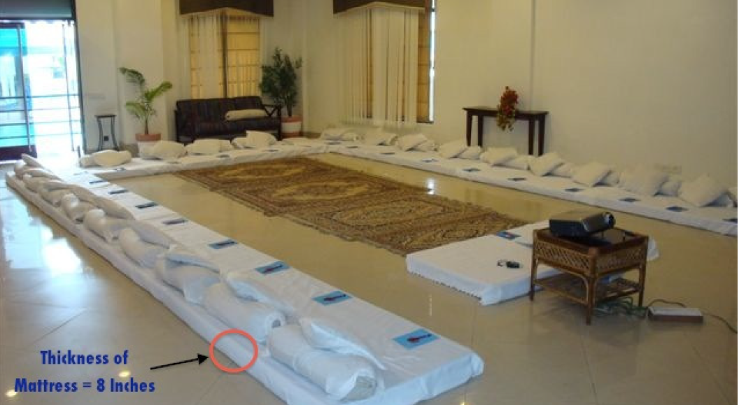
Room Layout – Gaddha Setting

Slide 30
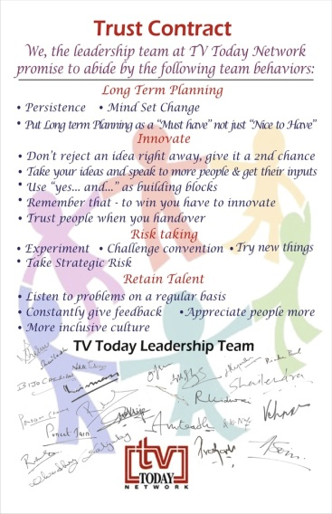

Trust Contract
SAMPLE
At the end of the workshop , the team decides the top few behaviors that they want to abide by and this is converted into a trust contract
( signed by all the participants)

Slide 31
DELIVERY
Information
1-2 days. Upto 25 participants per MaynardLeigh consultant.
Style
This will be a totally interactive learning experience. We believe people learn by doing, so there will be many opportunities to express, play, act, debate, explore & experience.
We also believe learning should be fun, so the experience is meant to be enjoyable as well as instructive. Most of all, it is intended to be of practical use; thus we will continually relate the learning back to real-live issues in the workplace, and ensure that the skills can be directly applied to the business.
Methodology
Interactive theatrical exercises. Experiential exercises. Participant led discussions. Practice. Coaching.
Supported by
Handouts & study material designed specifically for the modules being covered in the workshop and our booklet “ACE Teams” on creating STAR performance in Teams

Slide 32
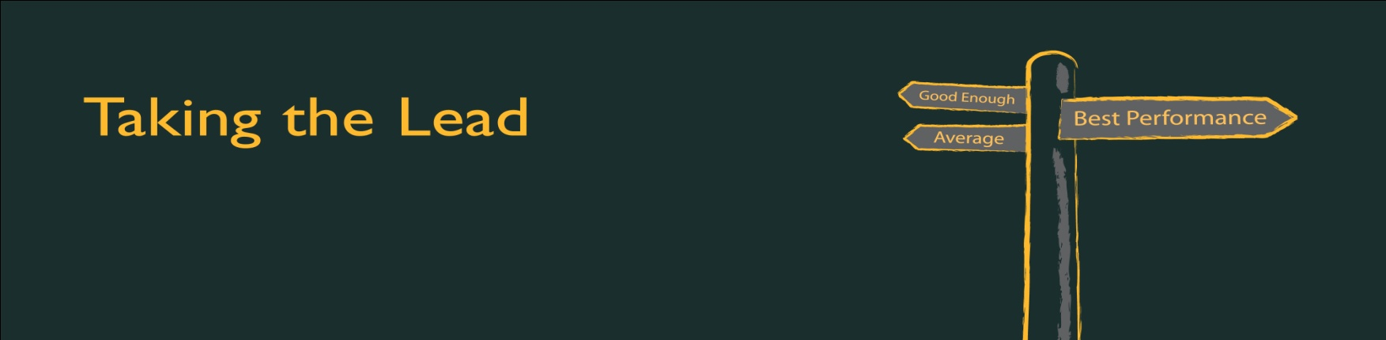
Leading your team

Slide 33
What is the need for the Leading your Team Workshop?
From the HR
There is a lack of ownership in the way in which delegation is currently happening.
With so many tasks to be done, they need to learn how to prioritize and manage their time well.
From Participants
I am not able to tell people
To do their jobs because a lot of them are much older than me.
Time is the biggest constraint in our industry.
Our Inferences
The entire workshop will be on the idea of creating ownership for their roles as leaders and everything that comes with it.
This will be workshop to ready the participants to lead and manage – the multitasking, thinking big, and building trust.

Slide 34
Leading your Team: Expected Outcomes
Think
““I will actively seek and share feedback for continuous improvement.”
Be more able to
Be more able to take decisions with the big picture in mind.
Feel
Empowered to take risks.
“I must build trust amongst my team and all my stakeholders.”
“I cannot have an ‘I’ approach, only with a ‘we’ approach can we succeed.”
Driven to stretch his/her own and the team’s limits to discover hidden talents and abilities.
Enthusiastic about learning and constantly digging deeper.
Be more able to be action and objective oriented.
Be more able to give and receive feedback productively.

Slide 35
Workshop Design: Leading the Way
Session | Session details | Methodology | Outcomes
Introduction | Welcome and context setting Maynardleigh & participant Introductions Permissive Encouragement – Play & Express yourself | Theatrical warm ups Experiential Context setting | Challenged to experiment Responsible for the growth and development of myself and my people
Leadership Journey | Participants story tell where they were able to recognize leadership in themselves. Recognizing the values & strengths that I bring as a leader | Participant stories Facilitator insights | Engaged- I own my career.
Inner cast of characters | The cuts story of our life – our limiting conversations. Identifying our sub personalities & patterns of leadership Leadership is about reclaiming lost personalities & using all the colors available to us purposefully | Experiential activity Group insight | Change is good, my attitude towards a situation/change determines the output, not the change itself.” Take risks and experiment.
Choices – Victim? Observer? Or Chooser? | Being a chooser NOT a victim–playing the different victim & chooser responses that transpire when challenges occur and stop us from initiating action. Participants devise on-the-job vital initiatives that will add value to their organisation | Psychodrama & participant led exercise | “I need to constantly innovate, to take myself and SRF to the next level”
Leadership DNA | An activity to see how we lead in changing circumstances & challenging situations. Do we look to engage & energize? Do we coach & develop? Or does it all take the sidelines when deadlines and challenges approach? (Looks deceptively simple but tests the water very easily !!) | Highly engaging team activity. Interactive, relevant and impactful facilitator insights | “My work should be one level above and not 2 levels below” Collaborate- interact more cross-functionally
Care communication | Introduction to the concept of - The balance between caring for results, relationships & quality. | Facilitator led presentation along with group activity. | “My communication can help create results and relations within my team.”
Feedback | Just say one – The 1 to 100 feedback game Feedback rules – The balls in a basket routine Feedback formula

Slide 36
Workshop Design: Leading the Way
Session | Session details | Methodology | Competency/Objective targeted
People centered leadership | Using Situational Leadership to recognize whom to involve from within the team. Coaching for Motivation-The Quick Coach - Ten goals to Lead | Practical exercises Trainer led presentation. Interactive exercise. | I feel responsible for the growth and development of myself and my people.
Understanding Motivation | What is motivation or demotivation? Understanding the concept of Peak performance. Aligning people’s personal goals. 10 goals to lead | Dramatic presentation of a philosophy.
Coaching for motivation | Coaching as a skill. Advise vs. coach Asking the right questions | Participant exercises. Coaching video
Guiding | The 5 steps of training / developing / guiding | Interactive role play between participants & facilitator | Develop & delegate effectively to create time for more strategic operations
Delegation | The time work-out – what would I do with one free hour a day? The circles of delegation | Participant exercise
VIDI Cards Exercise | Introducing the VIDI philosophy & the Vidi cards. An experiential game to help managers support their people to feel valued, involved, developed and inspired | Facilitator presentation. | Responsible for the growth and development of myself and my people.
Leading through change - The leader that improvises | Using improv theatre to learn the rules of creative collaboration. Taking risks & stretching ourselves Applying accept & build to brainstorming | Improv theatre. Brainstorming | “I need to constantly innovate, to take myself and SRF to the next level” Take risks and experiment. Collaborate- interact more cross-functionally
Push Pull Support | Communicating with Inspiration Practicing inspirational communication • Push Pull Support The Trust Formula | Participant presentations Using objects of Inspiration | Communicate using facts with people above and below
The final scene | Each person has 60 minutes to implement as much as they can of their plan. They need to make as much progress as possible in the time allowed. Action planning-finalizing learning goals from the workshop | Participant led real life implementation. Action planning, goal setting & follow-up planning | Responsible for the growth and development of myself and my people.

Slide 37
Delivery
Information
2 days with upto 15 participants per MaynardLeigh consultant.
Style
This will be a totally interactive learning experience. We believe people learn by doing, so there will be many opportunities to express, play, act, debate, explore & experience.
We also believe learning should be fun, so the experience is meant to be enjoyable as well as instructive. Most of all, it is intended to be of practical use; thus we will continually relate the learning back to real-live issues in the workplace, and ensure that the skills can be directly applied to the business.
Methodology
Interactive theatrical exercises. Experiential exercises. Participant led discussions. Practice. Coaching.
Supported by
Handouts & study material designed specifically for the modules being covered in the workshop and our booklet “ACE Teams” on creating STAR performance in Teams

Slide 38
Timelines ( L1-L2 & L3-L5 )
Dates | Details (L3-L5) | Status
1st & 2nd Dec | Vital Leader workshop | Completed
10th & 11th Jan | One on One Coaching Session | Completed
16th & 17th March | Ace Team Workshop | Confirmed
TBD | Individual Coaching Calls | to be confirmed by SRF
TBD | Wrap up & Share | to be confirmed by SRF
Dates | Details ( L1 –L2) | Status | Batch 1
15th & 16th Dec | Leading The Way | Done
15th & 16th March | Ace Team Workshop( combined with L3- L5) | Confirmed
TBD | Wrap up & Share( combined with L3- L5) | to be confirmed by SRF
Dates | Details ( L1 –L2) | Status | Batch 2 ( remaining L & L2 participants)
27th & 28th March OR 28th & 29th March | Leading The Way | to be confirmed by SRF
TBD | Ace Team Workshop( combined with L3- L5) | to be confirmed by SRF
TBD | Wrap up & Share( combined with L3- L5) | to be confirmed by SRF
Dates | Details ( L1 –L2) | Status | Batch 3( remaining L & L2 participants)
TBD | Leading The Way | to be confirmed by SRF
TBD | Ace Team Workshop( combined with L3- L5) | to be confirmed by SRF
TBD | Wrap up & Share( combined with L3- L5) | to be confirmed by SRF

Slide 39
What is the need for Individual Coaching?
From the HR
Take ownership of their learnings.
There need to be actionable behaviours that are identified and followed up.
Our Inferences
Handholding through a journey will be essential to actually anchor the learnings and follow up on actionable behaviours in everyday work-life attached to these learnings.

Slide 40
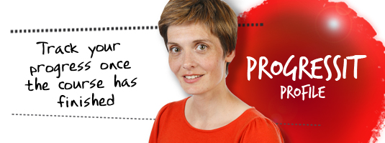
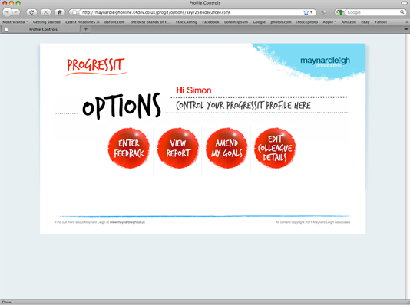
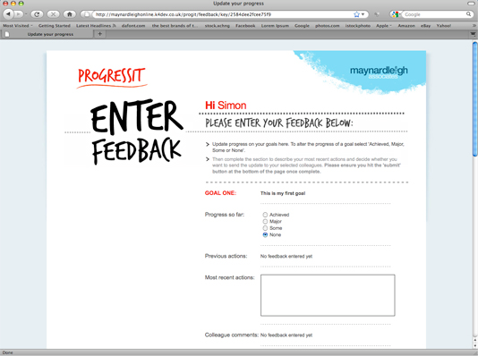
Other support through the journey
Online goal tracking
A nine week support service for people on learning events
Participants choose behavioural goals from their development event
E-mail reminders seek participants’ updates on progress
Records “best opportunity to make progress next week”
Participants record what they’ve learned
Produces a Business Benefits Report

Slide 41
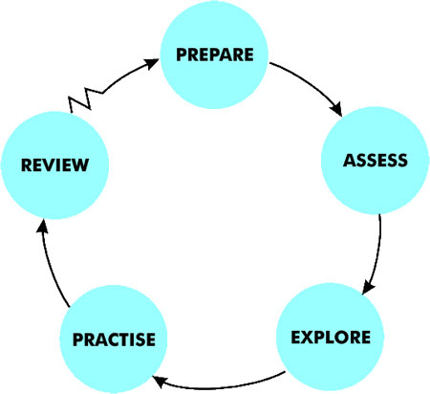

Slide 42

Individual Coaching
Coaching Calls
We suggest executive coaching calls for each participant for 45 Minutes each. Maynard Leigh coaches possess particular skills in creating a safe place in which to practise new ways of thinking and behaving.
The Maynard Leigh performance coaching experience resembles the relationship between a theatre or film director and an actor. The director’s job in rehearsal is to unlock the actor’s potential in order to deliver outstanding performance. They do this in many ways using insightful feedback, suggesting exercises, encouraging experimentation and working in a creative partnership. This is why actors will always expect to get up on their feet and try things out in the rehearsal stage of a production
These sessions will allow the coach & the executive to delve deeper into the area of development and as the sessions progress they will be better suited to practise the learning and revisit what worked & what could be better . Coaching makes a huge impact.

Slide 43
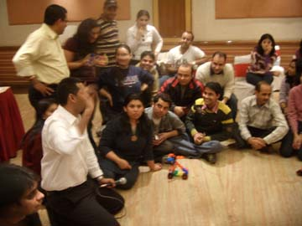
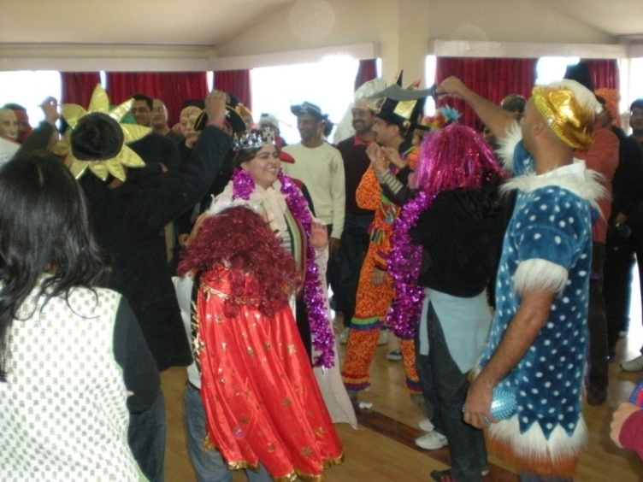
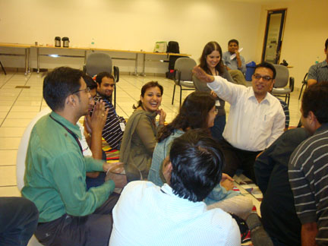
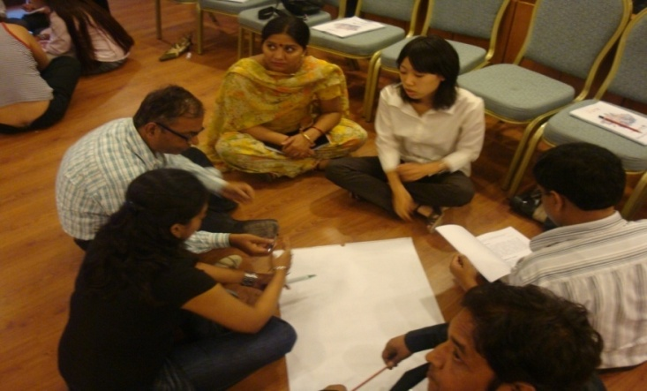
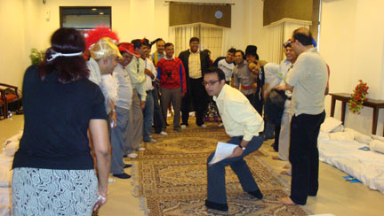

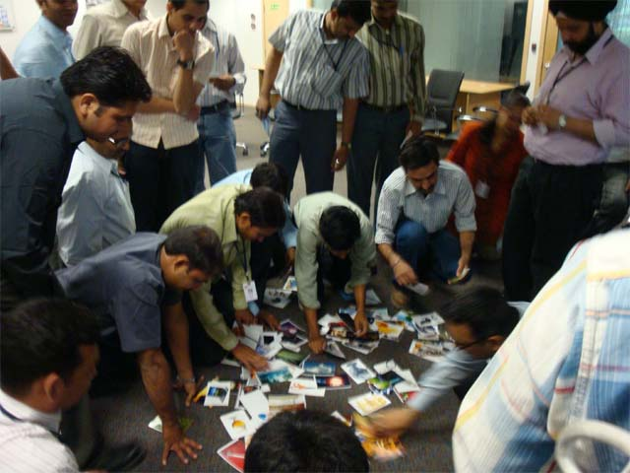
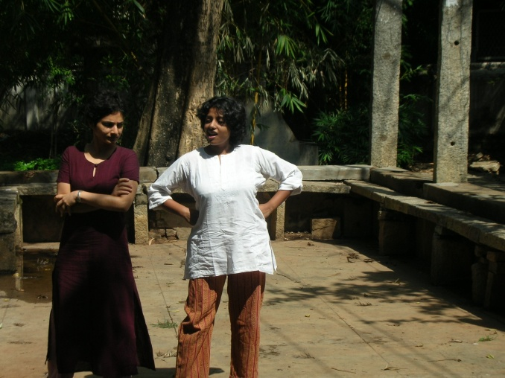
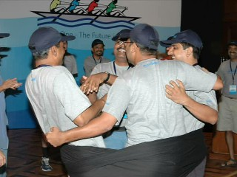
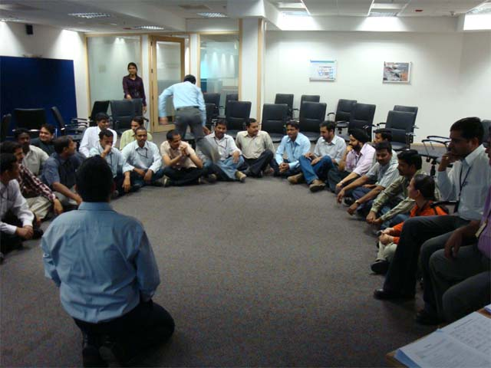
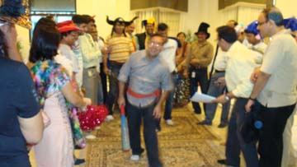

Slide 44

.
For further details, please contact:
Varun Gupta +91 9560192443 (Varun@maynardleigh.in)
Rohit Parewa-+91 9717922446 (rohit@maynardleigh.in)
We look forward to working with you.

