Slide 1


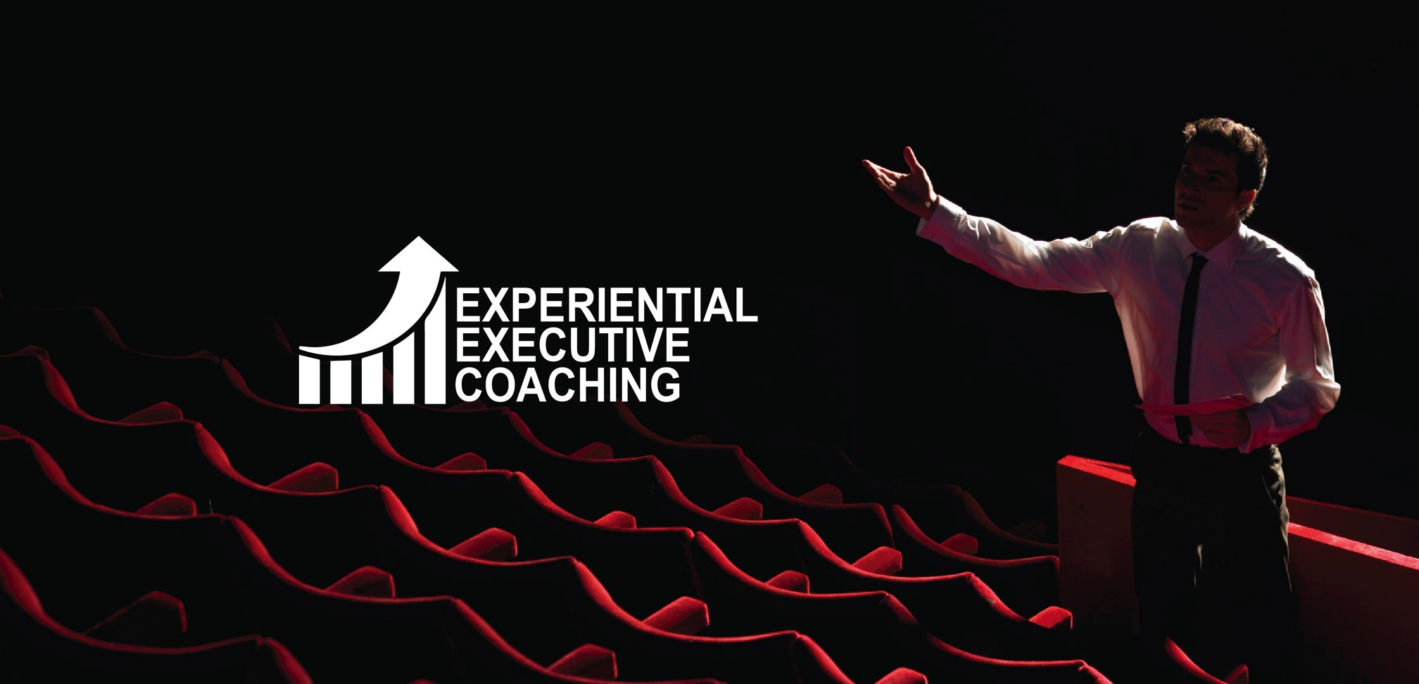

Slide 2

TABLE OF
CONTENTS
The Approach
The Mandate
Executive Coaching- Maynard Leigh’s Lens
The Journey
The Coaching Sessions
ProgressIT
Tentative Investment
Commercial T&C
The Ambience
Contact Us
Page 3 Page 4
Page 5
Page 6
Page 7 Page 8 Page 9 Page 10
Page 11 Page 12

Slide 3
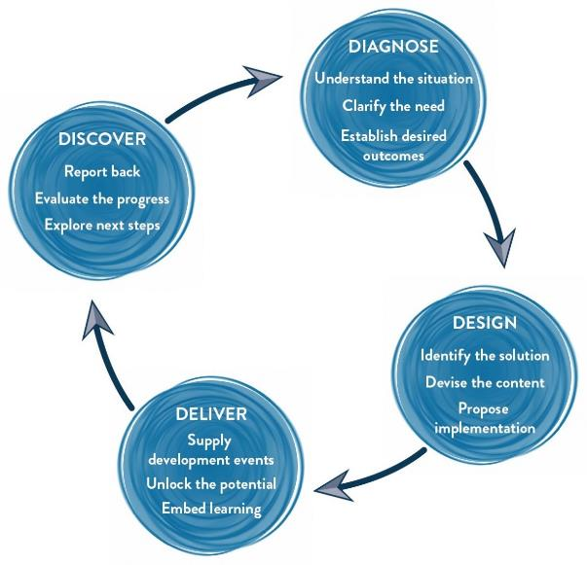
THE
APPROACH
We would start with a further diagnostic conversation with different participants in your organization . We may also run an online profile to gauge the feedback for individuals to then design experiences delivered using theatre methodologies in the workshop along the lines indicated in this proposal.
The experience for the leaders would be delivered by an experienced MaynardLeigh facilitator. We pride in creating unique experiences which would help the team connect back to their behaviour's at work and otherwise.
We would recommend a discovery meeting with you after the workshop has been completed in order to get feedback on the themes and issues that were uncovered.
Methodology
We use Interactive theatrical exercises along with Psychological and L & D tools.

Slide 4
THE
MANDATE
To make an impact in public forums such as interactions with large, unfamiliar groups at seminars, online and offline journalist interviews, etc.
To combine a sharp understanding of the business along with confident communication.
To develop versatility and courage as a communicator.

Slide 5
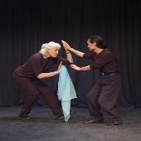
EXECUTIVE COACHING
FROM MAYNARD LEIGH’S LENS
The director’s job in rehearsal is to unlock the an actor’s potential and push him to deliver outstanding performances, our Executive Coaching Experience mirrors the relationship between a theatre or film director and an actor. At Maynard Leigh we take our driving inspiration from the world of performing arts. This is achieved using tools such as insightful feedback, suggesting exercises, encouraging experimentation and working in a creative partnership. This intervention provides a platform for trial and error, which in-turn enhances the participants performance during real life scenarios.
Leaders can work with our coaches to develop themselves on specific areas such as “delivering an inspirational speech at a town hall” , “Preparing themselves for a bigger and better role” or “preparing for leading a big change that is about to happen in the organization”. On the other hand they can choose to work with broader subjects like developing their overall impact. We believe that leadership, communication, impact, performance happen in the body and in the being. Therefore, our coaching sessions go beyond the simple question-based conversation, exploring barriers to high performance; our coachees get on their feet and try things out. They practise, feel & actually experience new ways of doing things in-turn expanding their range and capability. While some of the session will crucially involve an in-depth conversation exploring the depth and dimensions of the issue at hand, its ramifications and ones thinking about it. It will also take the participant into the realm of experience. It will explore their emotional states and the way the choose to express it. It will, more than likely, provide potential opportunities for them to experiment with alternative behaviours and rehearse in anticipated situations. Whatever else, it will certainly be an experience – one that comes out of the dynamic creative partnership between the coach and the participant.

Slide 6




THE
JOURNEY
NEED
GATHERING
MEETING
COACHING
SESSIONS

Slide 7
IMPLEMENTATION
DAY
COACHING
SESSIONS
Participants embarks on the Executive Coaching Journey. For this particular coaching partnership we suggest:
8 one-on-one coaching sessions, followed by 4 tentative sessions if needed.
Each coaching session would be for 90 minutes based on the mandate shared with the coach.
The participant will get assignments, reading tasks and action steps to do between two sessions
These sessions will allow the coach & the executive to delve deeper into the area of impact, influence and pitching. As the sessions progress and they go through mock presentations, the participants would be better suited to practice the learning and revisit what worked & what could be better when the learnings were implemented
01. FOUR <4>
Coaching sessions
02. Mock Presentations
With stakeholders
05. FOUR <4>
Coaching sessions
06. Mock Presentations
With stakeholders

Slide 8
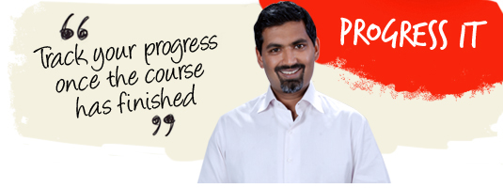
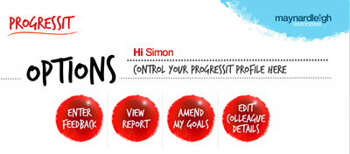
PROGRESS IT
9 WEEK GOAL
TRACKING SYSTEM
Progress IT ® is a powerful on-line support system that provides follow through after a course, a workshop or learning event. We use this innovative service to:
Help participants reach their self selected behavioral goals
Show line managers what their colleagues have learned and report on the business results from their new learning
Enable Human Resources departments to offer evidence of specific business gains stemming from a particular learning experience.
Assign supporters to these participants who will give feedback for a period of nine weeks.
Progress IT ® tackles these with a nine-week support service and a report at the end summarizing progress.

Slide 9
TENTATIVE
INVESTMENT
Delivery
Activity | Investment | Total
8 Executive Coaching Sessions (90 minutes / session) | INR 23,300/- per session per participant X 1 participant X 8 sessions | INR 1,86,400/-
4 Tentative Coaching Sessions (90 minutes / session)** | INR 23,300/- per session per participant X 1 participant X 4 sessions | - to be decided -
Shadowing the leader (half day)** | INR 42,900 per half day per consultant X 1 half day X 1 consultant | - to be decided -
Progress IT | INR 500 per participant X 1 participant | INR 500/-
Total investment |  | INR 1,86,900/-
** to be decided by the MLA coach as the coaching journey progresses.

Slide 10
COMMERCIAL
T&C
Client is responsible for providing venue, conference facilities, AV equipment.
Travel outside Delhi NCR - Air, stay & airport/ venue cab transfers to be taken care by the client.
Travel inside Delhi NCR - at Rs. 12.00 Per Km.
Not inclusive of applicable taxes (GST @18%).
A commercial contract will be signed before the execution of the project.
50% of cancellation fee will be charged on any cancellation or postponements that occur within 3 to 20 working days of the confirmed date of delivery.
100% of cancellation fee will be charged on any cancellation or postponements that occur within 0 to 2 working days of the confirmed date of delivery.
The above commercials are valid till the 31st March 2019
Contracts, legal & accounting paperwork (including billing & payments) will be in the name of “Life Strategies Humancare Pvt. Ltd.”

Slide 11
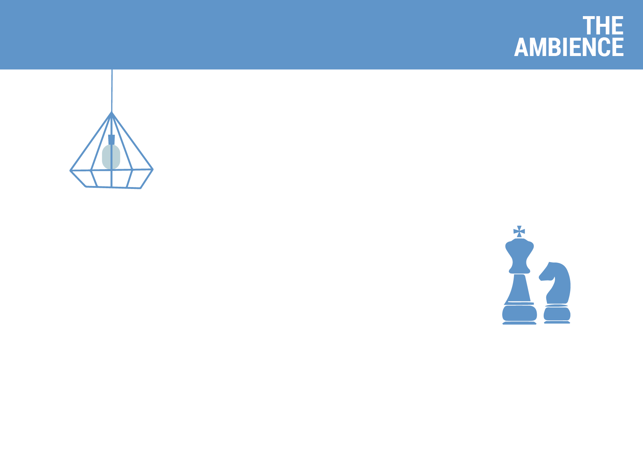
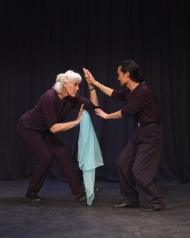
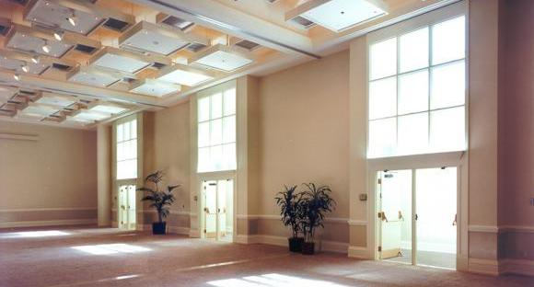
THE
AMBIENCE
We love alternative ways of setting up a workshop! Creating an atmosphere where the participants feels absolutely comfortable and yet challenged. In this workshop, the use of theatre, team games and experiential methodologies are essential ingredients, hence we’d require ample place to move around and make noise. Please book a space with ample natural light (Yes, we want sunlight streaming in) and no fixed furniture for the participant to work with one Maynard Leigh coach.

Slide 12

“You never learn to act in front of a camera.
But you learn to act in a rehearsal room
with a good director”.
- Tim Pigott-Smith
IMPLEMENTATION
DAY
Get in touch
Contact:
Email:
Telephone:
Vivek Arora
vivek@maynardleigh.in
+91 9810811385

