Slide 1



JUICE: Join us in creating energy
Creating an environment of collaboration and trust with top leadership at Maxhealthcare
Approach note- 20th September 2017

Slide 2

Why Maynardleigh?
Over 27 years of experience - delivering work across the globe from our offices in UK, India and US.
We understand that each team, company, industry has its unique needs. We follow an exhaustive 4-D process to customize interventions.
Methodology includes Theatre, Psychology & L&D tools to create experiential learning solutions.
With years of research, their philosophies are published with leading publishing houses like Financial times, Pearson, DK, etc.
Have worked with people at Fortis Healthcare, Maxlife, GSK, Stryker, Maxbupa, Coca Cola, Nestle, Pepsico, Fidelity, SC Johnson and many more

Slide 3
Your need as we understand
22 people from the Neuro team are going for their offsite on the 18th and 19th of November. These people are doctors ( neurologists/ neuro surgeons) who come from a very rich experience and head different specialities. They would be in the age range starting 45 to 50 years and would lead between 4 – 5 people. Through this offsite, the target audience is required to:
Get to know each other and engage formally/ informally
Create an alignment on the vision for neuroscience
The current scenario is-
The target doctors are SMEs however they are required to work with each other to share best practices
To increase efficiency and succession planning, these doctors need to align on the neuroscience vision and create mutual buy in towards it.
Situation
The vision has been shared with the team however they might not be aligned to the vision 20-20
To deliver best services to customers, the doctors need to share their resources and refer patients to each other which might be missing.
Problem
You would like us to design an experiential yet transforming intervention for the target audience which would help create their buy in on strategy and vision for neuroscience and also take them into a place of getting to know each other informally in 3 – 4 hours.
Need

Slide 4
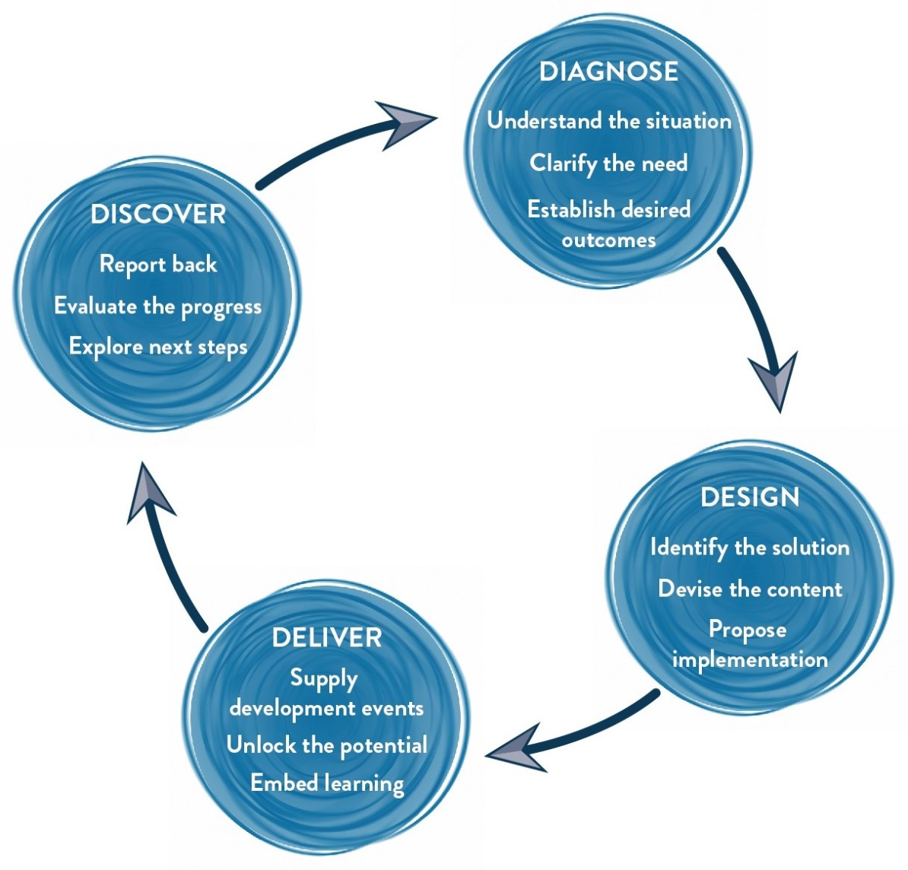
Our Approach
Methodology
We use Interactive theatrical exercises along with Psychological and L & D tools

Slide 5
Tentative Learning Objectives of the Workshop
Think :
I can make a bigger impact when I collaborate in my team and use strengths of others.
I will talk to people and not about people
There is great power in synergy
Feel:
Bonded to work & collaborate in a more exciting way
Excited with what potential lies ahead
At ease and relaxed around team members
Be more able to:
Leverage strengths and growth opportunities across teams for individual’s and team’s benefit.
Support others to perform outstandingly
Build productive, long-term mutually beneficial partnerships with each other
Build an enabling environment that leads to better organizational performance

Slide 6
Tentative Design I Max 25 participant per batch per consultant
Narrative | Session | Session details | Methodology
Starting a day in a state of play helps one to consider and connect with new ways of doing things more readily | Introduction | Welcome and a warm up, setting the context, Maynardleigh & facilitator | Theatre exercise
Getting to know each other. | Brief Encounters | A series of questions are asked which participants share the answer in pairs. An “informal looking” discussion to touch upon the aspects of the workshop. | Centrally trainer led activity
To be able to collaborate with each other, and build positive relationships, we need to check the behaviors around how everyone is currently working together. | Team DNA: Blood Test | To create a highly engaged atmosphere where leaders/team members can gauge their current state & then talk about key excellence, leadership and cross-functional team co-ordination attributes like communicating to increase co-ordination, strategizing for effectiveness, planning, cascading vision, building an internal service culture, being proactive and focusing on process orientation for implementing goals. | A high adrenalin team game, to check team’s behaviors'.
What can we do differently at work to promote this culture at work ? As the senior most leaders what do we need to be doing to promote this behaviour organization wide | Principles of Collaboration | Participants learn tangible tools of Yes Anding and Yes Let’s to be able to build a culture of creative collaboration: Make other’s shine, take risks, | Experiential learning
Sometimes we want to collaborate but our perceptions about others holds us back from going any further? Why do these perceptions get formed? How does impact work? Can we talk to people and not about them | SPY | Teams will be competing with each other. Job is to replicate the model that has been kept in the cupboard in 12 minutes. Powerful way to uncover that we live in assumptions and our subjective reality may be guided by our perceptions. A total shake up experience for participants. | Interactive team game, one of our most loved experiences with teams to shake and wake up leaders.
Every working relationship works when there is TRUST in it. How does one build people's trust in themselves? Is it even possible? Credibility is something that you have been hired for. Reliability, intimacy and self-orientation have to be worked upon in every new space that we enter. | TRUST Formula | The foundation of any new relationship is trust. How does one build a solid foundation? | Individual plus Team Activity
Anchor Learning’s from the workshop. | Trust Contract | Team democratically vote and choose the top 3 behaviors that they will live and demonstrate together for at least a year. | Summarizing the learning

Slide 7
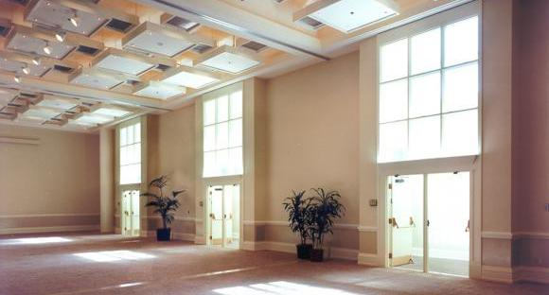
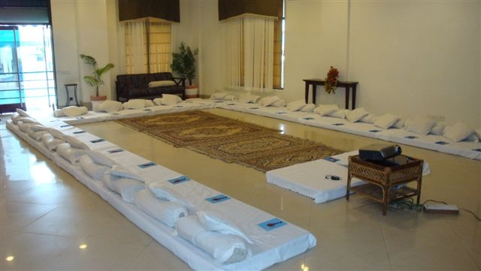
Room Layout
The Setting
We love alternative ways of setting up a workshop! Creating an atmosphere where the participants feels absolutely comfortable and yet challenged. In this workshop, the use of theatre, team games and experiential methodologies are essential ingredients, hence we’d require ample place to move around and make noise.
Please book a space with ample natural light (Yes, we want sunlight streaming in) and no fixed furniture for the participants to work with one Maynard Leigh consultant.

Slide 8





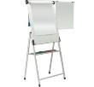


Things Required at the Venue
For the workshop, we will need the below mentioned:
LCD projector and projection screen
UPS Power Back-up for Laptop, LCD projector & Laptop speakers
External speakers (for laptop connectivity). The external speakers should be loud
enough to play music for the team.
White board & White board markers (2 blue, 2 black, 2 green)
Flip chart and Flip chart stand with suitable clips
Colour pens (Normal sketch pens - about 30)
Notepads and pens (for participants)
Blu Tac (This substance is used to stick things, posters or paper on the wall)
20 A4 Size normal and drawing sheets
2 tables for the consultant( one will be used for the projector and the other for keeping the handouts)

Slide 9
Your Investment
Diagnose & Design (For the whole Intervention) – ONE TIME COST
One Day Diagnostic Interviews One day Design ( creating report, customizing design, presentation of design) | INR 66,000/- INR 66,000/-
Delivery (for 25 participants)
Activity | Investment
Professional fee for delivery of half day ACE Teams workshop ( Dehradun) Learning Material and folders Trust Contract | INR 66,000 per half day per consultant X 1 day X 1 consultant INR 100 per participant X 25 participants INR 3000 /- | INR 66,000 /- INR 2,500 /- INR 3000/-
Total Investment for journey covering 25 Participants |  | INR 2,03,500/-

Slide 10
Commercial Terms & Conditions
Client is responsible for providing venue, conference facilities, AV equipment.
Travel outside Delhi NCR - Air, stay & airport/ venue cab transfers to be taken care by the client.
Travel inside Delhi NCR - at Rs. 12.00 Per Km.
Not inclusive of applicable taxes (GST@ 18%)
A commercial contract will be signed before the execution of the project.
50% of cancellation fee will be charged on any cancellation or postponements that occur within 20 working days of the confirmed date of delivery.
100% of cancellation fee will be charged on any cancellation or postponements that occur within 0 to 2 working days of the confirmed date of delivery.
The above commercials are valid till the 31st March, 2018
Contracts, legal & accounting paperwork (including billing & payments) will be in the name of “Life Strategies Humancare Pvt. Ltd.”

Slide 11

Next Steps
Call with Tina: We would love to schedule a time next / this week to have a conversation with Tina to understand the mandate
Contracting and PO: Once we close on the commercial, let us work on the contract and PO
Book: Let us block the dates for the Diagnosis and Design right away so that we have consultants available for you.

Slide 12

Let’s work in partnership to create impact & unlock potential
For further information please connect with:
Contact Jigyasa Sharma
Email jigyasa@maynardleigh.in
Telephone +91 9717922445

