Slide 1



Shake-up, Wake-up
The Vital Leader workshop journey provides a direct and hand-on approach to effective leadership and people management
This Masterclass is a rare and demanding way of exploring limits in a safe yet challenging environment

Slide 2
Your Need As We Understand
Delhivery is India’s largest E-commerce enablement company today which provides express logistics services expanded to 350+ cities and processing capacity to over 1.2million shipments/day. You have about 8 - 24 Senior leaders/Directors/VP’s who are the target audience for this learning journey. They come with experience ranging between 8-10 years in the industry within the age bracket of about 26-32 years. They lead a team of about an average of 8-10 people. They are extremely analytical, sharp and primarily engineers with management degrees from the IIM’s or ISB.
Situation
A few of the issues at hand are:
Transmitting of thoughts and effective communication among people within the organization is not part of their ethos
Need to learn how to manage and cascade change within the organization
Require more clarity in terms of how to give feedback and constructively work on it
Need to understand the depth of how to actually take care of their people
Require to understand the importance of taking decisions with a consensus
Problem
High level of stress and strain among people which results in people leaving the organization
Attrition rates are extremely high at 30%.
Some of the people are unable to keep up with constant change
People part of the equation is missing
Implication
Need
Delhivery would like to bring about a change within the organization via an experiential learning journey. The culture of the organization needs to be cascaded to an extent where the “People’s part of the equation” begins to be given importance.

Slide 3
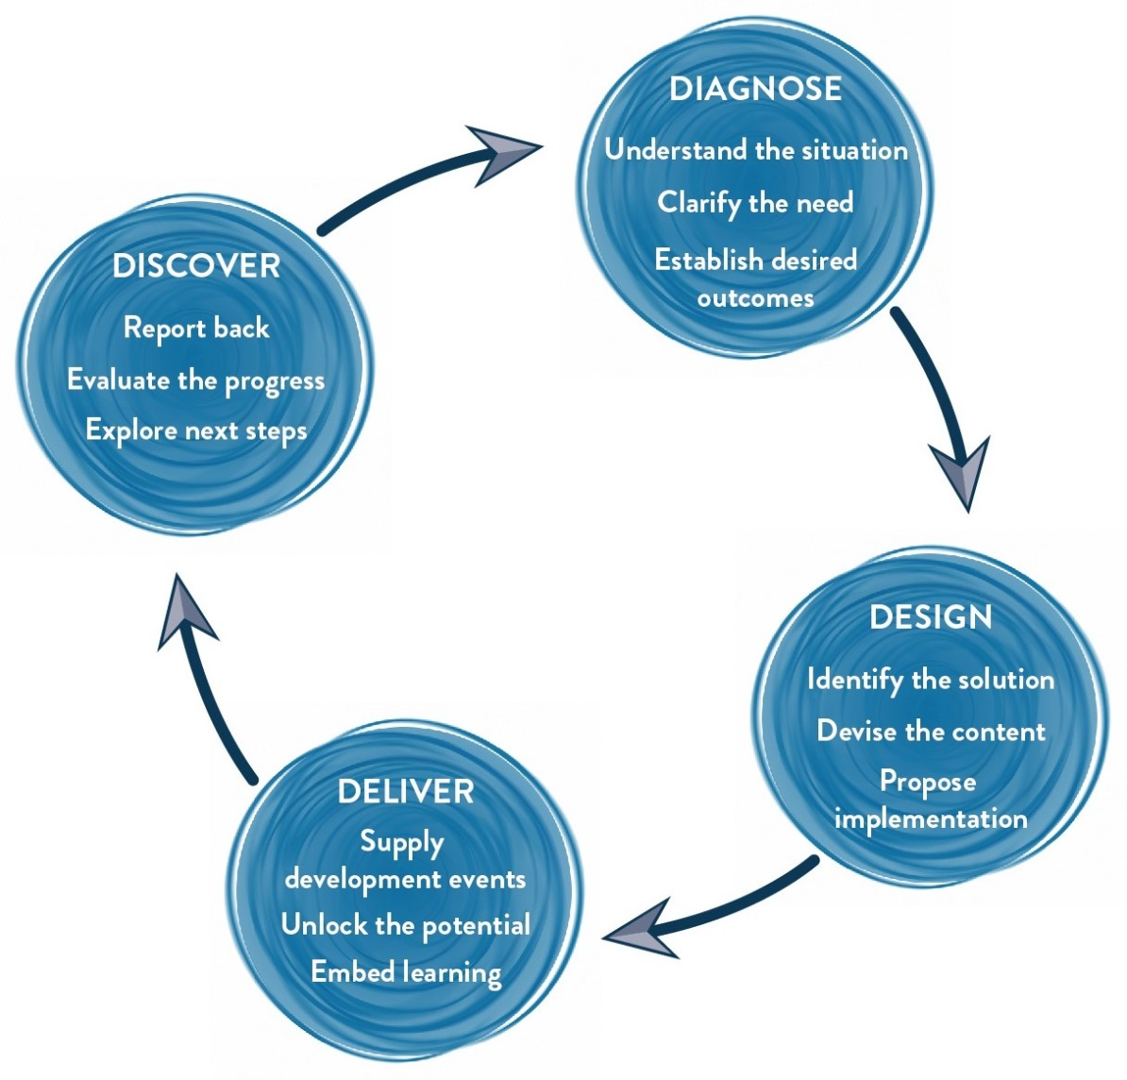
Our Approach

Slide 4
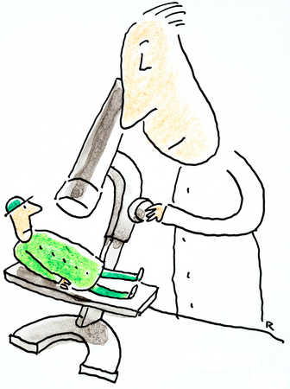
Our Approach | Diagnosis
In the Diagnosis Stage we delve deeper into the issues faced by the participants:
We would want to connect with a sample of the target participants, HR stakeholders and business stakeholders to collect information about the business, target participants, possible gaps, expectations & objectives. This shall be done via in-person meetings.
We specifically gather information on:
What do the leaders currently believe in and what do we want him/her to Think, Feel and Do differently
What is the focus of business for the next 2-3 Years
What business case should these leaders be focusing on? How can their improved efficiency impact the business?
Gather anecdotes, examples & situations where you’ve seen the leaders behave in a certain way and the impact it had on the business according to the sample of the target participants

Slide 5

Our Approach | Design
Post the diagnosis, we get into the design phase of the learning intervention.
Here are 2 things we will do:
Diagnosis report: A report is generated which would reflect the outputs from Diagnosis (The identity of the participants would be kept confidential)
Design Customization: The consultant will design the final objectives and customize the content of the learning intervention. Modules of the workshops are designed, activities are mapped to the examples, new handouts are drafted based on the content.

Slide 6
Tentative Outcomes of the Workshop
Think
Inspiration can unlock my and my team’s performance
A big part of my responsibility as a leader is to create inspiration and manage my people
To enliven my teammates working life
I can share my doubts & fears in the open
If I motivate my people authentically it will go a long way
Feel:
More comfortable in expressing passion
Engaged with my co leaders/managers
Refreshed and alive
Bigger, bolder and better
Vulnerable as a leader
Be more able to:
Inspire themselves and their team members
Create better team working
Take productive risks with consensus
Have compelling conversations
Manage people with focus on productivity, quality and emotions

Slide 7
Our Testimonials
Naming it training might not be just. It was an amazing experience where the coach was more interested (and rightly so) in actual counseling and problem solving rather than preaching the words of wisdom with silly slides. Totally worth the time and unique. Thanks for the opportunity
- Leader at American Express
This workshop provides a break to the engrossed mind and pushes you to think about yourself and people around you in an altogether new way. Impacting people around you will become so much more interesting as you will use different techniques for different people around you. Facilitator takes you to a WORLD OF DRAMA AND PSYCHOLOGY, which will tease your mind to fly and be creative. It will teach you to KEEP ALL YOUR COLORS ALIVE!!!
- Leader at PepsiCo India
I have attended lot of such sessions earlier and I don’t remember any other session that has impacted me so much. I think the last 2 days were one my most productive days. It was very thought provoking and helped me realize myself. The session has left a huge impact on me and I am still into that world thinking about what I can do different that would have a greater impact both on me as well as others. I know I have already started practicing some of them.
- Leader at Cognizant

Slide 8
The Vital Leader Workshop | Day 1 Sample Design
Session | Session details | Methodology
Starts at 9.30 AM
Hello | Quick facilitator & MLA intro followed by loosening exercises. Tight circles, Columbian hypnosis. | Actor Prep Exercises
Brief Encounters | A series of questions are asked, to which participants share the answer in pairs. An “informal looking” discussion to touch upon the aspects of the workshop. | Group Exercise
Context Setting | Why we are here? Clarity on learning objectives. Purpose – Leading through change. Principles – the responsibility is yours. What it takes – INSIGHT, INTIATE, INVOLVE, INSPIRE & IMPROVISE. | Facilitator Led
INSIGHT SELF - Business Transformation Scenes | Assessment of current business situation, viewed from a creative perspective of each participant. A chance for each person to tackle a tricky situation in the business and change it. Each participant gets support from the fellow participants for the change. | An inspiring group exercise
INSIGHT OTHERS - Seeing the Potential | Leading by looking at the invisibles in a person. Looking beyond our perceptions & judgments about people to find their real potential and then helping them develop that. Napoleon slide. | Facilitator Led; Participant Work
Getting ready | Leaders work in groups to define INTIATE, INVOLVE, INSPIRE & IMPROVISE. They create actionable behaviors around each and work on creating theatre. | Experiential activity Group insight
INITIATE | Theatre from INITIATE Team. What stops us from initiating? Victim Vs Observers Vs Chooser - The pillow fight | Activity done individually and then explored as group.
Homework | Overnight homework on inspiration | Homework Exercise

Slide 9
The Vital Leader Workshop | Day 2 Sample Design
Session | Session details | Methodology
Starts at 9.30 AM
INVOLVE | Involve group performs theatre, forum theatre happens afterward. Coaching skills. Working on people. | Theatre, Forum Discussion, Group Exercises
INVOLVE | Constant communication without emotional vomiting. Creating permissive encouragement Feedback is a gift. | Group Exercise
IMPROVISE | Improvise group performs theatre, forum theatre happens afterward. | Theatre, Forum Discussion, Group Exercises
IMPROVISE - Creative collaboration | Learning what it takes to create an environment where people feel involved. The rules of creative collaboration with team members. | Improv Theatre with Real Life Experience
INSPIRE | Inspire group performs theatre, forum theatre happens afterward. | Theatre, Forum Discussion, Group Exercises
INSPIRE - Inspirational pieces. What inspires me? | Participants present a 2-3 min inspirational piece i.e. song, poem, prose, speech from a play etc. ( asked to come prepared ). They need to choose a piece they find inspiring. | Coaching and Creative Partnership
Action Planning and Commitment Videos | Participants create their own commitment videos and finalize their “Stop Start Continue” | Goal Setting

Slide 10
Tentative Commercial Investment Cost (for Vital Leader)
Diagnose & Design (For the whole Intervention)
One Day Diagnostic Interviews Half-Day Design Customization (Creating a report, customizing design) | INR 75,000/- (One time charge) INR 46,000/- (One time charge)
Delivery (Max Participants in Each Batch can be 14)
Activity | Investment Rate | Actual Investment Per Batch
Professional Fee For Workshop Delivery | INR 75,000 Per Consultant Per Day x 2 Days | INR 1,50,000
Leading the Way Book, Hand-Outs, Use of Props & Certificates | INR 2100 Per Participant x 12 Participants | INR 25,200
Total Investment for journey covering 12 Leaders |  | INR 296,200
Cost per leader |  | INR 24,683.33

Slide 11
Commercial Terms & Conditions
Client is responsible for providing venue, conference facilities, AV equipment.
Travel outside Delhi NCR - Air, stay & airport/ venue cab transfers to be taken care by the client.
Travel inside Delhi NCR - at Rs. 12.00 Per Km.
Not inclusive of applicable taxes (service tax @ 15.00%).
A commercial contract will be signed before the execution of the project.
50% of cancellation fee will be charged on any cancellation or postponements that occur within 3 to 20 working days of the confirmed date of delivery.
100% of cancellation fee will be charged on any cancellation or postponements that occur within 0 to 2 working days of the confirmed date of delivery.
The above commercials are valid till the 31st March, 2018
Contracts, legal & accounting paperwork (including billing & payments) will be in the name of “Life Strategies Humancare Pvt. Ltd.”

Slide 12
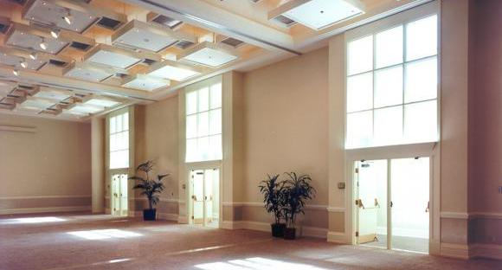
Ambience Required
We love alternative ways of setting up a workshop! Creating an atmosphere where the participants feel absolutely comfortable, yet challenged. In this workshop, the use of theatre, team games and experiential methodologies are essential ingredients, hence we’d require ample place to move around and make noise.
Please book a space with ample natural light (Yes, we want sunlight streaming in) and no fixed furniture for the 12 leaders to work with one Maynard Leigh consultant.

Slide 13

Next Steps
Vendor Empanelment: Since this is the first time we are working for you, let us start the process of vendor empanelment for smooth processing
Contract and PO: Once we close on the commercials, let us begin the process to close the contracts and get the PO
Diagnose - We’d like to begin the diagnosis phase to clarify the need and establish the learning outcomes.
Book: Let us know the dates you are looking at so that we can have consultants available for you

Slide 14

Contact Us
Let’s work in partnership to create impact & unlock potential
For further information please connect with:
Varun
varunh@maynardleigh.in
9560192443

