Slide 1




Slide 2
Index
Title | Page Number
Your Need As We Understand | 3
Our Approach | 4
Tentative workshop learning outcomes | 6
Tentative workshop design | 5,7
Tentative Commercial Investment | 8
Terms & Conditions | 9
Room Layout Required | 10
Things Required at the Venue | 11
Next Steps | 12
Contact Us | 13

Slide 3
Your Need As We Understand
Background
IDFC Bank Ltd. (Infrastructure Development Finance Company) is an Indian banking company with headquarters in Mumbai that forms part of IDFC, an integrated infrastructure finance company. The bank started operations on 1st October 2015. IDFC received a universal banking licence from the Reserve Bank of India (RBI) in July 2015.
Situation
The target audience includes 12 members of the asset management sales team headed by Gourab and have an experience of 15-20 years. The are team leaders who have been working together 5-6 years.
There is an opportunity for them:
Work cohesively as a team
Align to the leader’s vision of high performance
Build skills to better relationships with channel partners
Improve on Executive Presence
Opportunity
You would like to do this intervention to:
Improve the ranking of IDFC fund
Have a committed and motivated team
Innovate processes of the team
Accept new changes that Gourab is proposing
Need
There is a need to create an intervention for alignment between the team members and enrich their executive presence. Maynardleigh recommends a 2.5 day workshop to create this transformation in the asset management sales team.

Slide 4
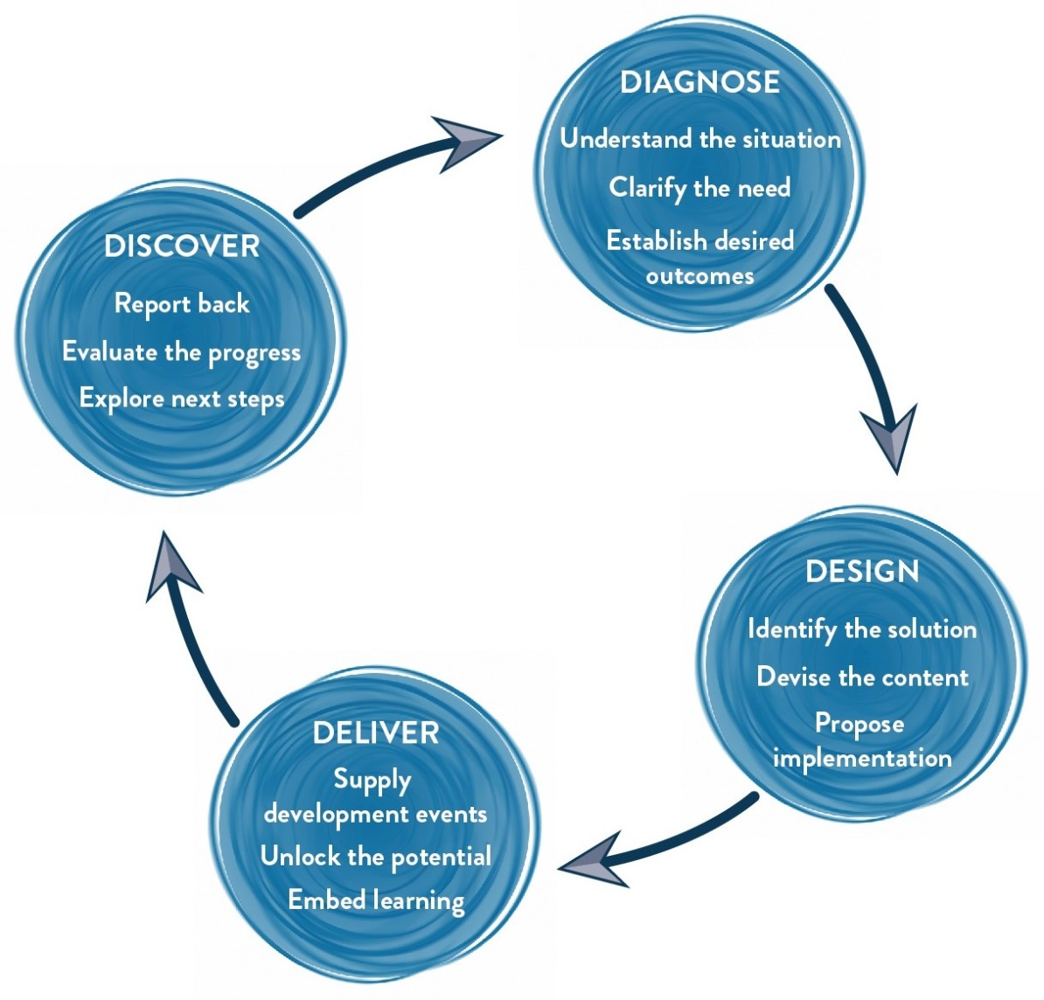
Our Approach – The 4D Model
We would start with a further diagnostic conversation with different participants in your organization . We may also run an online profile to gauge the feedback for individuals to then design experiences delivered using theatre methodologies in the workshop along the lines indicated in this proposal.
The experience for the leaders would be delivered by an experienced MaynardLeigh facilitator. We pride in creating unique experiences which would help the team connect back to their behaviour's at work and otherwise.
We would recommend a discovery meeting with you after the workshop has been completed in order to get feedback on the themes and issues that were uncovered.

Slide 5
Vital Leader Journey –Workshop – Day 1, Upto 11 participants per batch per consultant
Time | Session | Session Details | Methodology | Outcome
9:30 am to 10:00 am | Brief encounters ( Ice Breaker) | Participant Introductions – done in a very fun & creative way. Permissive Encouragement – Play & Express yourself | Activity done in Pairs | Getting to know each other
Review Meetings ( 10:00 am to 12:00 pm)
12:00 pm to 1;00 pm | Team DNA: Blood Test | To create a highly engaged atmosphere where leaders/team members can gauge their current state & then talk about key excellence, leadership and cross-functional team co-ordination attributes like communicating to increase co-ordination, strategizing for effectiveness, planning, cascading vision, building an internal service culture, being proactive and focusing on process orientation for implementing goals. | A high adrenalin team game, to check team’s behaviors. | To be able to collaborate with each other, and build positive relationships, we need to check the behaviors around how everyone is currently working together.
Lunch and Review meetings ( 1:00 pm – 4:15 pm)
4:15 pm to 5:30 pm | Spy | Teams will be competing with each other. Job is to replicate the model that has been kept in the cupboard in 15 minutes. Powerful way to uncover that we live in assumptions and our subjective reality may be guided by our perceptions. A total shake up experience for participants. | Facilitator led activity | While the teams have gotten an understanding on the pillars of collaboration, we create an experience where the leaders learn to share their feeling with each other and not create perceptions
 | Wrap Up

Slide 6



Tentative Workshop Learning Outcomes
Think:
People notice my impact, no matter when & where I am and I can grab their attention
I need to be clearer on my branding and who I am
I need to be clearer on my aim and how I come across
I now understand the importance of executive presence
Feel:
Energized to make an impact
Confident in pushing for sales
Connected to their personal brand
Be more able to:
Build a stronger executive presence
Be more impactful conversations that lead sales
Convery a sense of quality and gravitas
Reflect the IDFC brand better

Slide 7
Vital Leader Journey- Workshop – Day 2, upto 11 participants per batch
Session | Session Details | Methodology | Outcome
Introduction | Welcome and context setting Maynardleigh & participant Introductions Permissive Encouragement – Play & Express yourself | Theatrical warm ups Experiential Context setting
Entrance Impact Presentation | “Make a pitch and present for 60 seconds as someone who is making an impact” Video graphed feedback | Video Playback in the room | Establish credibility in professional encounters
Issues List & Buddy Up | Based on the experiences above participants narrow down on the 2-3 things they need to work on in order to increase their impact. Coaching pairs are made. | Discussion with coach and putting issues on a flipchart | Participant led
AIM | Clarifying objectives. What is the purpose of any communication? What would a positive outcome look like? Working with purpose and performance objectives. Structuring communication for Impact | Facilitator led presentation. Participant exercises. | I will clarify the impact I want to have before any communication
Personal Branding | Answering questions about self and finding a symbol that defines 'me'. | Reflective Exercise and Sharing | What is the point of you? What is your point of view? What are your values? What makes you, you?
B = Be Yourself | Preparing all your resources to create a Personal Impact MIND –BODY – BREATH –VOICE – EMOTIONS | Rehearsals Coaching Experiential activity | Tools that help us build presence and stature with our audiences.
Status | Mind-body-breath are connected. Any one of these affects the other two. Just changing your body, voice, eye contect, pace, can affect the level of confidence you feel. Just learning to tweak these can make you a status expert. | Role Plays. | Exhibiting high self esteem
Chemistry | ATTENTION Focusing attention on the other person or people. RAPPORT Mirroring and developing sensitivity to others | Experiential exercises. Participant practice exercise. Participant led peer coaching | Able to create/build productive relationships. Exhibit greater empathy.
Homework | Participants get a homework to come prepared with quality pieces

Slide 8
Tentative Commercial Investment
Diagnose & Design | For The Whole Intervention
Delivery (Max 12 Participants Per Batch)
Activity | Investment | Total Cost
Professional Fee for delivery | 75,000 Per Day Per consultant X 2 Days X 1 Consultant | INR 1,50,000/-
Folders, Handouts, DO IT NOW Cards, Charisma Effect Book | INR 930 X 12 Participants | INR 11,160/-
Total Investment for 12 Participants |  | INR 1,61,160
Cost per participant |  | INR 13,430

Slide 9
Commercial Terms & Conditions
Client is responsible for providing venue, conference facilities, AV equipment.
Travel outside Delhi NCR - Air, stay & airport/ venue cab transfers to be taken care by the client.
Travel inside Delhi NCR - at Rest 12.00 Per Km.
Not inclusive of applicable taxes (GST applicable at 18%).
A commercial contract will be signed before the execution of the project.
50% of cancellation fee will be charged on any cancellation or postponements that occur within 3 to 20 working days of the confirmed date of delivery.
100% of cancellation fee will be charged on any cancellation or postponements that occur within 0 to 2 working days of the confirmed date of delivery.
The above commercials are valid till the 31st March 2018
Contracts, legal & accounting paperwork (including billing & payments) will be in the name of “Life Strategies Humancare Pvt. Ltd.”

Slide 10
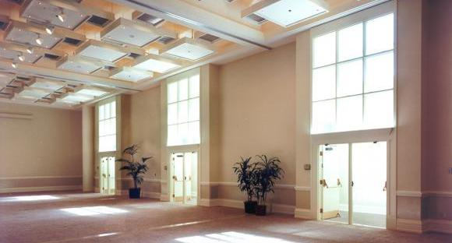
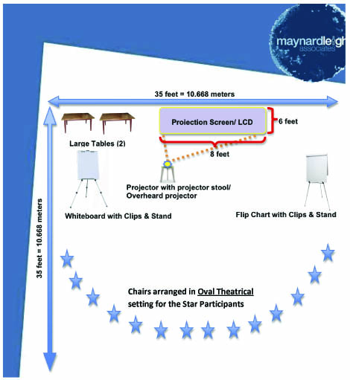
Room Layout Required
We love alternative ways of setting up a workshop! Creating an atmosphere where the participants feel absolutely comfortable, yet challenged. In this workshop, the use of theatre, team games and experiential methodologies are essential ingredients, hence we’d require ample place to move around and make noise.
Please book a space with ample natural light (Yes, we want sunlight streaming in) and no fixed furniture for the participants to work with Maynard Leigh consultant.

Slide 11
Things Required at the Venue
For the workshop, we will need the below mentioned:
LCD projector and projection screen
UPS Power Back-up for Laptop, LCD projector & Laptop speakers
TV with Remote for Video playback (Day 1)
External speakers (for laptop connectivity). The external speakers should be loud enough for music playback
White board & White board markers (2 blue, 2 black, 2 green)
Flip chart and Flip chart stand with suitable clips
Color pens (Normal sketch pens - about 30)
Notepads and pens (for participants)
Blu-Tac (This substance is used to stick things, posters or paper on the wall)
20 A4 Size normal and drawing sheets
2 tables for the consultant (one will be used for the projector and the other for keeping the handouts)

Slide 12

Next Steps
Vendor Empanelment: Since this is the first time we are working for you, let us start the process of vendor empanelment for smooth processing
GST information: to expedite the commercial contract and PO, we would require the GST information
Travel: since this workshop would be held on the 10th, 11th & 12th August, we would need to arrange for the consultant’s travel

Slide 13

Contact Us
Let’s work in partnership to create impact & unlock potential
For further information please connect with:
Jigyasa Sharma/ Vivek Arora
jigyasa@maynardleigh.in / Vivek@Maynardleigh.in
+91 9717922445 / +91 9810811385

