Slide 1
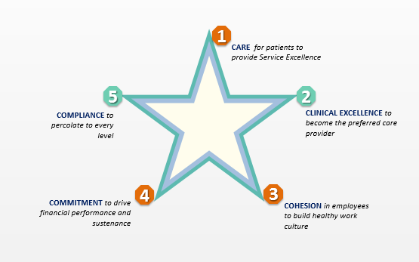

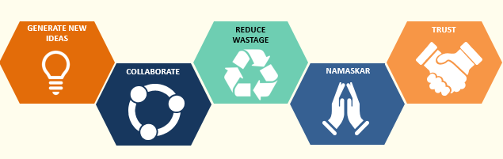
Brand MaxHealthcare: Great Place to Work
5 C’s

Slide 2

Our People in 2020 and beyond
Brand MaxHealthcare: Great Place to Work
Transparent & Fair Process to Manage performance:
E-enabled self assessment and manager assessment that is driven by clear metrics
Happy place to work: support systems like EAP, Concierge desk, Empowerment to appreciate and award, Employee App on mobile - company policies, leaves, attendance
Robust IJP System :
70% of job opening up to GM level to be filled through internal talent. Building strong line of leaders
Equal opportunity for all irrespective of gender, state, educational qualification. Opportunities for differently abled
E-enabled learning opportunities:
Build your own learning calendar
Support Employee life cycle: self development opportunities, support for family through career counselling, Health camps, work experience scholarship for employee children
Culture of collaboration and interdependence between clinicians and non-clinician world, Celebrating Success
Growth & Recognition : based on performance outcome AND display of valued based leadership. Contribution to patient outcomes and patient service.
Excellence in domain displayed through external recognition of expertize.
Market value of MAX Employees will be multiple of 2 or more
Chasing Zero: Zero Lead time to close positions – employer of choice
Notes:
Rajit/Lead EC Facilitator
Paint a picture on the positive impact for our people if we are able to meet our vision 2020

Slide 3
MHC : 2020 and beyond
Brand MaxHealthcare: Great Place to Work
Setting new benchmarks in the healthcare sector, in India
Differentiated (ETGYH) and Trusted healthcare provider in India
Known for leading technology in clinical space – eg. Robotics, Genomics
Well on the way to build the single largest, medical facility in Asia
Providing integrated, digitally enabled, comprehensive care with Max@Home, MaxLab, Day care, E-ICU
Known for Centers of Excellence with super-specializations in Oncology, Neurosciences, Cardiology, Renal sciences and Transplants
Empathetic and Exceptional Service enabled by patient friendly processes & people
Attracting patients from over 20 countries with Industry standards of Care, Cure and Comfort
Recognized as a Top Quality institution for Research and Publications
Talent Powerhouse for Best in Class Doctors, Nurses and Best Practices in the industry
“The Apple of Healthcare”
Notes:
Rajit/Lead EC Facilitator
Paint a picture of what MAX Healthcare would look like in 2020if we get the panchkarma right

