Slide 1
Redux
By- Priyanka Kesharwani

Slide 2
Overview
Redux is a predictable state container for JavaScript apps.
To rephrase that, it’s an application data-flow architecture.
Redux is a pattern and library for managing and updating application state, using events called "actions". It serves as a centralized store for state that needs to be used across your entire application, with rules ensuring that the state can only be updated in a predictable fashion.
Redux helps you manage "global" state - state that is needed across many parts of your application.

Slide 3
MVC VS REDUX VS FLUX
In MVC architecture, there is one issue with this, especially in large-scale applications: The flow of data is bidirectional. This means that one change (a user input or API response) can affect the state of an application in many places in the code — for example, two-way data binding. That can be hard to maintain and debug.
The main difference is with Flux is that Flux has multiple stores that change the state of the application, and it broadcasts these changes as events. Components can subscribe to these events to sync with the current state.
Redux doesn’t have a dispatcher, which in Flux is used to broadcast payloads to registered callbacks.

Slide 4
Where to use Redux
You have large amounts of application state that are needed in many places in the app
The app state is updated frequently over time
The logic to update that state may be complex
The app has a medium or large-sized codebase, and might be worked on by many people

Slide 5
Create a React Redux App
npx create-react-app my-app --template redux
Redux Core
npm install redux

Slide 6
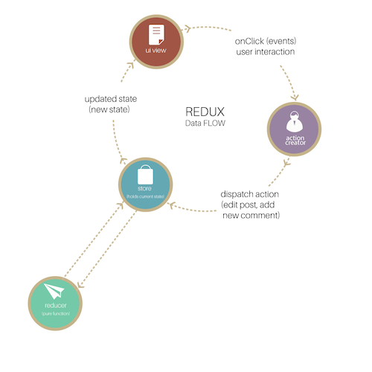
Building Parts Of Redux
Notes:
Some of our top engagements.
Extensive expertise in all areas of mobile application ecosystem.

Slide 7
ACTIONS
An action as an event that describes something that happened in the application.
Actions send data from the application (user interactions, internal events such as API calls, and form submissions) to the store.
Actions are simple JavaScript objects that have a type property (usually constant), describing the type of action and payload of information being sent to the store.
Actions are created with action creators. That sounds obvious, I know. They are just functions that return actions.
function incrementCounter(payload) {
return { type: INCREMENT_COUNTER, payload };
}
To call action use the dispatch method, like so:
dispatch(incrementCounter(counter));

Slide 8
Reducers
In Redux, reducers are functions (pure) that take the current state of the application and an action and then return a new state.
Here is a very simple reducer that takes the current state and an action as arguments and then returns the next state:
function rootReducer(state = initialState, action) {
if (action.type === INCREMENT_COUNTER || action.type === DECREMENT_COUNTER) {
return {
...state,
counter: action.payload
};
}
return state;
}
For more complex apps, using the combineReducers() utility which combines all of the reducers in the app into a single index reduce.
const rootReducer = combineReducers({
handleAuth: handleAuth,
editProfile: editProfile,
changePassword: changePassword
});
If an object (state) changes only some values, Redux creates a new object, the values that didn’t change will refer to the old object and only new values will be created.

Slide 9
STORE
Store is the object that holds the application state and provides a few helper methods to access the state, dispatch actions and register listeners. The entire state is represented by a single store. Any action returns a new state via reducers. That makes Redux very simple and predictable.
import { createStore } from "redux";
import { incrementCounter } from "../actions";
import rootReducer from "../reducers/index";
const store = createStore(rootReducer);
window.store = store;
window.incrementCounter = incrementCounter;
store.dispatch(incrementCounter(2));
export default store;

Slide 10
DISPATCH
The only way to update the state is to call store.dispatch() and pass in an action object.
store.dispatch({ type: ‘INCREMENT_COUNTER’, 1 })
console.log(store.getState())
SELECTOR
These are functions that know how to extract specific pieces of information from a store state value.
const selectCounterValue = state => state.counter
const currentValue = selectCounterValue(store.getState())
console.log(currentValue)

Slide 11
STORE
Store is the object that holds the application state and provides a few helper methods to access the state, dispatch actions and register listeners. The entire state is represented by a single store. Any action returns a new state via reducers. That makes Redux very simple and predictable.
import { createStore } from "redux";
import { incrementCounter } from "../actions";
import rootReducer from "../reducers/index";
const store = createStore(rootReducer);
window.store = store;
window.incrementCounter = incrementCounter;
store.dispatch(incrementCounter(2));
export default store;

