Slide 1
Pattern Discovery in the Global Terrorism Database
Daniel Berezovsky
CS 4412 Data Mining
Video presentation: findings, interpretation, and limits Presentation video
Notes:
Hi, this is my project on pattern discovery in the Global Terrorism Database. The focus is not prediction, but identifying meaningful patterns in incidents from 2000 onward.

Slide 2
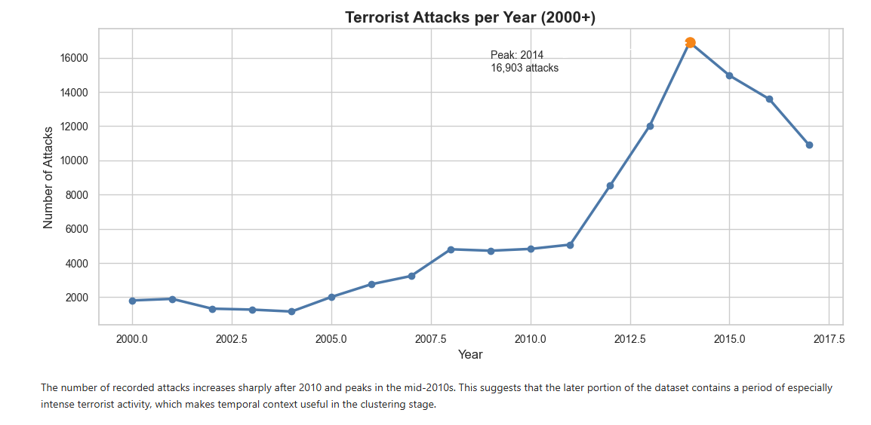
Problem & Data
Dataset: Global Terrorism Database, filtered to 2000+
Goal: discover structure in the data, not predict future events
Core question: do incidents form meaningful groups by attack type, region, and severity?
Time trend shows why temporal context matters
Notes:
This project analyzes incidents from 2000 onward. I filtered to modern records for consistency. The goal is to identify patterns, and the time trend shows a sharp increase after 2010, so time and context matter.

Slide 3
Approach
K-Means: primary clustering method for broad groups
PCA: visualization of high-dimensional clustering results
DBSCAN: comparison method for density-based structure
Decision tree: interpretability tool for explaining cluster differences
Notes:
I used K-Means for broad segmentation, PCA to visualize the high-dimensional results, DBSCAN as a comparison method, and a decision tree to help interpret which features separate the clusters.

Slide 4
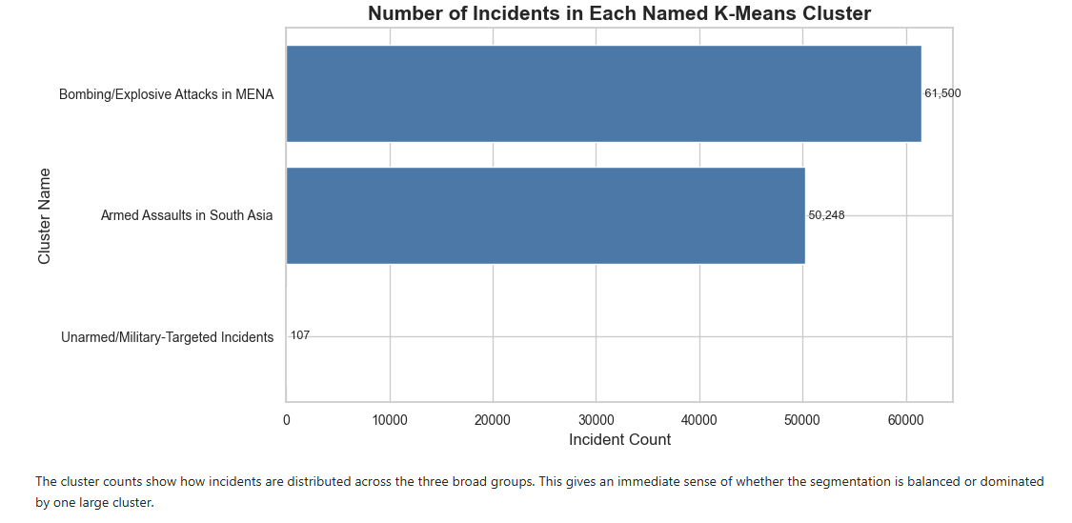
Key Finding 1: K-Means Clusters
K-Means produced 3 interpretable incident groups
Bombing/explosive cluster: high severity, Middle East and North Africa
Armed assault cluster: frequent incidents, South Asia
Small military-targeted cluster: possible conflict overlap
Notes:
The main result is that K-Means produced three interpretable groups. The goal was interpretability, not just the highest numeric score. The clusters differ by method, severity, and region.

Slide 5
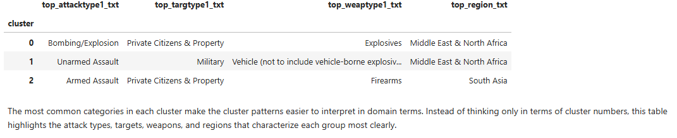
Cluster Profiles
Cluster names come from dominant attack, target, weapon, and region patterns
Bombing cluster is tied to explosives and private citizens/property
Armed assault cluster is tied to firearms and South Asia
Military-targeted incidents are small but analytically important
Notes:
The cluster profile table is one of the strongest outputs because it translates cluster numbers into real-world descriptions. This makes the results easier to interpret.

Slide 6
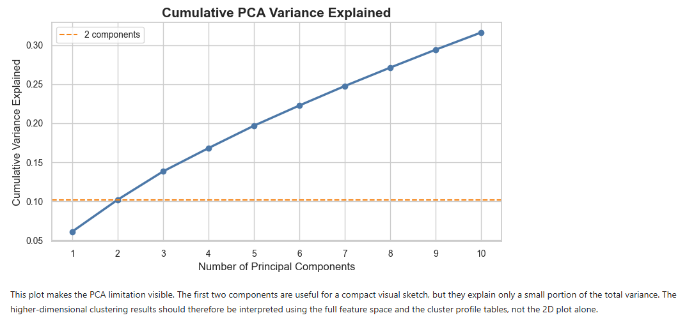
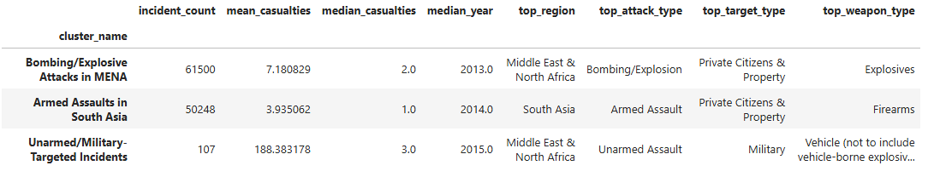
Key Finding 2: PCA Visualization
2D PCA shows partial cluster separation
Only about 10% of variance is captured in the first two components
The plot is useful as a rough visual sketch
The real clustering exists in the full high-dimensional feature space
Notes:
PCA helps visualize the clusters, but it has an important limitation. The first two components only capture about 10 percent of the variance, so I treat it as a rough sketch rather than proof of separation.

Slide 7
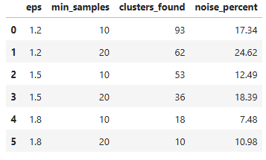
Key Finding 3: DBSCAN Fragmentation
DBSCAN did not produce a few clean clusters
It created many small groups and noise points
This suggests weak global density structure
The data appears fragmented and context-dependent
Notes:
DBSCAN produced many small clusters and noise points. That tells us the dataset does not form a few clean density-based groups. This is a finding because it shows the complexity of the data.

Slide 8
Interpretation: What the Clusters Mean
Clusters represent different behaviors, not just mathematical groupings
Bombings suggest strategic, high-impact violence
Armed assaults suggest frequent localized violence
Military-targeted incidents may overlap with broader conflict dynamics
Context is critical: the same label can mean different things in different regions
Notes:
The most important part is interpretation. The clusters are not arbitrary; they represent different patterns of violent activity. Bombings are more strategic and high-impact. Armed assaults are more frequent and localized. The military-targeted cluster is the most complex because it may overlap with broader conflict dynamics. In regions like Iraq during the mid-2010s, incidents labeled as terrorism may also reflect armed conflict, so context matters.

Slide 9
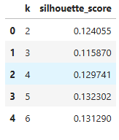
Critical Assessment
k = 3 was chosen for interpretability, not the highest silhouette score
PCA captures limited variance, so visuals must be interpreted carefully
DBSCAN fragmentation shows the data is not cleanly density-clustered
Dataset labels can oversimplify complex conflict situations
Notes:
The main limitations are methodological and ethical. K equals 3 was chosen because it was interpretable, not because it had the highest silhouette score. PCA captures limited variance, and the dataset itself has classification ambiguity.

Slide 10
Conclusion
Meaningful patterns exist, but they are complex
Different methods reveal different aspects of structure
Interpretation matters as much as clustering output
Future work could add deeper regional analysis and alternative clustering methods
Notes:
In conclusion, meaningful patterns exist in the GTD dataset, but they are complex and context-dependent. The project shows both the value and the limitations of data mining when applied to real-world sensitive data.

