Slide 1

Gift- thrift shop
Customer needs, our concern
BOSCO ITHAU MUSAU COM/056/19
CALEB VINCENT KIPTOO COM/023/19
ANTHONY MAIYO COM/1005/18
EVANS WANYAMA COM/036/19
MICHAEL AHAYA COM/001/19

Slide 2
INTRODUCTION
People usually have second hand items which can be sold second time at cheaper price as compared to when buying it new
In our daily life, it is difficult to find those second hand items as it needs movement which is costly and time consuming.
Let us also consider scenario where first year students have reported and need to have outside residence ,how will you get cheaper items ? To answer this questions we decided to come up with a website that can provide these services to the users.
Currently there is no website that fully offers online services such as selling and buying of second hand items. Most websites offers selling of new items. Therefore, we saw that there is a niche and it needs to be bridged.

Slide 3
General objective
The project aims to design a cross platform website that will offer Second Hand order services to the users
Specific Objectives
To investigate the problems of the existing online shop websites.
To investigate the problems faced by individuals to look for a products service .
To analyze the problems of current systems and problems faced by clients and second hand shop owners, thus come up with possible solutions
To design and implement a cross platform website that will give best solution after analysis

Slide 4
limitations
entrepreneur and client must own a smart phone/Laptop/desktop computer in order to access Gift-Thrift Shop.
Lack of shopping experience .
Lack of interactivity in online shopping.
Online shoppers do not have the ability to physically inspect or try on the item being considered for purchase.
Online shoppers often do not have a person to talk to directly when dealing with a problem.

Slide 5
Literature review
PRIOR RELATED STUDIES
Jumia App Jumia is an app that gives you access to an African shopping portal where you can get all sorts of products at a great price. E-Commerce With the growth of e-commerce, a lot of benefits come in hand to the business owners and consumers.
Jiji
Jiji is an app that gives you access to an African shopping portal where you can get all sorts of products at a good price
FRAMEWORK
Django framework Django is the latest framework of python . This is another open-source, cross-platform framework that seamlessly creates websites backend.

Slide 6
CHAPTER 3: SYSTEM ANALYSIS AND DESIGN
Analysis is defined as the process of carefully studying an object or something that can be studied either carefully or with the use of statistical methods with an aim of understanding it and maybe explaining it in a better way.
It involves:
Fact-finding
Feasibility study and report
Requirements specification

Slide 7
Requirement analysis
Functional requirements;
User’s details including username, email, and password
Seller can add products and delete them.
Store this information
Accept orders as input and enable clients to track their orders
Authentication to ensure safe usage of the application
Non-functional requirements;
Easy to use interface
Portability to enable the system to be used in various devices
Continuous access to the services
The system should be able to handle 20 million users without performance deterioration

Slide 8
GIFT-THRIFT FLOWCHART
Start
customer
Shop Admin
No
login
No
register
login
Yes
Yes
Search Product
Add /Update Category
View Product
Add /Update Product
Buy Product and add to cart
Manage Product Attributes
Manage Order
Payment
No
Manage Payment
Check Feedback
Yes
Order Placed
Logout
Stop

Slide 9
METHODOLOGY
We chose the Iterative waterfall model for the project
With an iterative, it is an improvement to traditional waterfall in that unlike with tradition, the iterative waterfall allows the developer to go back to another process thus ensuring that requirements are addressed fully.
With the waterfall model, we went through a series of steps as defined by the model including;
Requirement definition
System and software design
Implementation and unit testing
Integration and system testing
Operation and maintenance

Slide 10
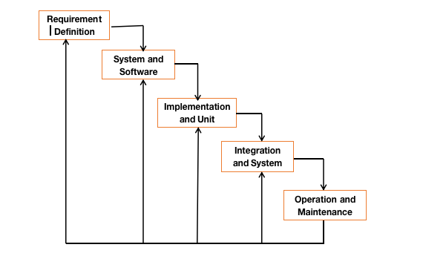

Slide 11
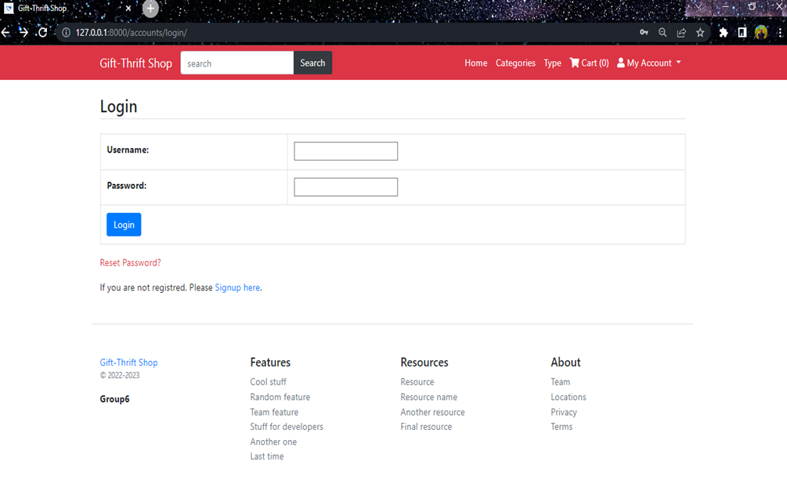
Discussion and results

Slide 12
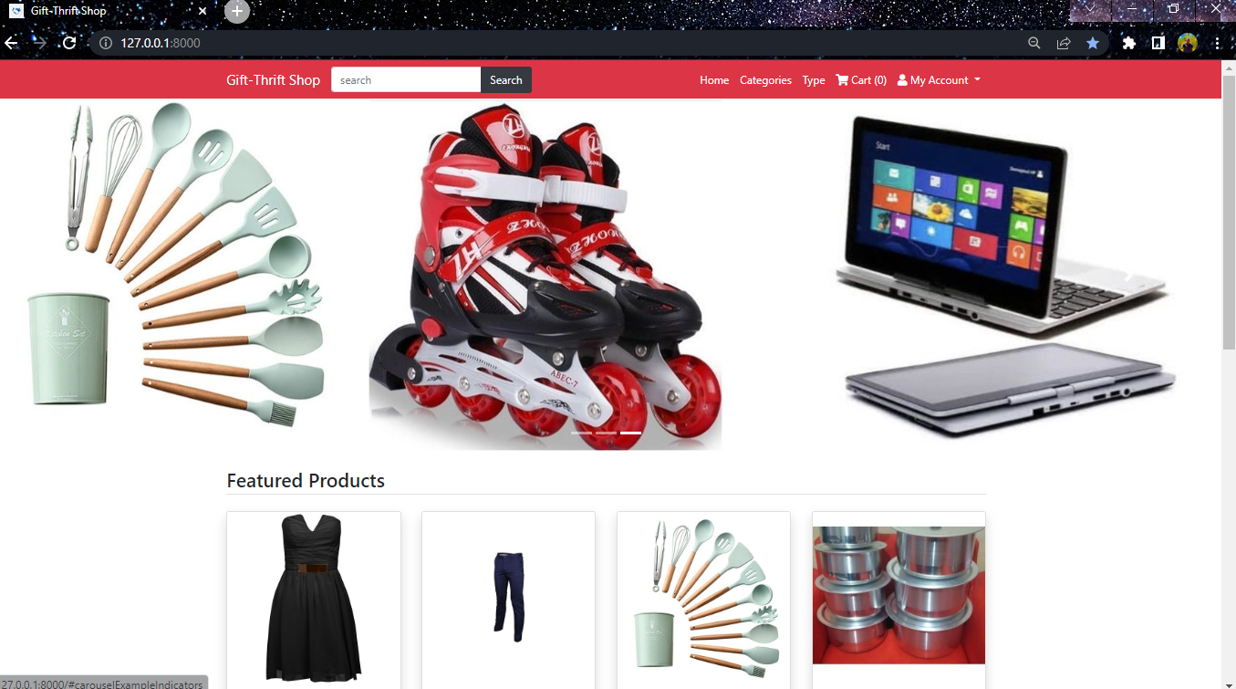

Slide 13
IMPLEMENTATION
The system was implemented by using: Development tools
Wix for the design of the Gift-Thrift logo
Paint app for designing the various pictures used in the Project
Microsoft Publisher for drawing different diagrams
Visual Studio Code for writing and running the Gift-Thrift code
Technology
Html,Javascript,Css for frontend development
Django for the backend development

Slide 14
CONCLUSION
In carrying out this project, we were able to develop a second hand market system that is easy to use and monitor selling of your items. We were able to finish these project with knowledge gotten from class work.the project was successful and can even be improved further to cater for users changing needs. We have also been able to acquire necessary skills such as researching skills, project management and programming in different languages example python, HTML, CSS and MYSQL.
RECOMENDATION
As technology grows, the need to keep track of user requirements grow daily and thus improving the system is a requirement. Project can be improved by adding levels of administrators, adopting payment technology such as MPESA, VISA, PAYPAL. We can encourage students and people at large to adopt to e-commerce as a way to do business.

Slide 15


Thank you

