Slide 1

Thera Bank – Customer Credit Card Churn Prevention
Bin Lu, Kwabensa Mensah, Frank Ivey

Slide 2

PROBLEM
Problem
Credit Card Customer Attrition
COSTS
The Thera bank recently saw a steep decline in the number of users of their credit card.
It’s been proven to cost more to generate new customers, so keeping our current credit card customers helps mitigate costs.
CUSTOMERS
Fees Loss by Customer Churn
Bank customers are the livelihood of the bank because, without them, the bank has no assets to hold and no cross-products to sell.
Credit cards are a good source of income for banks because of the different kinds of fees charged by the banks like annual fees, balance transfer fees, and cash advance fees, late payment fees, foreign transaction fees, and others.
FINANCIALS
Customers’ leaving credit card services would lead the bank to losses in profit.

Slide 3

SOLUTION
CLOSE THE GAP
Our product makes investing and portfolio management easier, and no other product on the market offers the same benefits
TARGET AUDIENCE
Professional investors
COST SAVINGS
Reduce costs for client by helping businesses increase their profits in the stock market
EASY TO USE
A simple product that gives businesses the information they need in order to make informed financial decisions

Slide 4

BUSINESS MODEL
RESEARCH
ABSTRACT
DESIGN
We based our research on market trends and stock market historical performance data
We believe people need new investment tools to help businesses grow their funds
Minimalist design and easy to use

Slide 5

OPERATIONAL, ETHICAL, and REGULATORY RISKS
UNIQUE
TESTED
Only product specifically dedicated to investment tools for business
Conducted testing with businesses in the area
FIRST TO MARKET
AUTHENTIC
First beautifully designed product that's both stylish and functional
Designed with the help and input of investment experts in the field

Slide 6
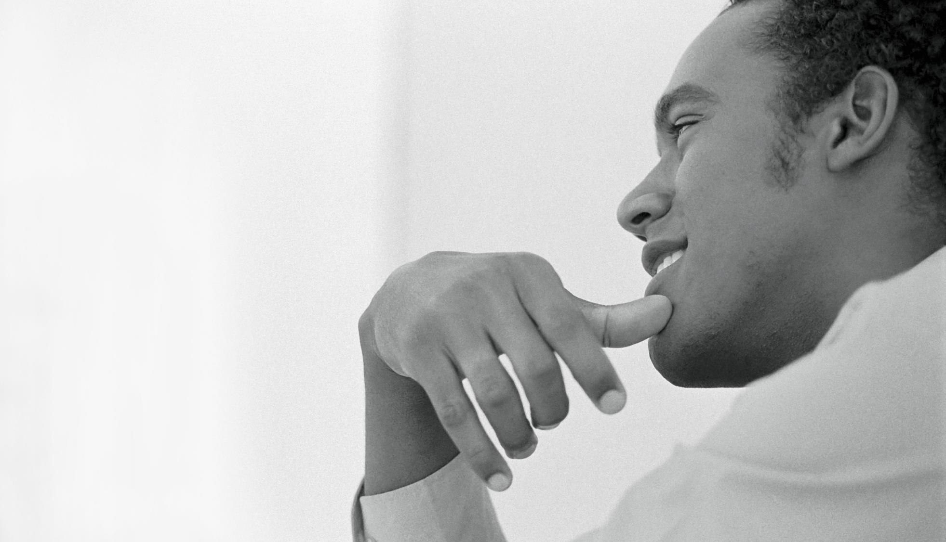
RISK MITIGATION PLAN
Simple and efficient to use
Quick customer service assistance
Free 90-day investment help for new customers
Benefits

Slide 7

Thank You
Bin Lu, Kwebensa Mensah, Frank Ivey
Team 1

